Slide 1
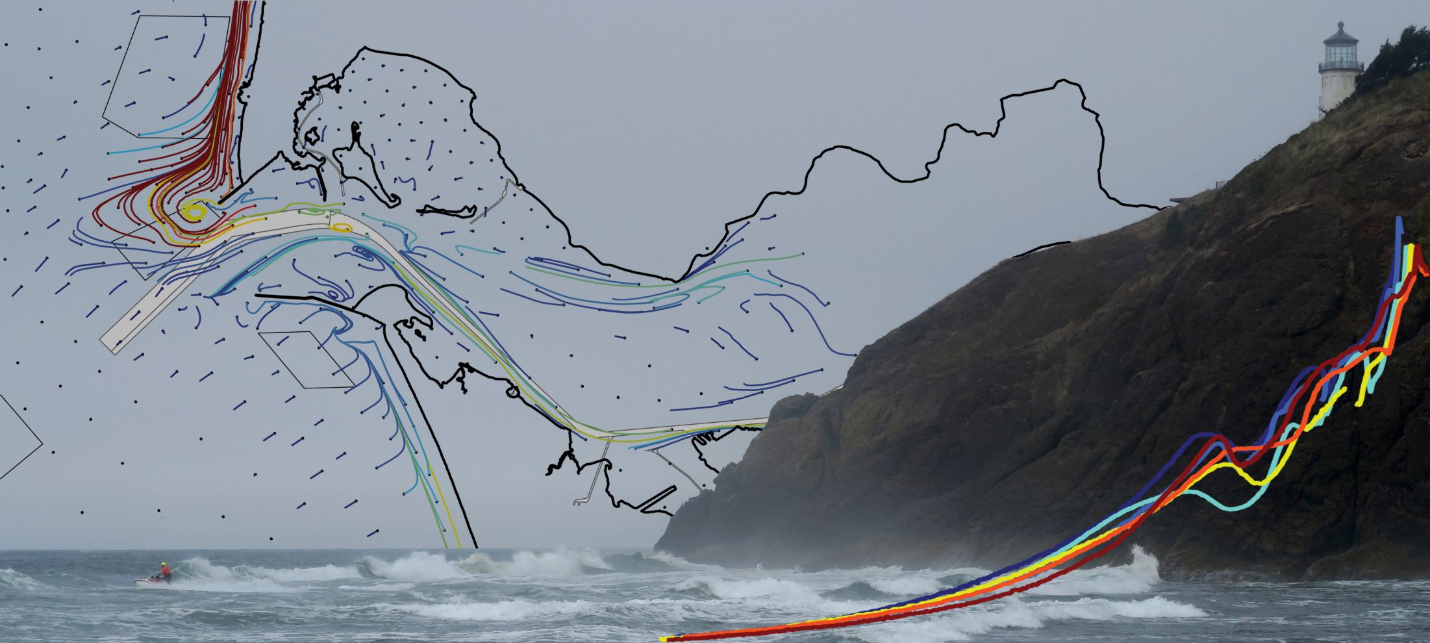





Observations of Coastal Change and Numerical Modeling of Sediment Transport Pathways at the Mouth of the Columbia River
Lower Columbia Solutions Group
January 14, 2020
Andrew Stevens, Guy Gelfenbaum (USGS)
Edwin Elias, Stuart Pearson (Deltares)
George Kaminsky, Heather Weiner (Ecology)
Peter Ruggiero (OSU)

Slide 2
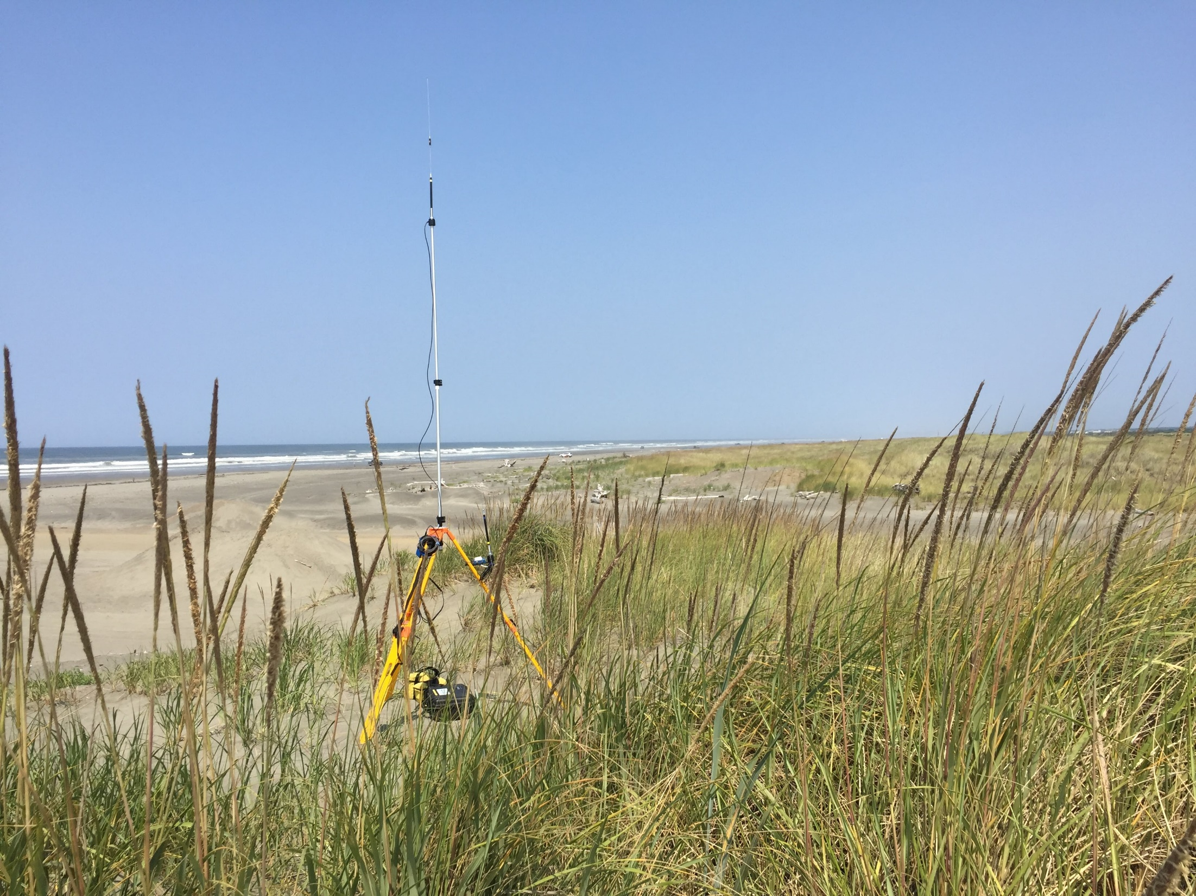
Objectives
Quantify beach and nearshore sediment budgets
Characterize sediment transport fluxes and pathways for evaluating the North Head Site
Approach
Annual beach and nearshore surveys
Hydrodynamic and sediment transport modeling

Slide 3
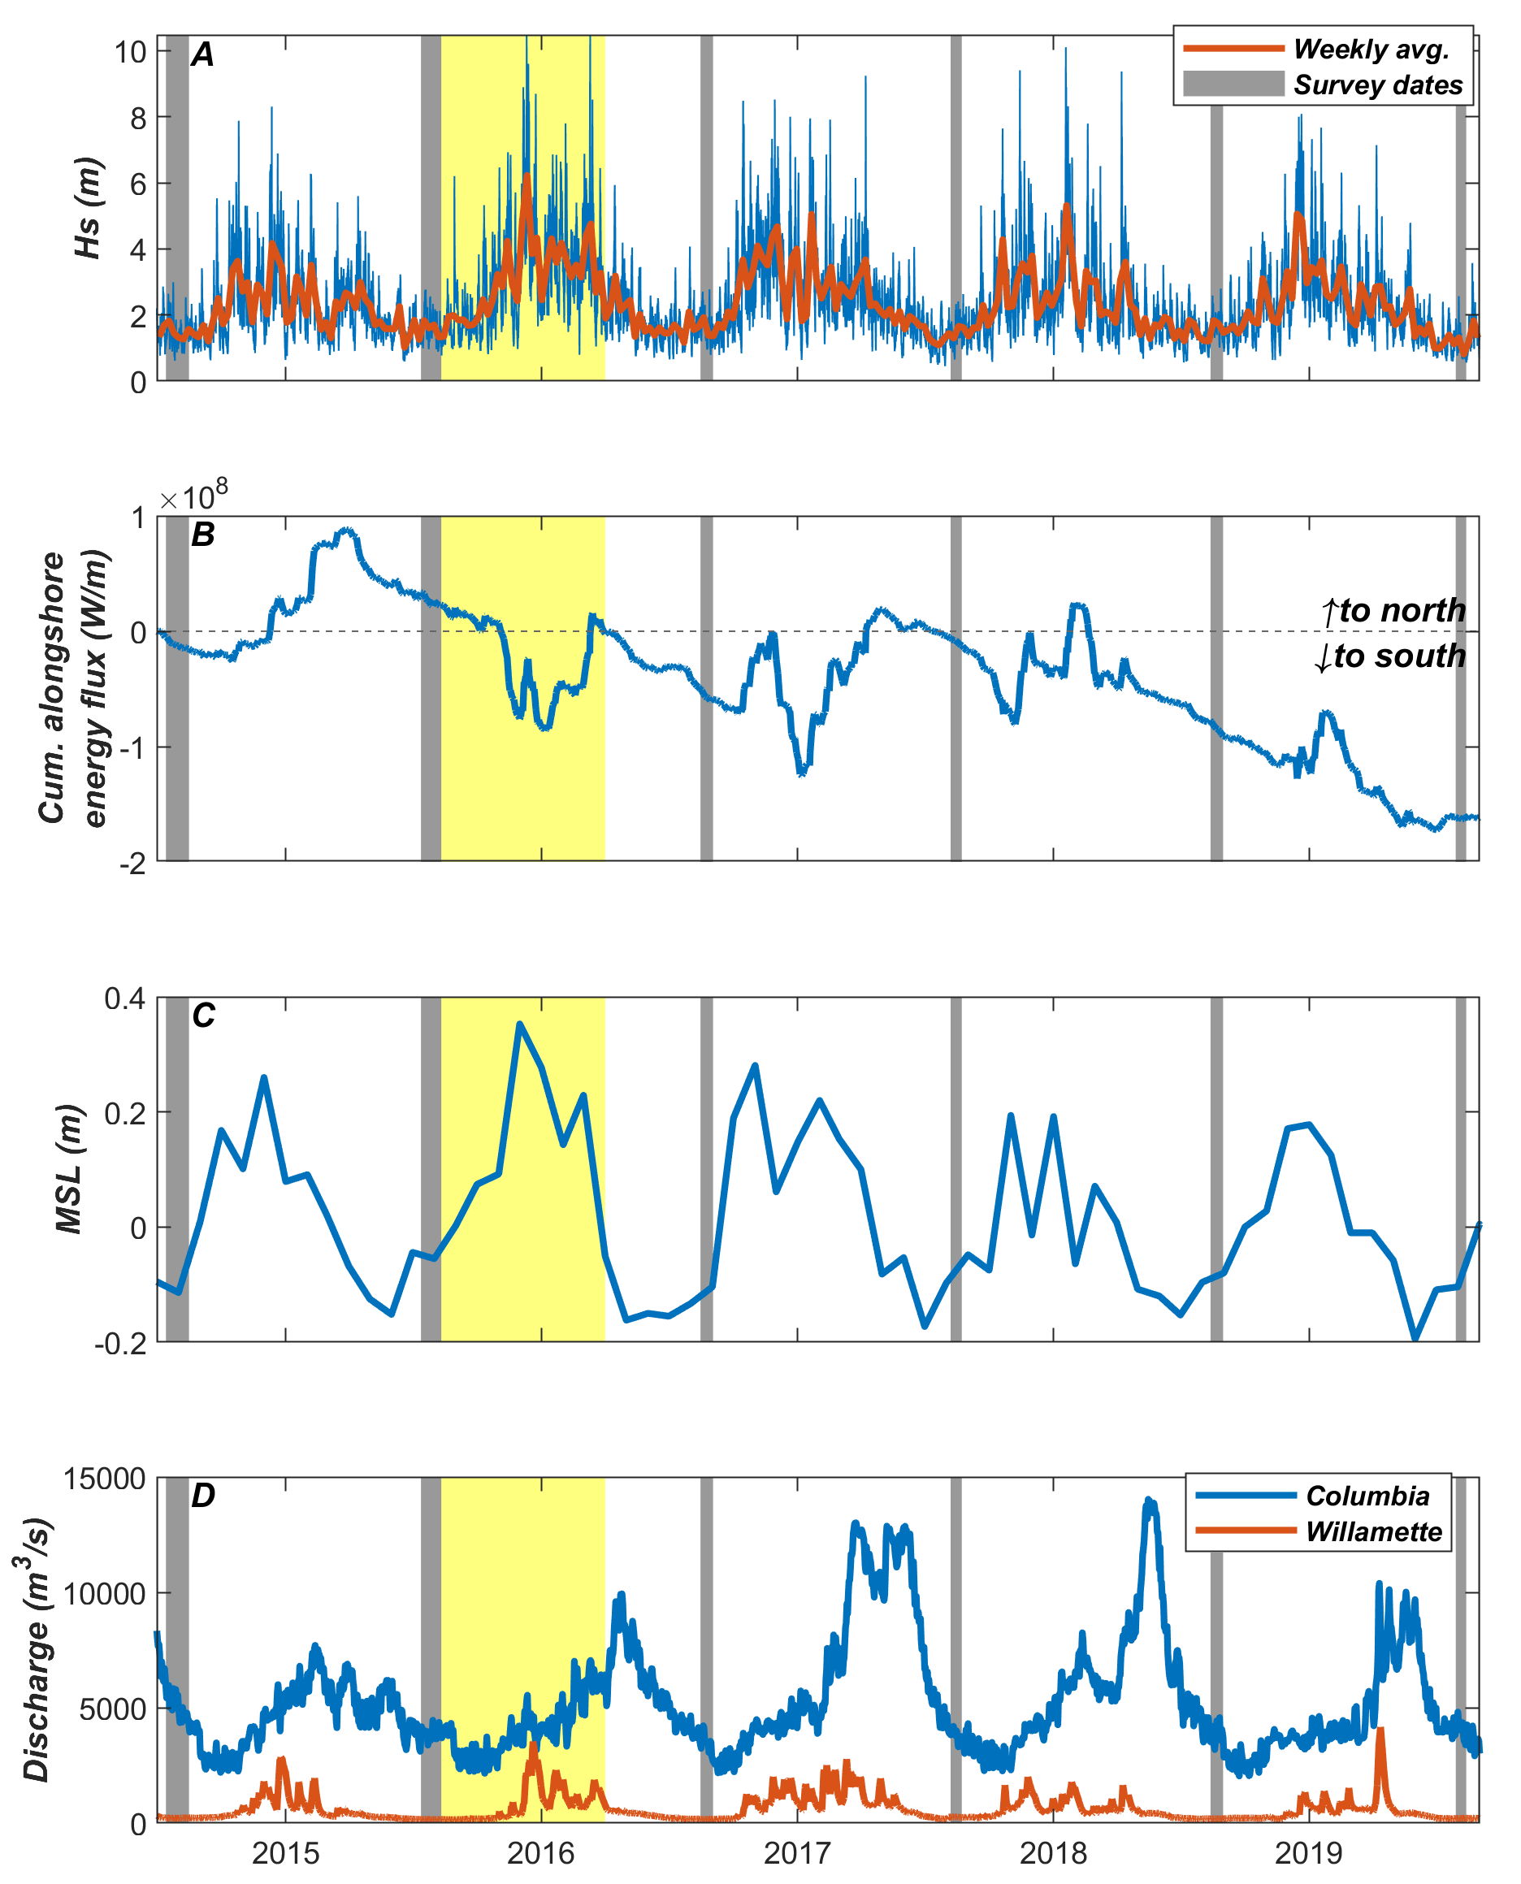
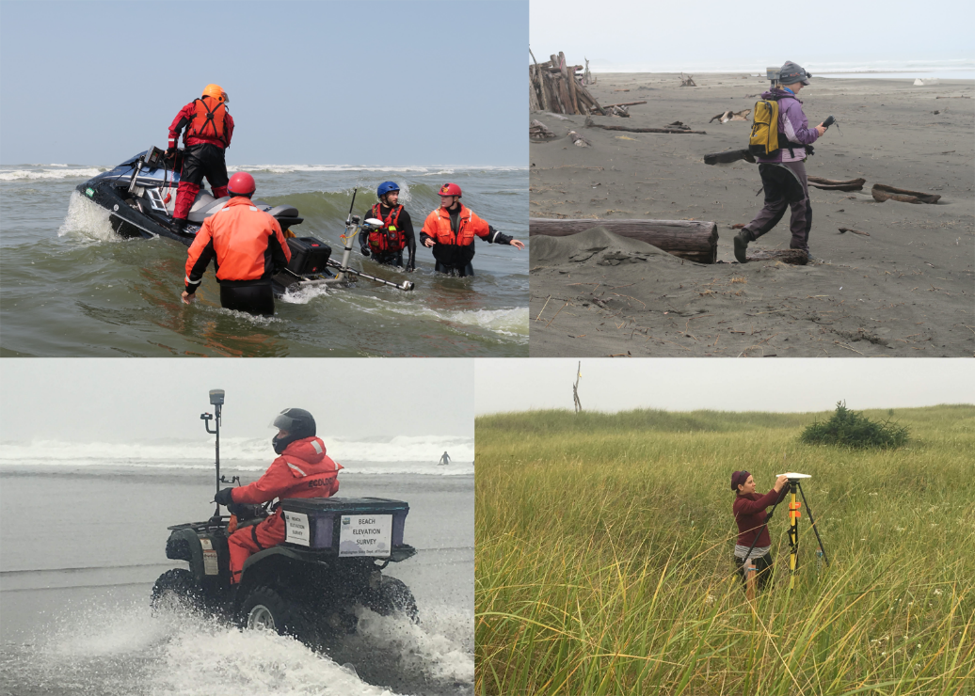
Beach and nearshore monitoring
Surveys performed annually between July and September as part of a broader survey of beaches throughout the CRLC
6 surveys between 2014 and 2019
2015/2016 El Nino

Slide 4
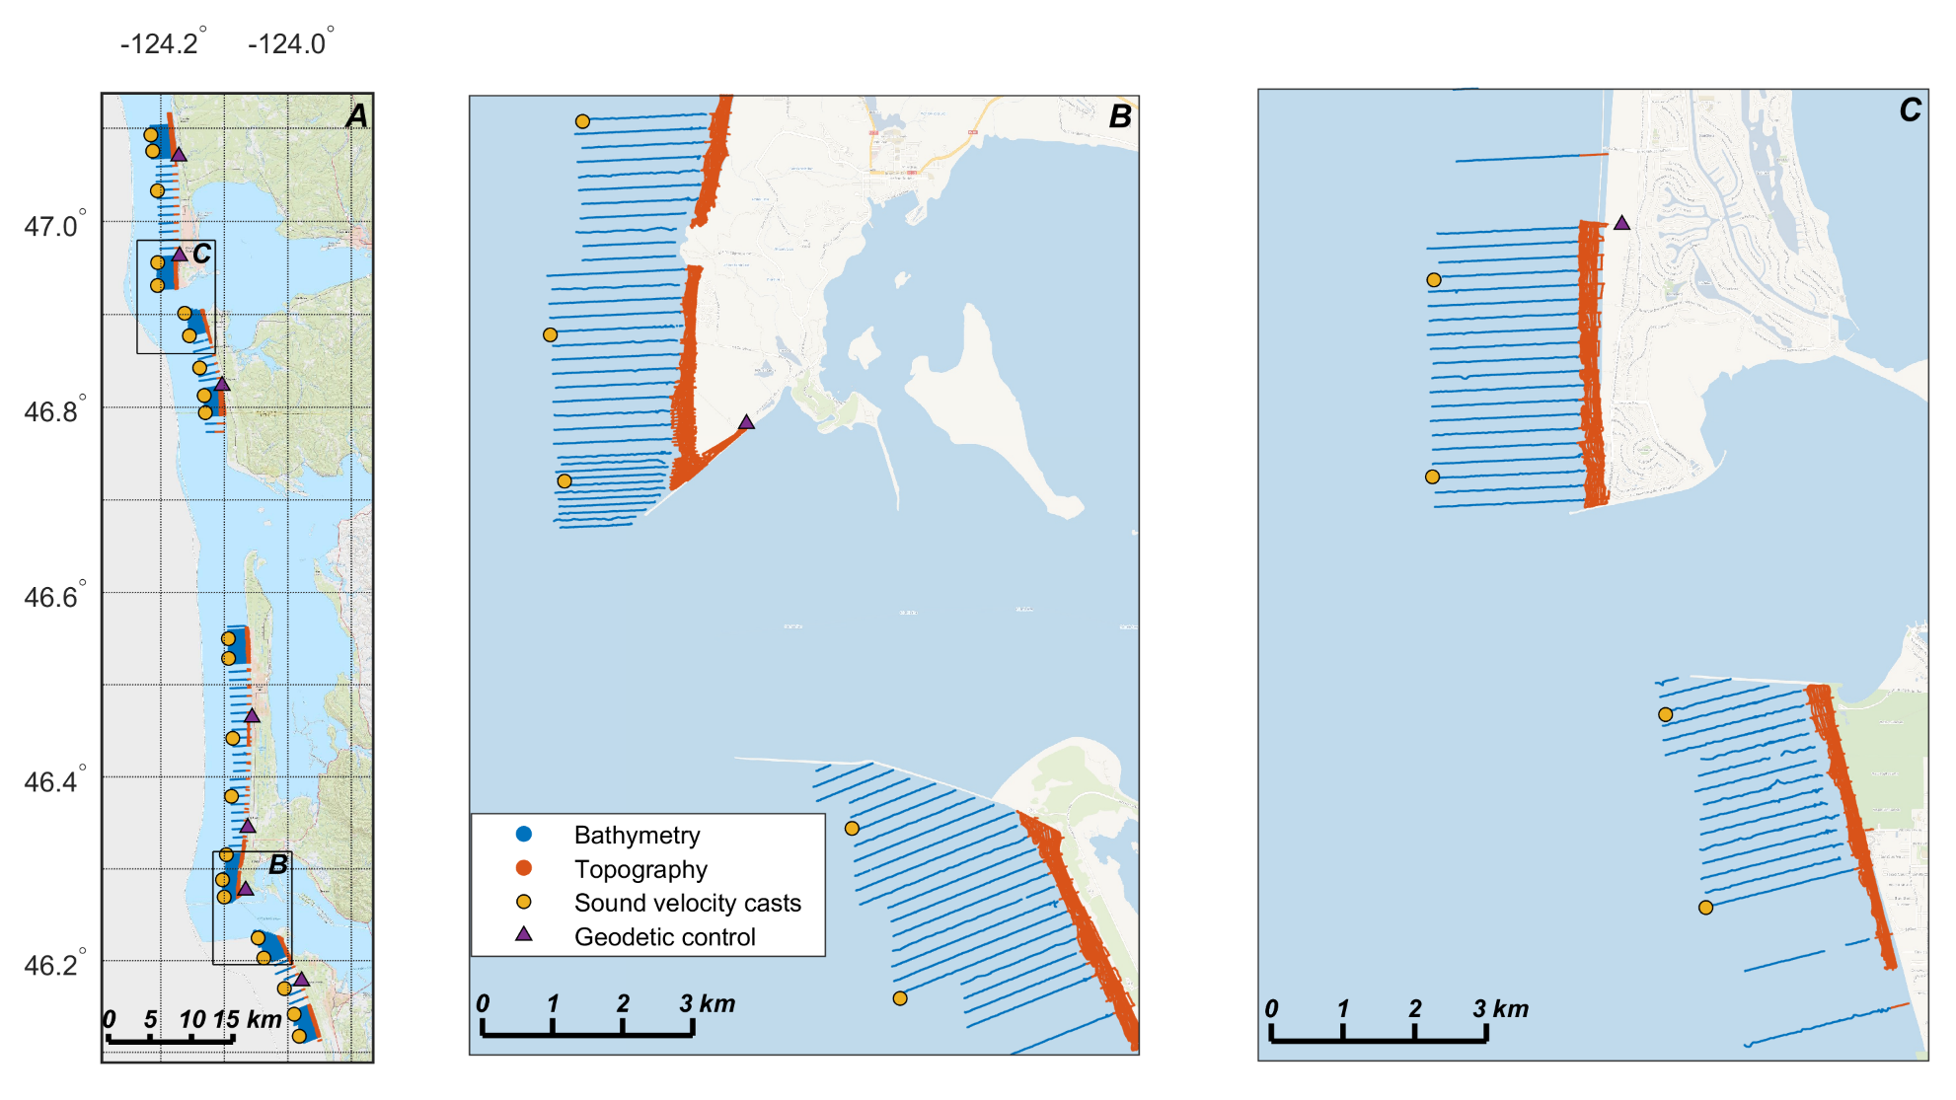
Beach and nearshore monitoring
Cross shore profiles measured at 100-200 m intervals on both sides of the Columbia Inlet
Additional topographic data collected between transects with an all-terrain vehicle

Slide 5
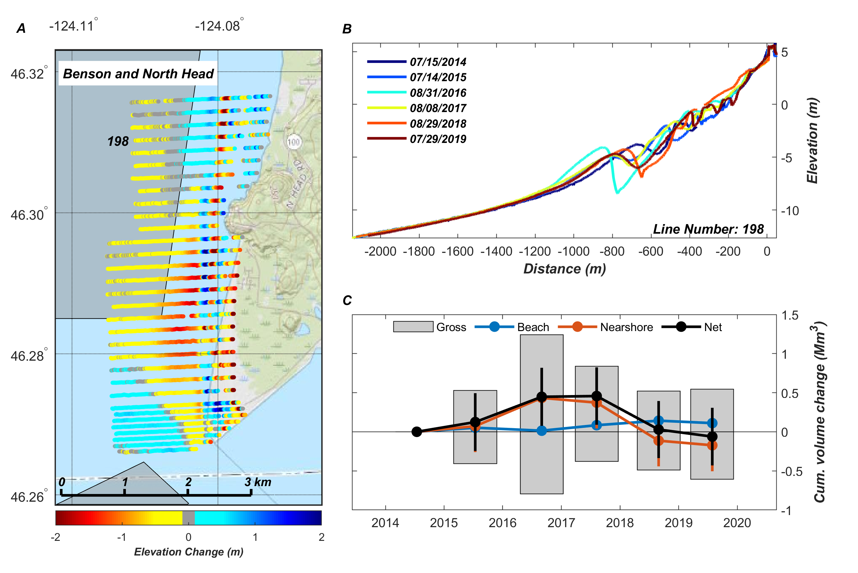
Beach and nearshore monitoring – North Head
No net volume change
Measurable accumulation on the beach (110,000 ± 36,000 m³) between 2014 and 2019
Notes:
Panel C is integrated volume change for the entire North Head Area

Slide 6
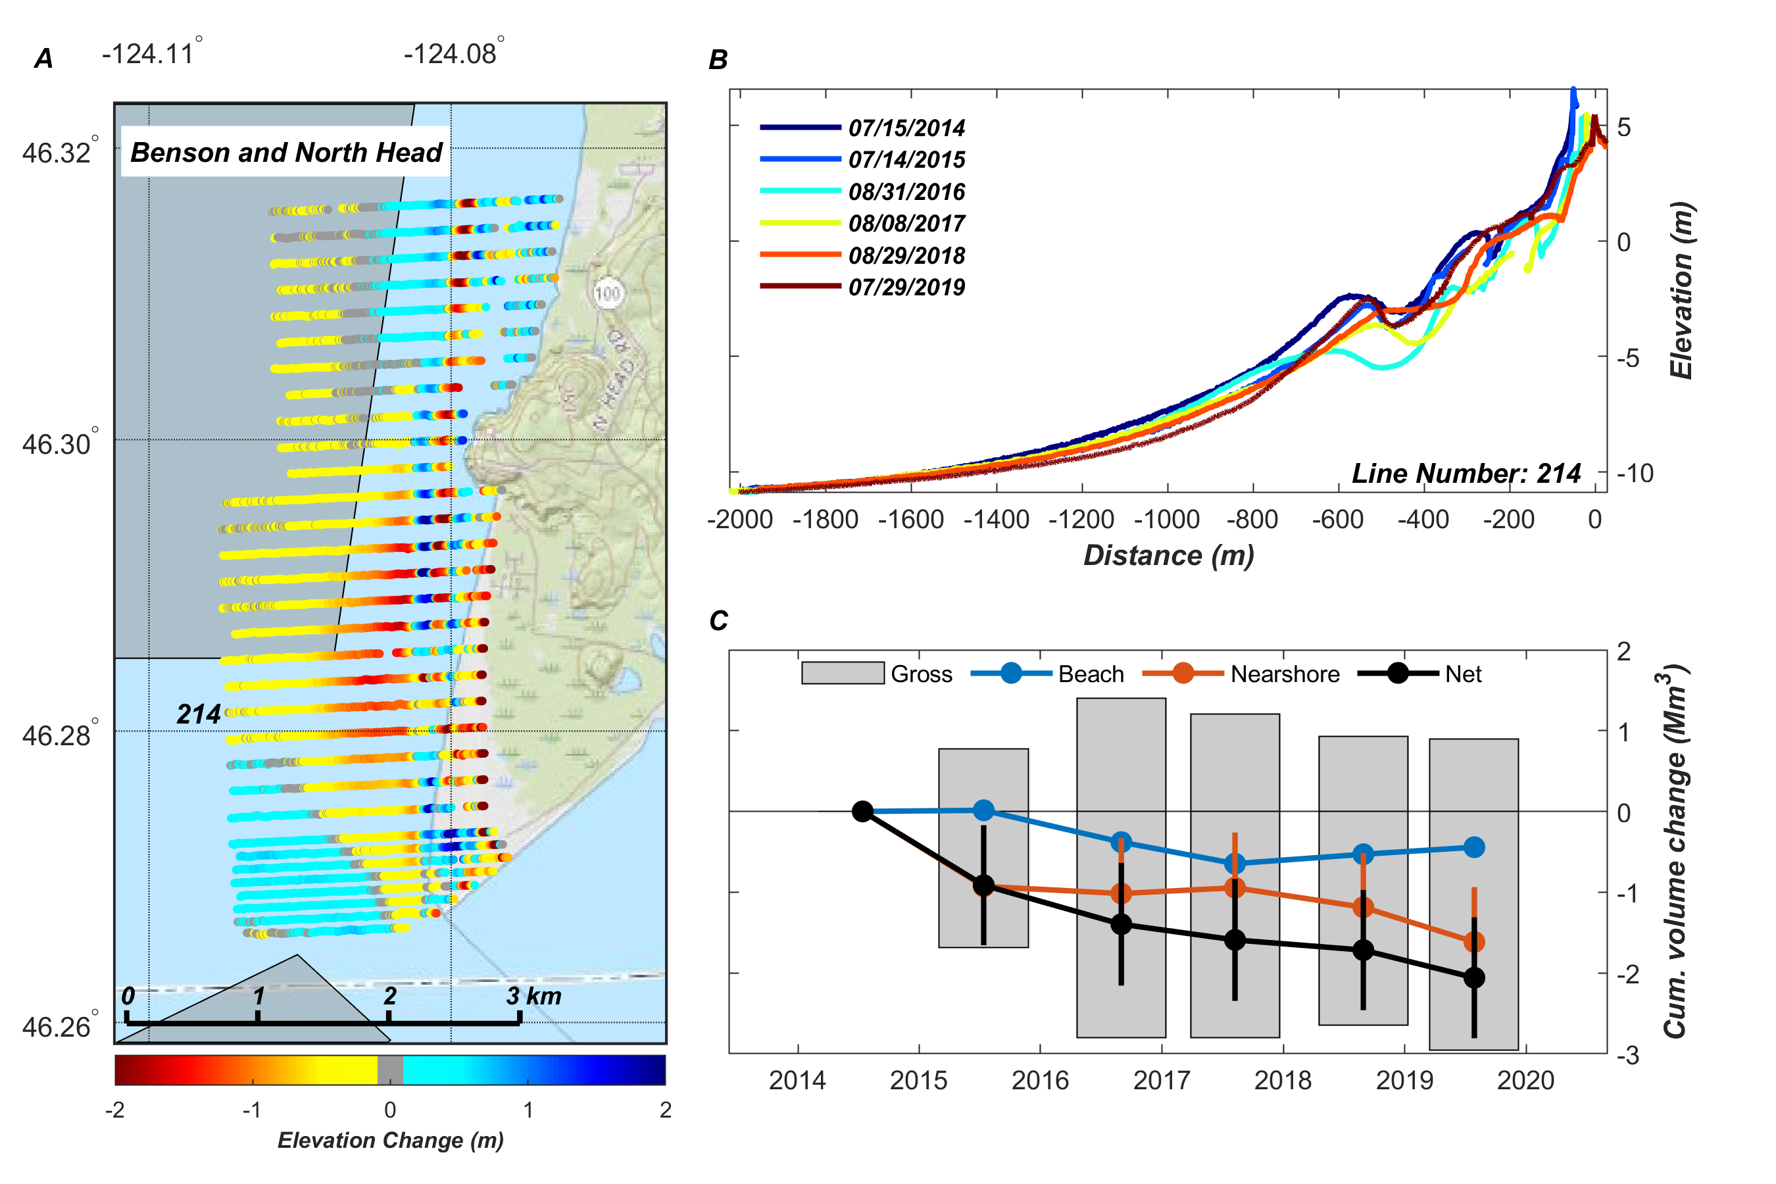
Beach and nearshore monitoring – Benson Beach
Net erosion of 2.1 ± 0.8 Mm³ (420,000 m³/yr)
Erosion is significant for both beach and nearshore areas
Dune crest height reduced by more that 1 m, with roughly 50-m dune retreat

Slide 7
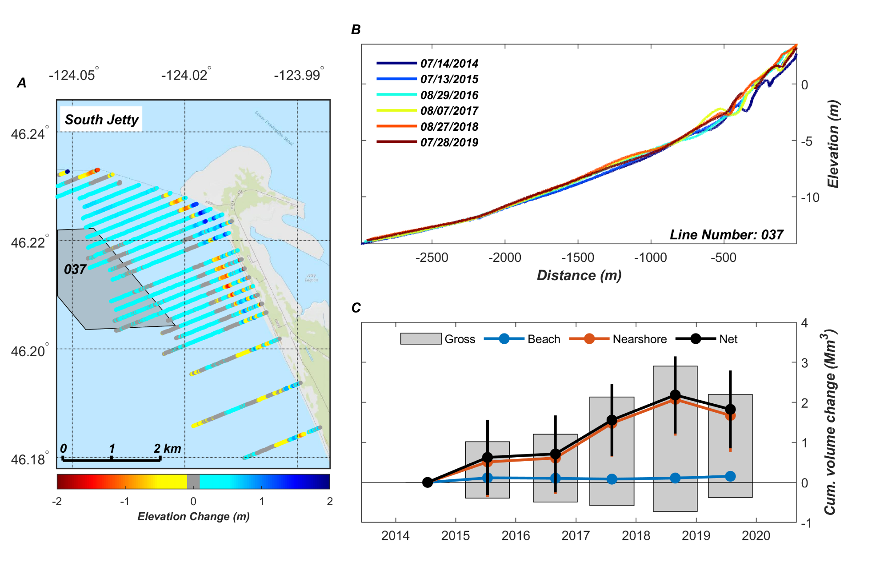
Beach and nearshore monitoring – South Jetty
Net accumulation of 1.8 ± 1.0 Mm³ (360,000 m³/yr)
Accumulation throughout the shoreface

Slide 8
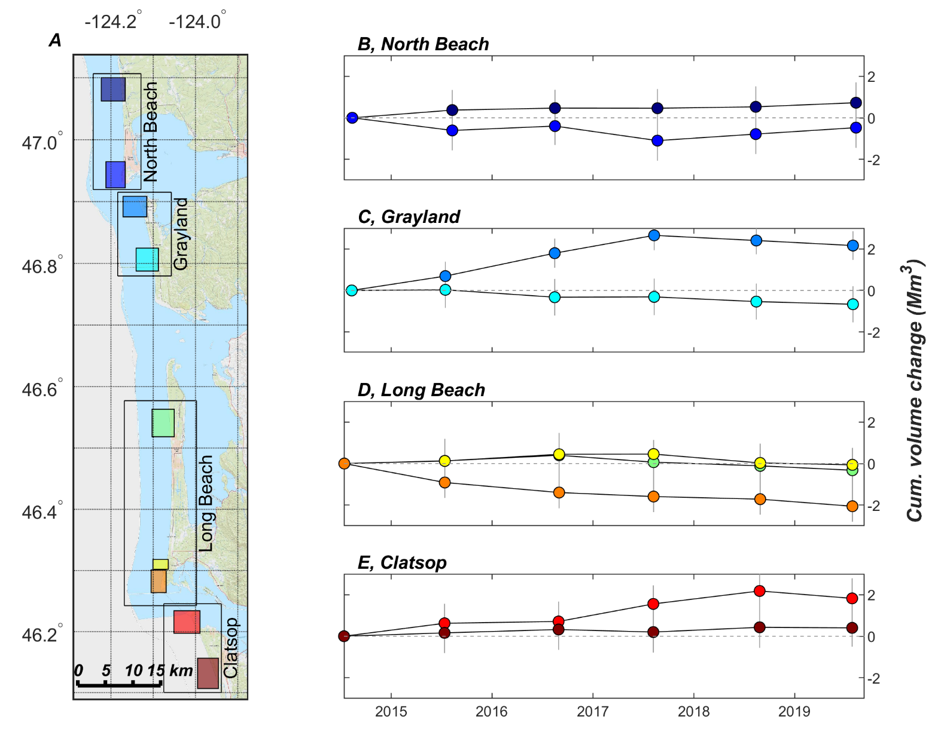
Beach and nearshore monitoring – Overview
Accumulation on south side of inlets (South Jetty, Westport)
Erosion on north sides of Grays Harbor and Columbia River inlets (Benson Beach, Ocean Shores)
Integrated volume change over all profiles within a sub-area. Average number of profiles per area is ~20

Slide 9
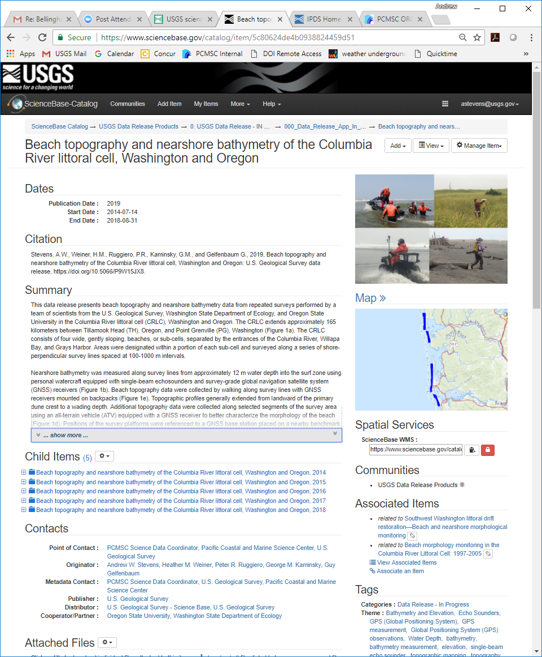
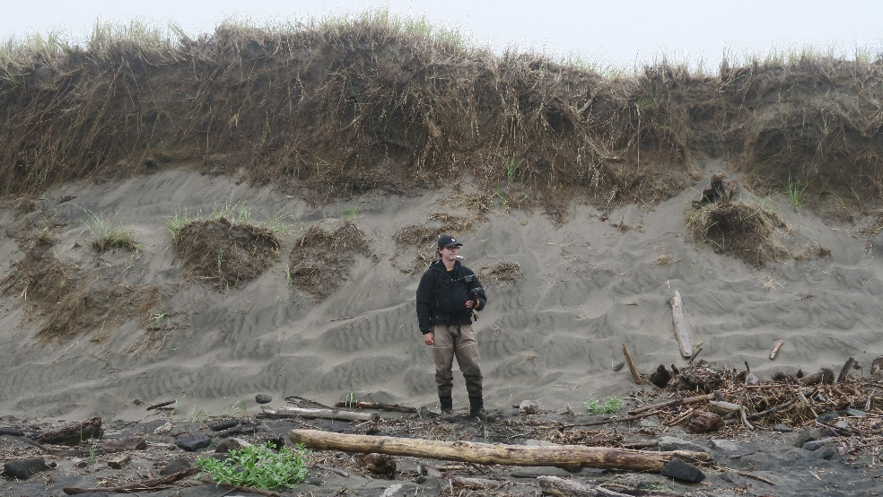
Beach and nearshore monitoring
Summary
Despite the placement of over 1 Mm³ of sediment in the Shallow Water Site annually between 2014 and 2019, Benson Beach continues to erode
Additional sediment supplies and efficient transport between nearshore placement areas and Benson Beach are needed to overcome the 420,000 m³/yr deficit
Numerical modeling used to evaluate and identify nearshore dredge placement areas that efficiently enhance the sediment budget of Benson Beach
Digital data release with bathymetry and topography data from 2014-2019: https://doi.org/10.5066/P9W15JX8

Slide 10
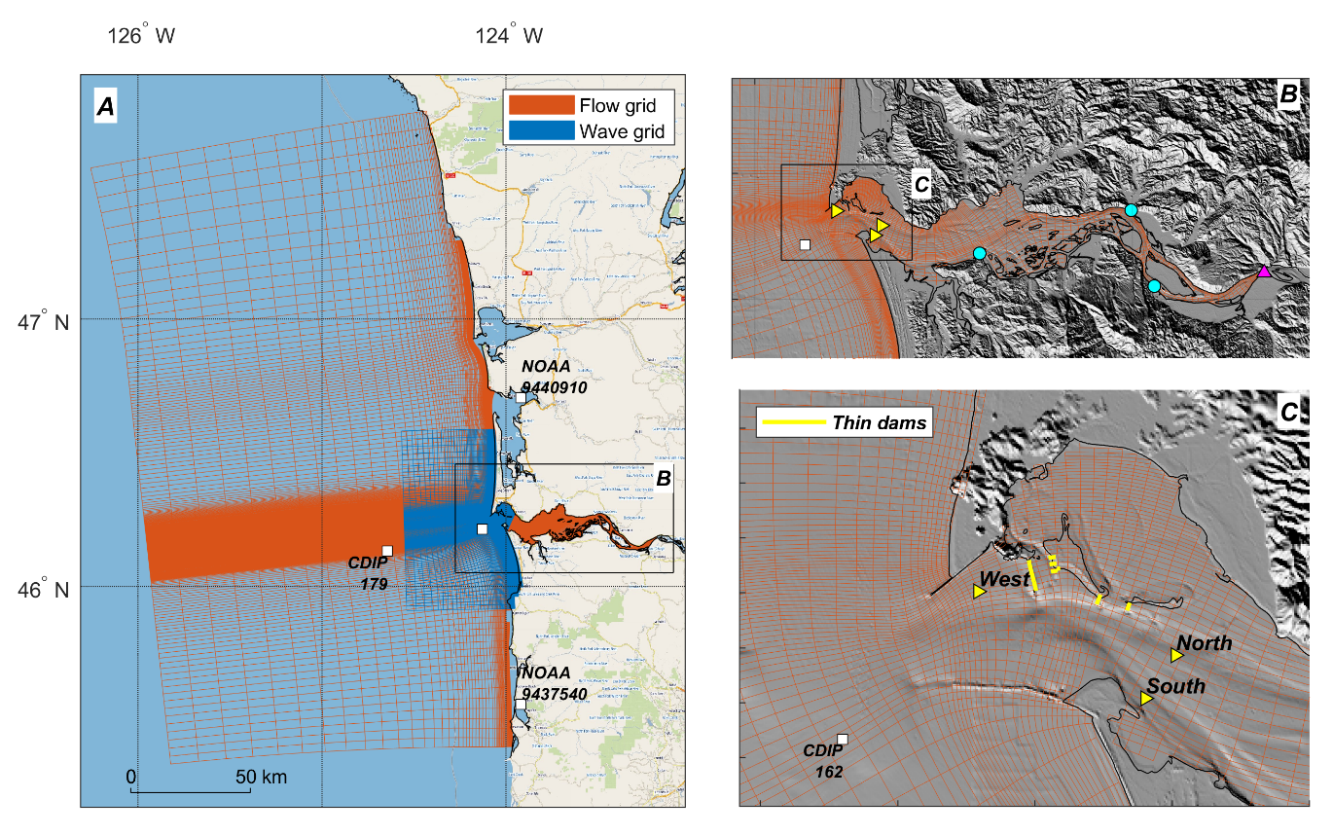
Sediment Transport Modeling
Goals:
identify transport pathways and the most beneficial locations for dredged material placement
Grid resolution reduced by 3X for display
Grid consists of 43,356 grid cells
Resolution varied between 15 m and 100 m in area of interest
10 vertical layers
Hydrodynamics validated with NOAA tide stations, NDBC wave buoys, and instrumented tripods deployed in 2013

Slide 11
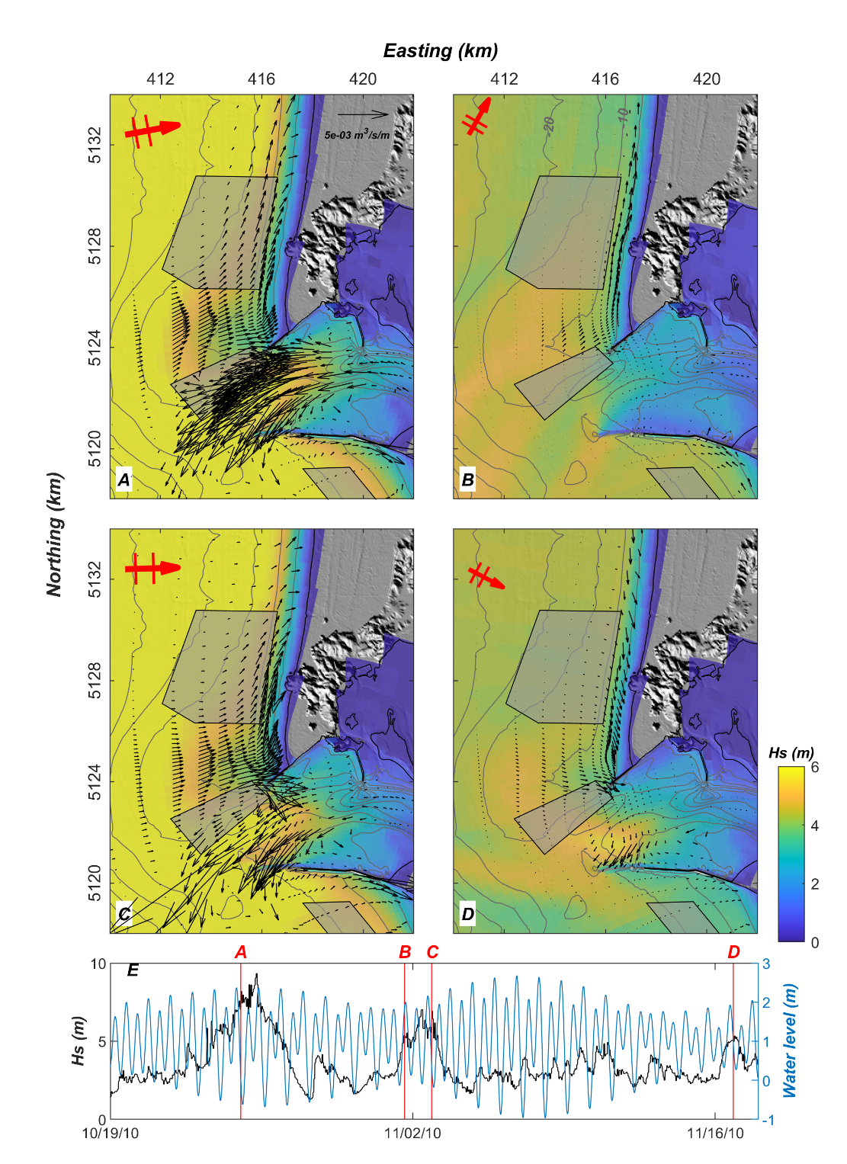
Sediment Transport Modeling
Examine transports during a series of energetic fall/winter storms
Simulate potential transport of medium fine sand (200 micron)
Wave directions shown with large red arrows
Wave processes dominant, but tidal currents enhance fluxes around the inlet
Sediment transport fluxes higher on Peacock Spit than within the North Head Site

Slide 12
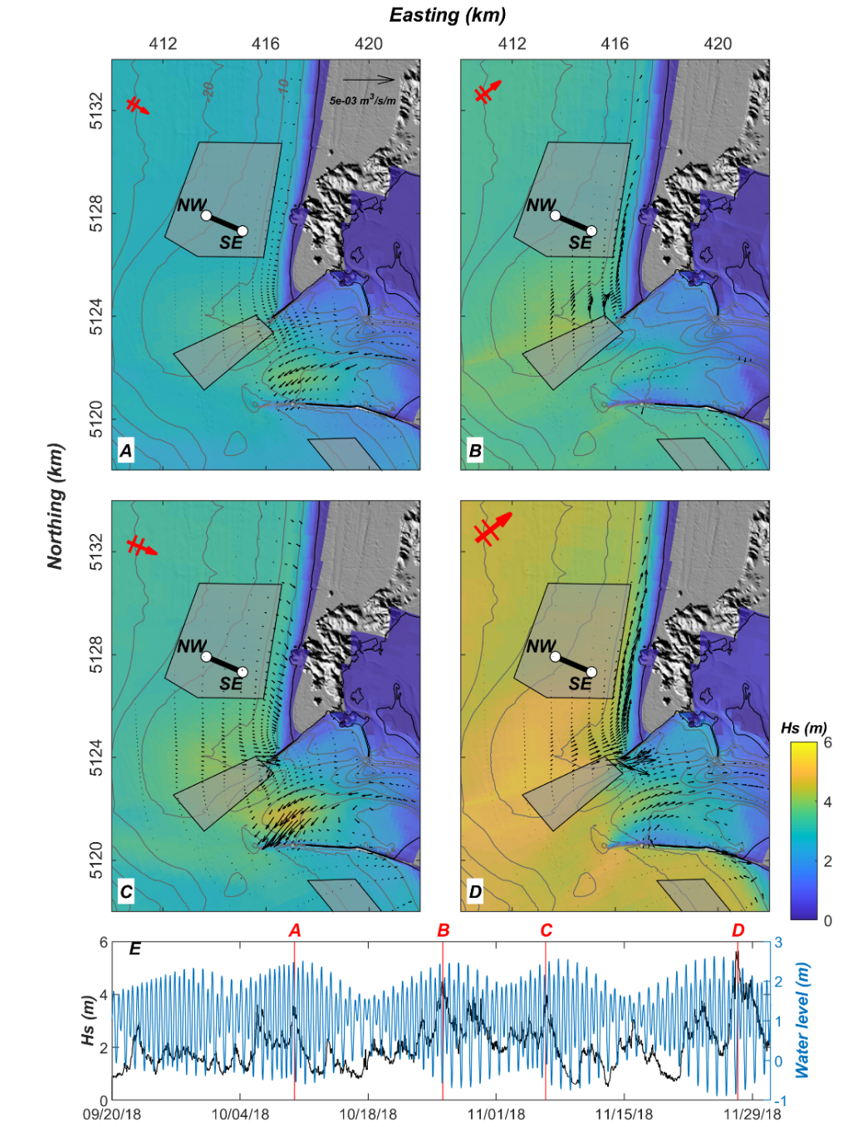
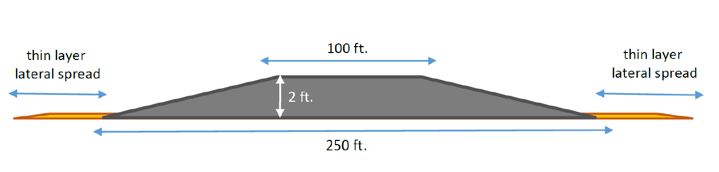
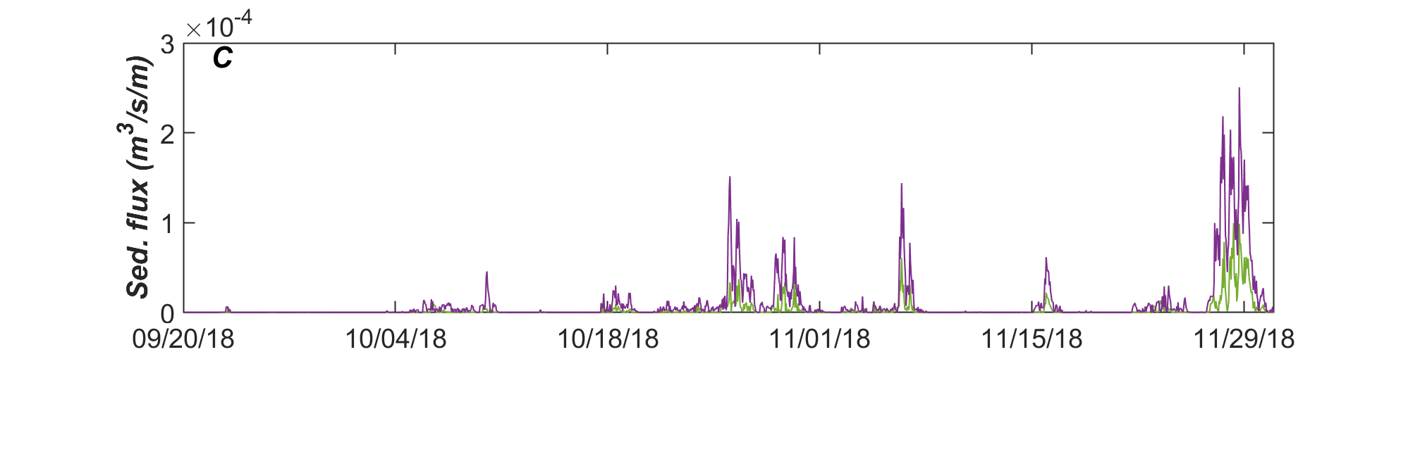

Sediment Transport Modeling
Examine transports following the 2018 North Head pilot placement (NW – SE)
Very low transport rates within the North Head Site throughout the simulation
Transport events coincide with larger waves
Transport rates were 3-10 times higher at the SE end of the pilot placement than to the NW
2018 Pilot placement cross section

Slide 13
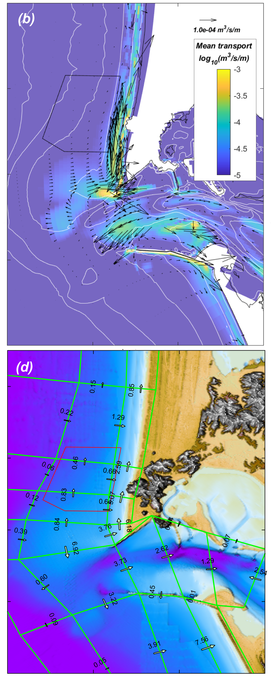
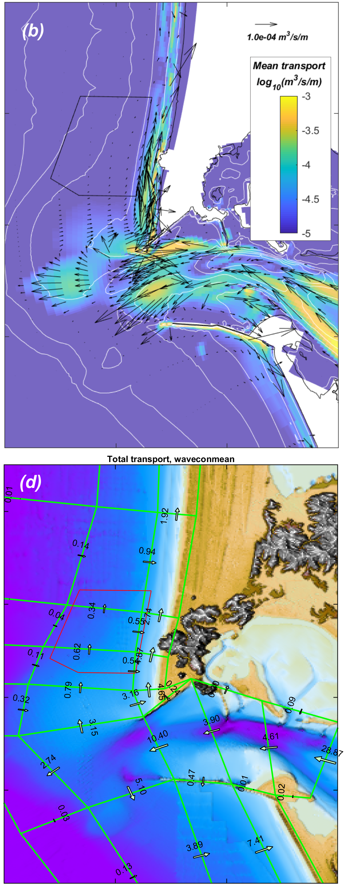
Sediment Transport Modeling
Low discharge
High discharge
Schematized wave climate used to simulate full range of forcing conditions and simulate annual average conditions
19 wave classes
2 discharge scenarios (4,000 m³/s and 8,000 m³/s)
Dispersal north and south of the inlet
Import into the MCR during low river flow, export during high river flow
Relatively large wave-driven net landward sediment transport occurs (3,160+ m³/tide) from the ebb-tidal delta towards Benson Beach. At the location of the North Head disposal site, landward transport rates are roughly 80% smaller
Mean transport of all wave classes scaled by probability of occurrence

Slide 14
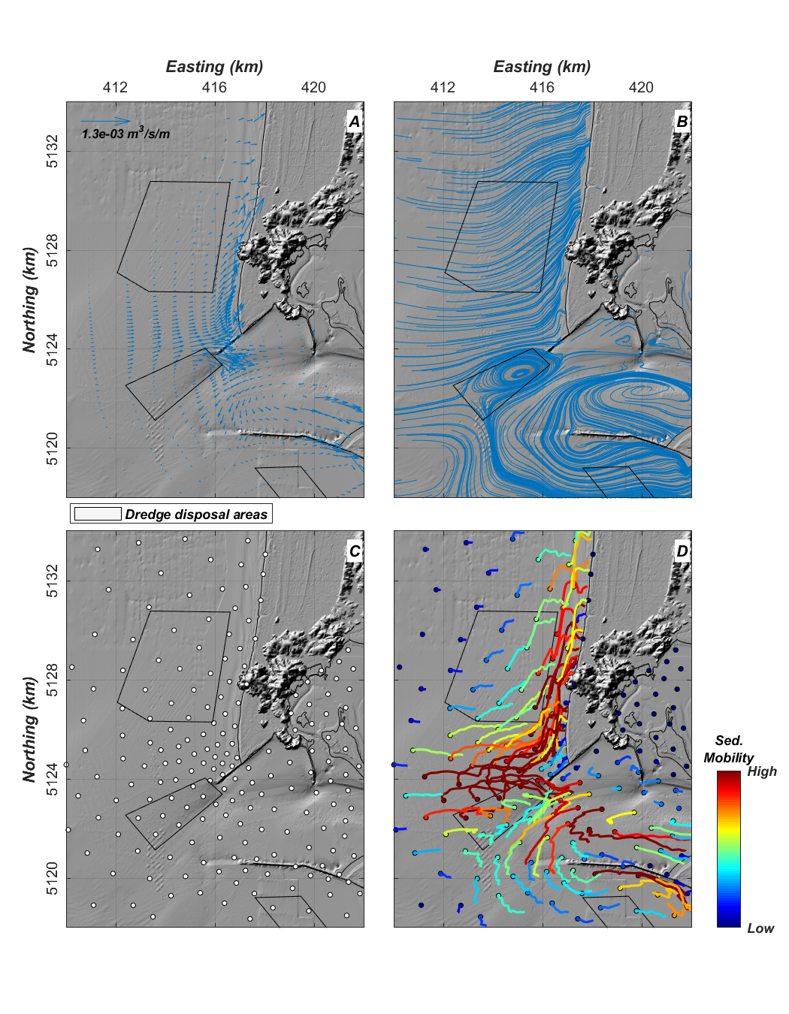
Sediment Transport Pathways Analysis
Sediment Pathway Interactive visualization Tool (SPIT) used sediment transport vector fields derived from transport formula to examine pathways and relative mobility of 500 source locations throughout the estuary, inlet, and coastal areas
Transport Vectors
Streamlines
Source locations
Pathways

Slide 15
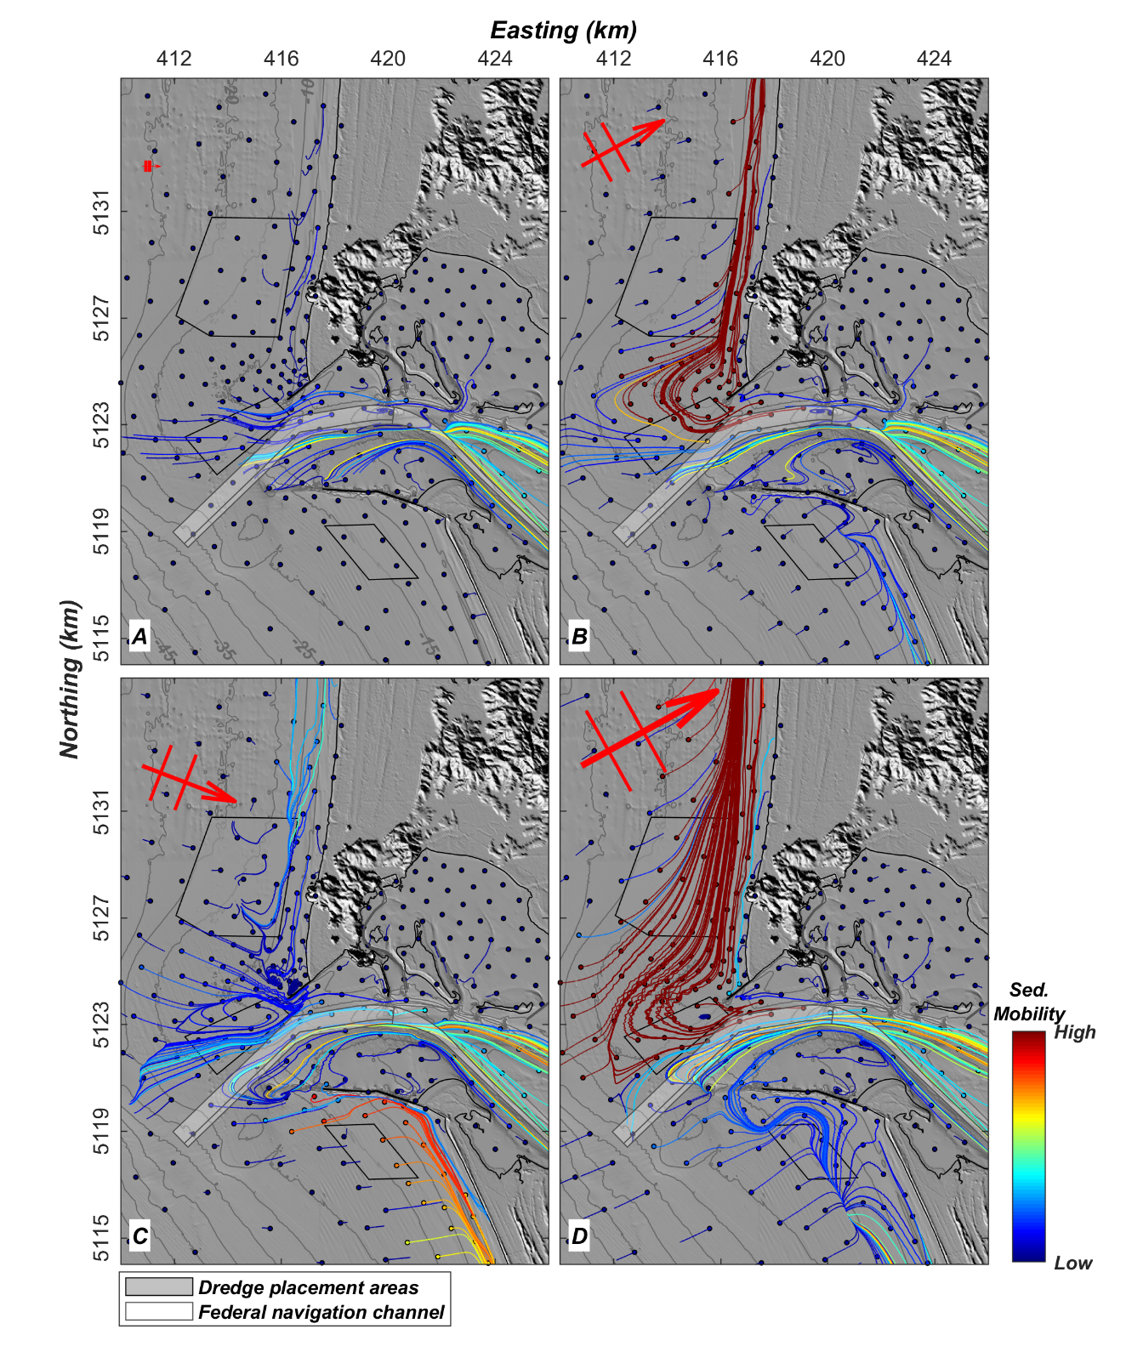
Sediment Transport Pathways Analysis
Example pathways under steady wave conditions
  Hsig = 0.7 m, Dp = 271°
  Hsig = 3.5 m, Dp = 241°
  Hsig = 3.7 m, Dp = 291°
  Hsig = 5.8 m, Dp = 241°
Transport pathways highly sensitive to wave height and direction
Highest sediment mobility is found on Peacock Spit and nearshore north of the MCR

Slide 16
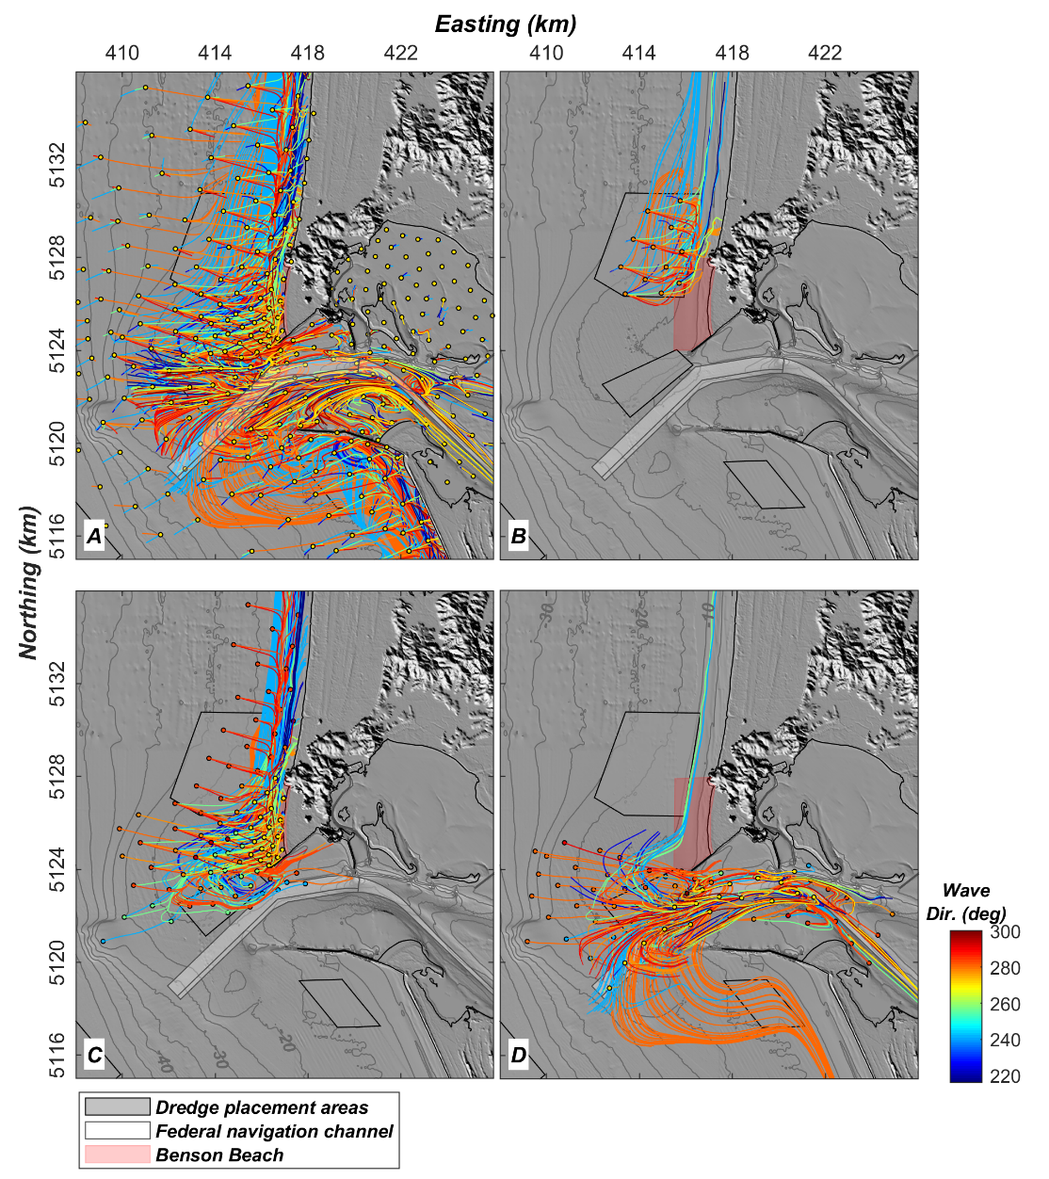
Sediment Transport Pathways Analysis
Total of 19,000 source pathways were computed (19 wave classes, 2 discharge scenarios, and 500 sources per simulation)
Sources originating within the North Head Site were primarily directed northward
Sources that interacted with Benson Beach originated within the inlet, SWS, along Peacock Spit, and from coastal areas to the north including the NH Site
Sources that interacted with the navigation channel originated within the estuary, MCR, and ebb delta

Slide 17
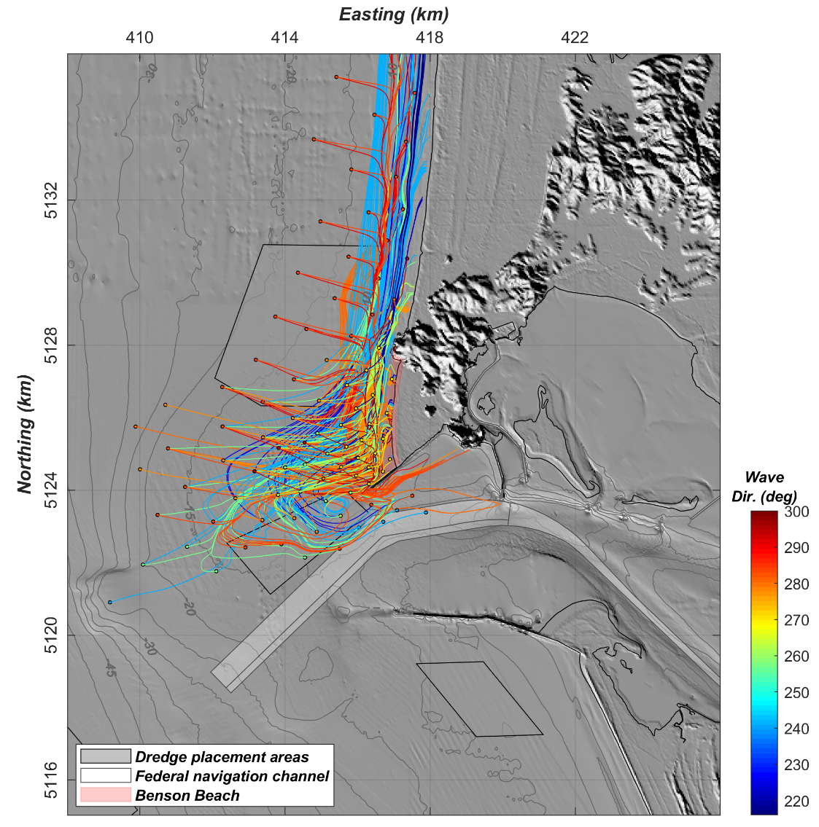
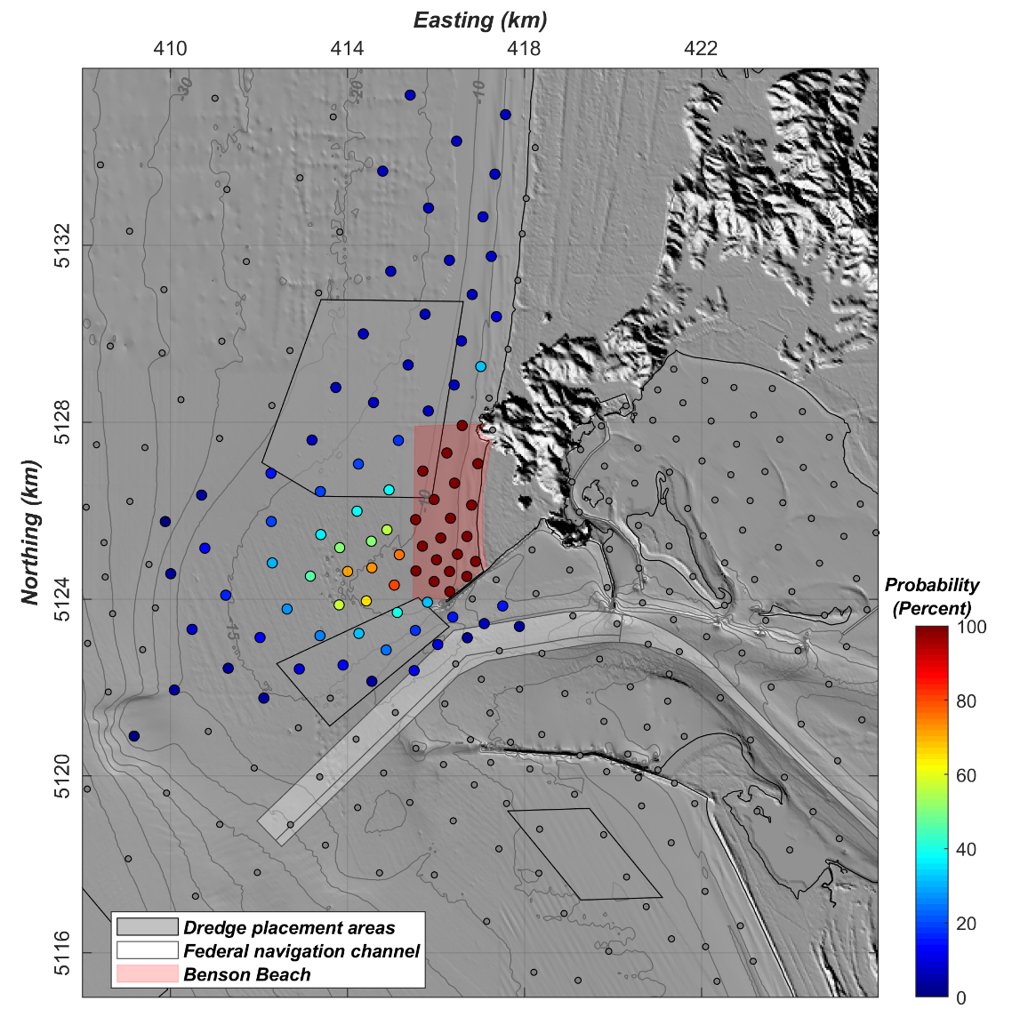
Sediment Transport Pathways Analysis
All sources interacting with Benson Beach
Probability of sources interacting with Benson Beach
Note that sources originating in the NH Site that interact with Benson Beach only do so under NW wave forcing
Sources located between SWS and NH Site much more likely to interact with Benson Beach

Slide 18
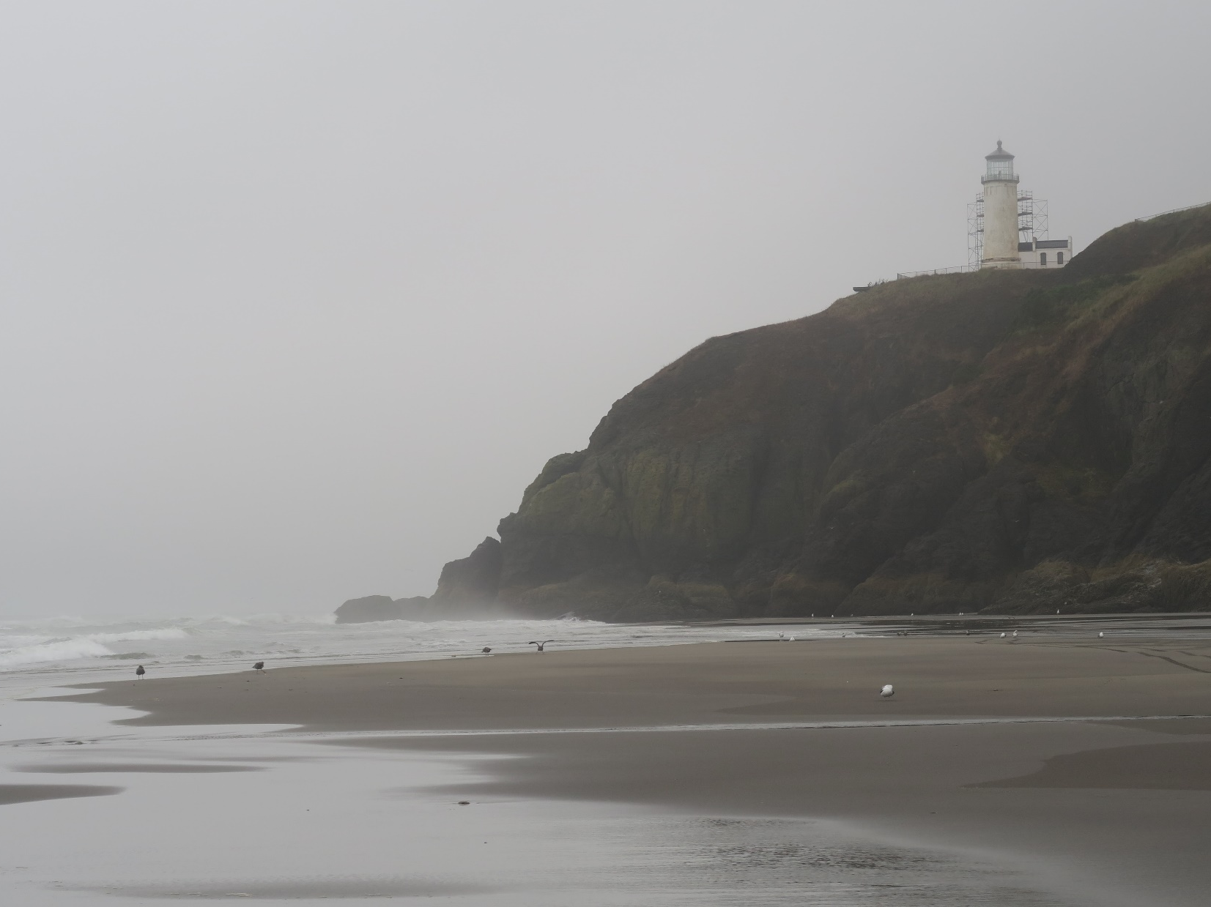
Conclusions
Despite the placement of approximately 1 Mm³ of sediment in the Shallow Water Site annually between 2014 and 2019, Benson Beach continued to erode 420,000 m³/yr
Sediment transport within the NH Site is driven by wave events and fluxes are low suggesting the NH Site is less dispersive than the SWS
Connectivity between current dredge placement areas (SWS and NH Sites) and Benson Beach is relatively low. Placing dredge material between the NH Site and SWS would most efficiently enhance the sediment budget of Benson Beach
Next Steps
Continue to monitor coastal morphology at Benson Beach and South Jetty in 2020
Examine conditions and predict fate of 2019 pilot placement
Compare model predictions of waves and currents to field data collected by the USACE at the North Head Site
More detailed point source analysis and comparison of sediment mobility to SWS placement management

