Slide 1
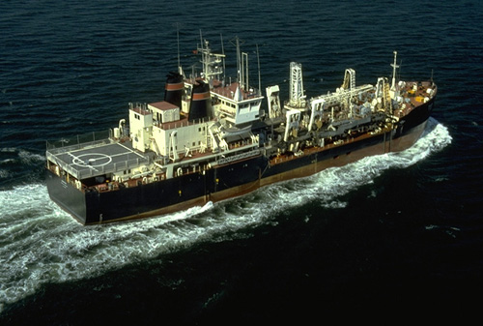
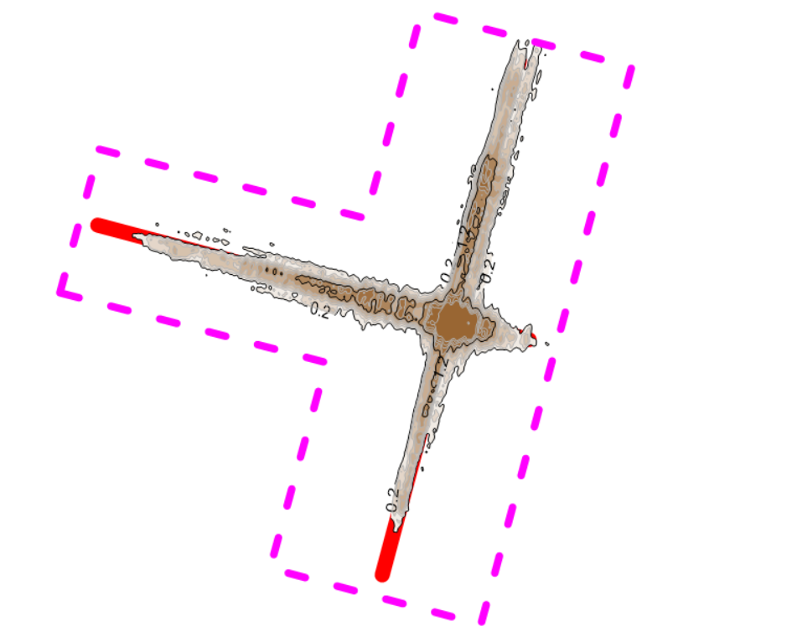
phase ii - north head site Pilot Study
Assessing Nearshore Placement of Dredged Material
Sustaining Peacock Spit at the
Mouth of Columbia River, WA
Hans R. Moritz, Rachel Stolt, Austin Hudson,
Jarod K. Norton, James M. McMillan, Terry Geroux,
Michael Booton, and Essayons Crew
USACE Portland District
Curtis Roegner
NOAA Fisheries, Point Adams Research Station
MOUTH OF COLUMBIA RIVER BENEFICIAL USE PROGRAM WORKSHOP
Astoria, OR
14 January 2002

Slide 2
Presentation Overview
Thin-Layer Placement at North Head Site – The Pilot Study
- Phase I (2018)
- Phase II (2019)
Dispersion of Dredged Sand Placed at North Head Site
- Monitoring Results
Operational Use of North Head Site – Initial Considerations

Slide 3
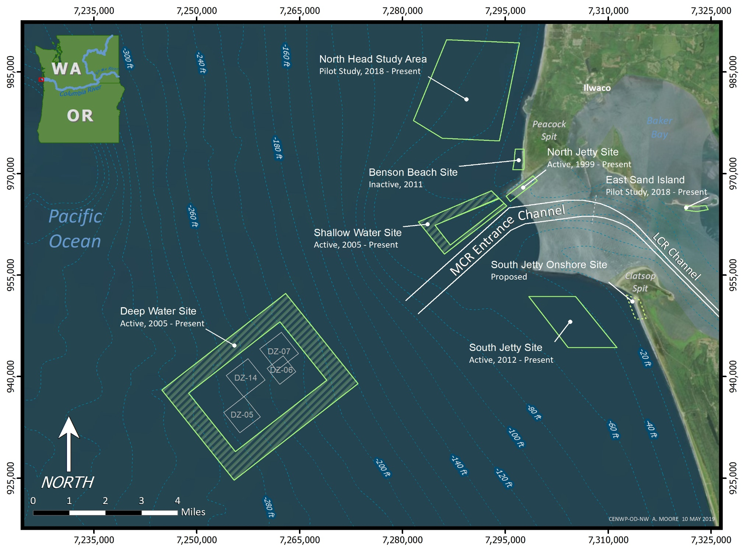
Mouth of the Columbia River

Slide 4
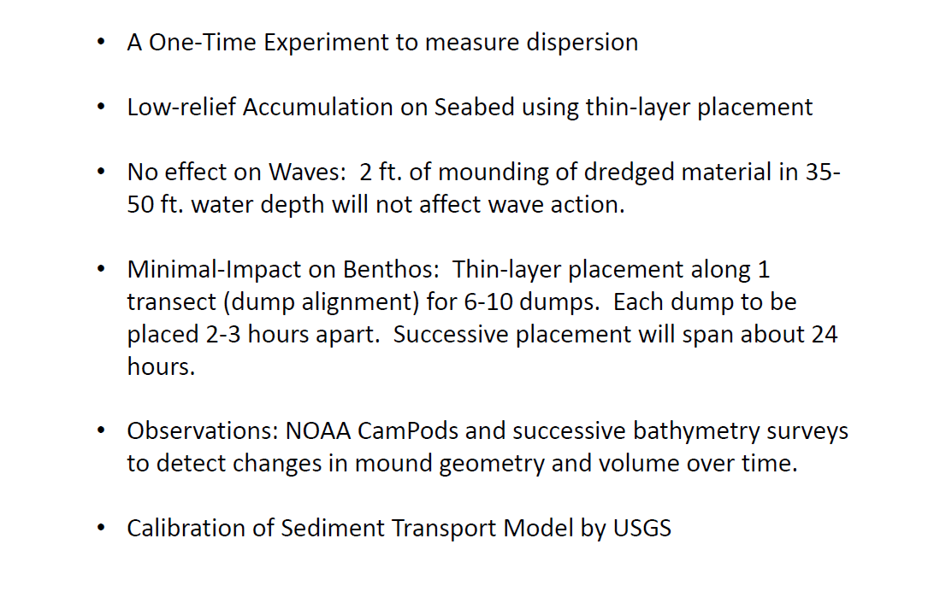
Intended Concept for Nearshore Placement at NHS 1/2
---Presented to Stakeholders and Agencies in MAY 2018---
Notes:
PROJECT: Dredged sand is being placed within a nearshore location adjacent to the Mouth of the Columbia River (MCR), USA to address a chronic coastal sediment deficit while minimizing impacts to the site’s benthic ecology.
MOTIVATION FOR PLACEMENT OF DREDGED MATERIAL IN NEARSHORE ZONE: The nearshore morphology along the south side of the MCR inlet has been receding for many decades compromising the stability of the MCR inlet, jetties, and navigation channel. Progressive loss of shoreface morphology (sand) at the MCR also degrades the benthic substrate for nearshore ecology.
Solution: Implement Regional Sediment Management.
Regional Sediment Management (RSM) sustains water resource projects, that interact with natural sediment processes, by implementing balanced approaches for managing affected sediment. An objective of RSM is to emulate the natural system of sediment transport pathways that may be affected by a project: To Work with Nature, Not Against.
At engineered coastal inlets where navigation channels are maintained through dredging, RSM coordinates dredged material placement activities to:
-> Sustain processes affecting the natural sediment budget and morphology,
-> Stabilize Infrastructure dependent upon ephemeral coastal morphology,
-> Improve efficiency of dredging maintenance for navigation projects, and
-> Protect Ecology affected by natural sediment processes or dredged material placement.

Slide 5
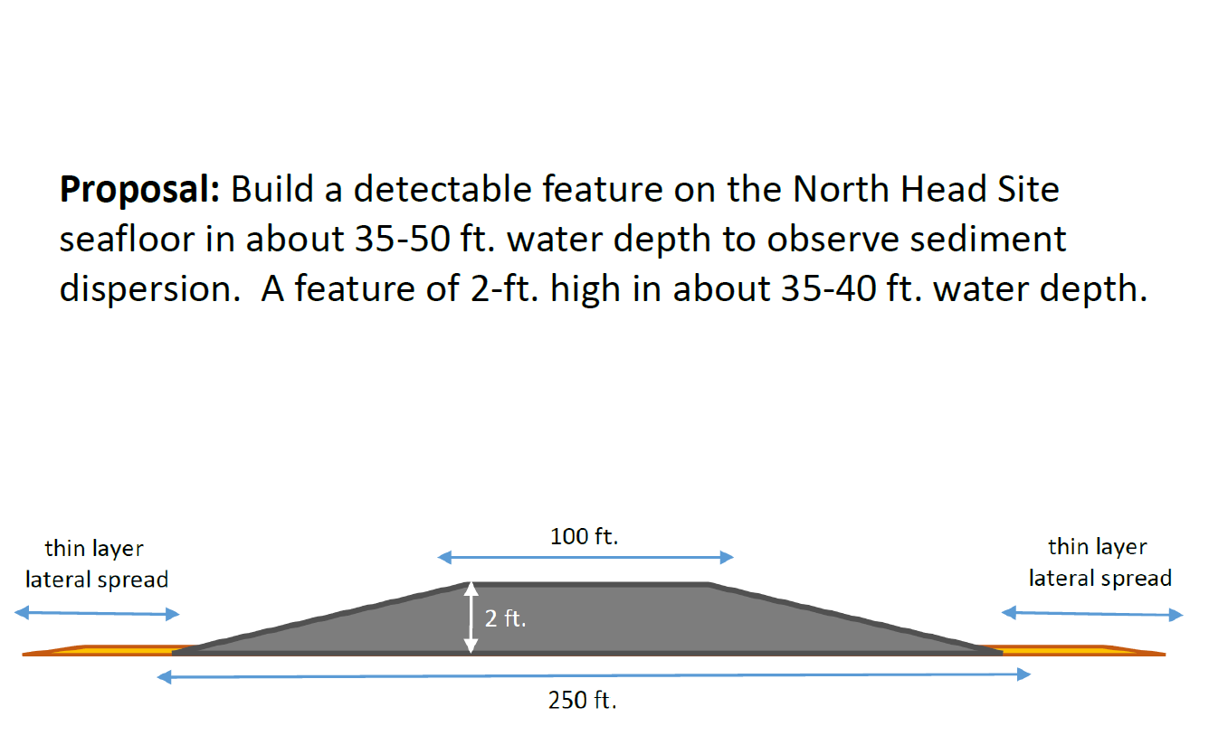
Intended Concept for Nearshore Placement at NHS 2/2
----Presented to Stakeholders and Agencies in MAY 2018---
PHASE I

Slide 6
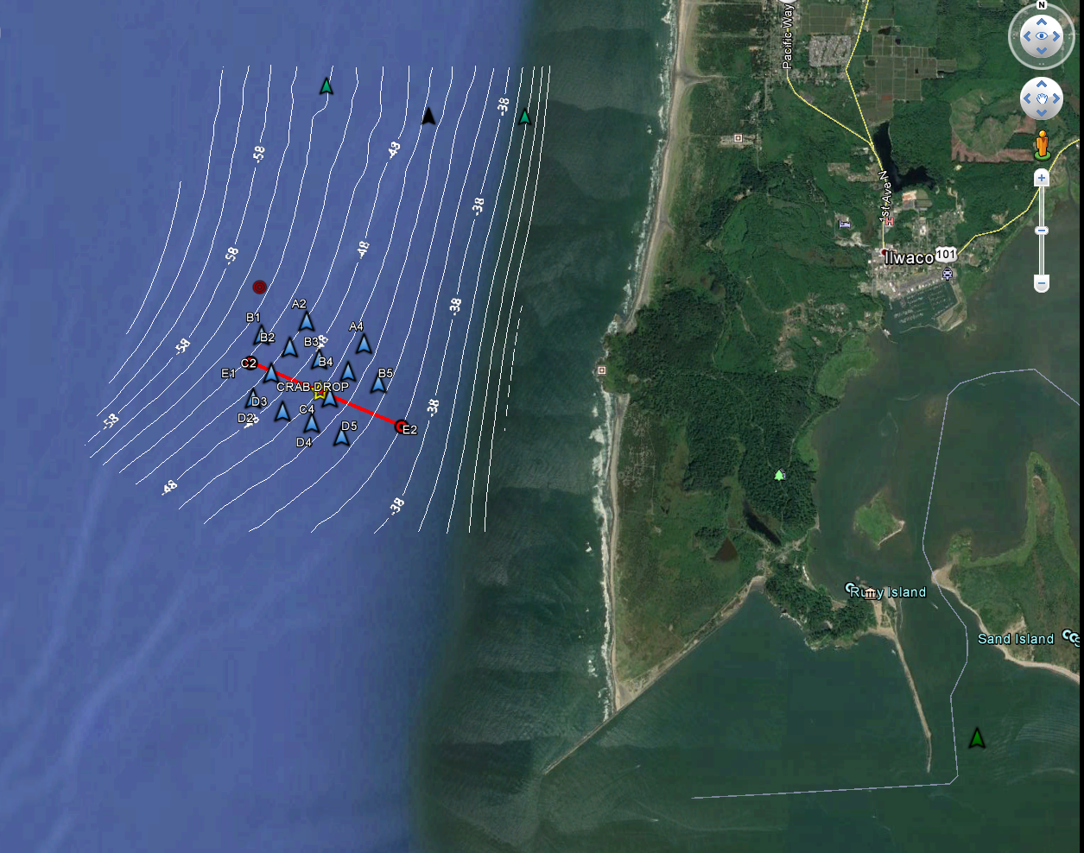
NORTH HEAD SITE STUDY AREA Phase I
Pacific
Ocean
North Head
Benson Beach
Peacock Spit
Mouth of Columbia River

Slide 7
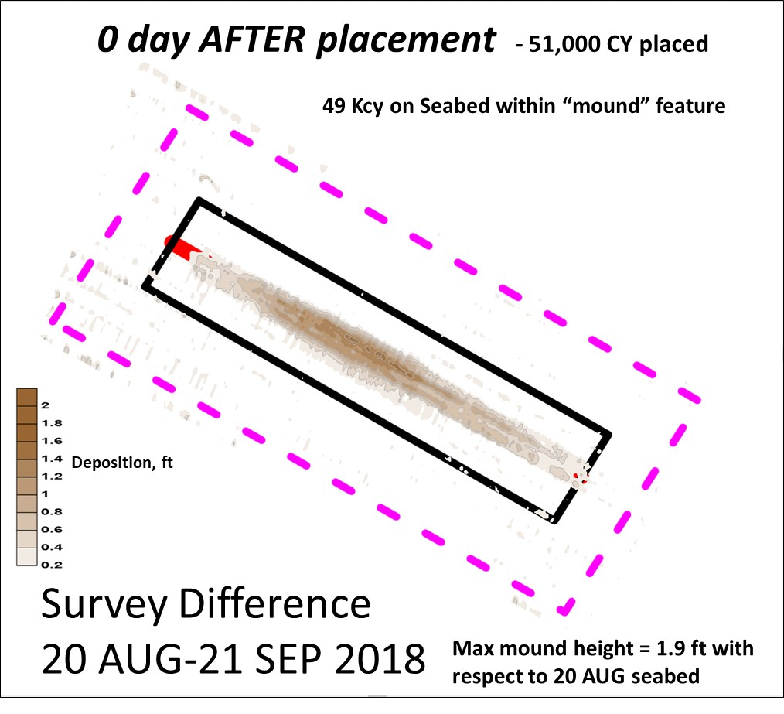
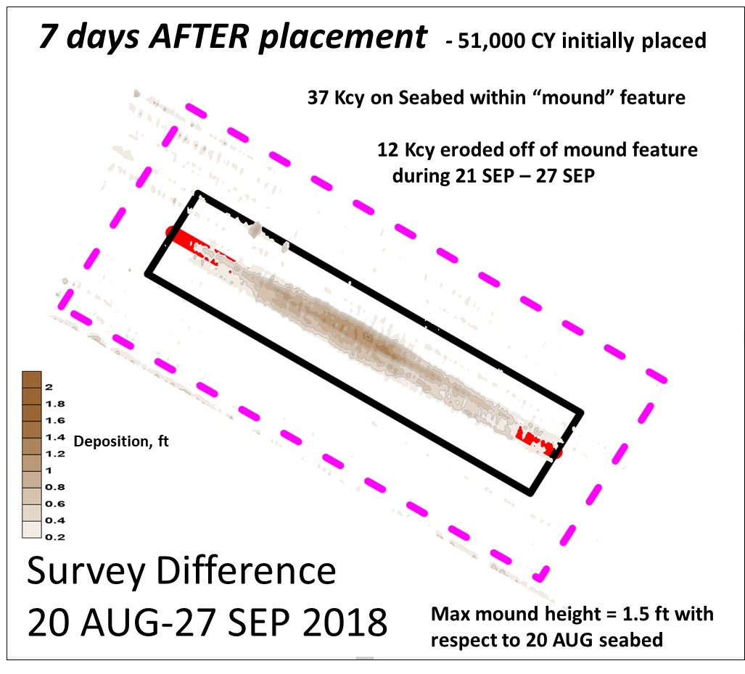
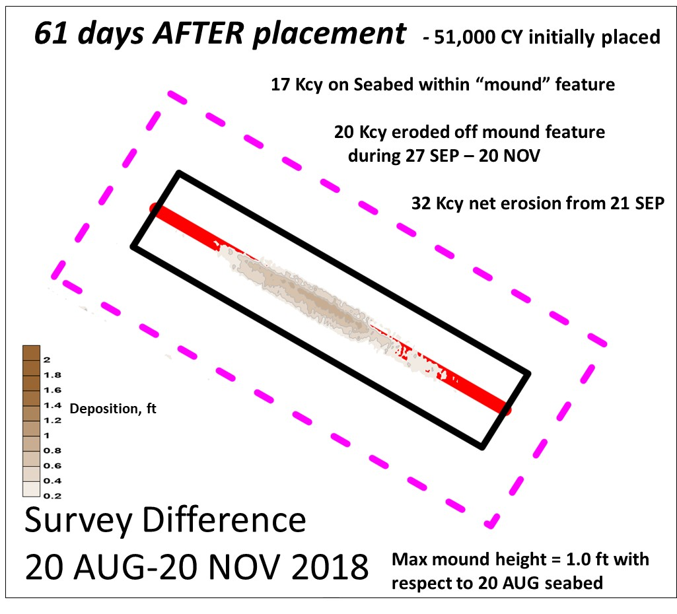
Monitor the Dispersion of Dredged Material Placed on Seabed at North Head Site
(1-2 ft high sand mound on sand substrate)
By evaluating bathymetry change measured by successive multi-beam surveys
PRE-PLACEMENT
POST-
POST-
20 AUG 2018
21 SEP 2018
27 SEP 2018
POST-
20 NOV 2018

Slide 8
NHS-Phase I Findings - 2018
9 loads (51,000 cy) of sand where placed by the gvt hopper dredge Essayons along a 5,000 ft-long transect, using thin-layer placement method, and produced a 2 ft high mound.
Placement occurred during 19-21 SEP 2018, in water depth of 40-50 ft depth along the northern flank of Peacock Spit.
Post-placement surveys were conducted at 0 days, 7 days, and 60 days after placement completion.
At day 0, The resultant mound formed on seabed was 5,000 ft long and 300 to 500 ft wide. All 9 loads were released within the 150 ft wide placement transect.
At day 0, the initial detectable volume of placed material along the mound feature was 49,000 CY, or 96% detected on seabed. (2,000 cy of dredged material was dispersed to the surrounding seabed during placement).
By day 7, the detectable mound volume had been reduced to 37,000 cy due to sediment dispersion; 37% (12,000 cy) dispersed from mound. Waves were 3-10 ft high, 6-10 sec, and S-NW.
By day 60, the mound volume had been reduced to 17,000 CY: 77% (32,000 cy) dispersed from mound. Max mound height was 1 ft. By Spring 2019, Mound was GONE.

Slide 9
Thin-Layer Placement at North Head Site
The Pilot Study – Phase II

Slide 10
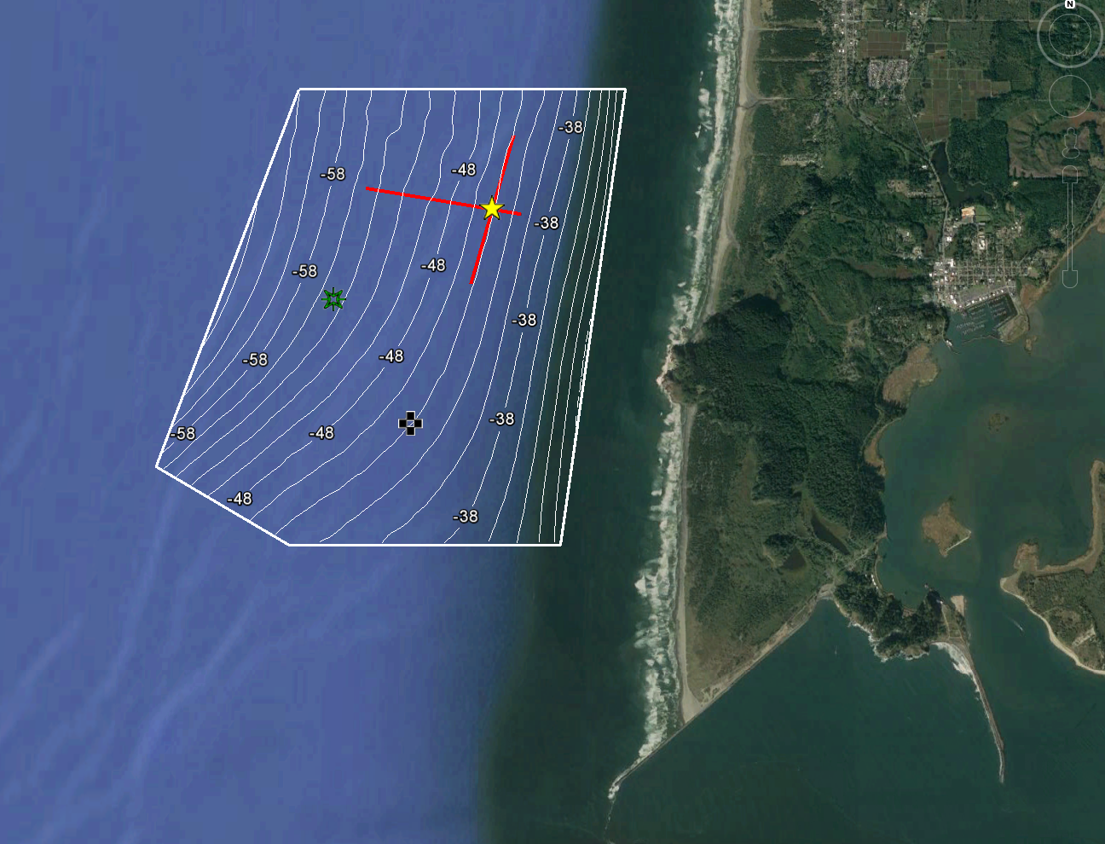
NORTH HEAD SITE STUDY AREA Phase II
Pacific
Ocean
North Head
Ilwaco
Benson Beach
Peacock Spit
Mouth of Columbia River

Slide 11
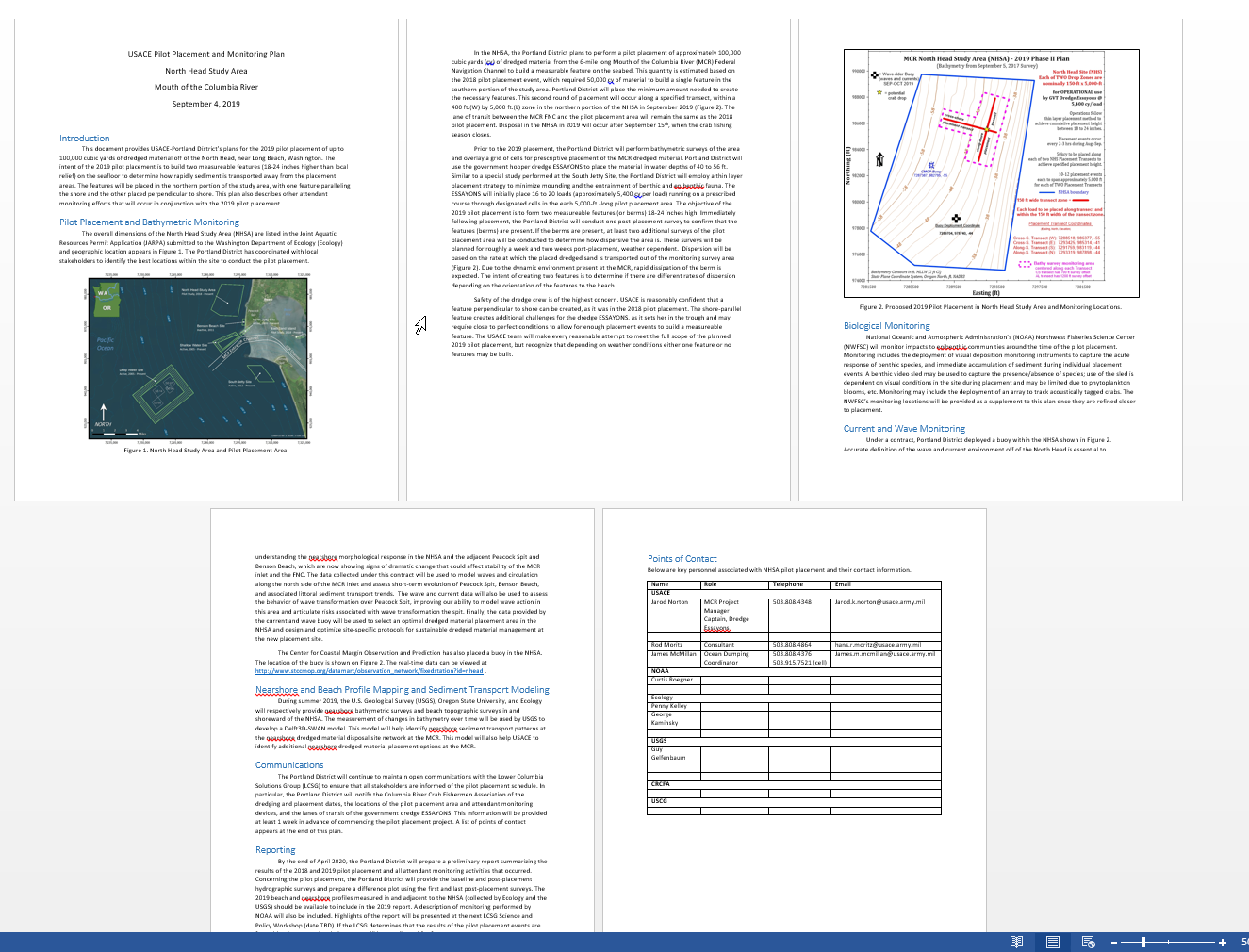
USACE Pilot Placement and Monitoring Plan – Phase II
North Head Study Area Mouth of the Columbia River
Finalized on September 4 2019 - After Regional Review & Consensus

Slide 12
North Head Site – PHASE II (2019 Placement)
100,000 CY placed
along TWO Transects
East-West transect = 50,000 CY
North-South transect = 50,000 CY
Motivating Questions from PHASE I
Is there a preferential transport direction based on “mound” transect orientation ?
Will sediment placed in a E-W (crosshore) berm be dispersed more readily
than material placed in a N-S (alongshore) berm?
Can a hopper dredge operationally place sediment N-S (alongshore) at MCR ?
Does the Northern End of NHS exhibit similar sediment transport rates as
the Southern End of NHS ?

Slide 13
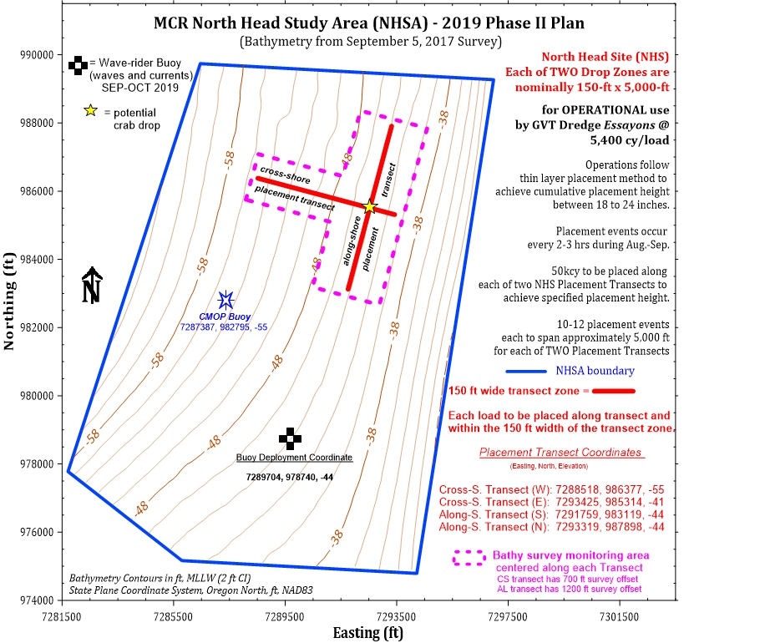

Slide 14
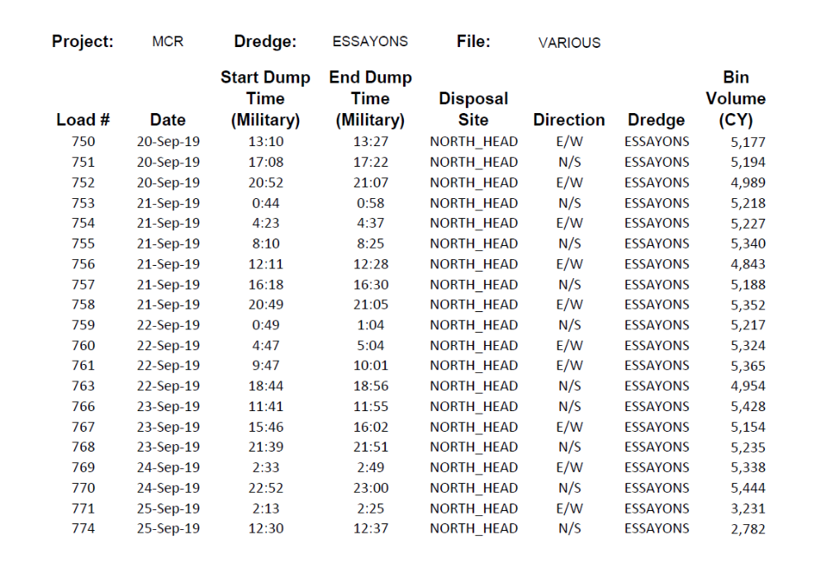
USACE Placed 100,000 cubic yards in NHS – Phase II Pilot during 20-25 SEP 2019

Slide 15
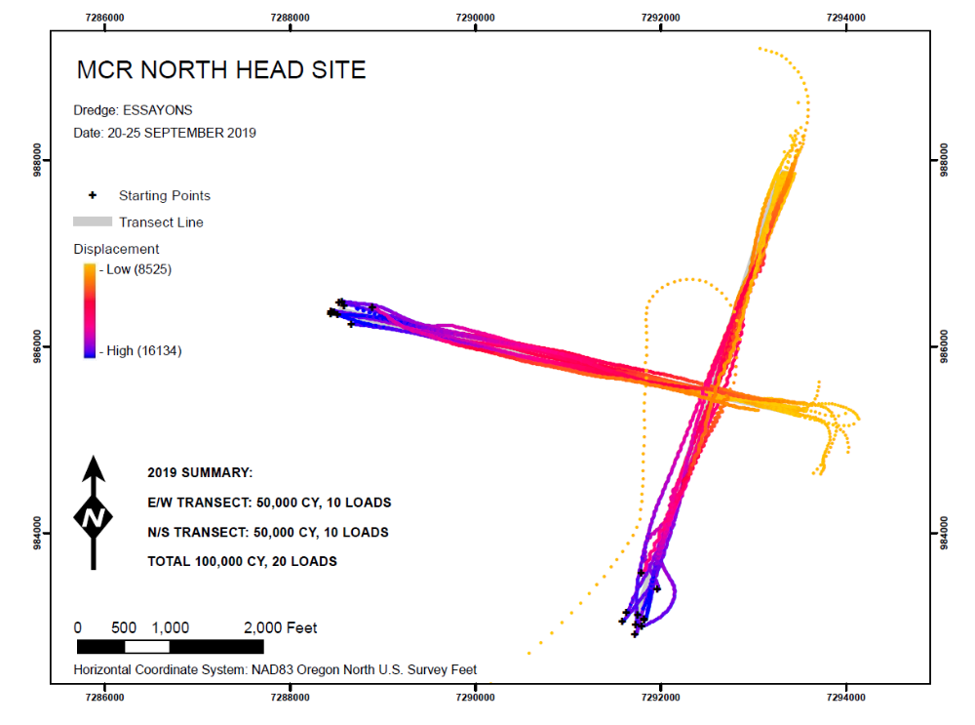
Phase II
Dredge track-lines during placement
E-W Transect
N-S Transect

Slide 16
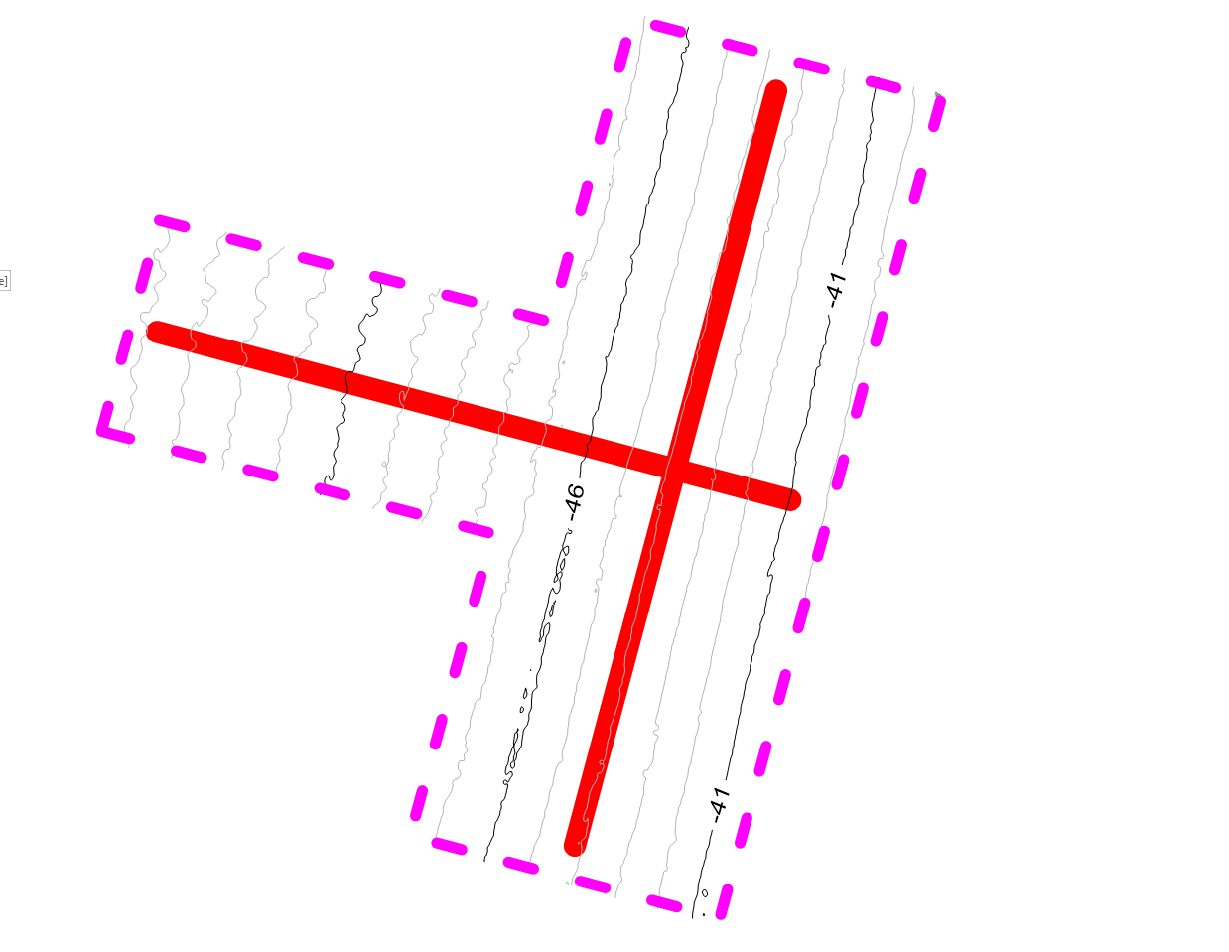

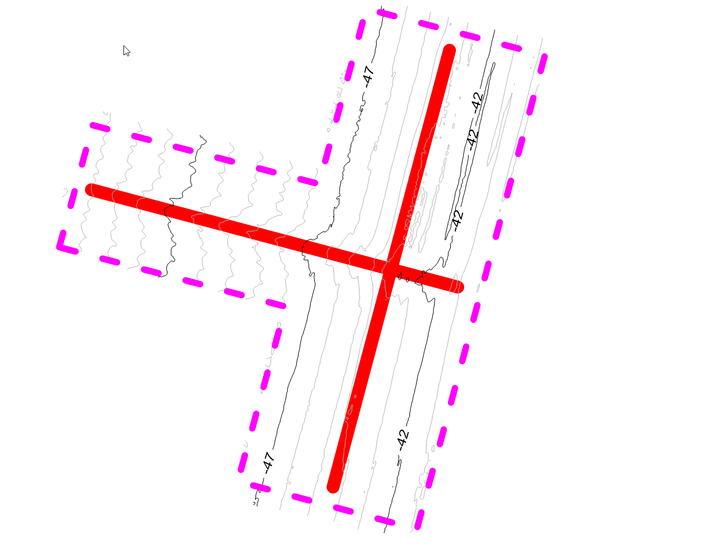

Monitor the Dispersion of Dredged Material Placed on Seabed at North Head Site
(1-2 ft high sand mound on sand substrate)
By evaluating bathymetry change measured by successive multi-beam surveys
PRE-PLACEMENT
POST-
POST-
14 SEP 2019
30 SEP 2019
11 OCT 2019
POST-
24 OCT 2019

Slide 17
6 days BEFORE
Initial placement
Placement = 20-25 SEP
East-West Transect
North-South Transect
-51 ft MLLW
14 SEP 2019
Contours = 1 ft, below MLLW

Slide 18
5 days AFTER
Final placement
Placement = 20-25 SEP
-51 ft
20 loads placed during 20-25 SEP
= 100,000 CY (50 Kcy each transect)
by hopper dredge Essayons
(~5,000 cy/load)
material = fine-medium sand
dredged from MCR-FNC
(sand dia=0.15 – 0.35 mm)
30 SEP 2019
Contours = 1 ft, below MLLW

Slide 19
16 days AFTER
Final placement
Placement = 20-25 SEP
-52 ft MLLW
11 OCT 2019
Contours = 1 ft, below MLLW

Slide 20
29 days AFTER
Final placement
Placement = 20-25 SEP
-52 ft MLLW
24 OCT 2019
Contours = 1 ft, below MLLW

Slide 21
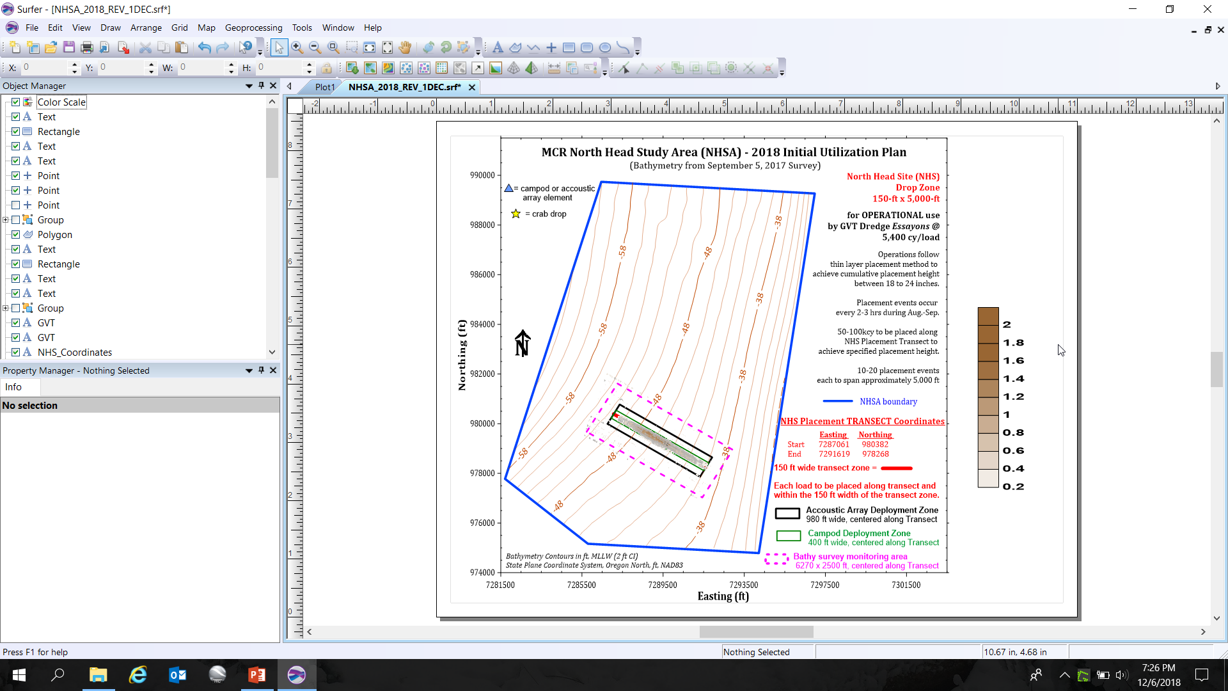
0 days AFTER placement* 100,000 CY initially placed
Placement = 20-25 SEP
96 Kcy on Seabed within feature*
4 Kcy dispersed since placement*
Deposition, ft
Survey Difference
25 - 14 SEP 2019*
Max mound height = 2.4 ft with respect to 14 SEP seabed

Slide 22
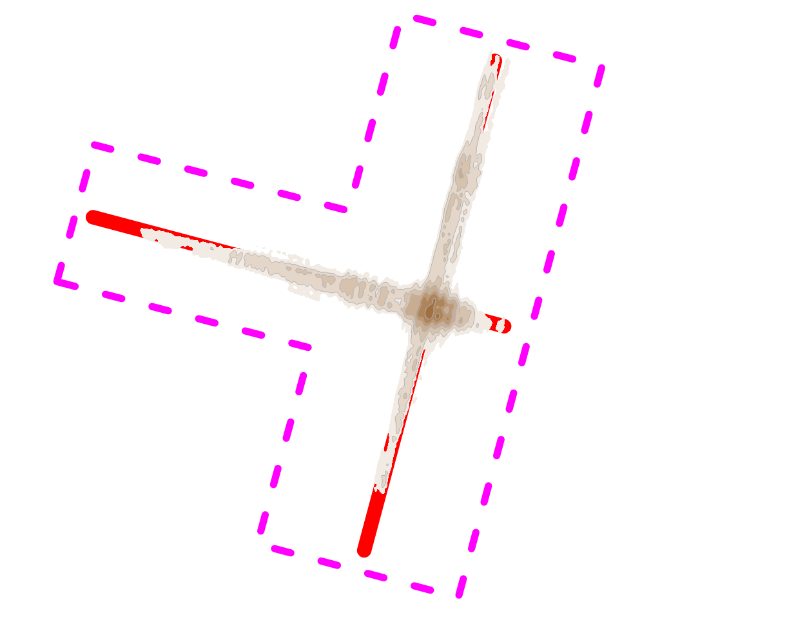
5 days AFTER placement 100,000 CY initially placed
Placement = 20-25 SEP
44 Kcy on Seabed within feature
56 Kcy dispersed since placement
Deposition, ft
Max mound height = 1.4 ft with respect to 14 SEP seabed
Survey Difference
30 - 14 SEP 2019

Slide 23
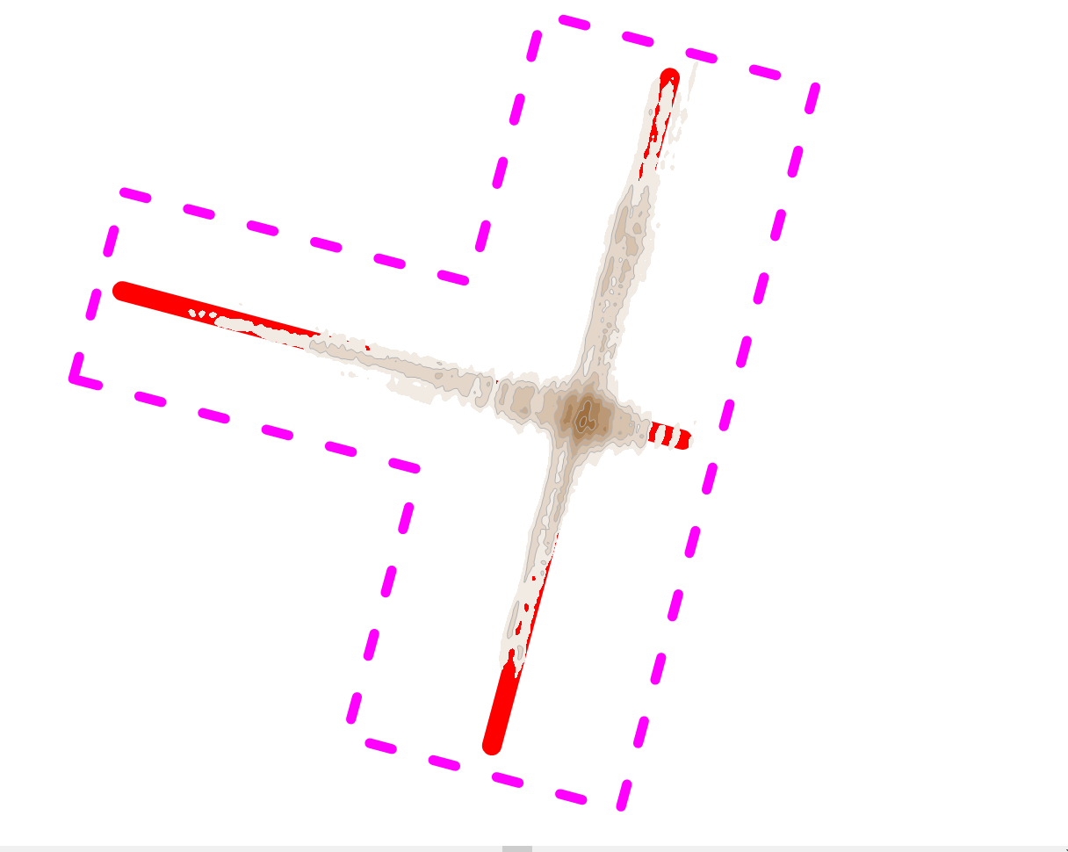
16 days AFTER placement 100,000 CY initially placed
Placement = 20-25 SEP
42 Kcy on Seabed within feature
2 Kcy eroded from feature
during 11 OCT – 30 SEP
58 Kcy dispersed since placement
Deposition, ft
Survey Difference
11 OCT- 14 SEP 2019
Max mound height = 1.6 ft with respect to 14 SEP seabed

Slide 24
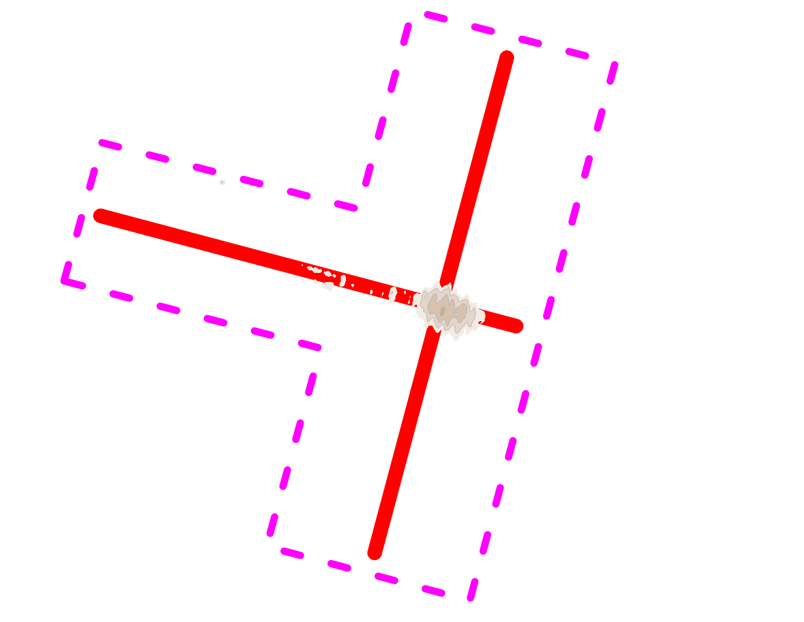
29 days AFTER placement 100,000 CY initially placed
Placement = 20-25 SEP
8 Kcy on Seabed within feature
34 Kcy eroded from feature
during 24 OCT – 11 OCT
92 Kcy dispersed since placement
Deposition, ft
Survey Difference
24 OCT- 14 SEP 2019
Max mound height = 0.8 ft with respect to 14 SEP seabed

Slide 25
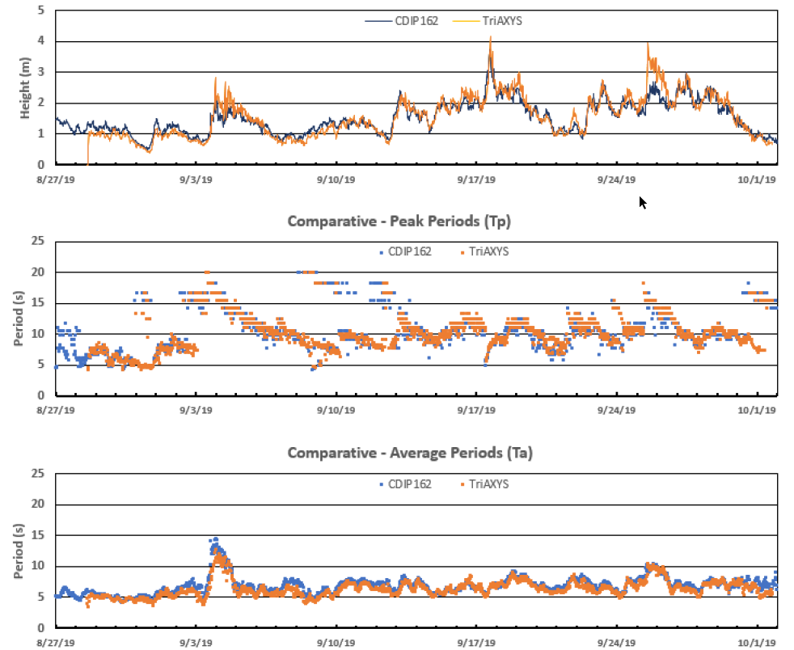
WAVES STIR the Sediment
14 SEP Survey
Placement
20-25 SEP
30 SEP Survey
11 OCT
Survey
24 OCT
Survey
Wave Height
Wave Direction
Wave Period

Slide 26
North Head Site – PHASE II (2019 Placement)
100,000 CY placed along TWO Transects
East-West transect = 50,000 CY
North-South transect = 50,000 CY
Motivating Questions Addressed in Phase II
Sediment is transported vigorously at NHS regardless of “mound” orientation
Transport direction could NOT be defined in Phase I or II (its like smoke, not a turtle).
More work is needed to establish sediment transport direction
----sediment transport direction at NHS likely varies by location
Hopper dredge can operationally place sediment alongshore & cross-shore at NHS.
The Northern End of NHS appears top exhibit similar sediment transport rate as
the Southern End of NHS.

Slide 27
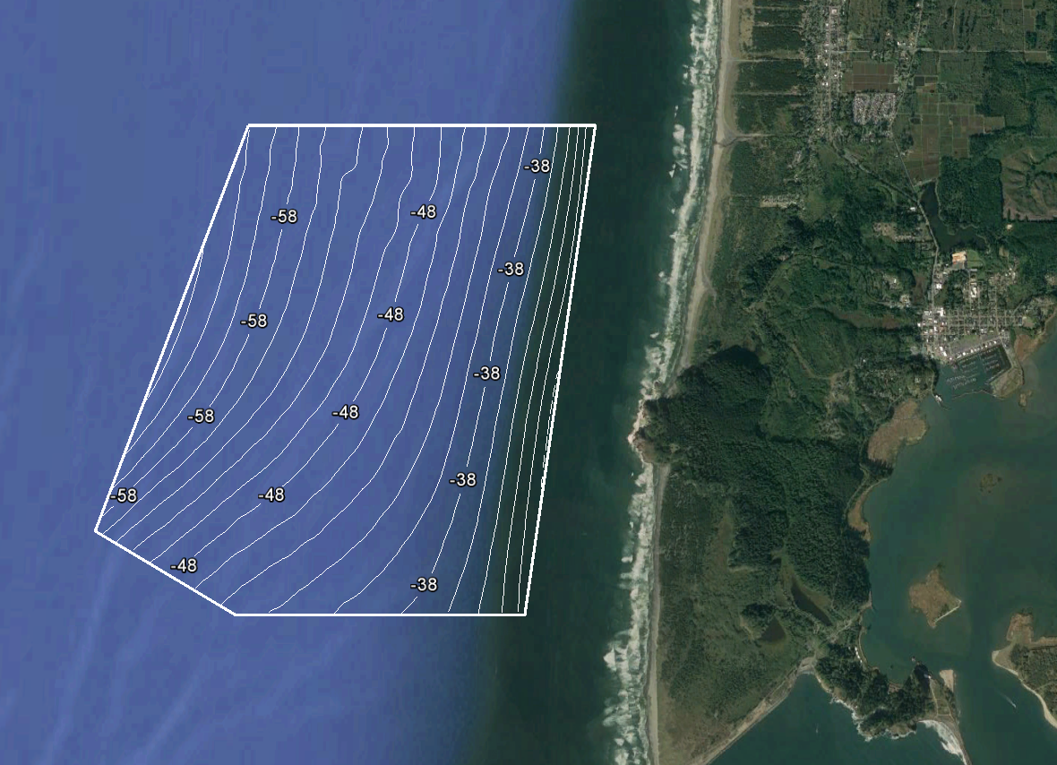
Proposed Operational Plan For North Head Site (NHS)
Use sub-areas of NHS on a rotational basis (annual use) at 300 - 500 KCY/yr
--> with close stakeholder coordination <--
Proposed Placement Rate
= 400,000 to 500,000 cy/yr
2.8 miles
North Head
Ilwaco
0.6 miles
2.3 miles
Peacock Spit
Benson Beach

Slide 28
Possible Future Distribution of MCR Dredged Sediment
MCR O&M dredging = 2,500,000 to 3,500,000 cy/yr
NHS = 300,000 to 500,000 cy/yr (Pilot I-2018 = 50,000 & Pilot II-2019 = 100,000)
NJS = 200,000 cy/yr (200,000 cy/yr)
SWS = 1,800,000 to 2,000,000 cy (1,400,000 cy/yr)
Benson Beach = 200,000 – 400,000 cy every 3 to 6 years
(placement in 2004, 2008, 2010: 40,000, 125,000, 330,000 cy/event)
SJS = 400,000 to 500,000 cy/yr (400,000 cy/yr)
DWS = < 200,000 cy/yr (800,000 cy/yr)
Values in ( ) are recent trend

Slide 29
Shallow Water Site

Slide 30
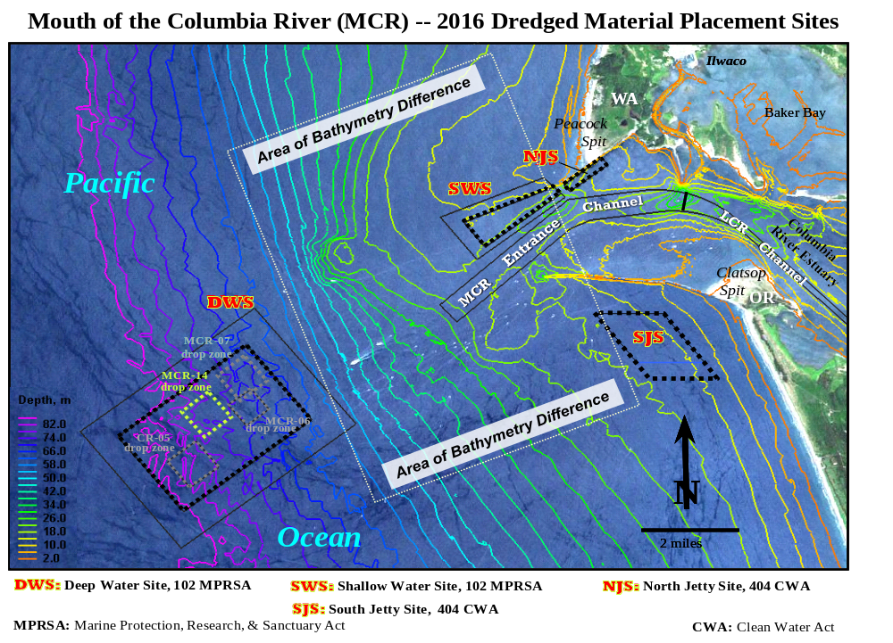

Slide 31
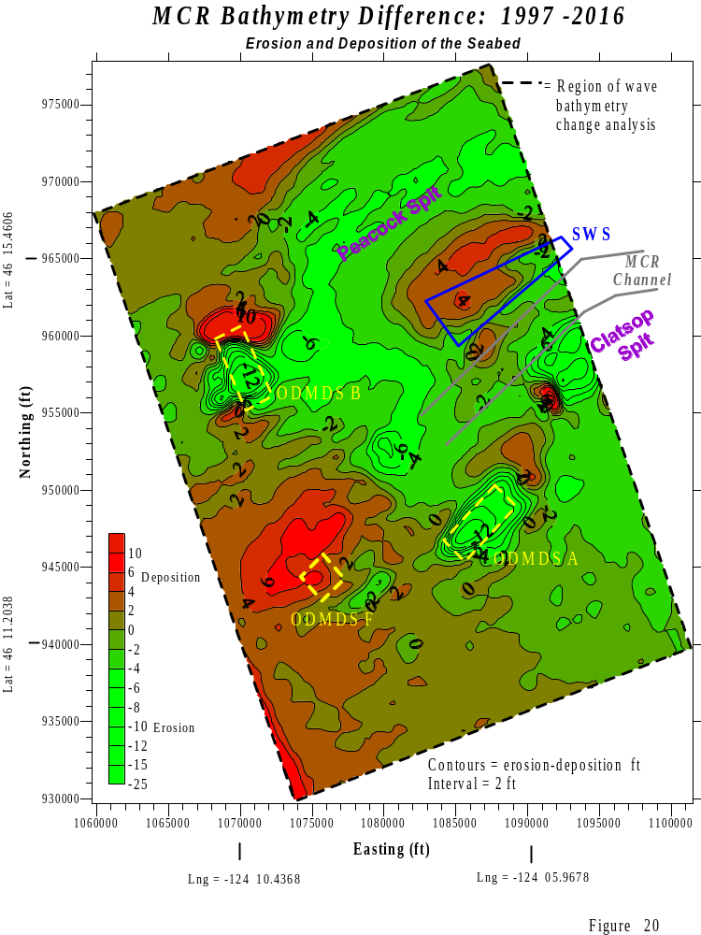
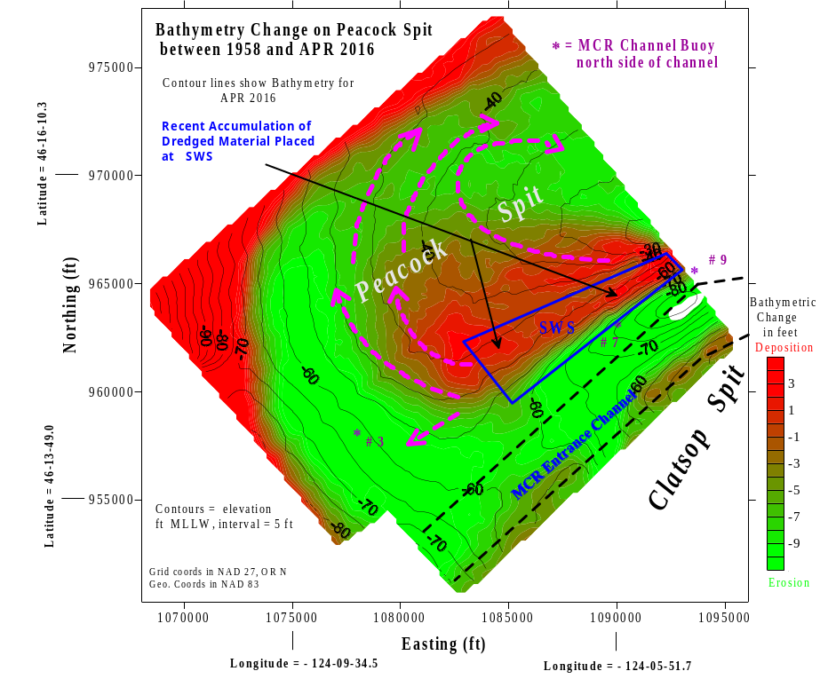
MCR Bathymetry Difference: 1997 to 2016
MCR Bathymetry Difference: 1997 to 2016
2 miles
Peacock Spit is Eroding Despite
USACE Placing 45 million cubic yards of sand within the SWS.
We Need to Feed Peacock Spit from its northern flank (NHS) & southern flank to sustain the Spit and the MCR inlet.
Notes:
ABOVE 3 Figures: Morphology change observed at MCR Peacock Spit, including SWS during, for 3 different time periods since 1958. Arrows indicate transport direction of sand eroded from SWS ODMDS, since 1997. GREEN is erosion and RED is deposition.
40 Million CY of sand have been placed within the SWS since 1997; 0.94 MCY remain. Had the SWS not been used during 1997-2016, much of Peacock Spit would have lost significantly more sediment than is presently the case. It is USACE’s position that the SWS must continue to be used to maintain the MCR inlet and stabilize the sediment budget north of the MCR.
ABOVE 3 Figures: Illustrating bathymetry change at MCR during three different time periods since 1997, highlighting large scale erosion (GREEN) of Clatsop Spit and Peacock Spit. Transport of dredged sediment placed at discontinued ODMDSs A, B, and F is also shown. Note how material had eroded from ODMDS A and Clatsop Spit is migrating northeast toward the MCR inlet. Use of ODMDS A, B, and F was discontinued in 1994, 1997, and 2002, respectively. The placement of 40 MCY of dredged sand at the SWS since 1997 (deposition = RED) has significantly abated erosion of Peacock Spit. Maintaining the morphology of Peacock Spit sustains the MCR inlet, North Jetty, and shorelands north of MCR. The area of bathymetry change for the above 3 figures is shown within context of the MCR inlet, in the uppermost left-hand figure.

Slide 32
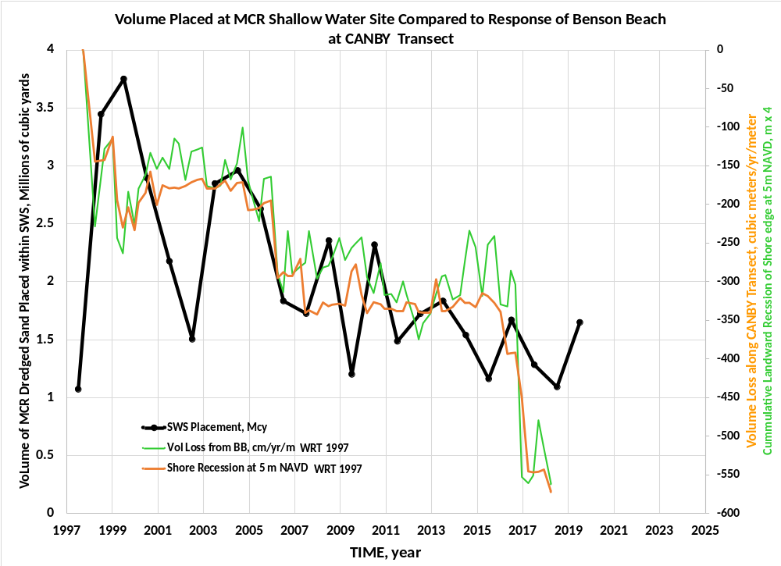
Increase use of SWS from
1.3 MCY/yr
to 2 MCY/yr
?
?
?

Slide 33
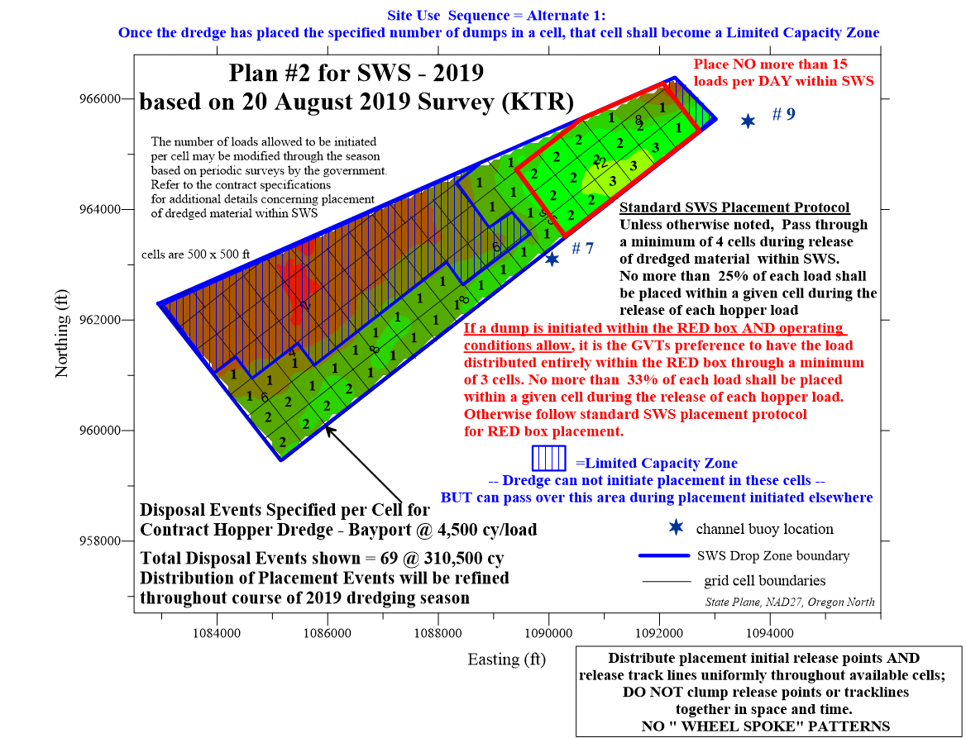

Slide 34
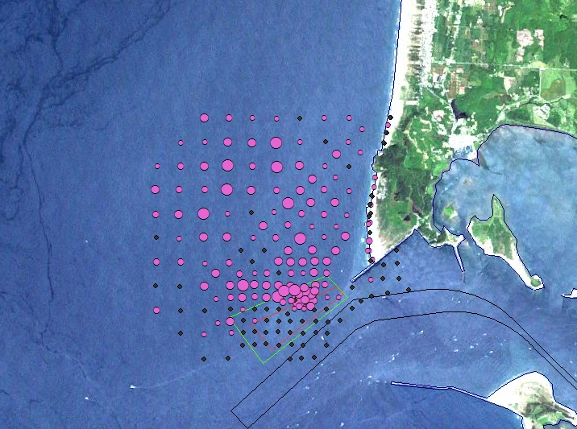
Data Fusion : Merging Tracer Data with
Other Geospatial Data

Slide 35

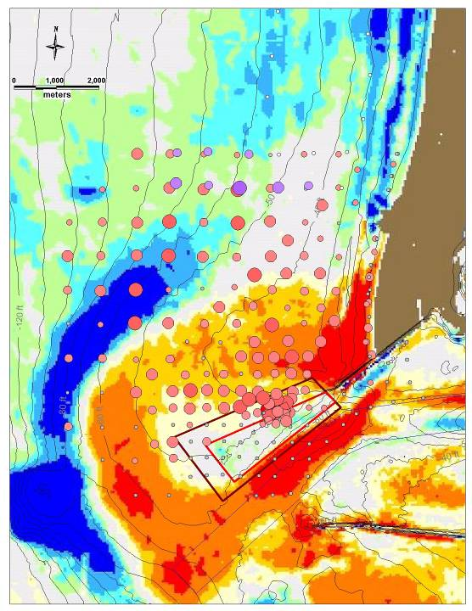
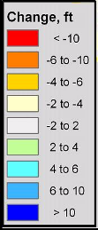
Bathymetry change
1958 – 2003
With 2006-2007
SWS Tracer Results
Superimposed

Slide 36
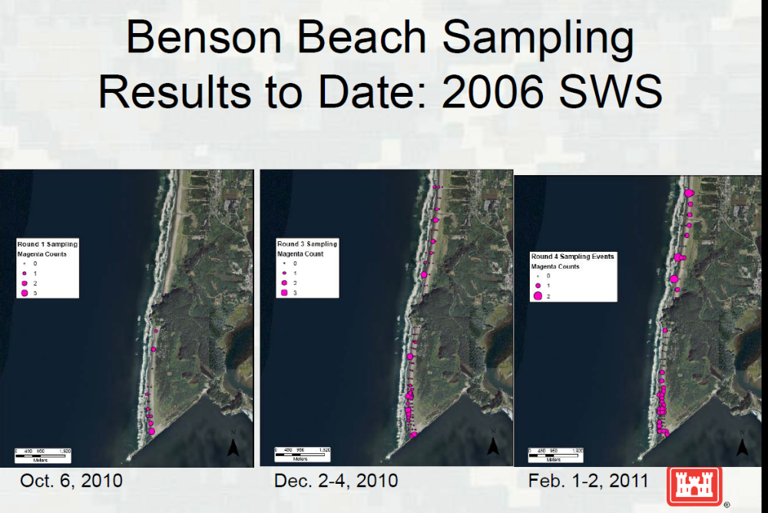

Slide 37
North Jetty

Slide 38
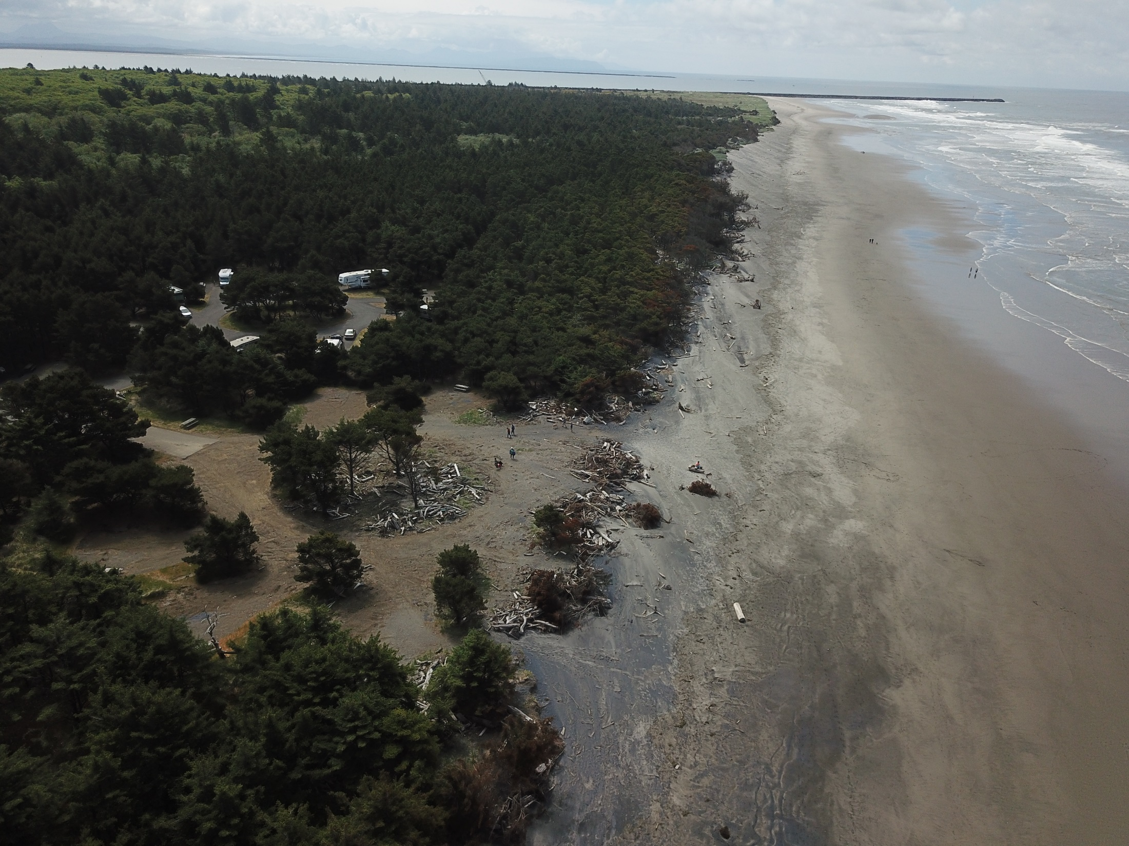
MCR North Jetty
Increased Rate of Shoreface Recession
Benson Beach
Topographic Expression of Peacock Spit
View to South

Slide 39
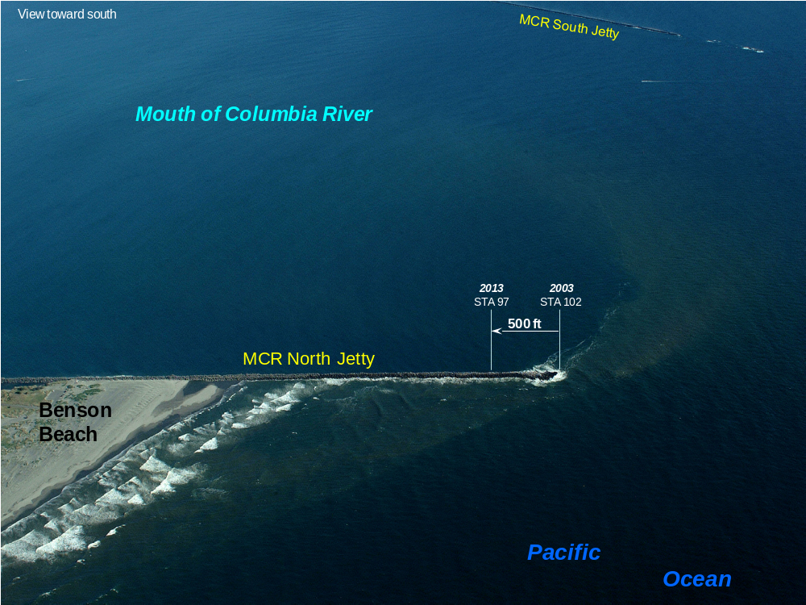

Slide 40
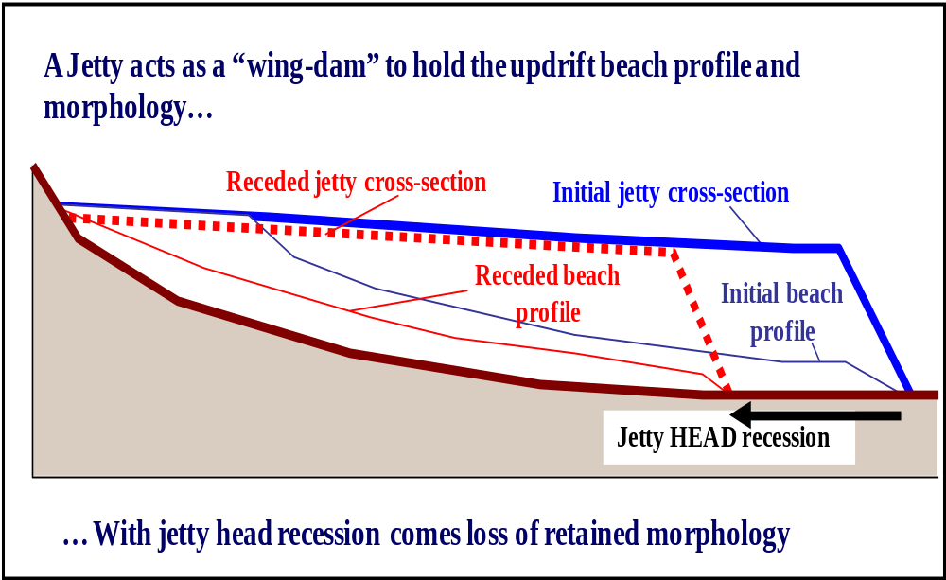
North Jetty was rehabilitated in 2019, with 200 ft of seaward length restored.
Benson Beach expected to exhibit a reduction in erosion rate, after 2019

Slide 41
BENSON BEACH
Pump Ashore

Slide 42
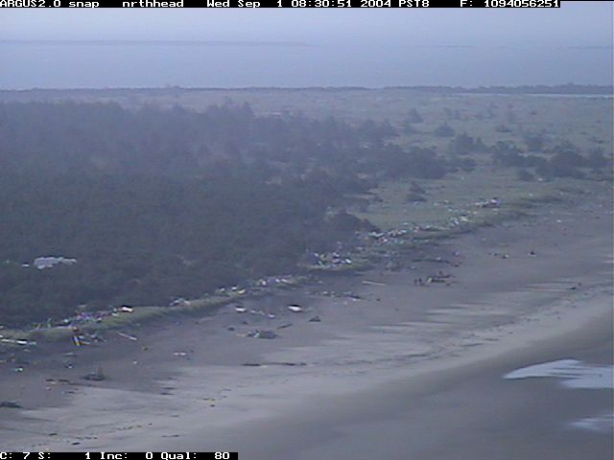
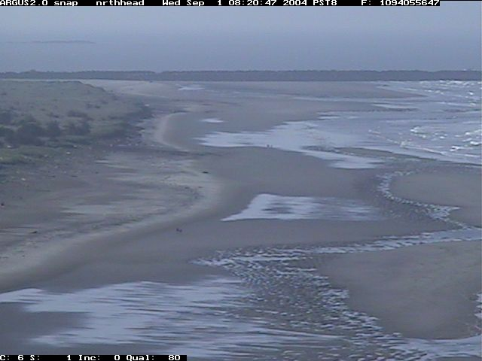
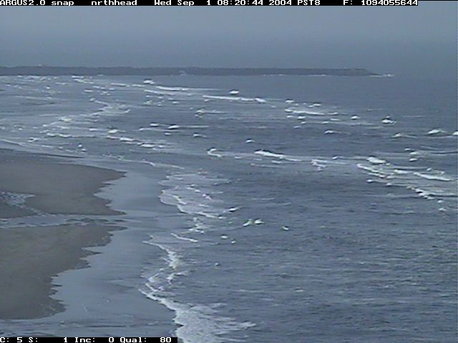
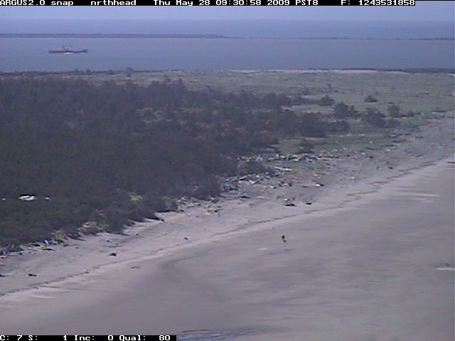
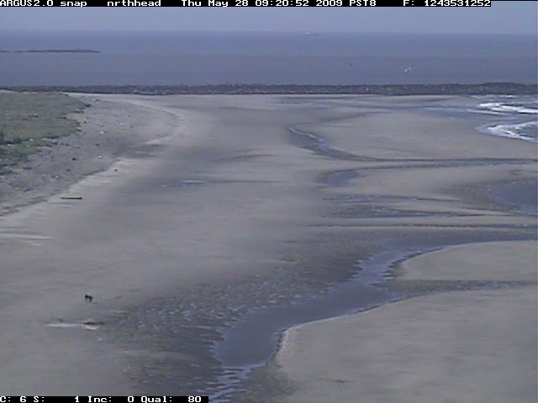
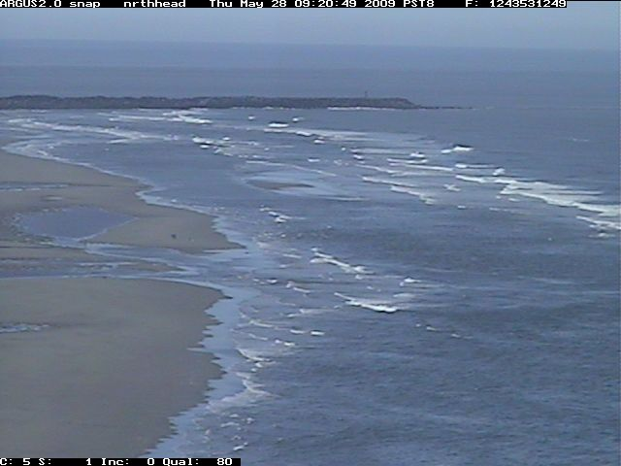
1 Sept 2004: ARGUS Beach Monitoring System at North Head, cameras 5-7
North Jetty
Benson Beach
Local time = 08:00
Inter tidal sand bars
MHHW level in Sept 2004
Low Tide @ -0.1 ft MLLW
28 May 2009: ARGUS Beach Monitoring System at North Head, cameras 5-7
North Jetty
Benson Beach
Local time = 09:00
MHHW level in Sept 2004
Inter tidal sand bars
Low Tide @ 0.0 ft MLLW
Southward view from North Head lighthouse onto Benson Beach, on 1 Sept 2004 and 28 May 2009. Tide level is approximately the same for both scenes. Note the growth of intertidal zone between 2004 and 2009, although the scarp along the backshore has receded between 2004 and 2009. The northward shift in winter storm wave direction during 2009 is believed to have promoted growth of the sand bars shown in the May 2009 scene. For more information, see http://www.planetargus.com/north_head/

Slide 43
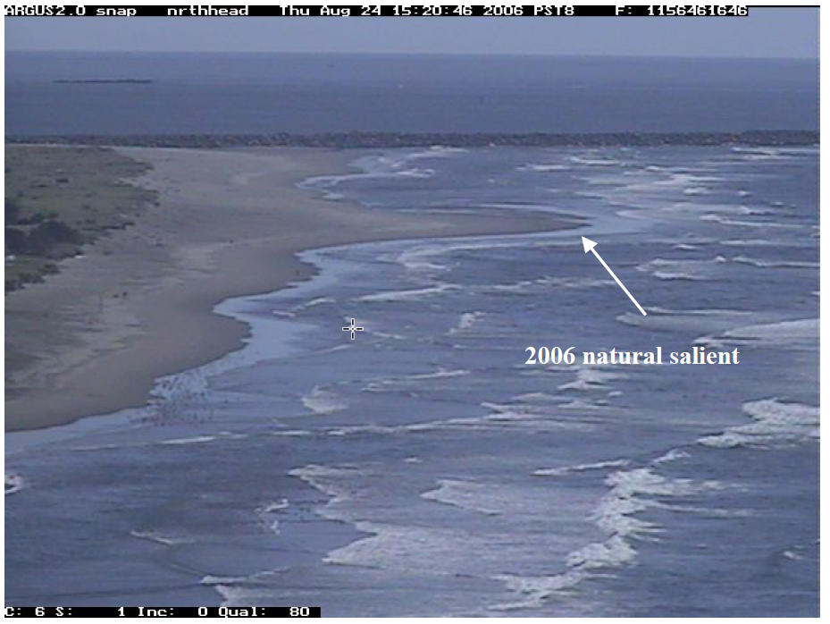
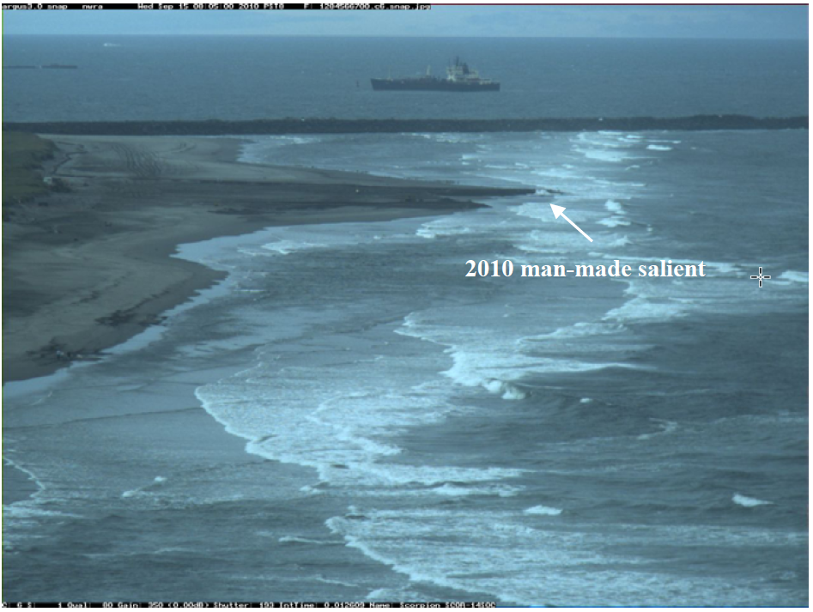

Slide 44
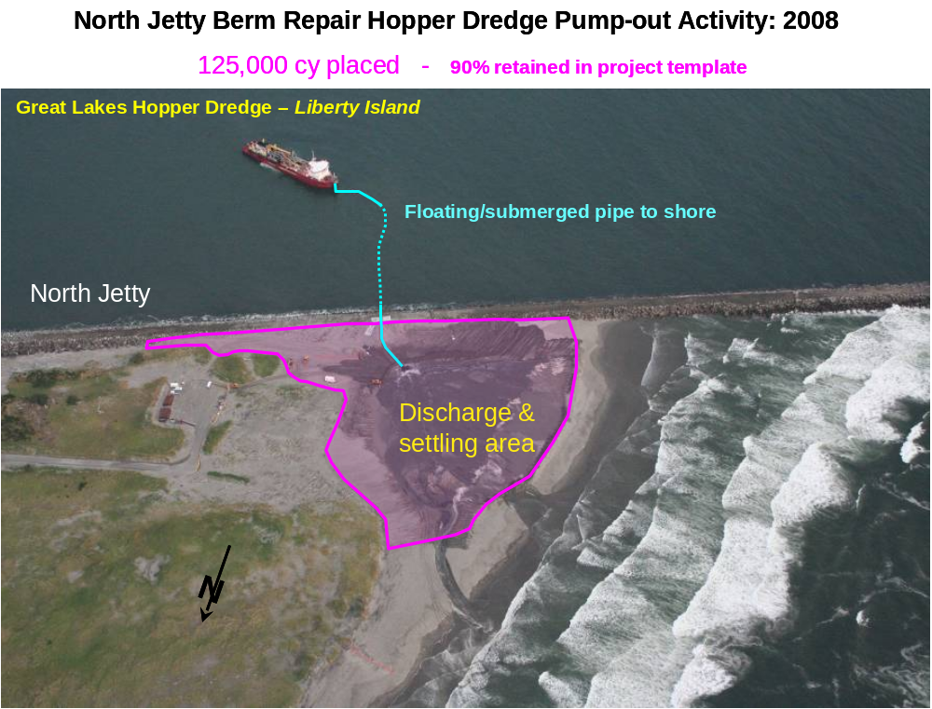

Slide 45
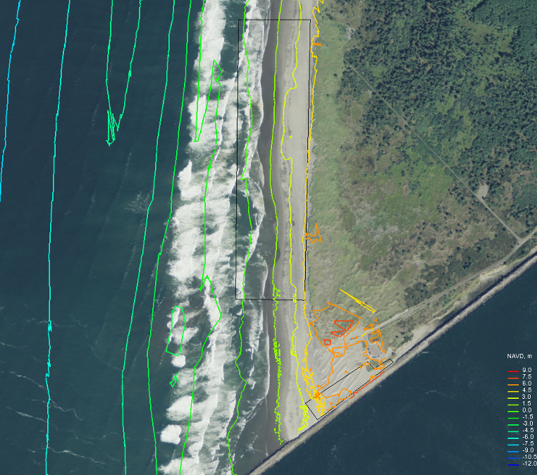
WA Littoral Drift Placement Area
Cape Disappointment State Park, WA
= Expected areal extent for deposition of 250-400 KCYof dredged material immediately after placement within the WA LDR area.. KTR to minimize re-handing of placed dredged material within the WA LDR area. Placed dredged material is to take-on natural morphology, as waves and tide re-work placed material. The intent is to create a depositional feature or salient which extents into the intertidal zone; along the northern-most 2/3’s of the WA drift area. Red dashed line indicates permit boundary for WA LDR.
3000 ft
A
A’
1500 ft
Benson Beach
-1.5 m
0 m
1.5 m
3 m
4.5 m
E
B
-3.0 m
1500 ft
D
C
E
D
North Jetty Berm (Foredune) Repair Placement Area.
C
B
Contours, m NAVD
From Sept 2009
Interval = 1.5 m

Slide 46
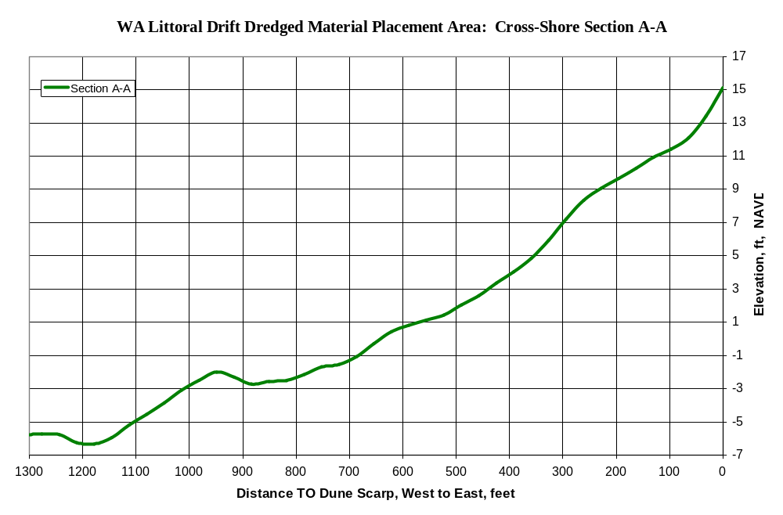
View to NORTH
‘
MHHW
Target Fill Template Grade
MLLW
Existing shoreface grade
A
A’
Oceanward <----- Cross-shore distance -----> Landward
0 ft NAVD =
+0.2 ft MLLW

Slide 47
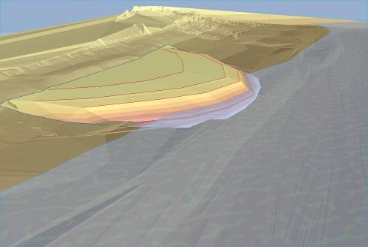
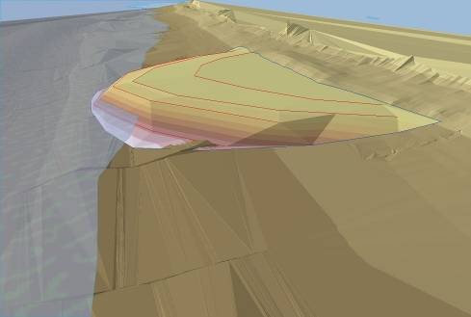
MCR North Jetty
3-dimensional view of the intended morphological feature to be formed along the intertidal zone of Benson Beach, in response to the placement of 250-400 KCY of sand (dredged from the MCR navigation channel) during 15 July – 15 September 2010.
present foredune scarp
2500 ft
900-1300 ft
transient morphology feature
Dredged material will be hydraulically placed to form the morphology feature as shown; side slope will be 1v:10h
Water level at 0 ft MLLW
View from the north, facing southward
The “transient morphological feature” will be dispersed by waves and currents through time; the rate of dispersion is unknown. As this feature is dispersed, the dispersed sand will augment the littoral sediment budget of the adjacent areas.
Execution of a pre-planned monitoring program will track the movement of the feature to gain understanding of how sediment is transported along Benson Beach and how to mitigate future erosion at this location.
present foredune scarp
700-900 ft
8 ft NAVD
Benson
Beach
View from the south, facing northward
Water level at 0 ft MLLW

Slide 48
