Slide 1
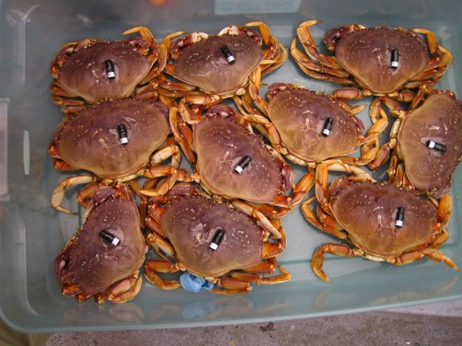

Mouth of the Columbia River
Crab Telemetry Study
Curtis Roegner
MCR Program
Meeting
~
Astoria, OR
14 January 2020

Slide 2
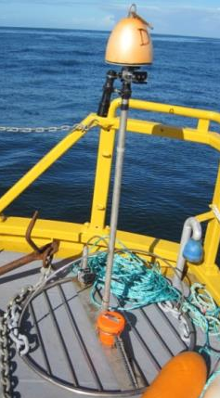

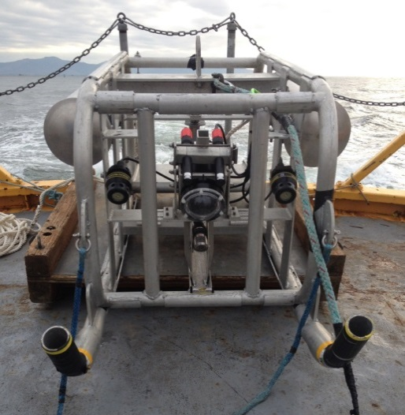
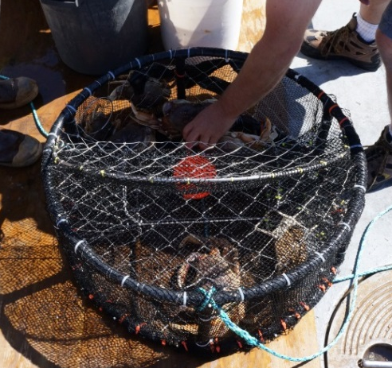
Monitoring Approaches
Mouth of Columbia River Sediment Management Plan
ü
Crab pots
Abundances of crab (traditional tool)
Video Sled
Densities in control and impact areas
Video Lander
Impact dynamics and crab abundances before and after disposal events
Acoustic Tags
Acute and long term movements of crabs in response to disposal events
(Fields et al. 2019.
Envir Monit Assess)
Notes:
We used a range of tools to monitor Dungeness at the SJS.
Traditionally they have been monitored with crab pots, which we deployed in 2015.
New tools include video sleds and baited cameras/landers.
They are non-extractive and actually put eyes on the seafloor for direct observation of organisms in their habitat and interacting with dredged material disposal.
The video sled allows us to assess the benthic community more on a whole (not just Dungeness), but for this talk I’ll focus on the crabs exclusively.
Acoustic tags to track movement through time…Curtis will follow my talk on this subject.

Slide 3
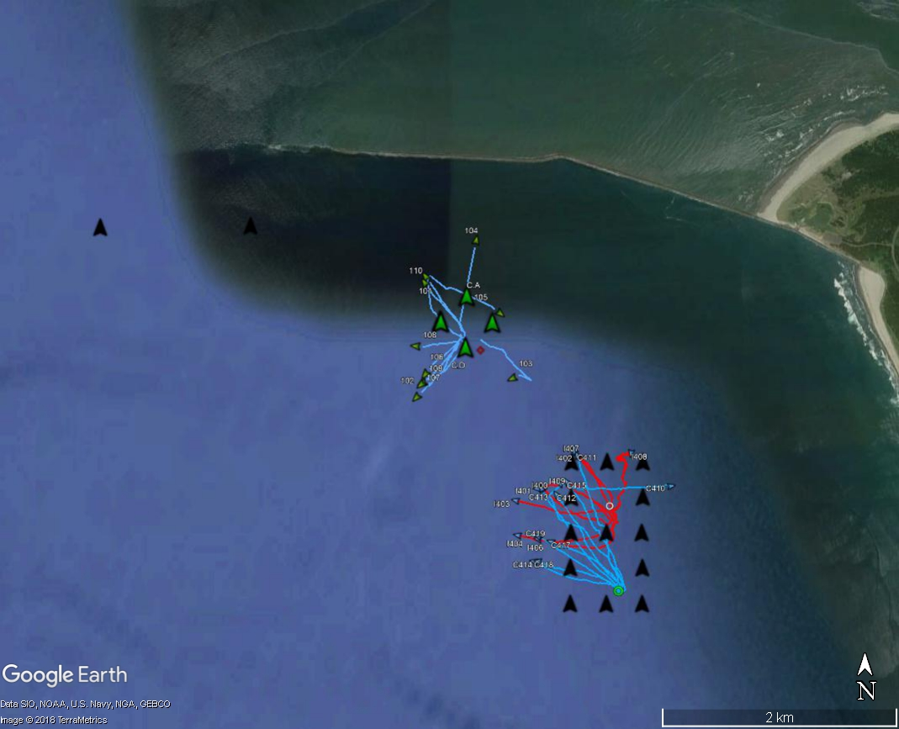
2015 & 2016
SJS
Movement characteristics
Few differences between impact and control
Extremely linear tracks
Low residence time in arrays (hours to days)
Little evidence of mortality
Crabs that return to arrays also have linear movements

Slide 4
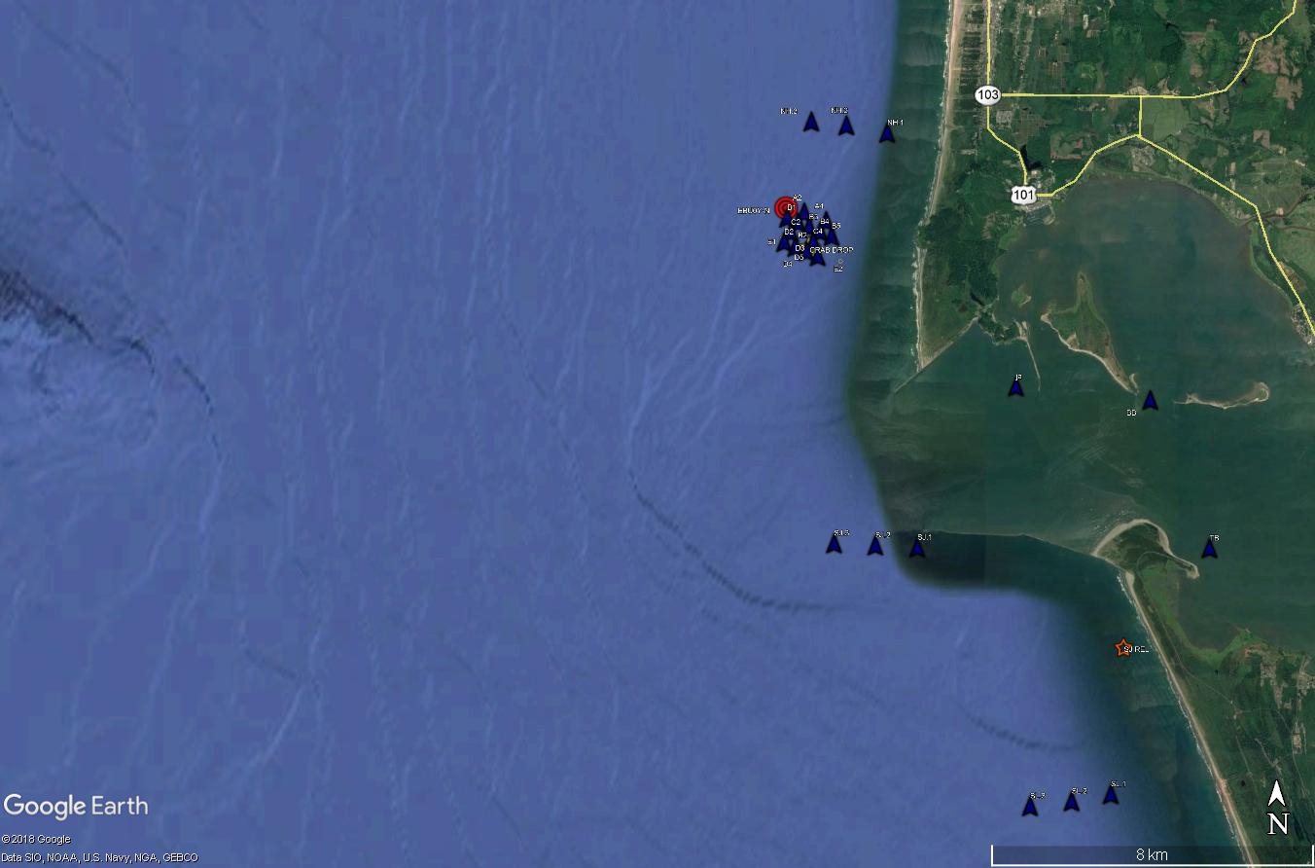
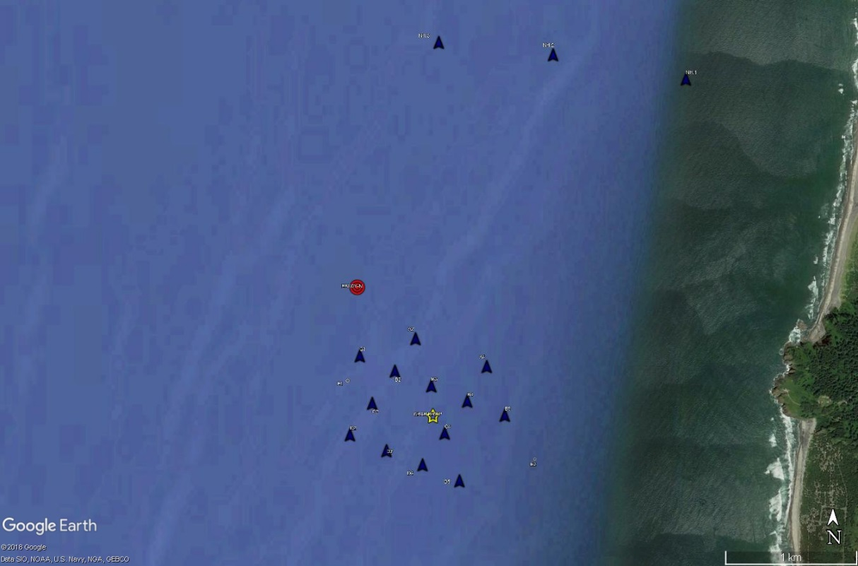
2018 MOUND EXPERIMENT
EBUOY
ESsAYONES TRACK

Slide 5
2018 EXPERIMENTS – MOVED TO NH SITE
TAG RELEASES
ESTUARY (E1) VRS SOUTH JETTY (SJ)
  22 & 23 August
MOUND EXPERIMENT
  19 Sept: IMPACT (MI) & ESTUARY (ME)
  21 Sept: CONTROL (MC1)
  28 Sept: CONTROL 2 (MC2)
HABITAT COMPARISON
  28 Sept: CONTROL 2 (MC2)
  3 October: FALCON COVE RELEASE (FC)

Slide 6
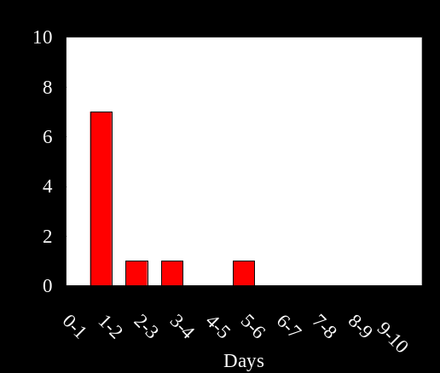
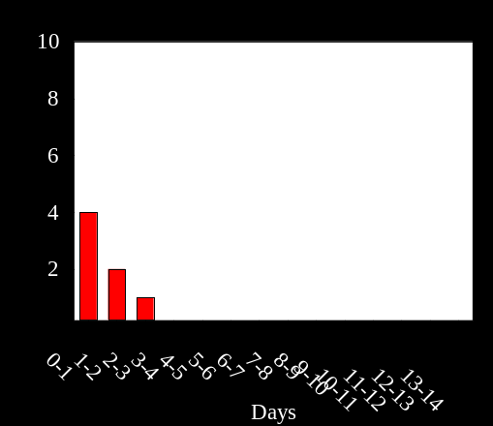
2018 MOUND EXPERIMENT
7
TAG RELEASES
19 Sept: IMPACT (MI)
21 Sept: CONTROL (MC1)
12 DAYS: CONTROL 2 (MC2)
10
X
RESIDENCE IN ARRAY
TRAVEL TO NHL
0
0

Slide 7
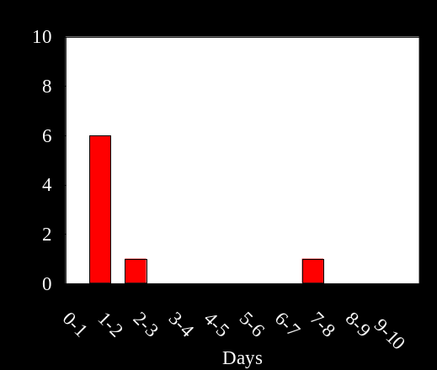
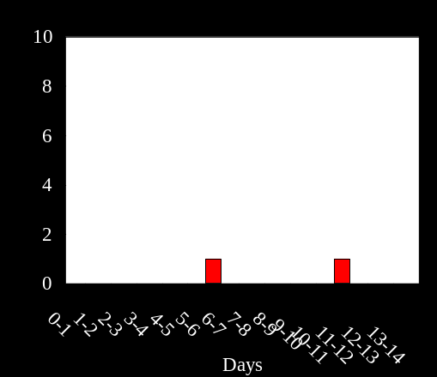
2018 MOUND EXPERIMENT
2
TAG RELEASES
19 Sept: IMPACT (MI)
21 Sept: CONTROL (MC1)
30 Sept: CONTROL 2 (MC2)
9
7.4 d
X
RESIDENCE IN ARRAY
TRAVEL TO NHL
1
0

Slide 8
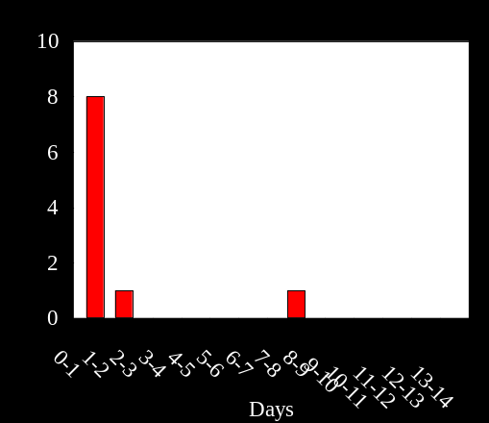
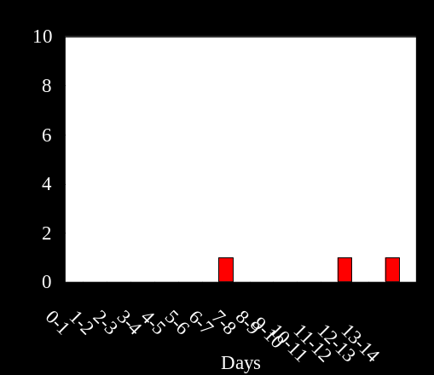
2018 MOUND EXPERIMENT
3
TAG RELEASES
19 Sept: IMPACT (MI)
21 Sept: CONTROL (MC1)
12 DAYS: CONTROL 2 (MC2)
10
34.6
X
RESIDENCE IN ARRAY
TRAVEL TO NHL
1
0

Slide 9
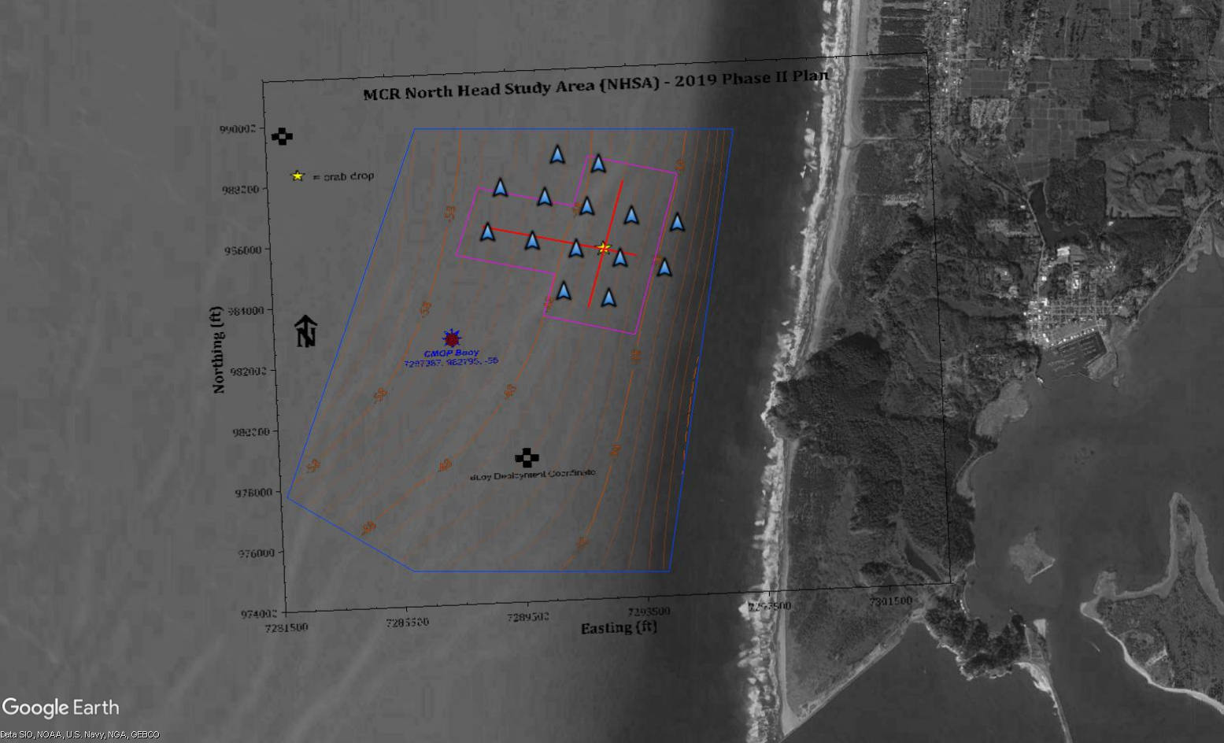
2019 MOUND EXPERIMENT

Slide 10
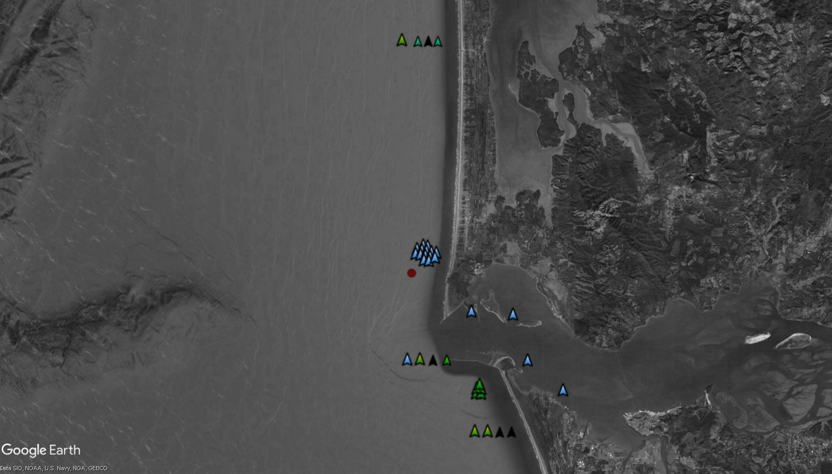
2019 MOUND EXPERIMENT
TAG RELEASES – Paired SJS & NHS
20 Aug: no deposition
29 Aug: 2 s < SJS deposition
6 Sept: SJS impact
13 Sept: Estuary Release
20 Sept: NHS impact, SJS impact
OCEAN
PARK
LINE
NORTH
HEAD
ARRAY
SOUTH JETTY LINE
SOUTH JETTY ARRAY
SOUTH LINE

Slide 11
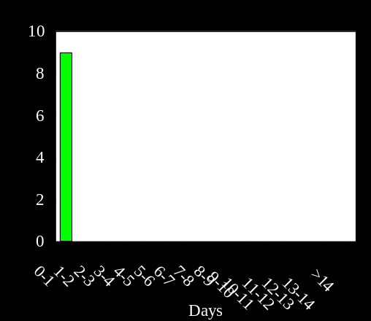
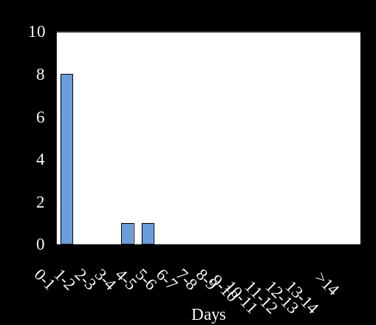
2019 MOUND EXPERIMENT
TAG RELEASES – Paired SJS & NHS
20 Aug: no deposition
29 Aug: 2 s < SJS deposition
6 Sept: SJS impact
13 Sept: Estuary Release
20 Sept: NHS impact, SJS impact
23.1 d
56.3 d
RESIDENCE IN SJA
RESIDENCE IN NHA
23.1 d
3; 3.0 d
1.0 d
0.4 d

Slide 12
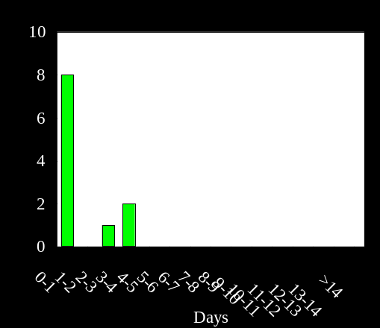
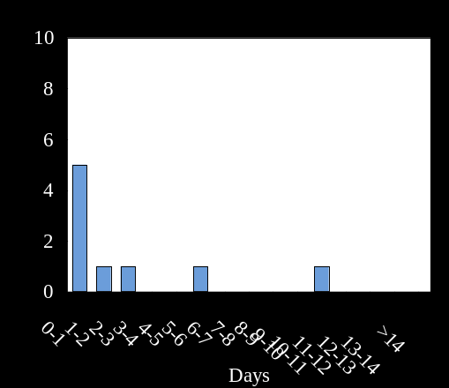
2019 MOUND EXPERIMENT
TAG RELEASES – Paired SJS & NHS
20 Aug: no deposition
29 Aug: 2 d < SJS deposition
6 Sept: SJS impact
13 Sept: Estuary Release
20 Sept: NHS impact, SJS impact
2; 15.6 d
13.9 d
2; >14 d
RESIDENCE IN SJA
RESIDENCE IN NHA
6.5 d
2.6 d
8; 4.5 d

Slide 13
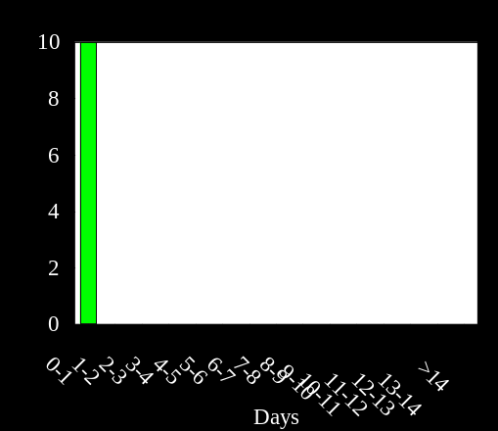
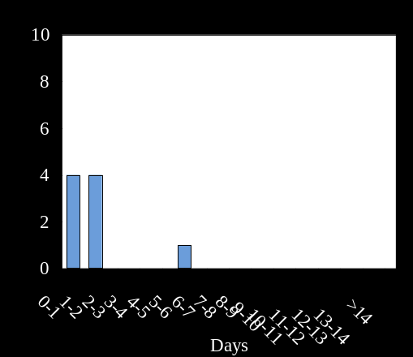
2019 MOUND EXPERIMENT
TAG RELEASES – Paired SJS & NHS
20 Aug: no deposition
29 Aug: 2 s < SJS deposition
6 Sept: SJS impact
13 Sept: Estuary Release
20 Sept: NHS impact, SJS impact
33 d
9.2 d
0 secondary detections
RESIDENCE IN SJA
RESIDENCE IN NHA
(2; 6.5d)
(91d)
(9; 2.4 d)
(3.0d)

Slide 14
2019 MOUND EXPERIMENT
TAG RELEASES – Paired SJS & NHS
20 Aug: no deposition
29 Aug: 2 s < SJS deposition
6 Sept: SJS impact
13 Sept: Estuary Release
20 Sept: NHS impact, SJS impact
(2)
0 Ocean detections
(2)

Slide 15
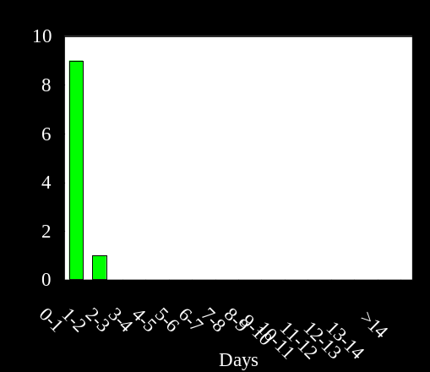
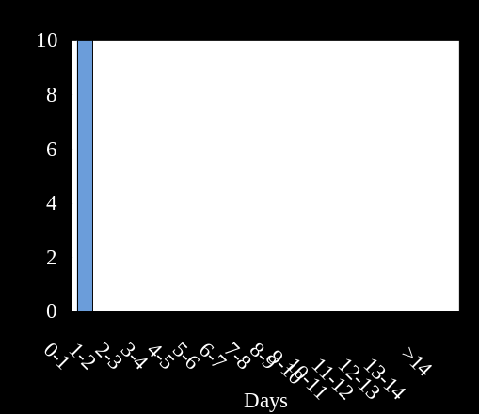
2019 MOUND EXPERIMENT
TAG RELEASES – Paired SJS & NHS
20 Aug: no deposition
29 Aug: 2 s < SJS deposition
6 Sept: SJS impact
13 Sept: Estuary Release
20 Sept: NHS impact, SJS impact
(7.9d)
RESIDENCE IN SJA
RESIDENCE IN NHA
(23.8d)
(31d)
(5; 7.3d)
(10.1d)
(2; 0.88d)

Slide 16
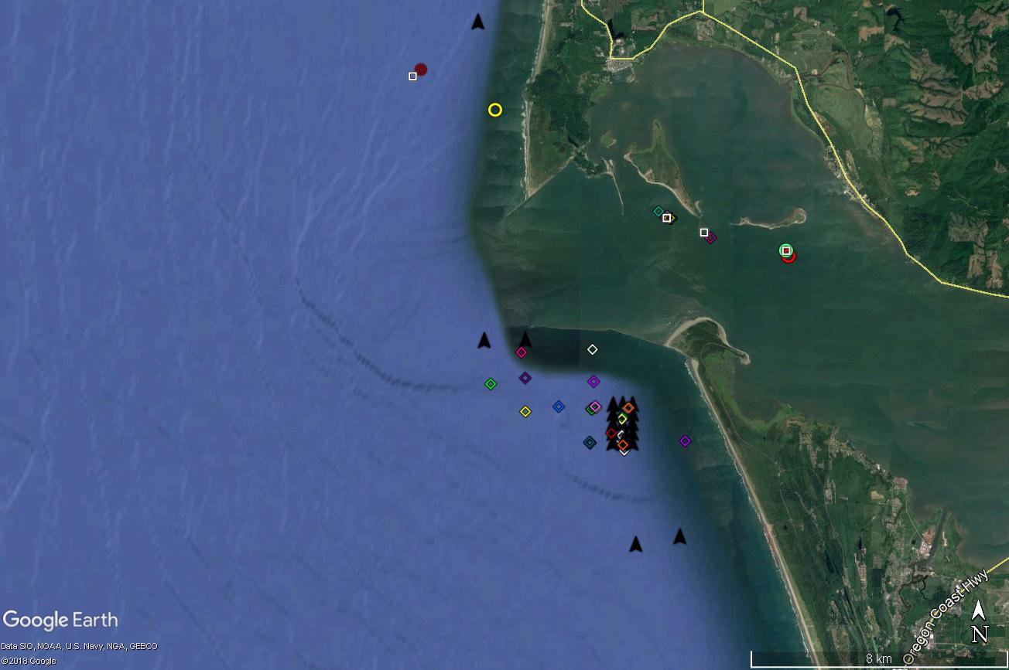
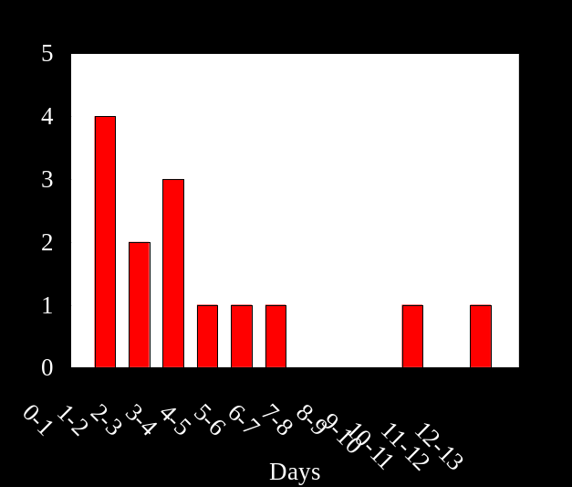
2017
SJS
0
2/5
Mean time = 4.52 ± 3.61 days
Range = 1.14 – 12.19 days
X
14/17
X
0

Slide 17
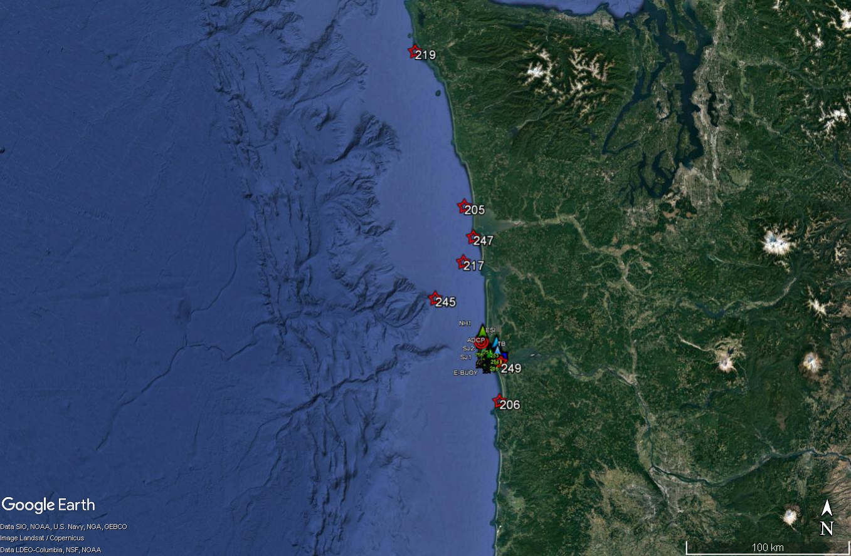
SUMMARY OF TAG STUDIES
ACUTE IMPACT VARIABLE
NO EVIDENCE OF INCREASED MORTALITY
CRABS HIGHLY MOBILE
NORTHWARD MIGRATION
LIMITED IMPORT/EXPORT FROM ESTUARY
MOUND EXPERIMENTS (PRELIMINARY)
SIMILAR RESIDENCE IN ARRAY
  BTW CONTROL & IMPACT
IMPACT –STRONG NORTHWARD MIGRATION
UNKNOWNS
EXTENT OF NORTHWARD MOVEMENT
CUMULATIVE EFFECT OF IMPACTS
LaPUSH
RELEASE
SEASIDE

Slide 18
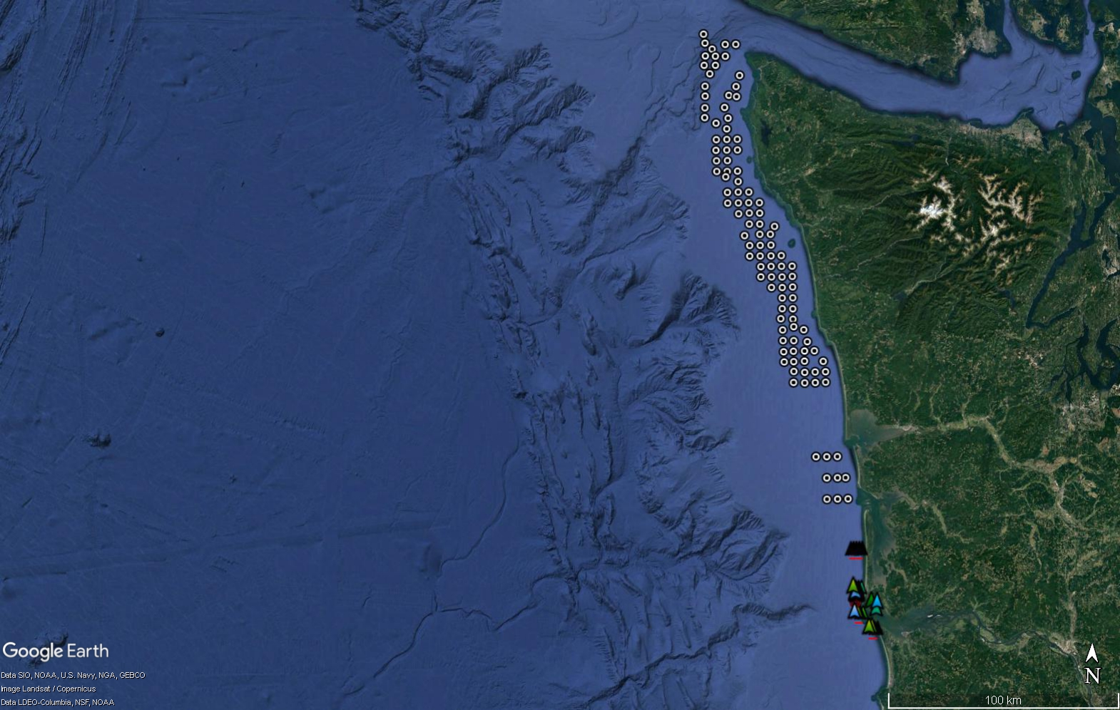
OPPORTUNITY FOR 2020
EXAMINE LARGE-SCALE MIGRATION PATTERNS
FILL IN GAP BEWTEEN MCR AND OLYMPIC GRID
CRAB BEHAVIOR AND LOW DO PATTERNS
OLYMPIC GRID
MCR ARRAY

Slide 19
COMPARISON OF METHODS USED IN BENTHIC MCR BENTHIC IMPACT STUDY
METHOD | PURPOSE & ORGANISMS | DATA TYPE | PROS | CONS | FINDINGS
BENTHIC VIDEO SLED | DETERMINE DENSITY AND SPATIAL DISTRIBUTION LARGER MOBILE EPIFAUNA AND SESSILE INVERTEBRATES | SURVEY BEFORE-IMPACT-AFTER EXPERIMENTAL DESIGN | RAPID SAMPLING HIGH REPRODUCIBILITY | VISIBILITY-LIMITED SPECIALIZED ANALYSIS | TEMPORAL EFFCT > TREATMENT EFFECT N LOWER AT SJS THAN DWS
BAITED CRAB POTS WITH FINE MESH LINING | TIME SERIES OF ABUNDANCE & SIZE PRIMARILY CRAB, SOME GASTROPODS, FISH | SIZE FREQUENCY DATA INDIVIDUAL METRICS (SEX. LIMB LOSS, ECT) | "HANDS ON" DATA COMPATIBLE WITH OLDER DATA SETS. VISIBILITY-INDEPENDENT | REQUIRES 2 CONSECUTIVE CRUISE DAYS FOR 24-H SOAK | NO TREATMENT EFFECT MAINLY ADULTS MALES > FEMALES
BENTHIC VIDEO LANDER (CAMPOD) | ACUTE EFFECTS OF DEPOSITION MOBILE MACROINVERTEBRATES & FISH | PRESENCE/ABSENCE RELATIVE TO DEPOSITION IMPACT-CONTROL EXPERIMENTS | EASILY DEPLOYED AND ANALYZED BEHAVIORAL OBSERVATIONS | LIMITED BATTERY LIFE VISIBILITY-LIMITED | SIG IMPACT EFFECT SEDIMENT LEVEL MINIMAL SHORT DURATION
ACOUSTIC TAGS | ACUTE AND LONG-TERM MOVEMENTS DUNGENESS CRABS (STURGEON, SHARKS) | IMPACT-CONTROL DESIGN FINE SCALE, INDIVIDUAL BEHAVIOR | VISIBILITY-INDEPENDENT LONG TERM BEHAVIORAL DATA | SPECIALIZED ANALYSIS SPATIAL SCALE RECEIVER-LIMITED | SLIGHT IMPACT EFFECT HIGHLY MOBILE MIGRATION NORTH? CUMULATIVE EFFECT?
ENVIRONMENTAL BUOY | COLLECT BIOPHYSICAL METRICS | TIME SERIES DEPTH STRATIFIED | PROVIDES CONTEXT TO ALL DATA COLLECTION CAPTURES EVENT SCALE LONG TERM DATA (CLIMATE CHANGE) | VISIBILITY-INDEPENDENT LONG TERM DATA | PHYSICAL CONDITIONS (HIGH TEMP, LOW DO) MAY EFFECT BEHAVIOR

Slide 22

2014-2015
SJS
CONTROL
IMPACT

Slide 23
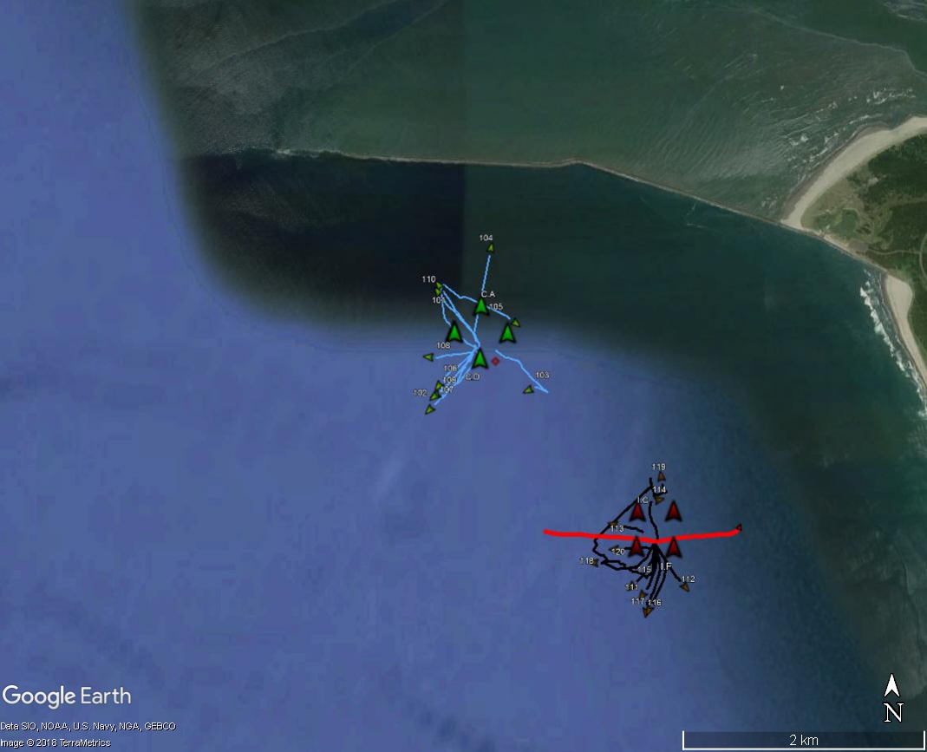
2015
RELEASE 4
ESSAYONS TRACK

Slide 24

2016-2017
SJS
IMPACT
CONTROL

Slide 25
2016 & 2017
SJS
2015
2016

Slide 26
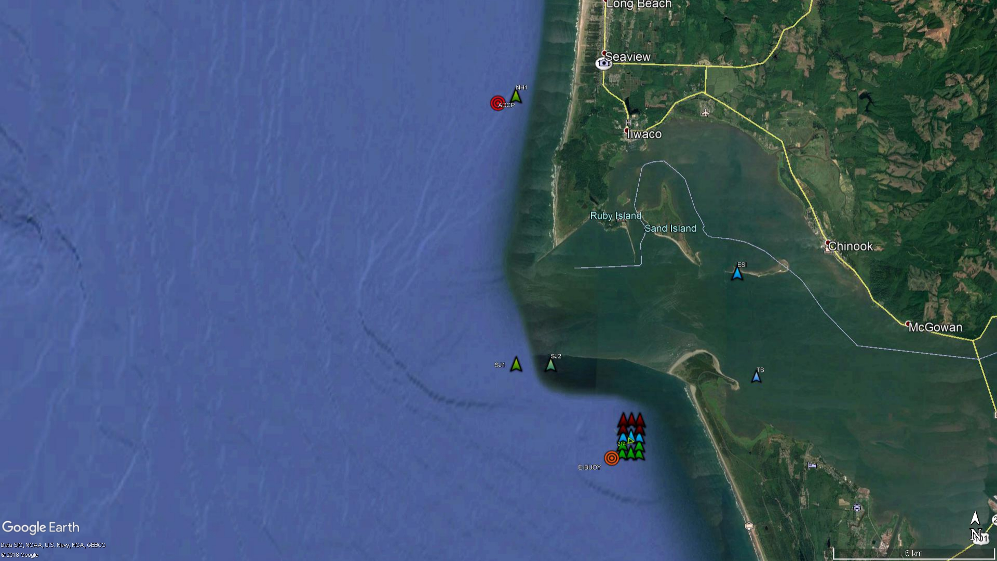
2016
SJS
SENTINEL
ESTUARY
SENTINEL
GATE
ARRAY

Slide 27
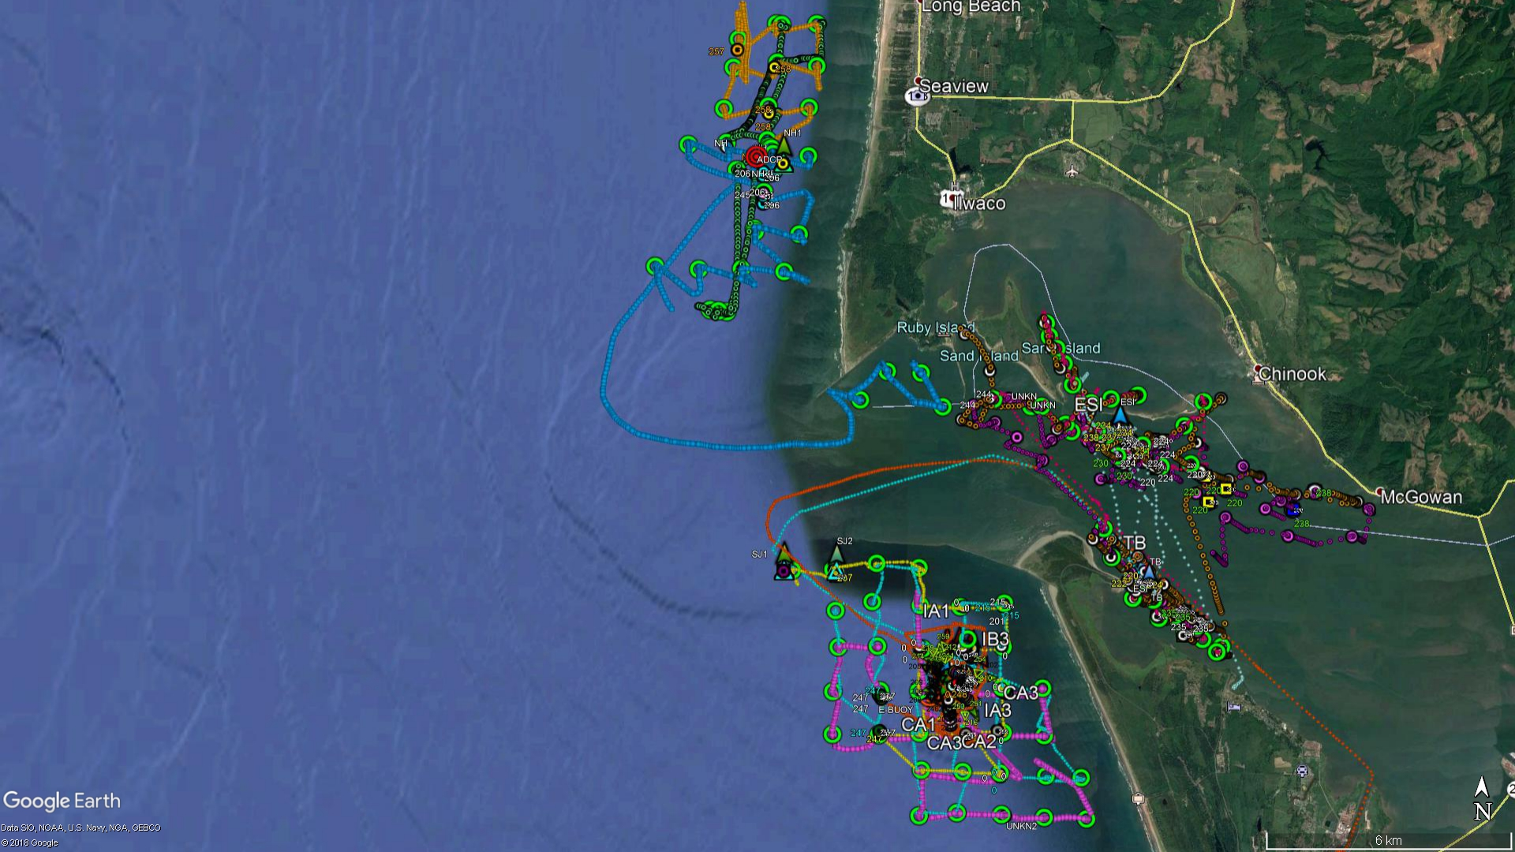
2016
SJS
HYDROACOUSTIC SURVEY TRACK

Slide 28
2017
SJS
0
2/5
Mean time = 4.52 ± 3.61 days
Range = 1.14 – 12.19 days
X
14/17
X
0

Slide 29
2018 MOUND EXPERIMENT
1
0.2 d
47.9 d
X
10
0
TAG RELEASES
19 Sept: IMPACT (MI) & (ME)
21 Sept: CONTROL (MC1)
12 DAYS: CONTROL 2 (MC2)
0

Slide 30
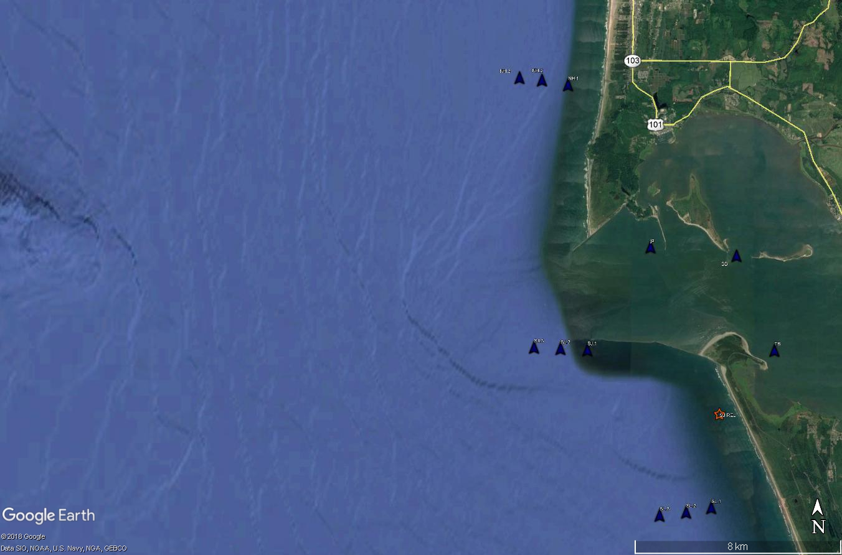
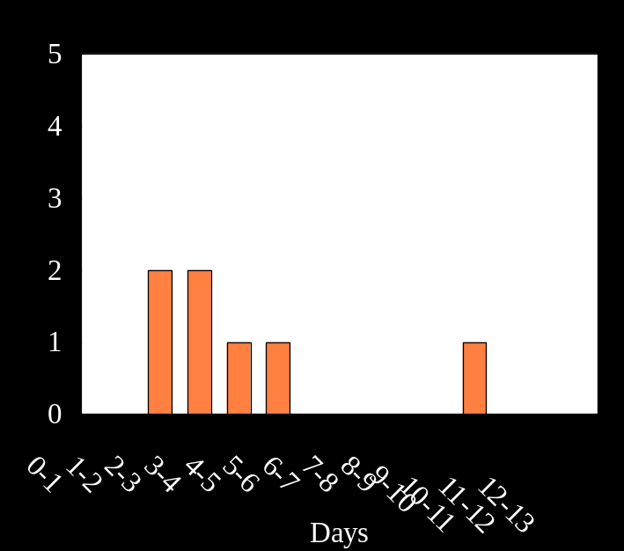
2018 OCEAN AND ESTUARY RELEASES
22-23 AUGUST
1
0
9.9 d
X
9
TRAVEL TO SJL
28.1 d
1
7
0
10
17.9 d
0
1

Slide 31
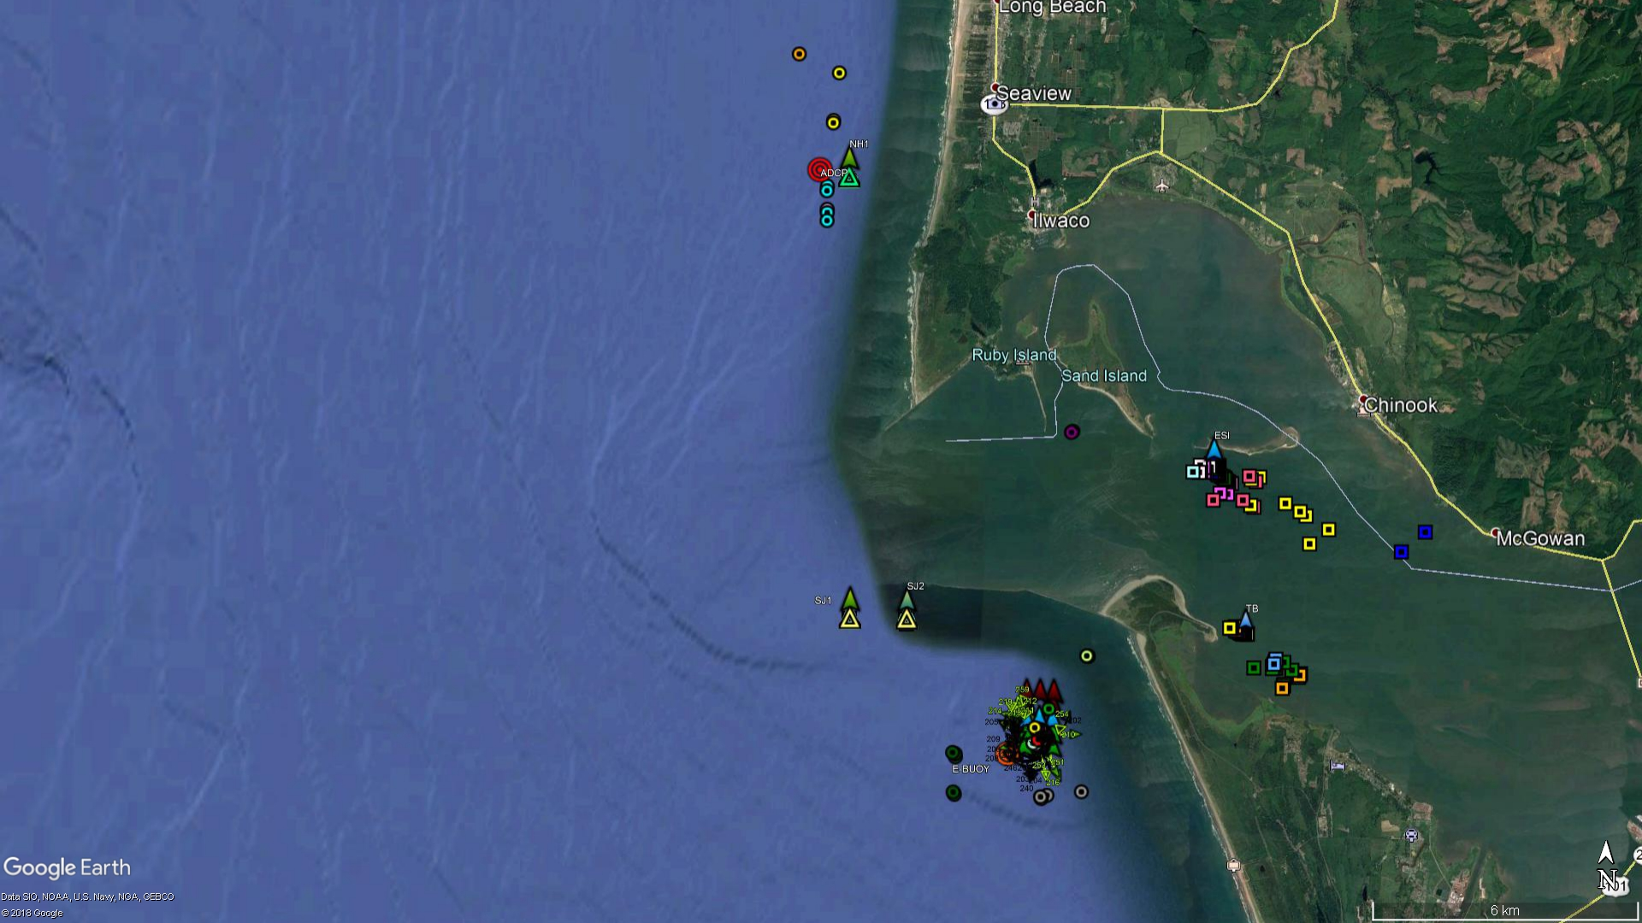
2016
SJS
5/40
E-RELEASE 2 16 CRABS
2/40
1/16
17/40
RELEASE 7 & 8 40 CRABS
1/40*

Slide 32
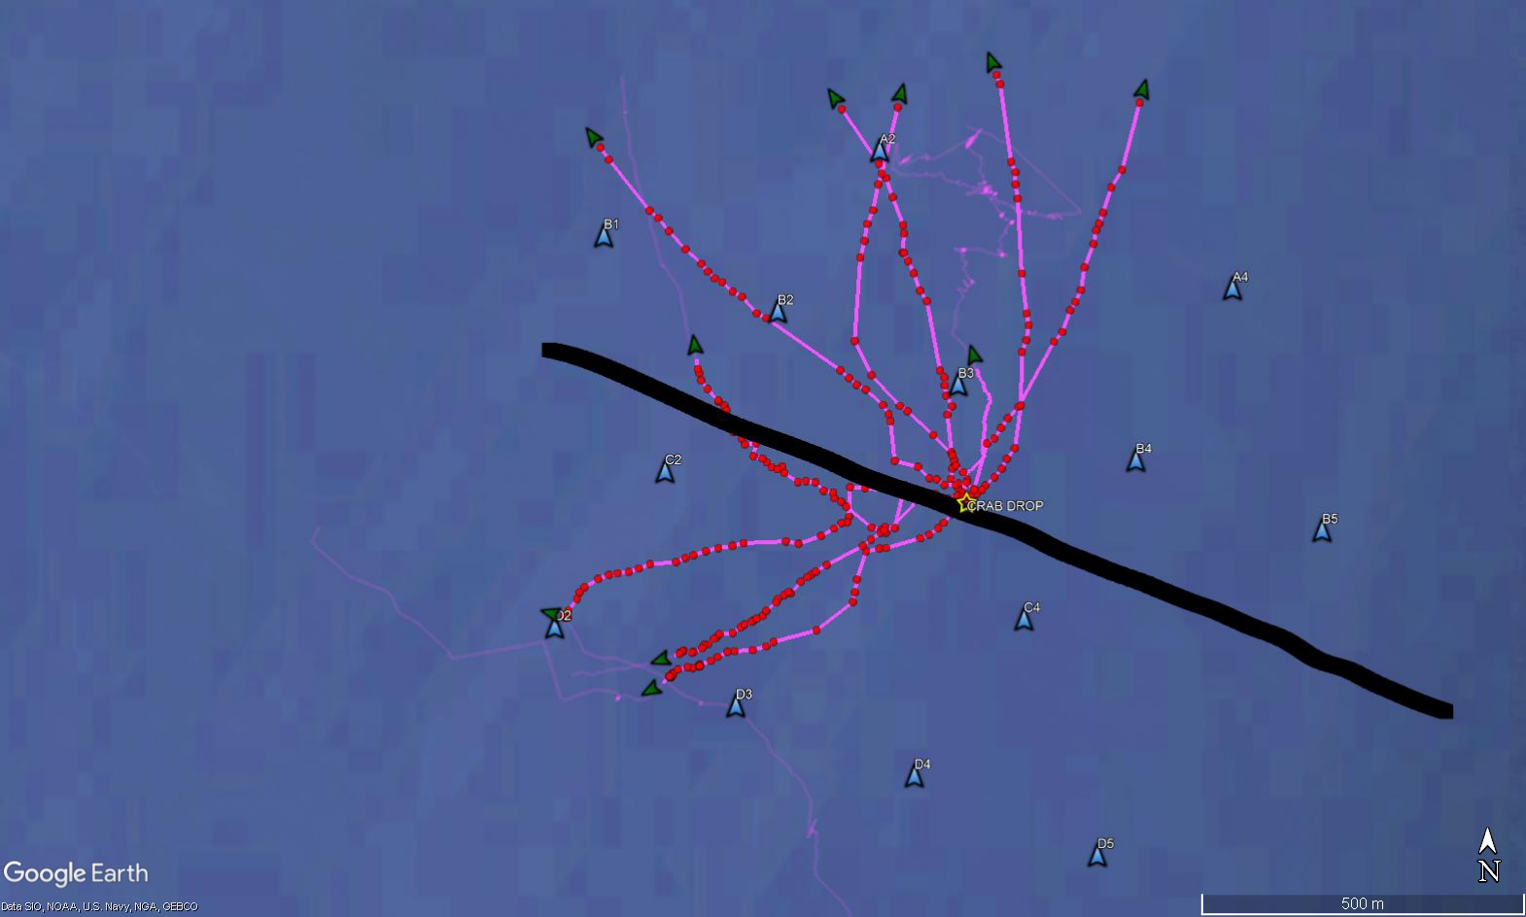

Slide 33
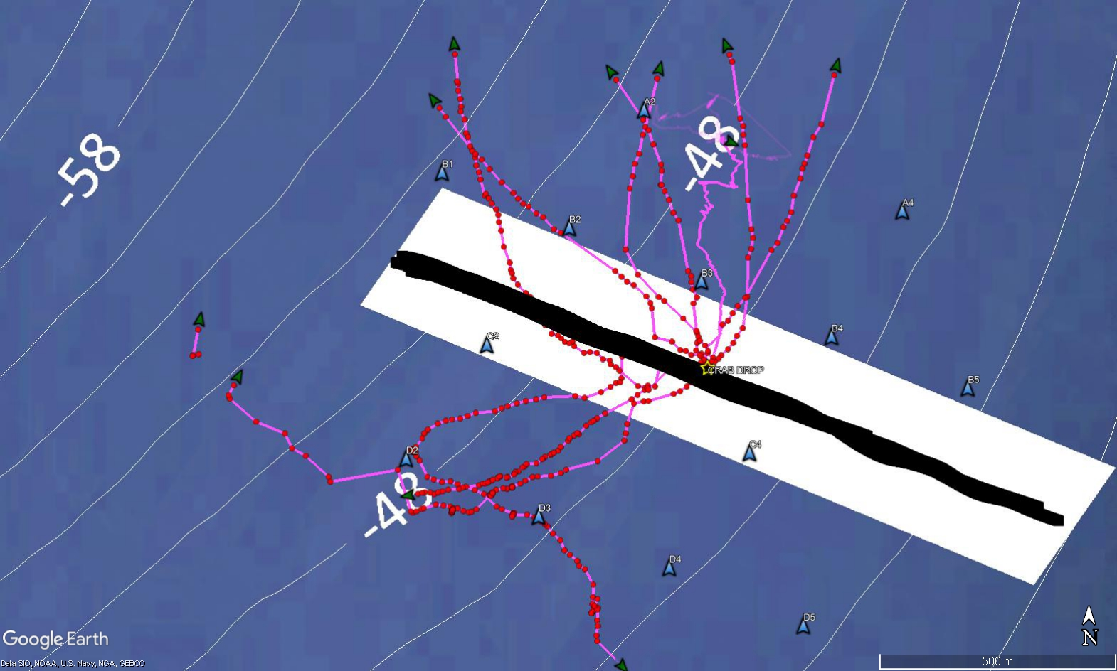

Slide 34
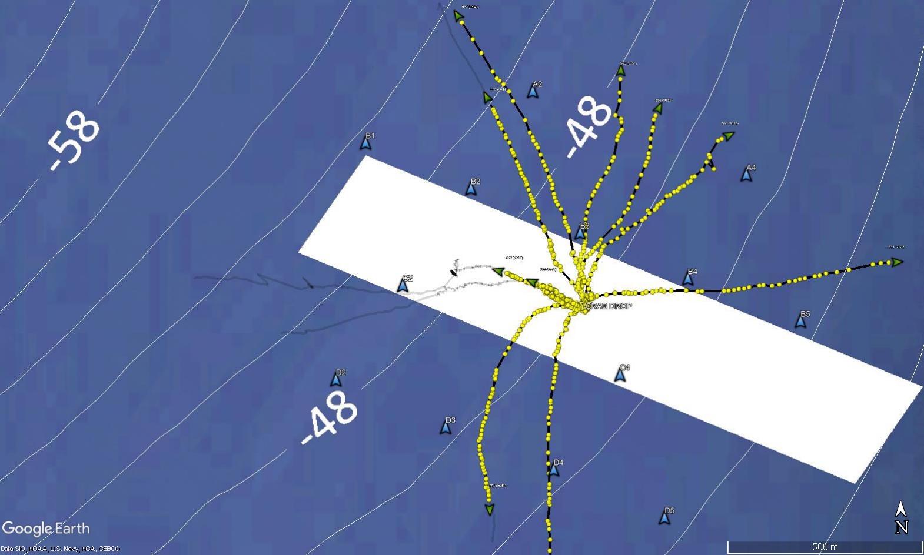
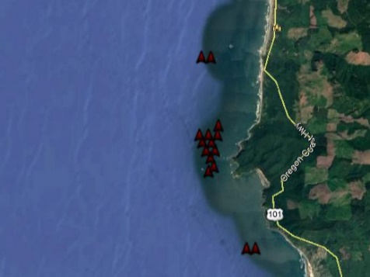

Slide 35
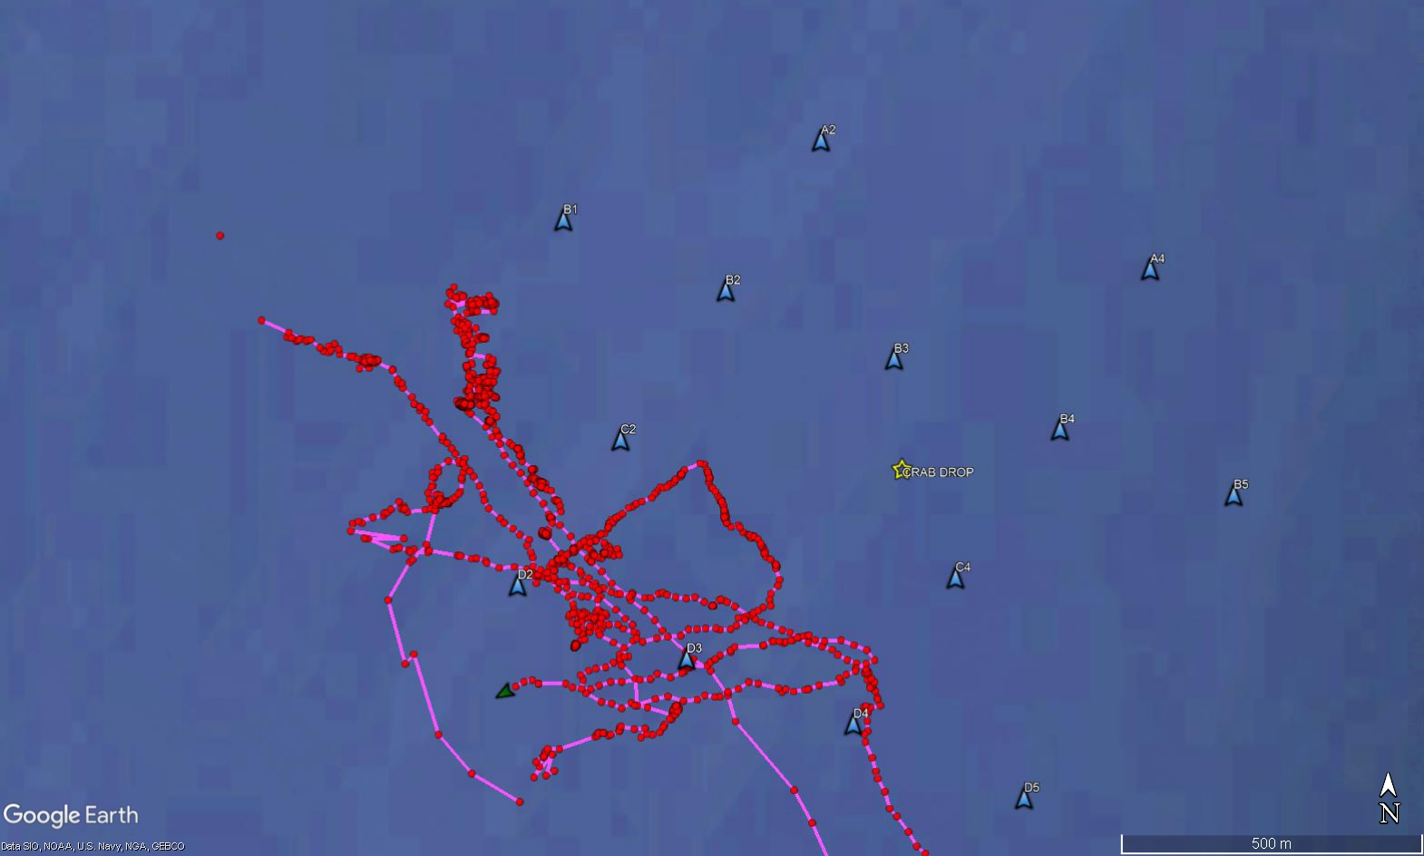

Slide 36
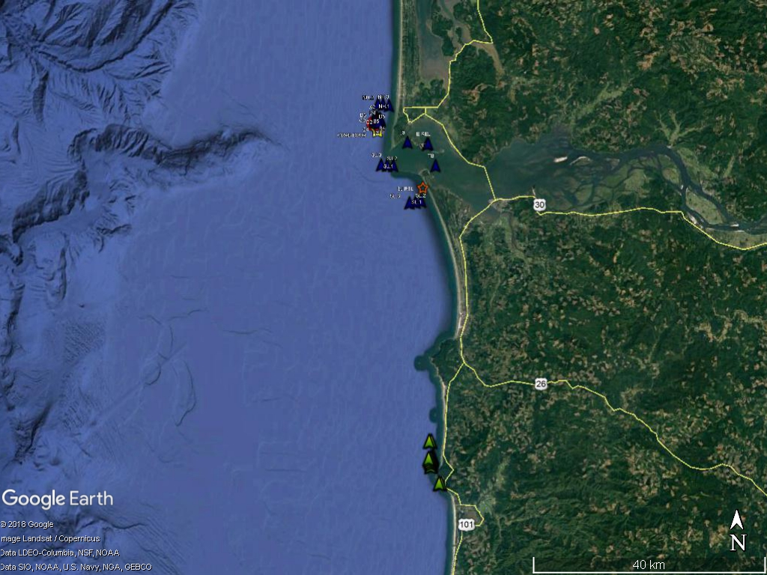
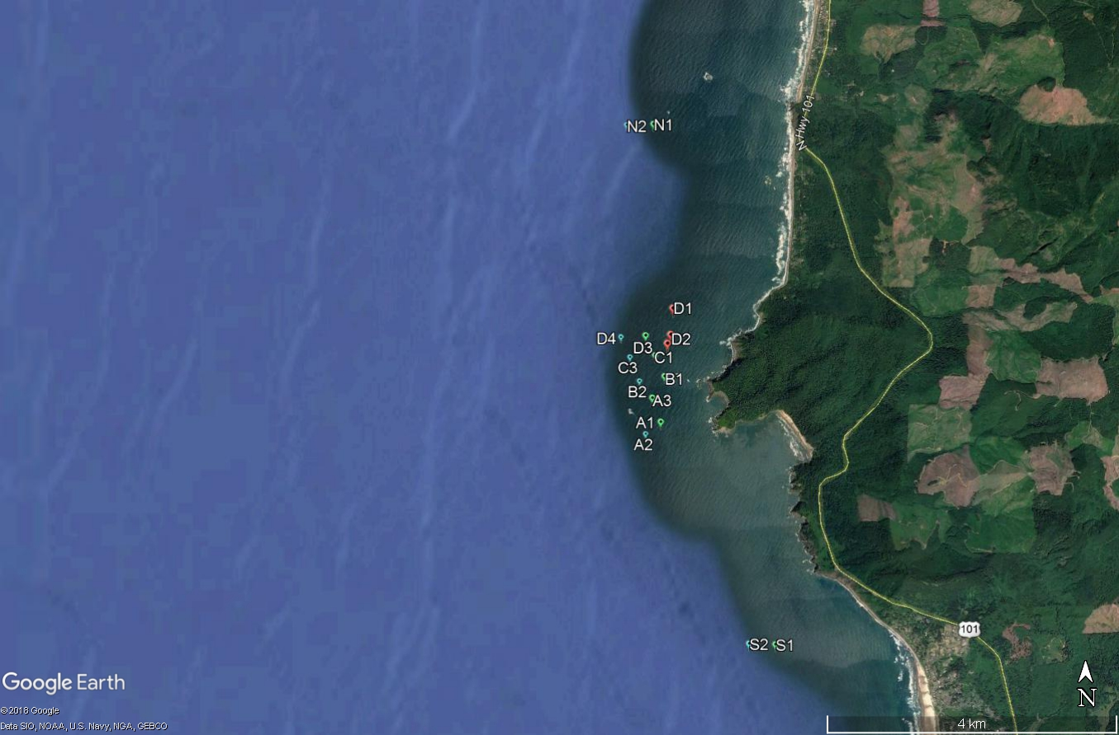
HABITAT COMPARISON STUDY
ROCKY VRS SANDY HABITATS
NEAR SIMULTANEOUS RELEASES
  @ FC & MCR
WILL EXAMINE RESIDIENCE TIME
TO DATE:
NO FC CRABS AT MCR
DATA FROM FC NOT AVAILABLE YET
SJL REDEPLOYED
NHL GATE
ARRAY
MCR
SJL GATE
SL GATE
GATE
ARRAY
GATE
FALCONCOVE
ARRAY
GATE
GATE

Slide 37
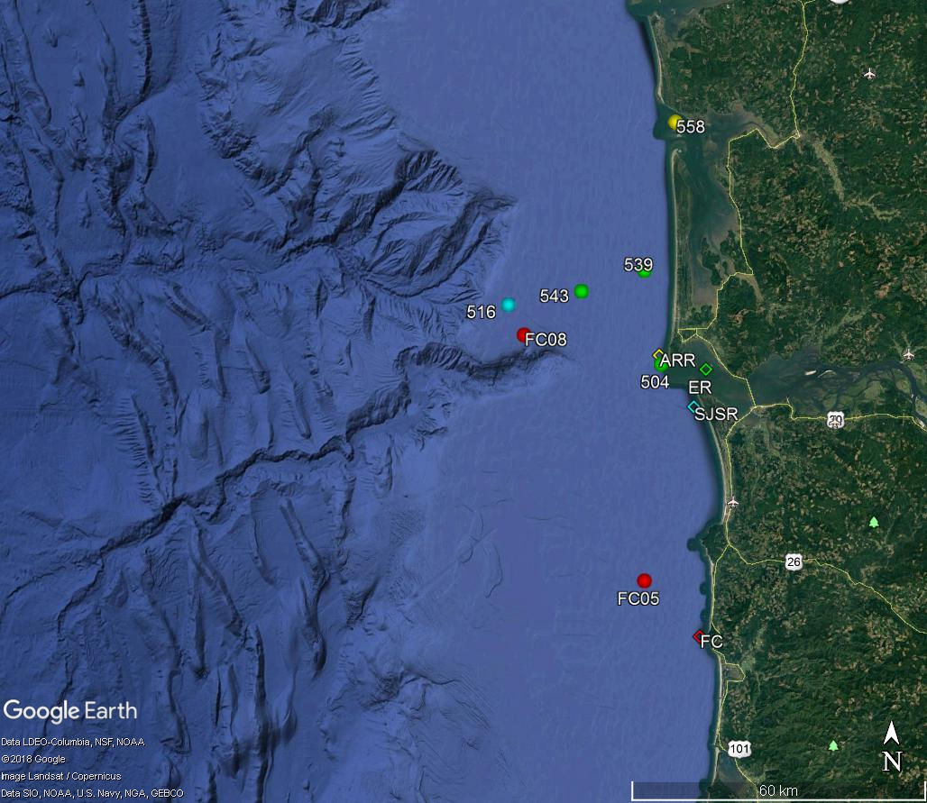
RECAPTURES 2017-2019

Slide 38
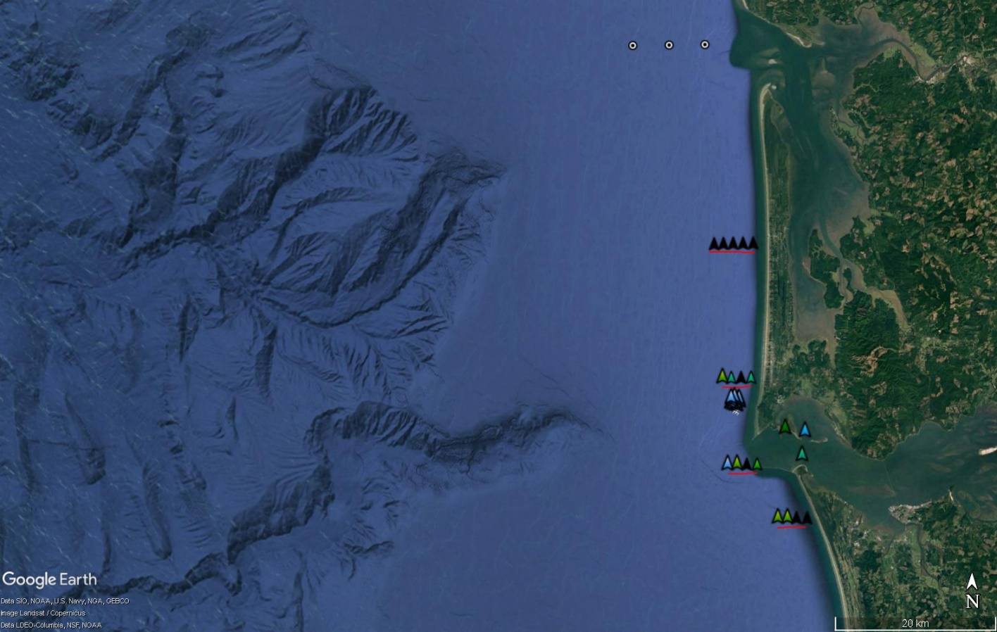

Slide 39
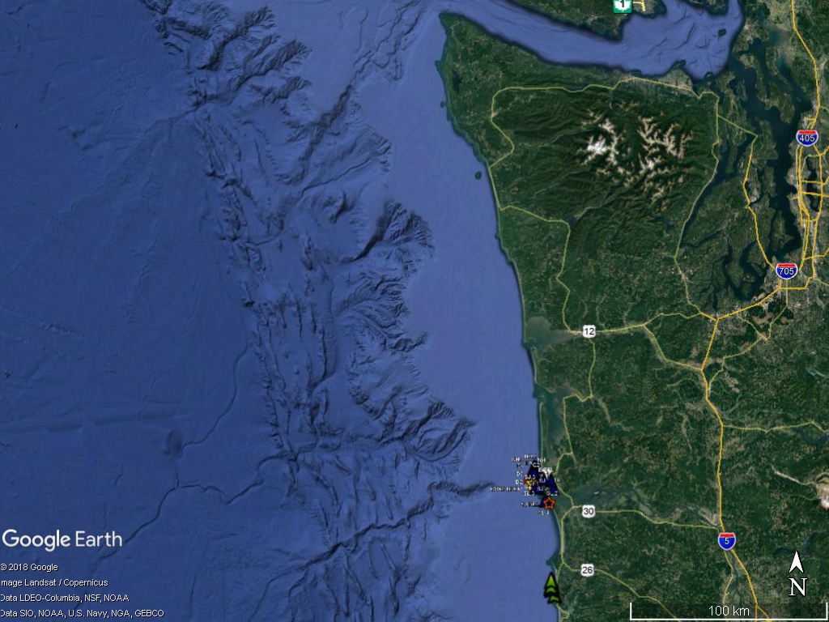
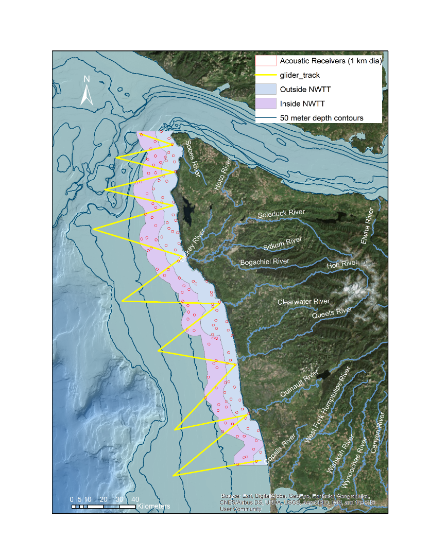
OPPORTUNITY FOR 2019
EXAMINE LARGE-SCALE MIGRATION PATTERNS
FILL IN GAP BEWTEEN MCR AND OLYMPIC ARRAY
CRAB BEHAVIOR AND LOW DO PATTERNS
New salmon tracking array

Slide 40
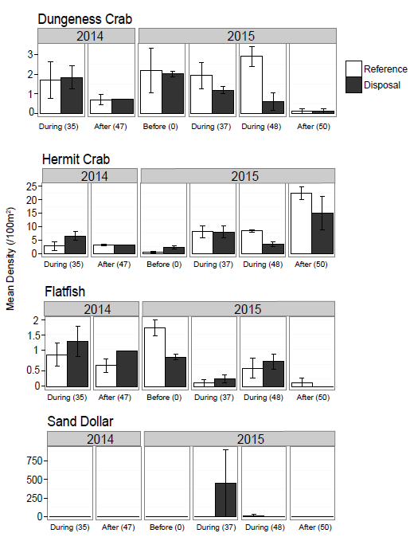
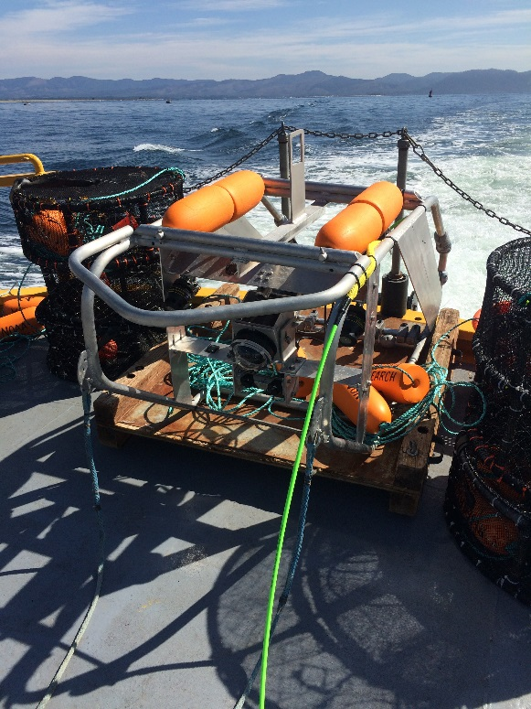
BENTHIC VIDEO SLED

Slide 41
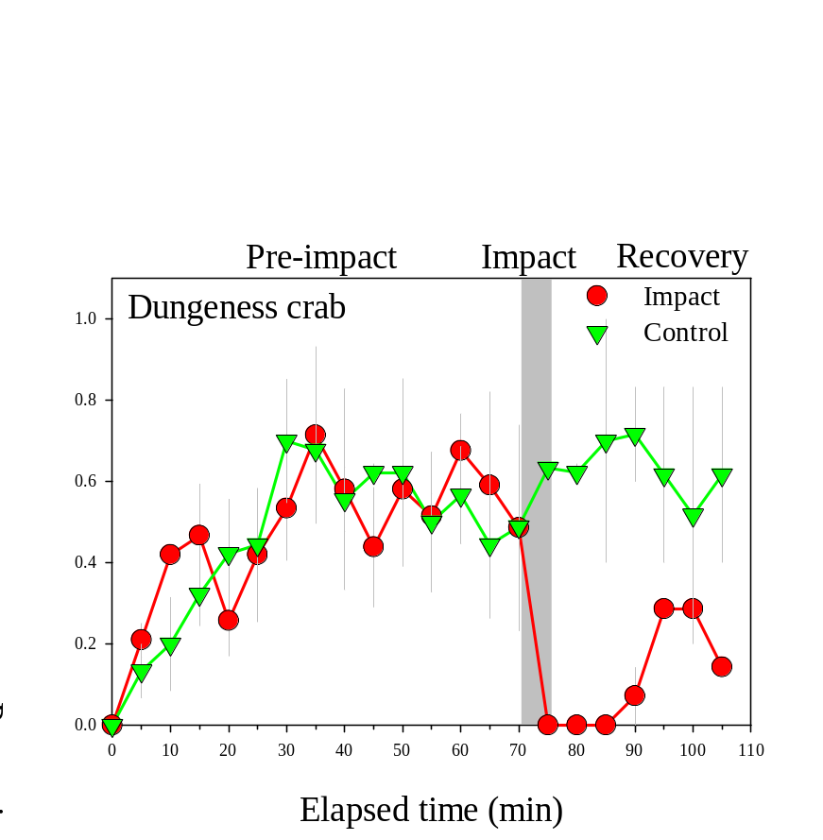
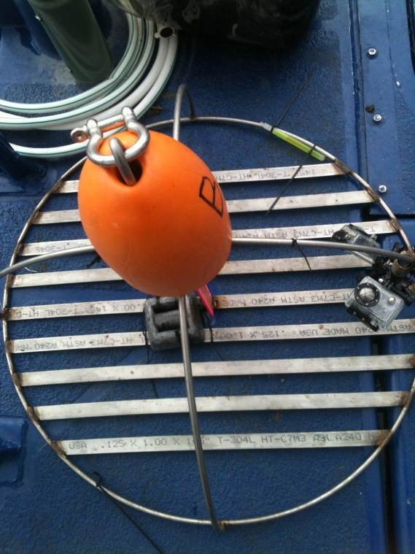
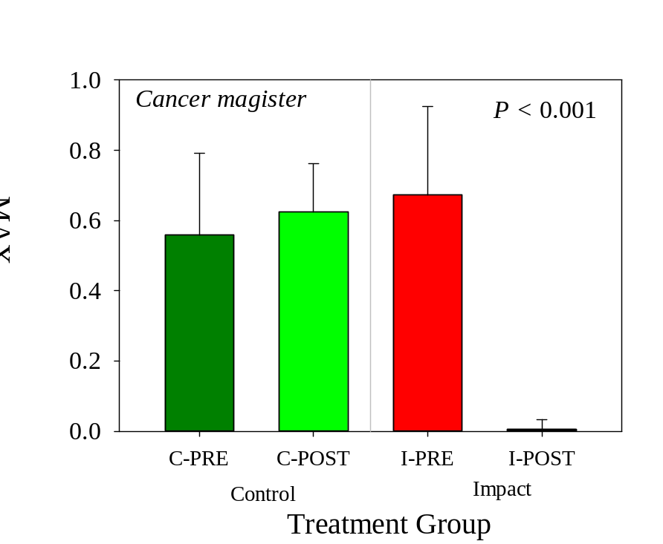
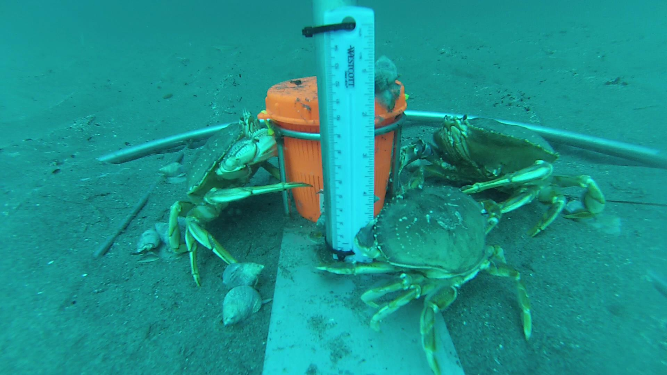
CAMPOD
IMPACT-CONTROL RESULTS

Slide 42


CRAB TRAP
CRAB ABUNDANCE, SEX, & SIZE FREQUENCY

Slide 43
LaPUSH
RELEASE
SEASIDE

Slide 44




ENVIRONMENTAL BUOY
VELOCITY
TIME SERIES DATA
CHLOROPHYLL AND OXYGEN

Slide 45

2016 Tag Releases

Slide 46

2015 Tag Releases

Slide 47


Slide 48





ACOUSTIC TAGS
IMPACT-CONTROL STATISTICS AND BEHAVIOR
0.01 m/s
7.5 h
0.06 m/s
DEPOSITION EVENT
RECEIVER
TAGGED CRABS
0.14 m/s
EXPERIMENTAL DESIGN

Slide 49


2018 Tag release at North Head
2
10
RESIDENCE IN ARRAY
TRAVEL TO NHL
34.6
X
1
0

