Slide 1
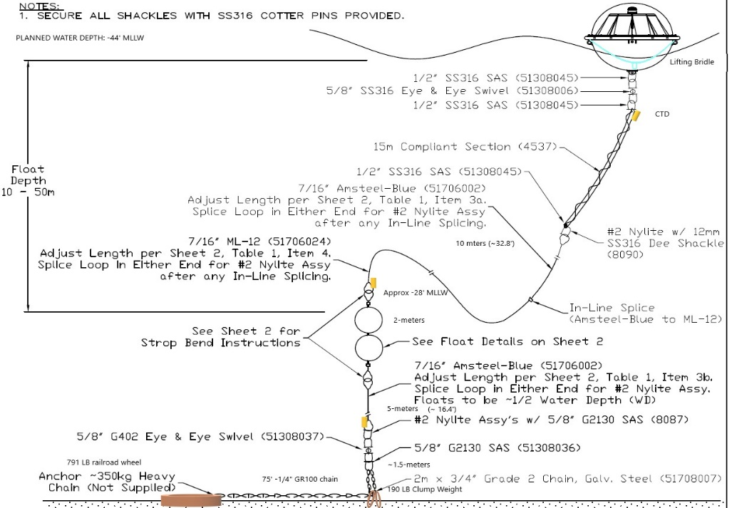
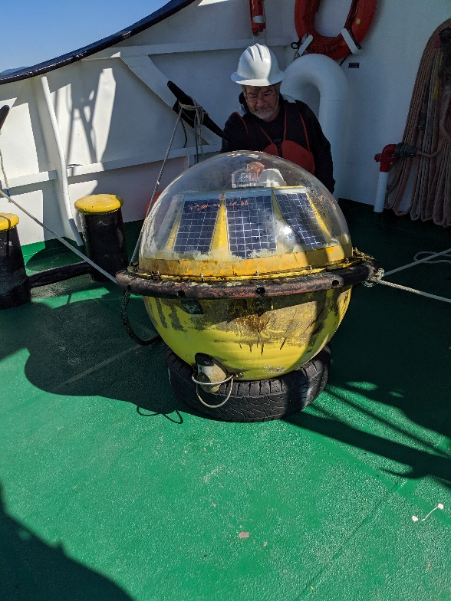

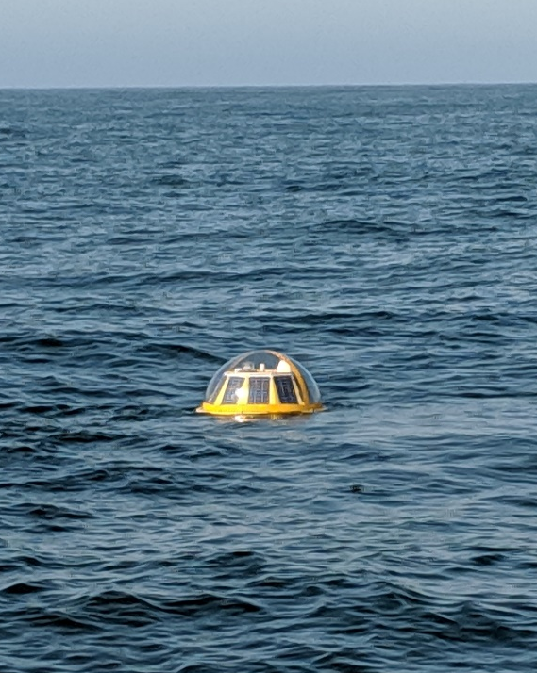

Axys Triaxys with Currents
Sensors:
Surface Directional Wave Spectra
Water Column Currents
Fixed-depth CTDs
Water Column CTD
Deployment:
Aug 28, 2019 – Oct 1 2019
-46’ MLLW
Clatsop CCC R/V Forerunner
JobCorps Ironwood
Notes:
Mike

Slide 2
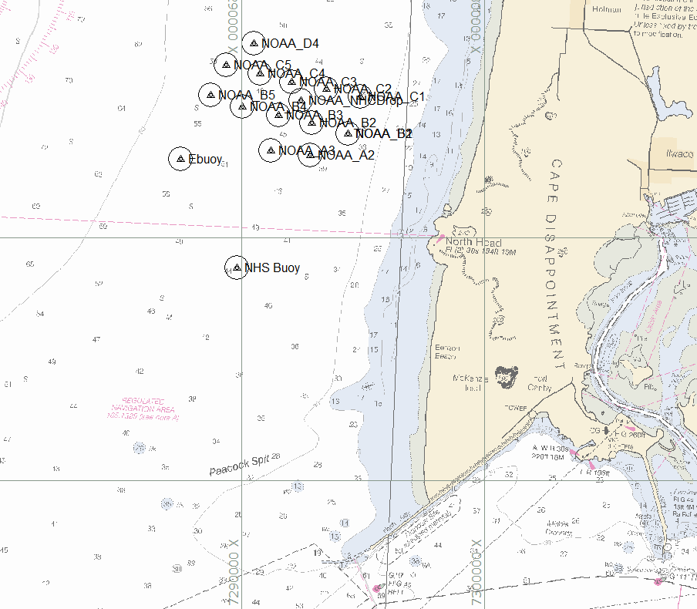
Location
0.8 nmi
1.3 nmi (2.5 km)
2 nmi (4 km)
Notes:
Mike

Slide 3
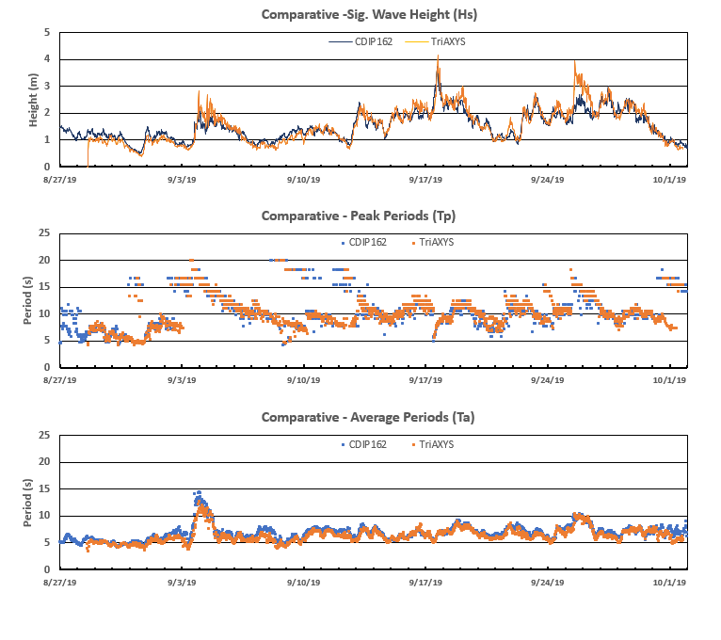
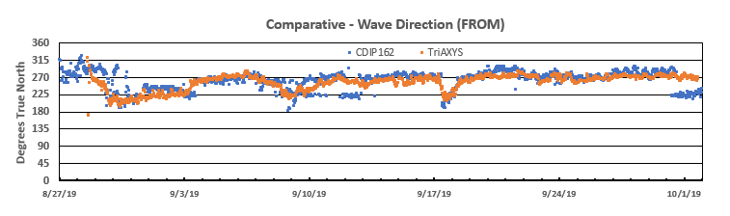
Surface Waves
Notes:
Mike

Slide 4
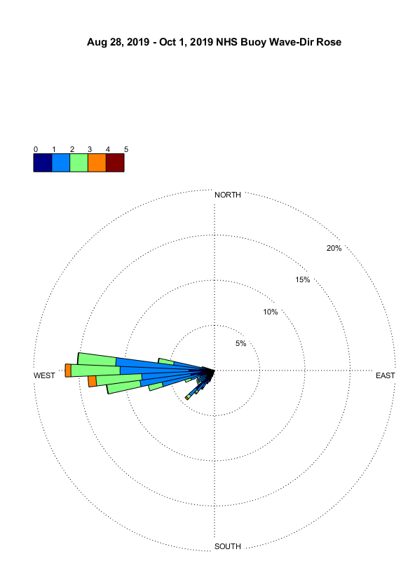
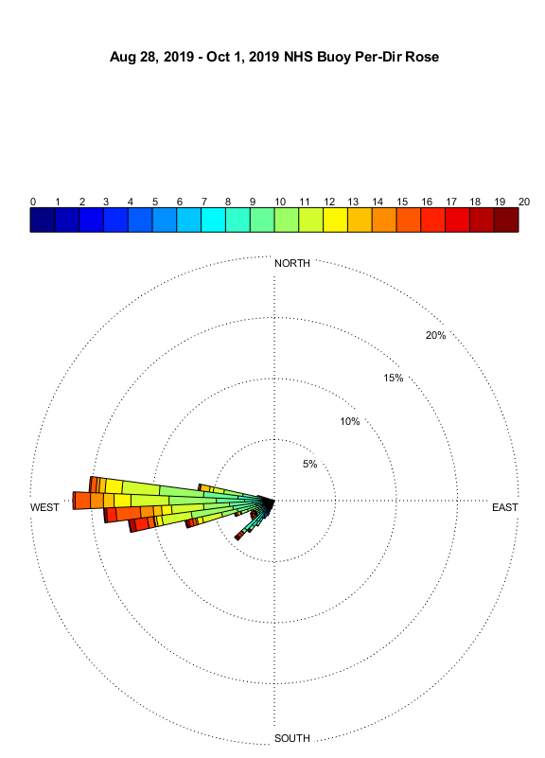
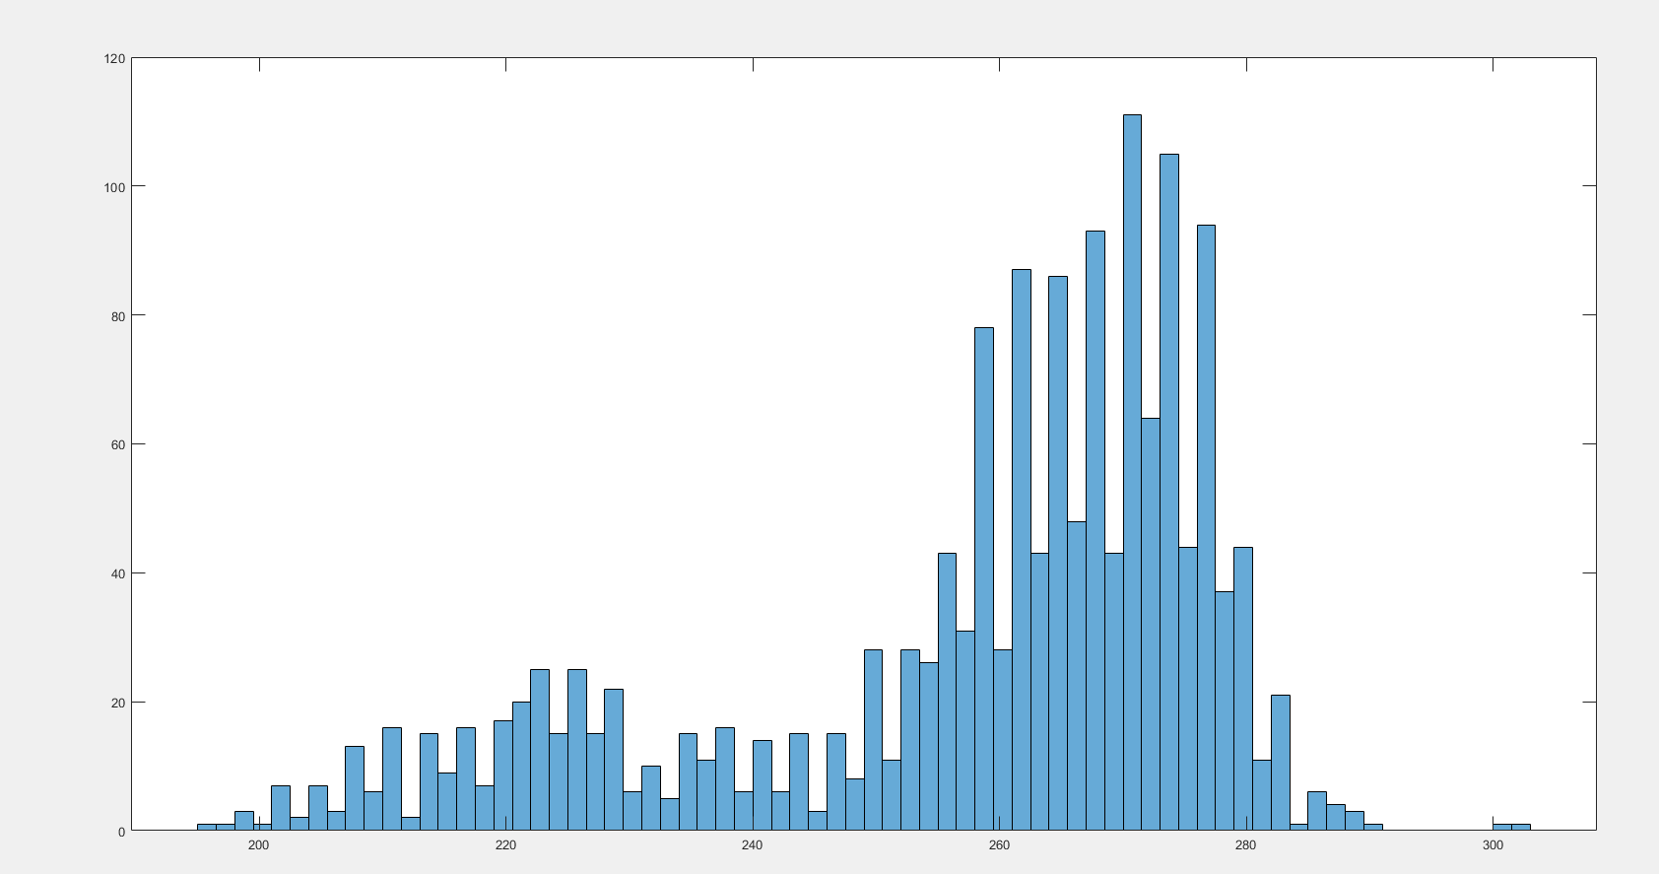
Surface Waves
Notes:
Mike

Slide 5
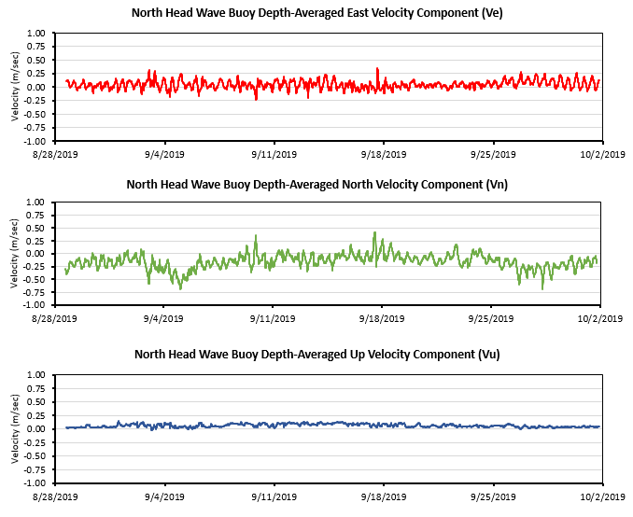
WC Currents
Notes:
Mike

Slide 6
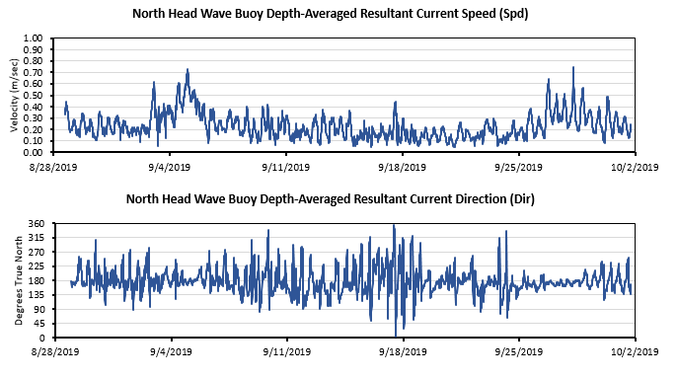
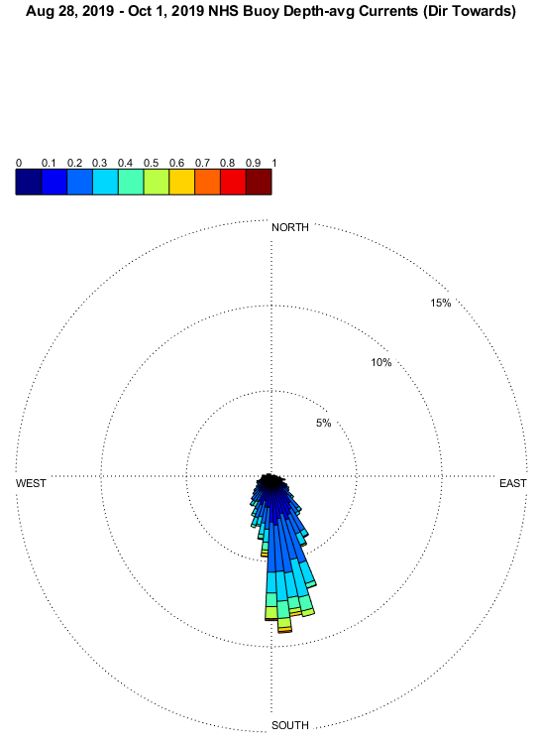
WC Currents
Notes:
Mike

Slide 7
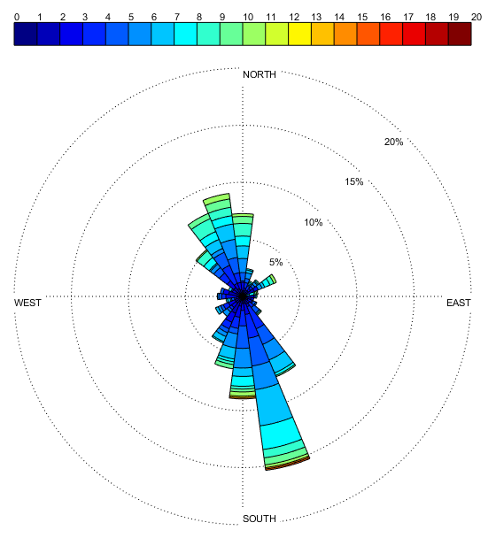
Waves and Currents
Wind Rose (46029)
Notes:
Mike

Slide 8
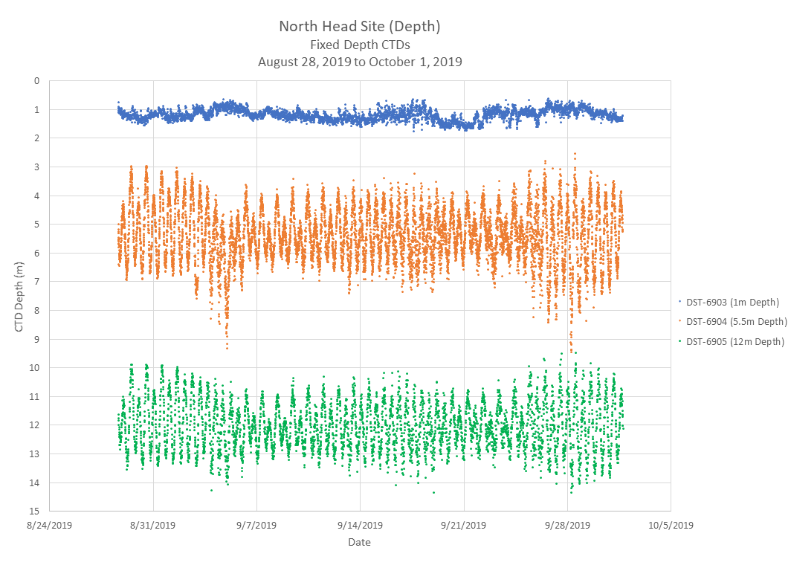
CTDs
Near-surface
Mid-column
Near-bottom
Notes:
Mike

Slide 9
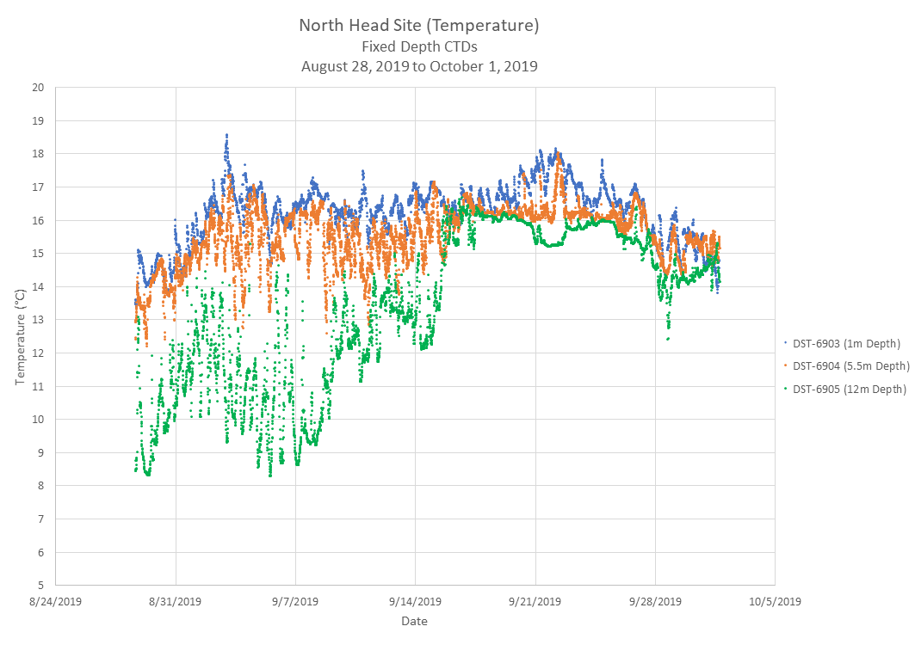
CTDs
Near-surface
Mid-column
Near-bottom
Notes:
Mike

Slide 10
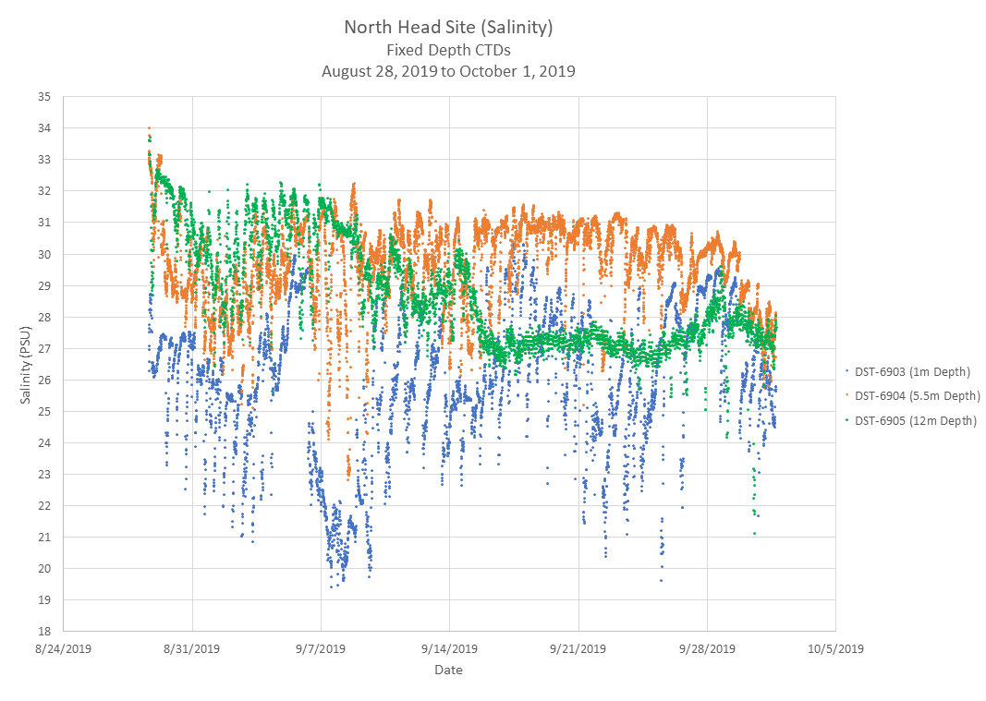
CTDs
Near-surface
Mid-column
Near-bottom
Notes:
Mike

Slide 11
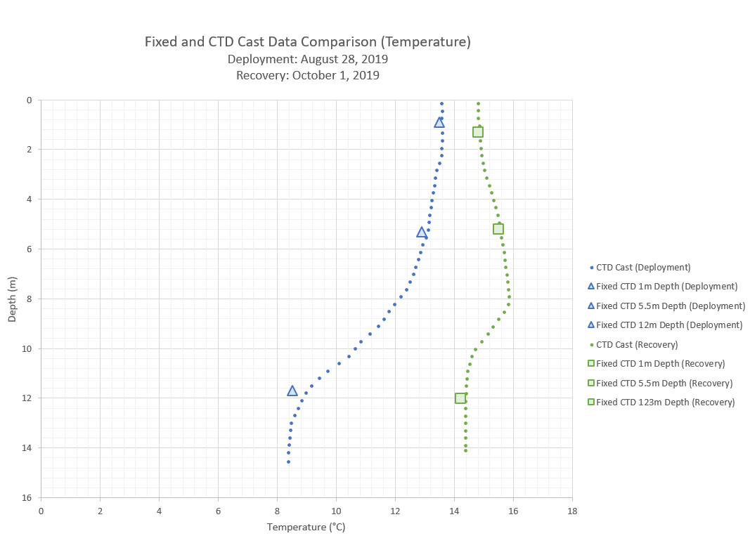
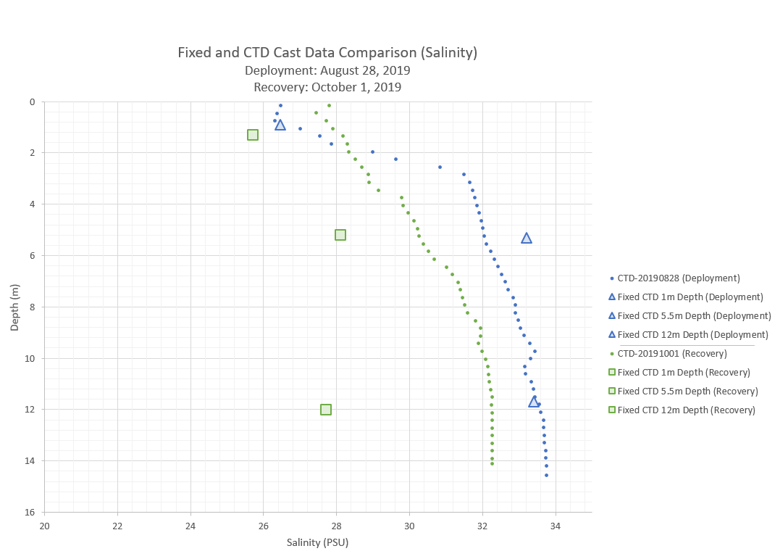
CTDs
Notes:
Mike

Slide 12
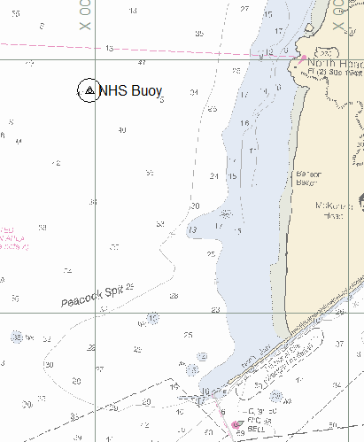
Summary
Wave heights generally 1-3 meters
  Increased in height mid-deployment (9/15/2019)
  Large Hsig/Tp event ~9/4/2019 (Hs up to 3 m, TP up to 20 sec)
  Agreement with CDIP buoy
Currents
  Fluctuate E-W with tides
  Predominately directed toward south
  Mean Ve = 4.5 cm/s (east)
  Mean Vn = 15.3 cm (south)
  Mean Vu = 6.2 cm/s (up)
  Mean Vavg = 22.9 cm/s (SSE)
CTD
  Temp near-surface and mid-column 14-17ºC throughout
    Near-bottom temperature increased mid-month to near agreement w/ surface
  Salinity near-surface fluctuated 20-30 psu
    Salinity mid-column remained relatively high (27-31 psu)
    Salinity near-bottom high near beginning deployment (27-30 psu) and dropped to ~27 psu after 9/15
Waves
Currents
Notes:
Mike

Slide 13
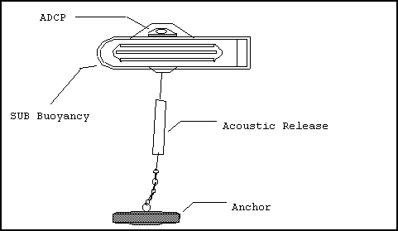
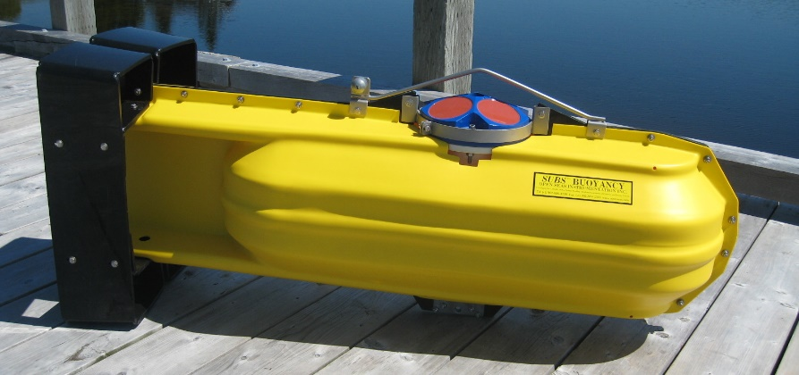
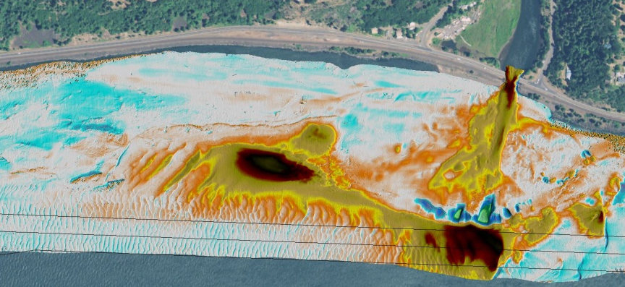
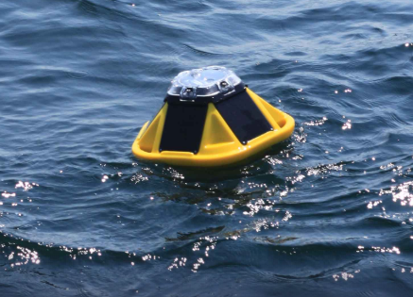
Next Steps?
What needs to be confirmed/understood better?
  Evaluate short-term bathymetry surveys to confirm hydrodynamic data?
  Long-term bathy monitoring to determine if southerly trend seasonal?
  Longer-term current data to better understand seasonal trends?
  Longer-term wave data, or more deployments, to better understand seasonal and spatial data (cost-effective deployments)?
Notes:
Mike

