Slide 1
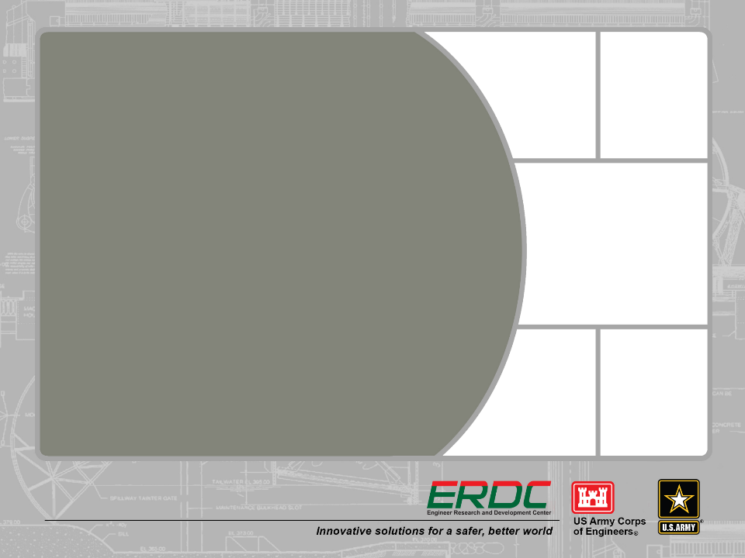
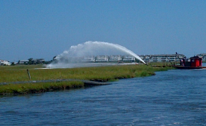
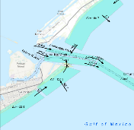
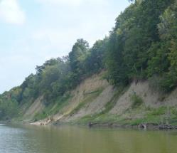
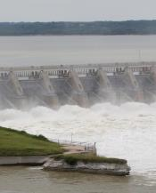
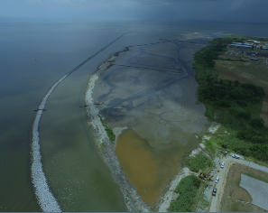
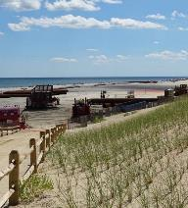


USACE Portland regional sediment management projects
Lower Columbia solutions group
January 14, 2020

Slide 2
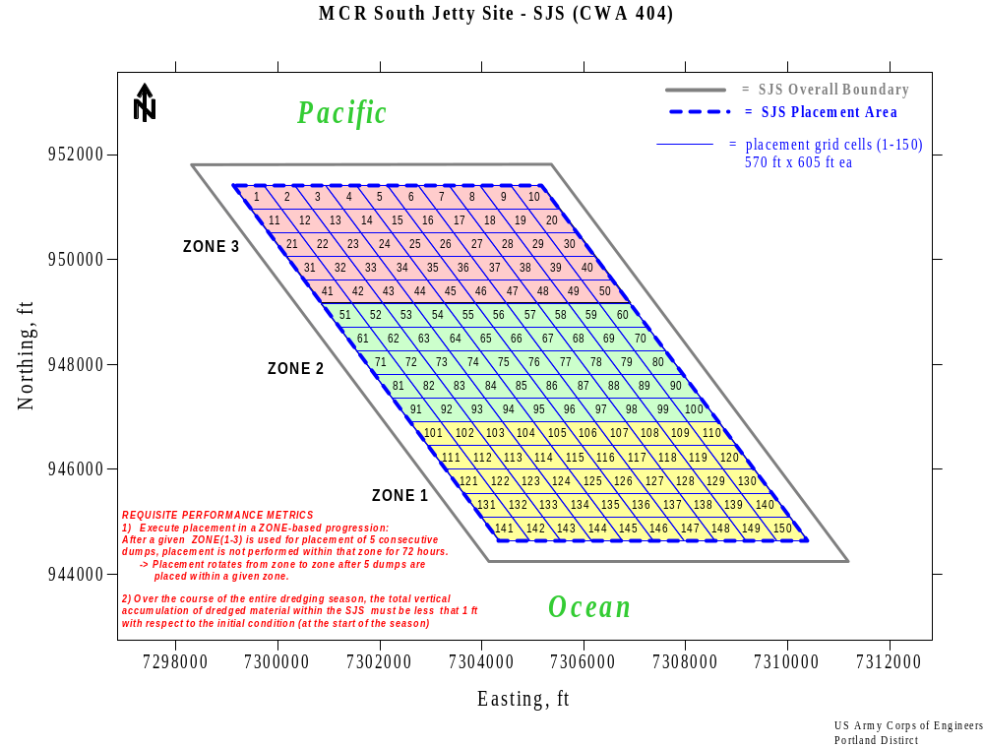
Notes:
- SJS became a placement site based on the need for RSM at the MCR inlet, and was the result of collaboration between stakeholders and USACE during 2003-2012.
- We’ve used SJS since 2012 (50 kcy); 2013 = 62 kcy (operational constraint), 2014-2017 = 300 kcy, 2018 = 400 kcy, 2019 = 285 kcy (operational constraint)
- SJS: 9,500 ft x 7,000 ft; depths of 40-53ft. Placement cell dimensions: 570ft x 605 ft
- Placement commences after Aug. 15th each year, after commercial Dungeness crab fishing season closes in OR.
- Cell-based utilization plan is used to guide even, thin-layer distribution of dredged material placement
- Minimizes burial impacts on the site’s benthic ecology and avoids localized mounding
- Placement limited to .25ft height per placement event (placement distributed along a track no less than 5,000ft and no more than 10% of dredge load (5,400CY/load) placed within any 500ft transit distance.
- SJS split into 3 zones (North, Central, South), and placement rotates between the 3 zones, where each zone is undisturbed by placement activity for 72 hours and 5 loads placed in one zone before dredge moves on.

Slide 3
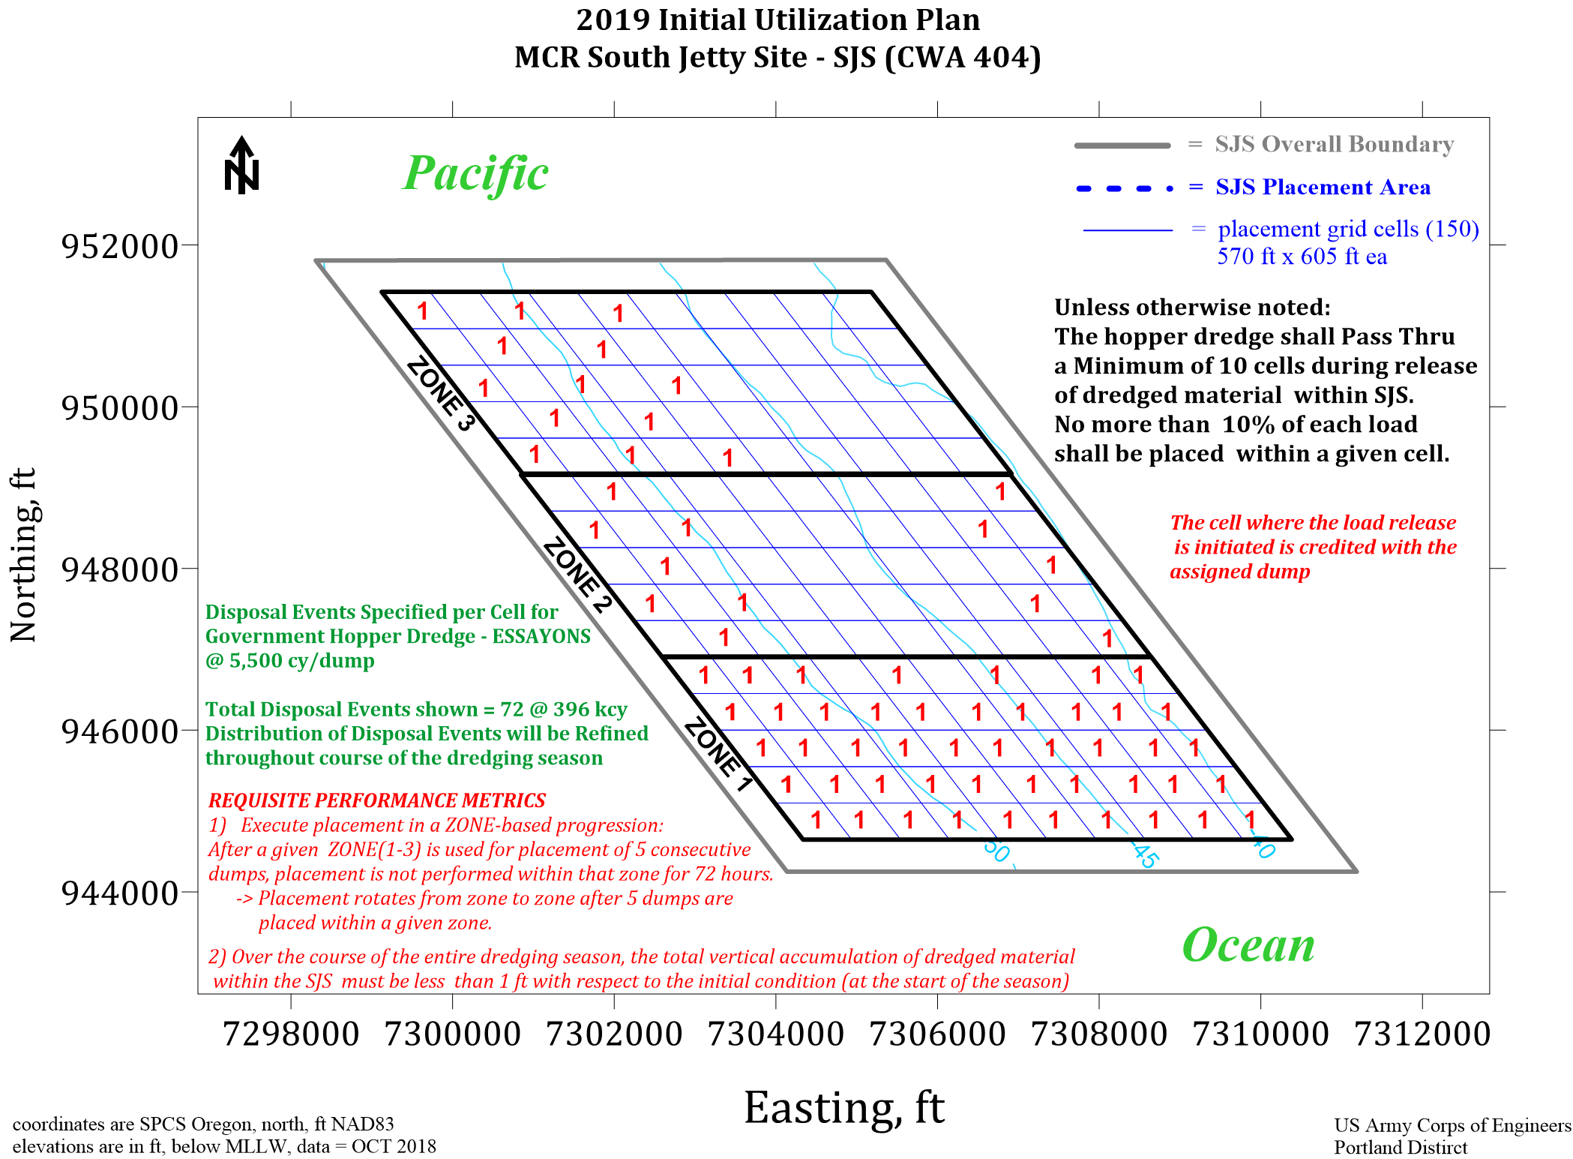
Notes:
Initial Utilization Plan for MCR Dredged Material Placement at the SJS

Slide 4
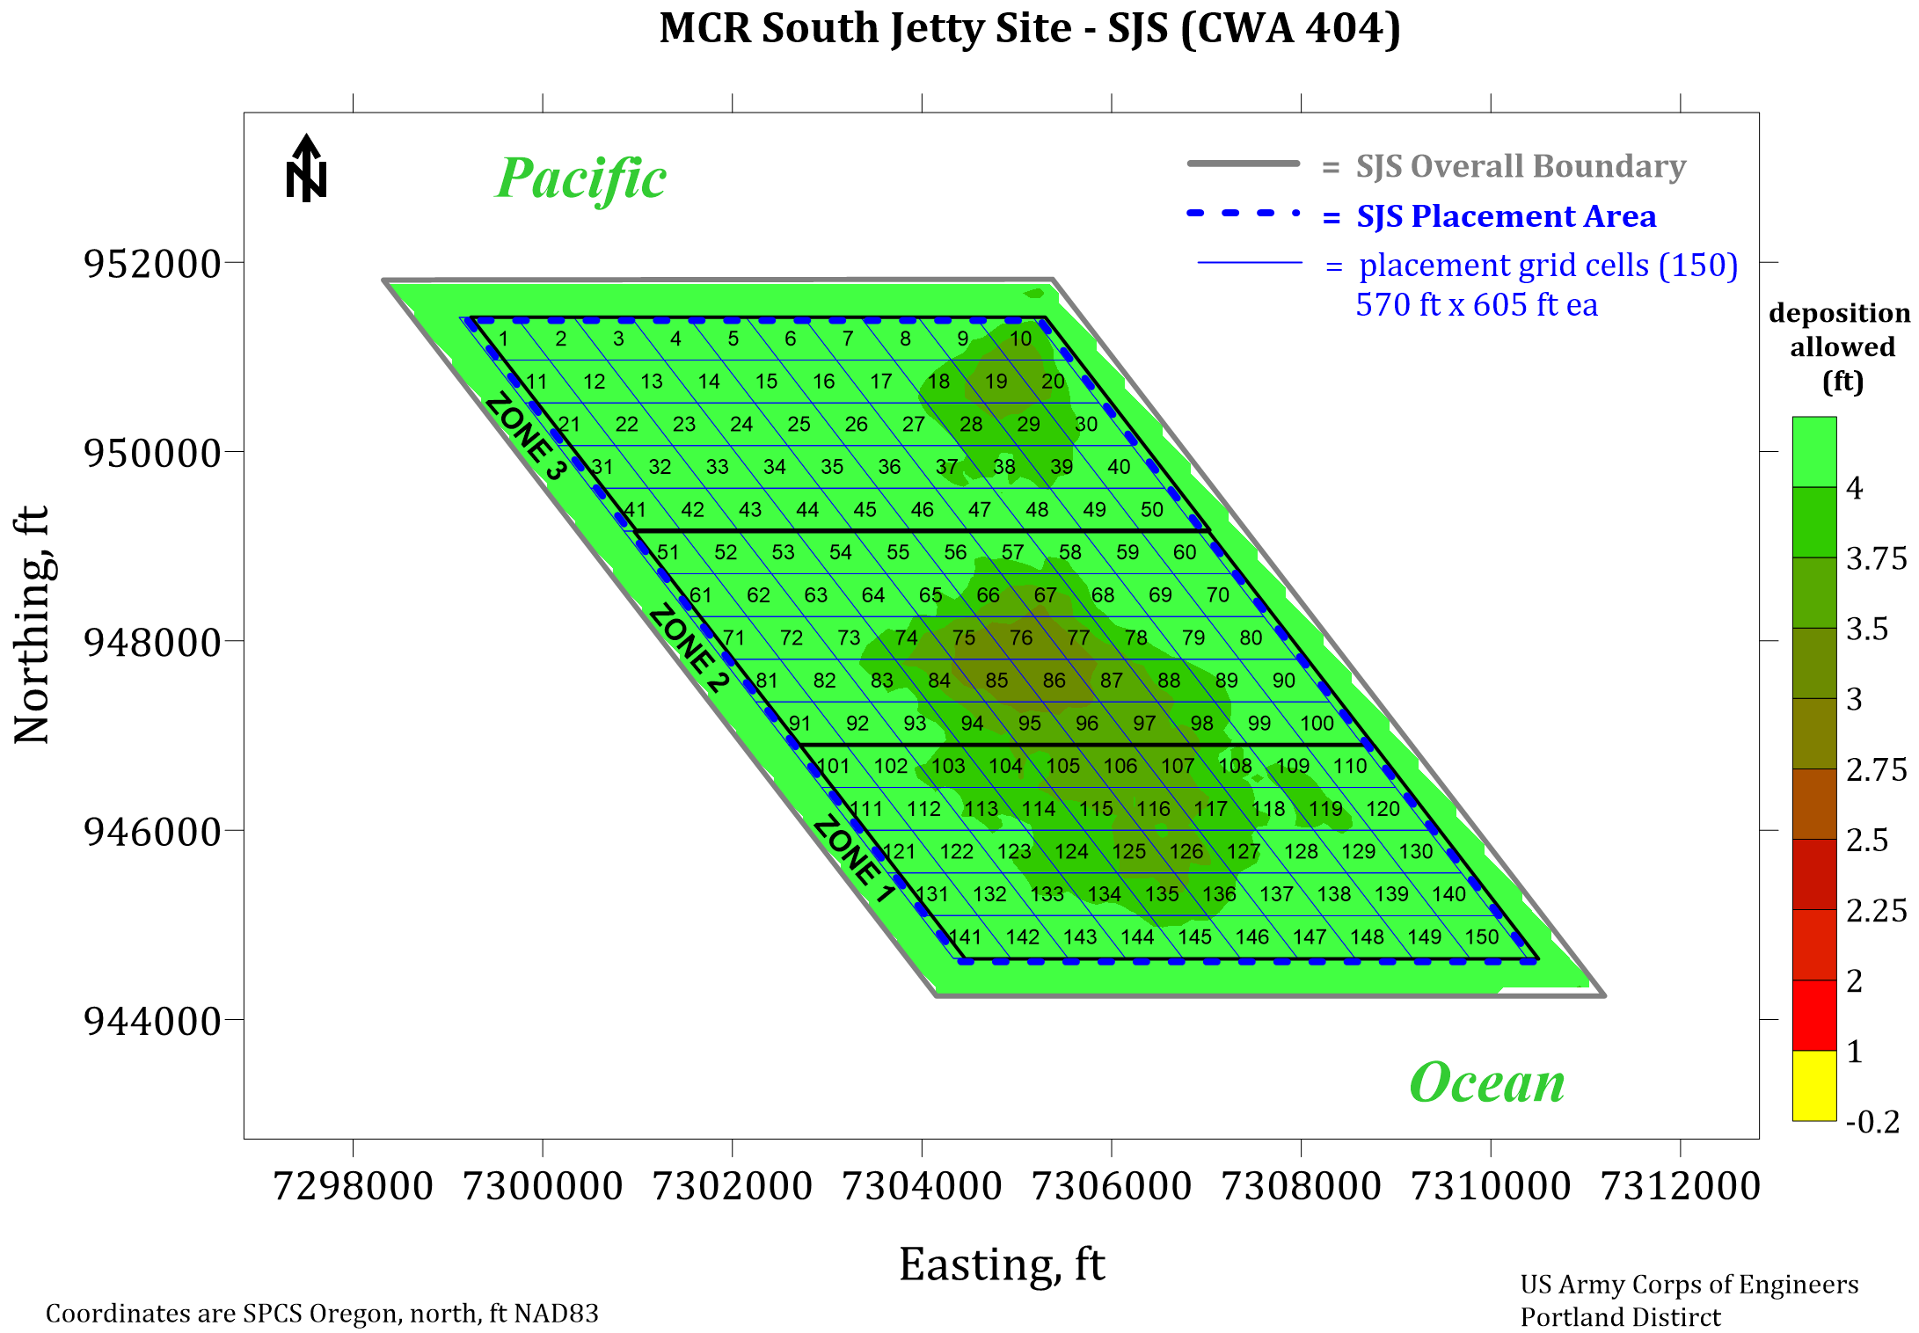
Notes:
SJS 2019 Pre-Season Capacity Assessment (based on 12 June 2019 survey) showing the Target Height of Accumulation for Dredged Material Placement

Slide 5
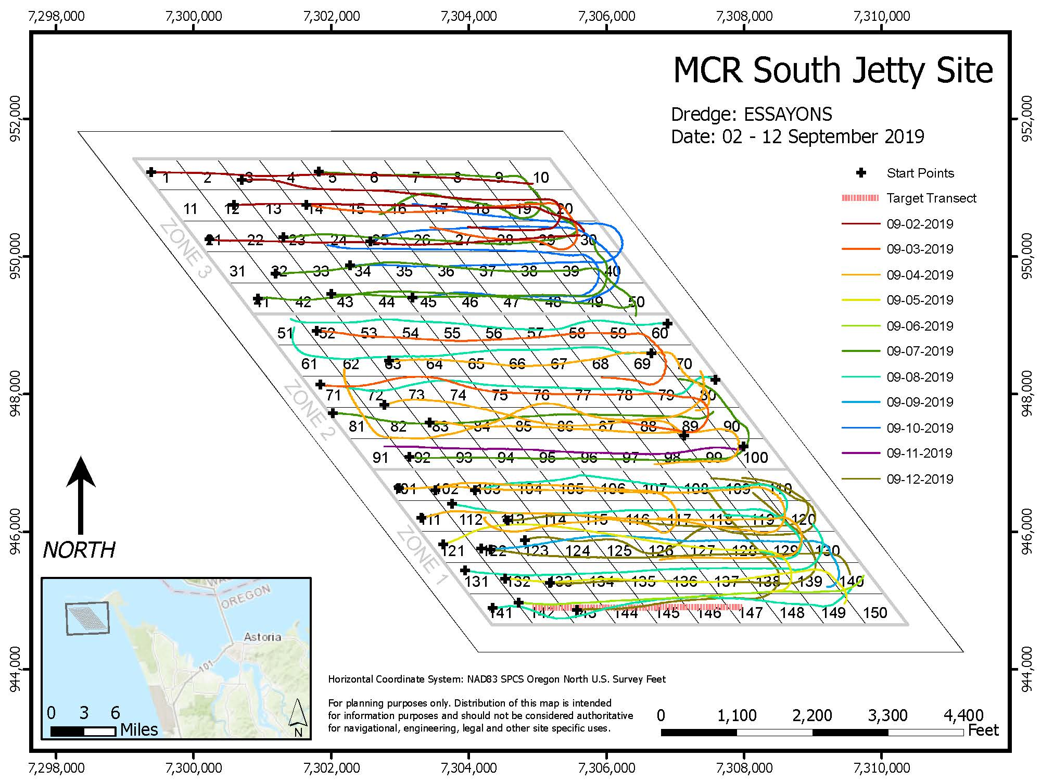
South Jetty Site Placement 2019

Slide 6
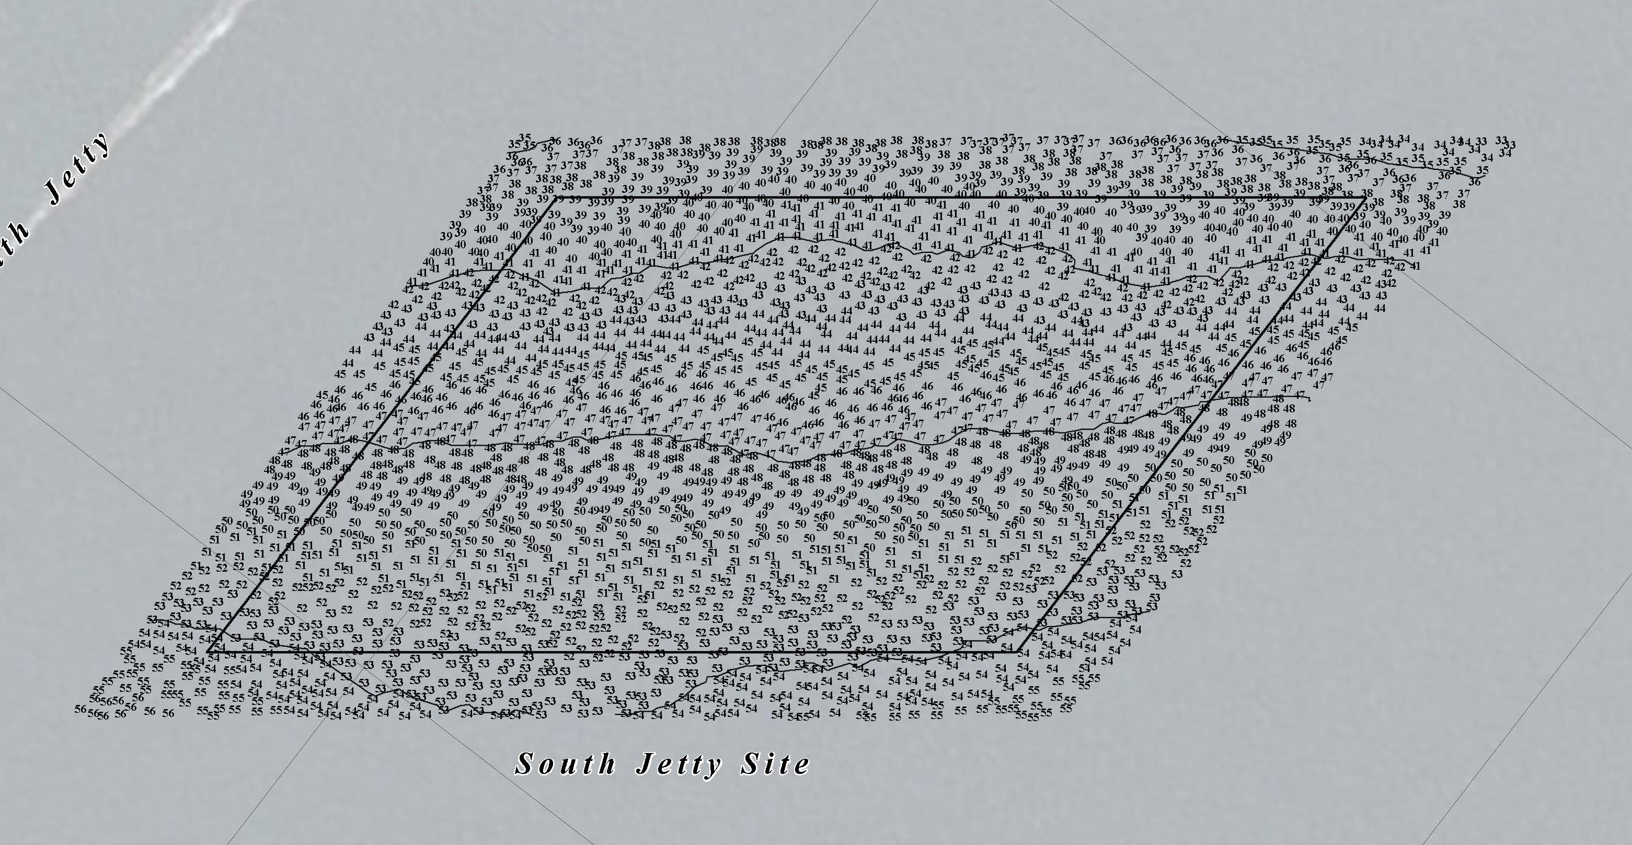
South Jetty Site Placement 2019

Slide 7
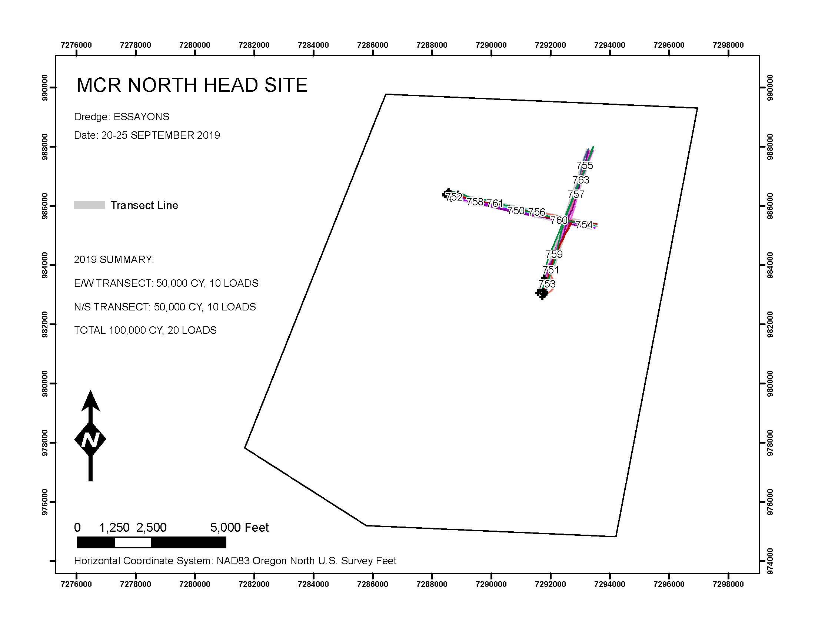
North Head Site Placement 2019

Slide 8
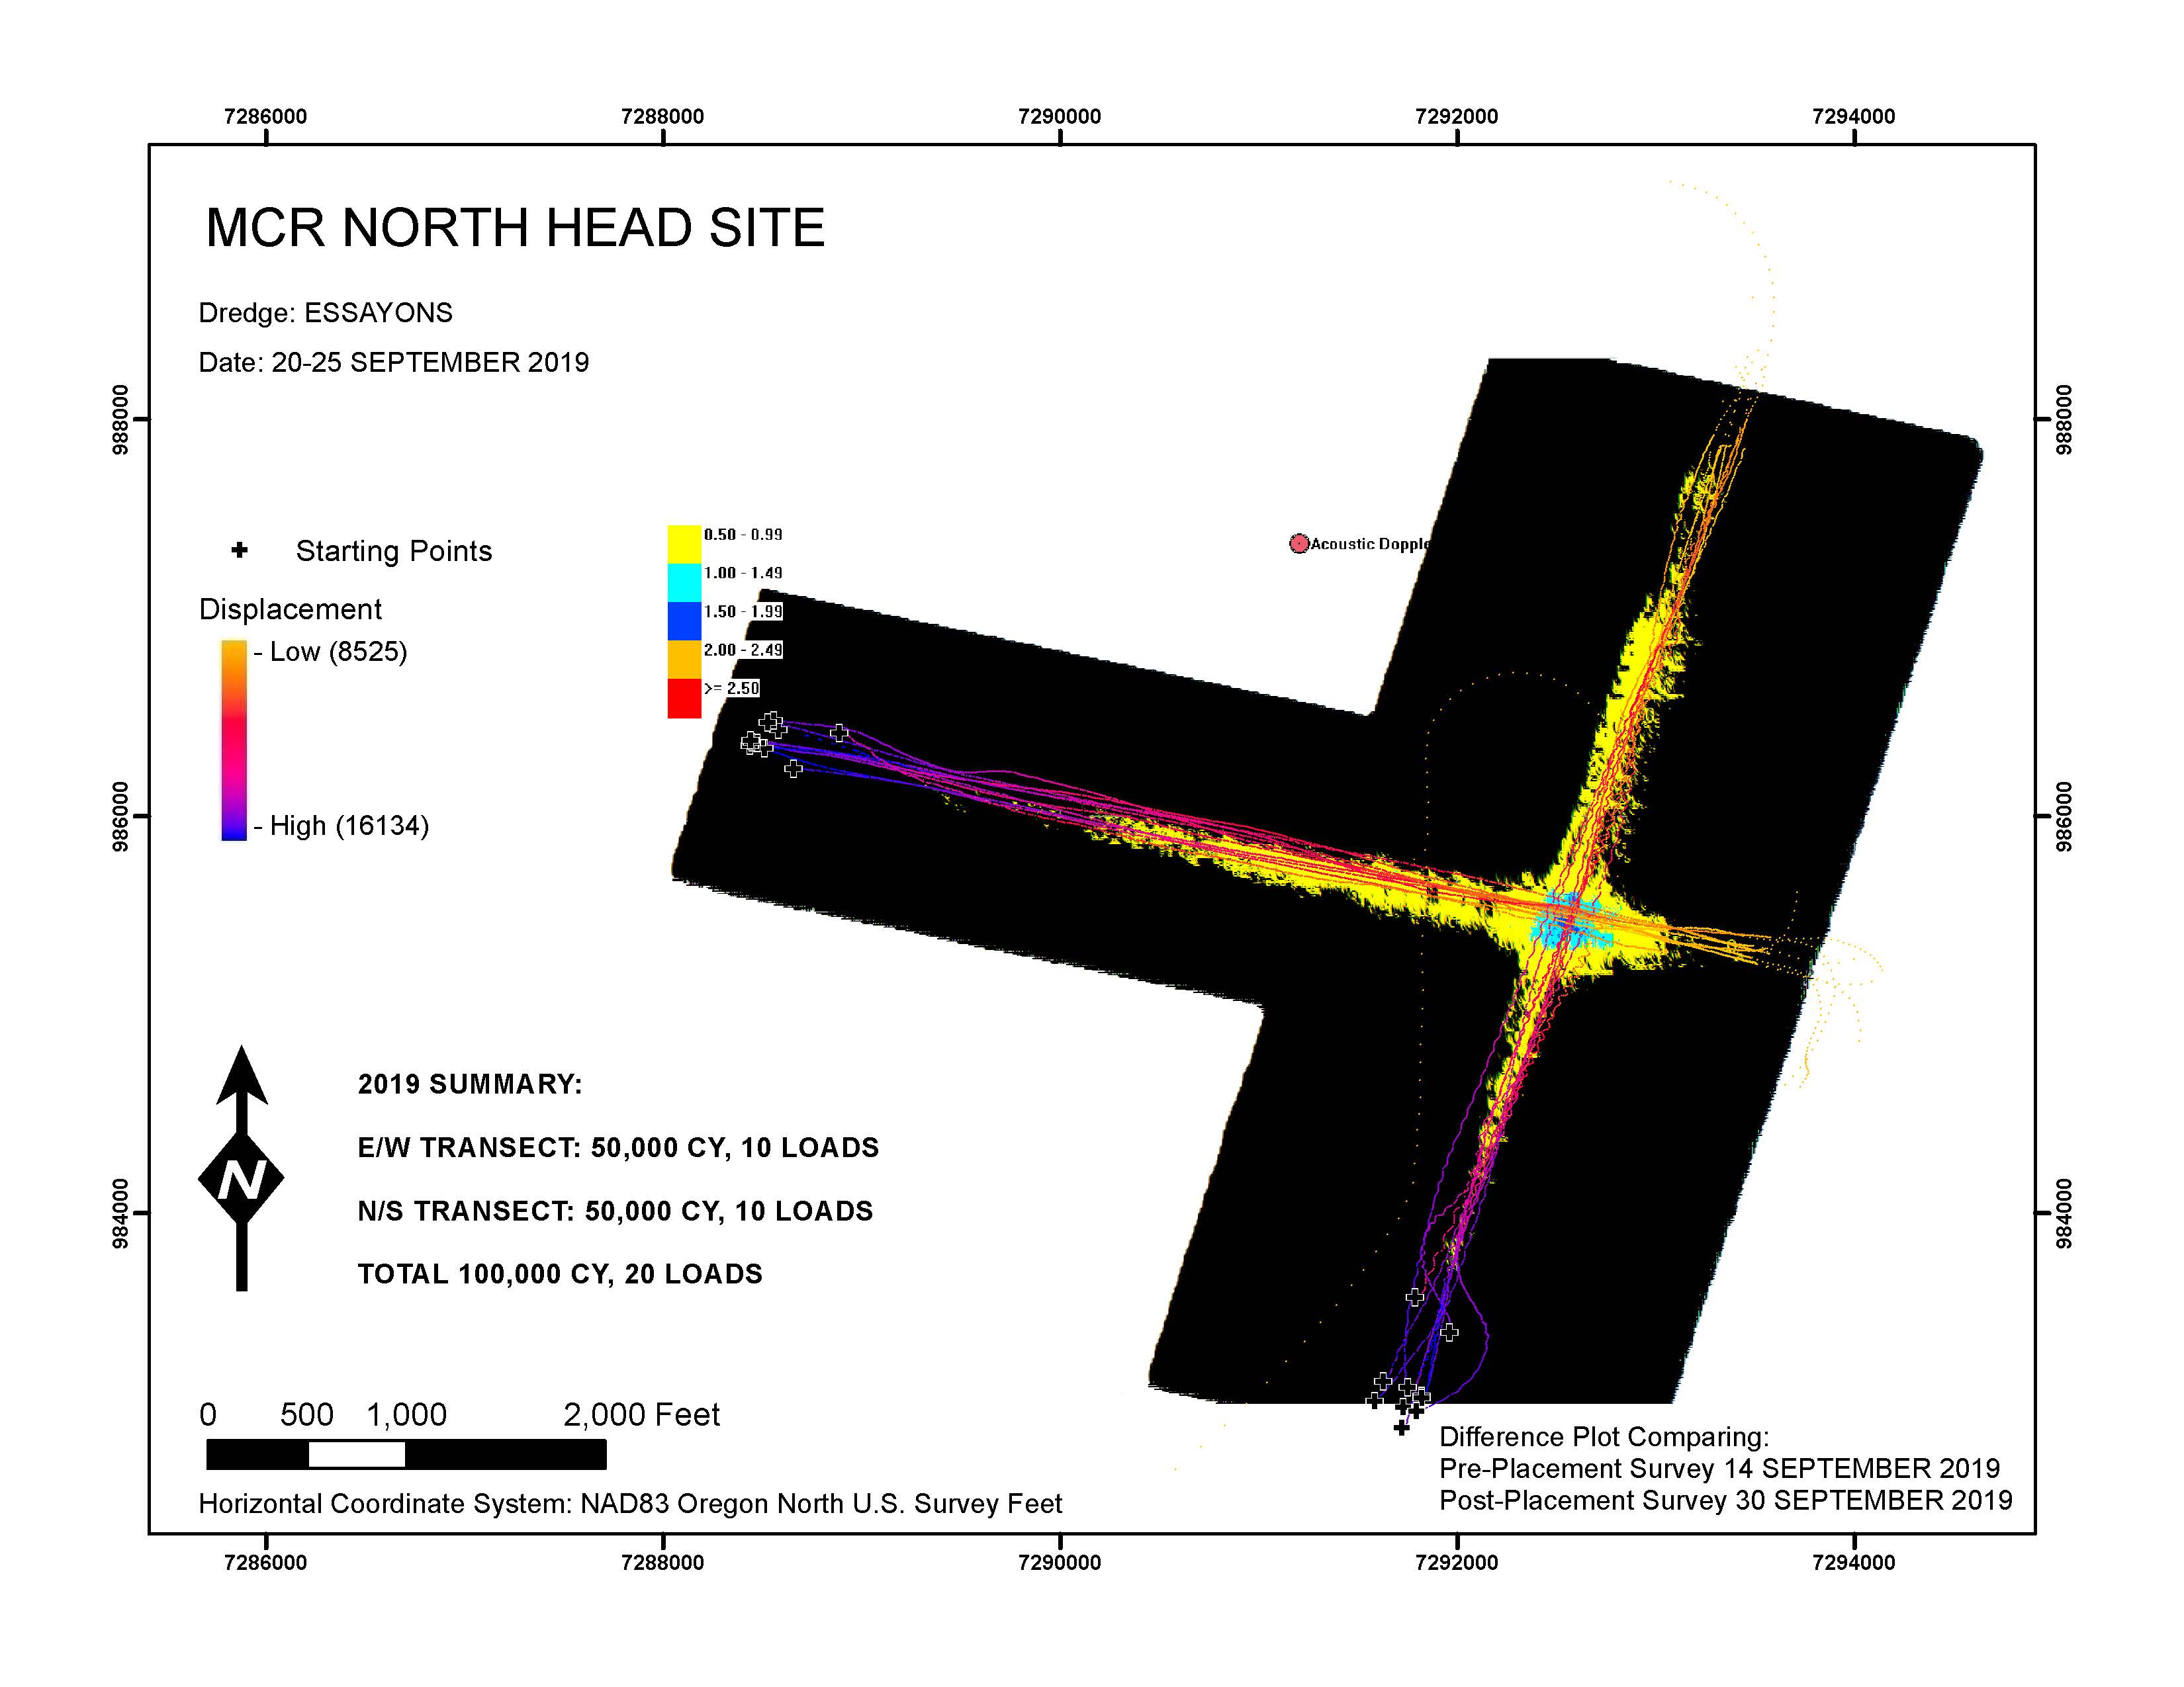

Slide 9
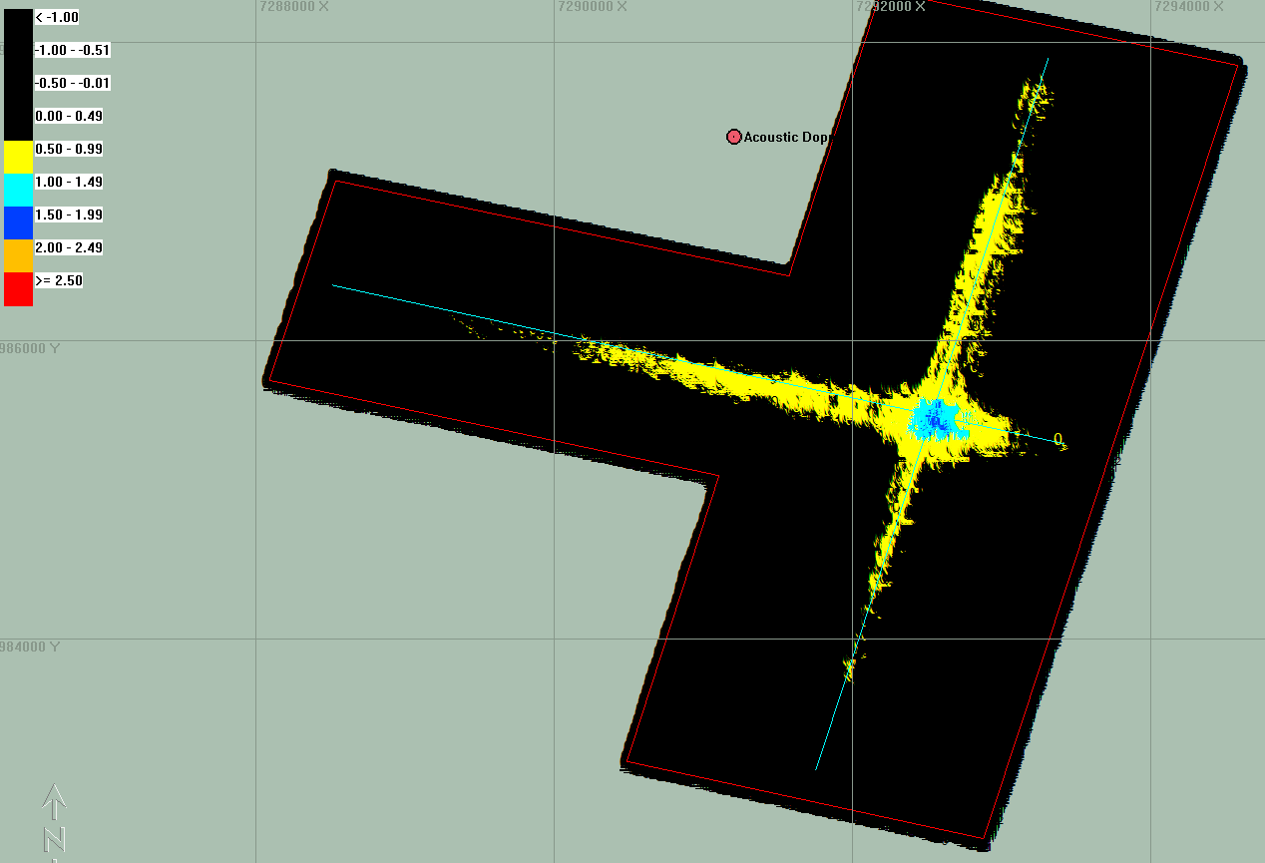
NHS Post Placement: Sept 30 survey

Slide 10
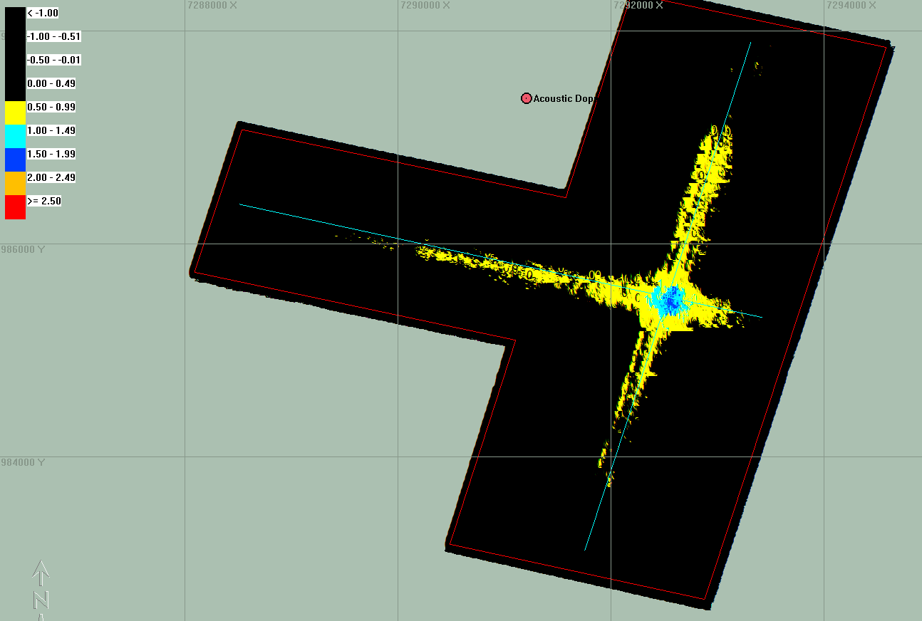
NHS Survey: Oct 11

Slide 11
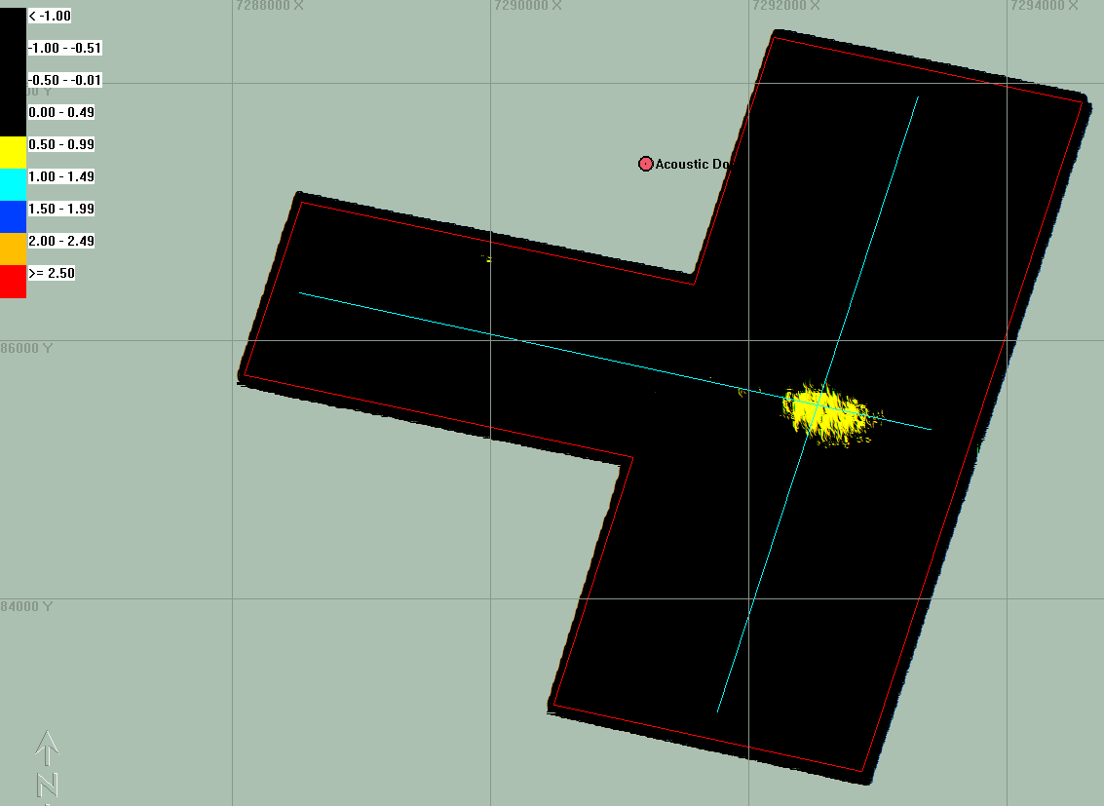
NHS Survey: Oct 24

