Slide 1
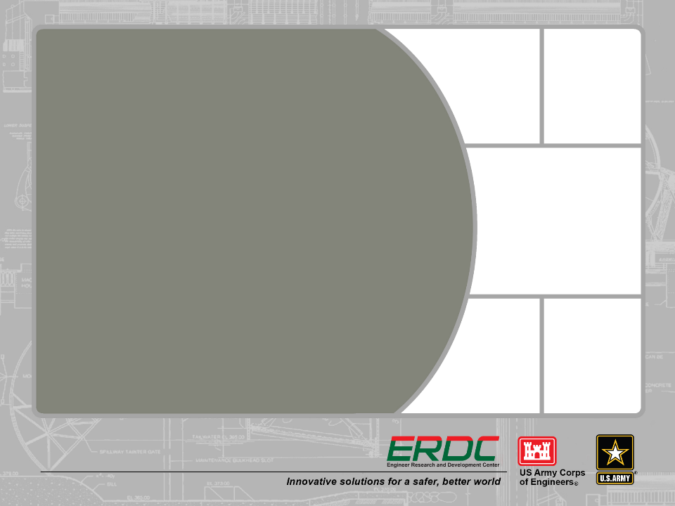
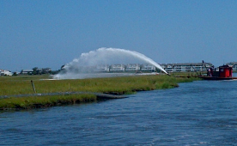
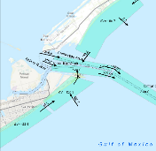
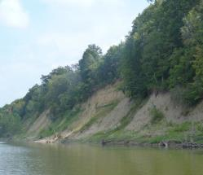
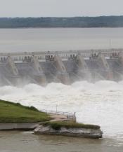
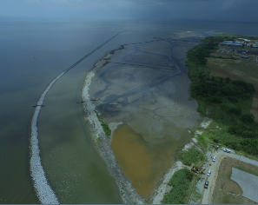
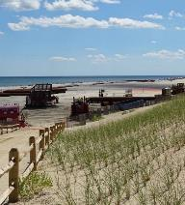


USACE Portland regional sediment management projects
Lower Columbia solutions group
January 14, 2020

Slide 2
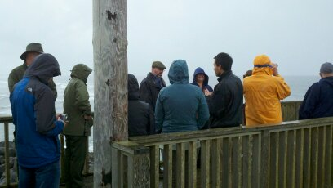
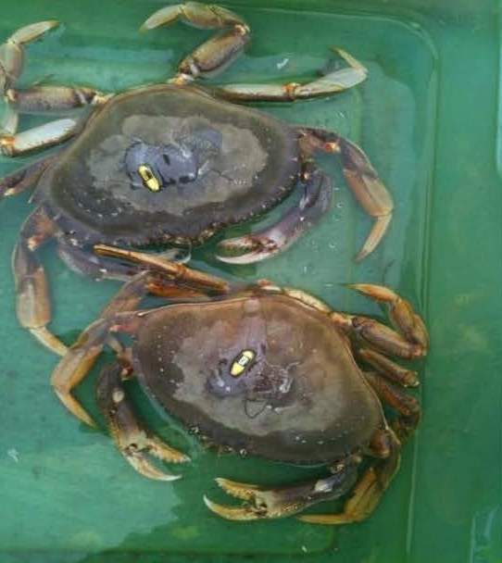
NWP RSM Highlights
2012
AdH Modeling in the Lower Columbia
MCR Adaptive Management
2013
Oregon Sediment Model (Port Orford)
MCR South Jetty Dune Stabilization
2014
Oregon Shoreface Sediment Stabilization (Yaquina South Jetty)
2015
Lower Columbia River RSMP
2016
Lower Columbia River RSMP
Optimizing Fall Creek Reservoir Flush
2017
Crab Response to Nearshore Dredged Material Placement (NAO)
Lower Columbia River RSMP
2018
North Head Argus Monitoring (ERDC)
Lower Columbia River Site Selection Framework for Habitat Creation
West Sand Island Shoreface Stabilization
2019
Sediment Mobility on the OR/WA Coast
Eagle Creek Fire
Notes:
Key component has been leveraging funds, from either outside groups or O&M

Slide 3
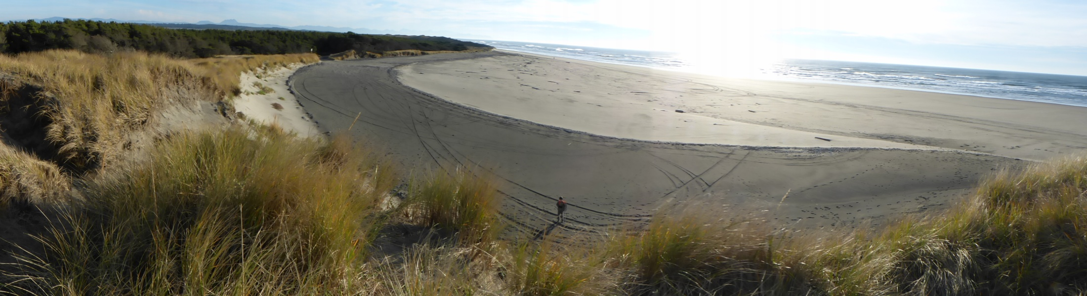
FY13 MCR South Jetty Dune Stabilization

Slide 4
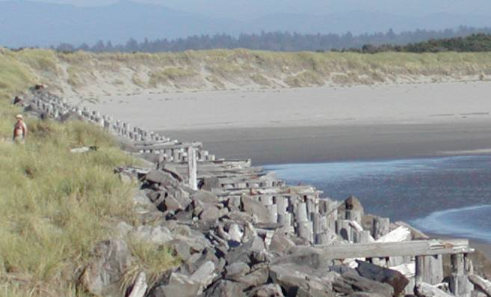
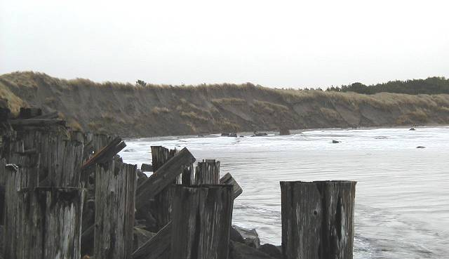
7/29/03
Wave-induced Erosion of primary Dune protecting low elevation backshore (east, behind dune)
DUNE
2/04/06
DUNE
View to east along south jetty root
Notes:
4

Slide 5
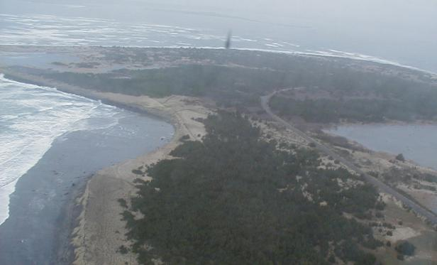
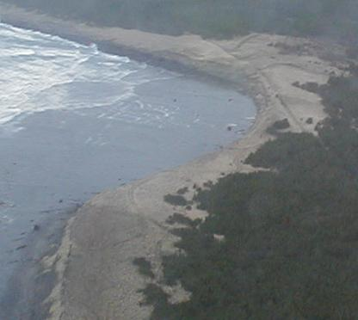
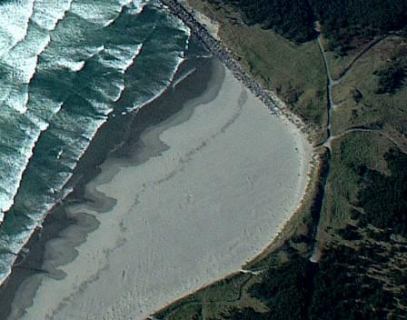
Clatsop Spit
31 JAN 2006
Previous Concern
Eroding South Jetty Foredune
Is the last line of defense
between Trestle Bay (estuary)
and Pacific Ocean
South Jetty
DUNE
LOW Elevation
Backshore
Trestle Bay
DUNE
DUNE
South jetty root
Erosion of Dune
31 JAN 2006
DUNE
Low
Elevation
Backshore
DUNE
11 SEP 2002
DUNE
Notes:
Distance from SJ dune to Trestle Bay roughly 1200’

Slide 6
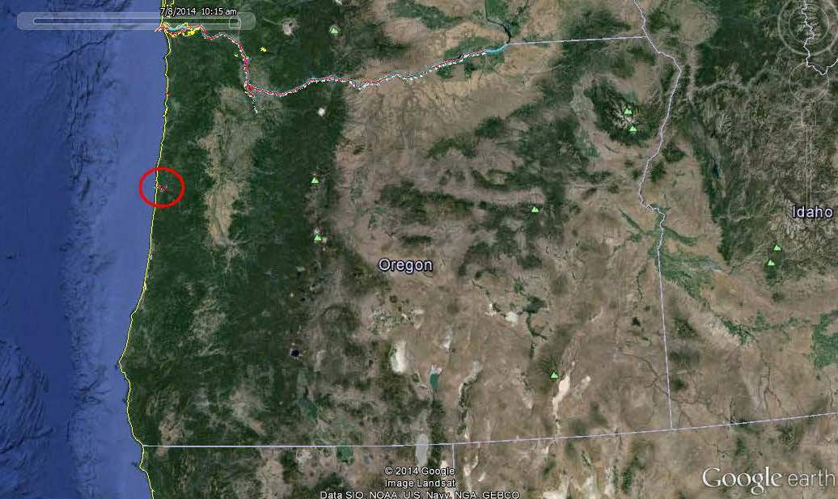
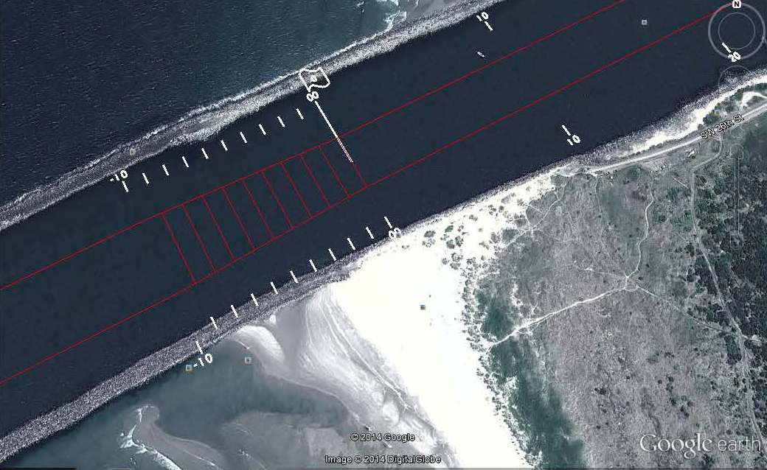
FY14 Oregon Shoreface Stabilization
BLUF: The Portland District speculated that increased shoaling in the Yaquina Entrance channel is a result of Aeolian transport. Sand fencing is proposed to interrupt a circular pattern of accretion on the south jetty, migration into the channel and movement out of the channel back to the jetty.
Challenges
Limited federal/state resources
City of Newport - South Beach State Park Master Plan
Public perception of sand fences
Stakeholder/Interest in the project area
Recreational use of the site
Expected Benefits
Up to 40,000 CY may be captured in the proposed sand fencing implementation plan, savings of roughly $300k
Unit price of $.03/CY for sand fencing compared to $7.50/CY for hopper dredging
Allows dredge YAQUINA to focus on other priorities
Build Yaquina South Jetty Foredune

Slide 7
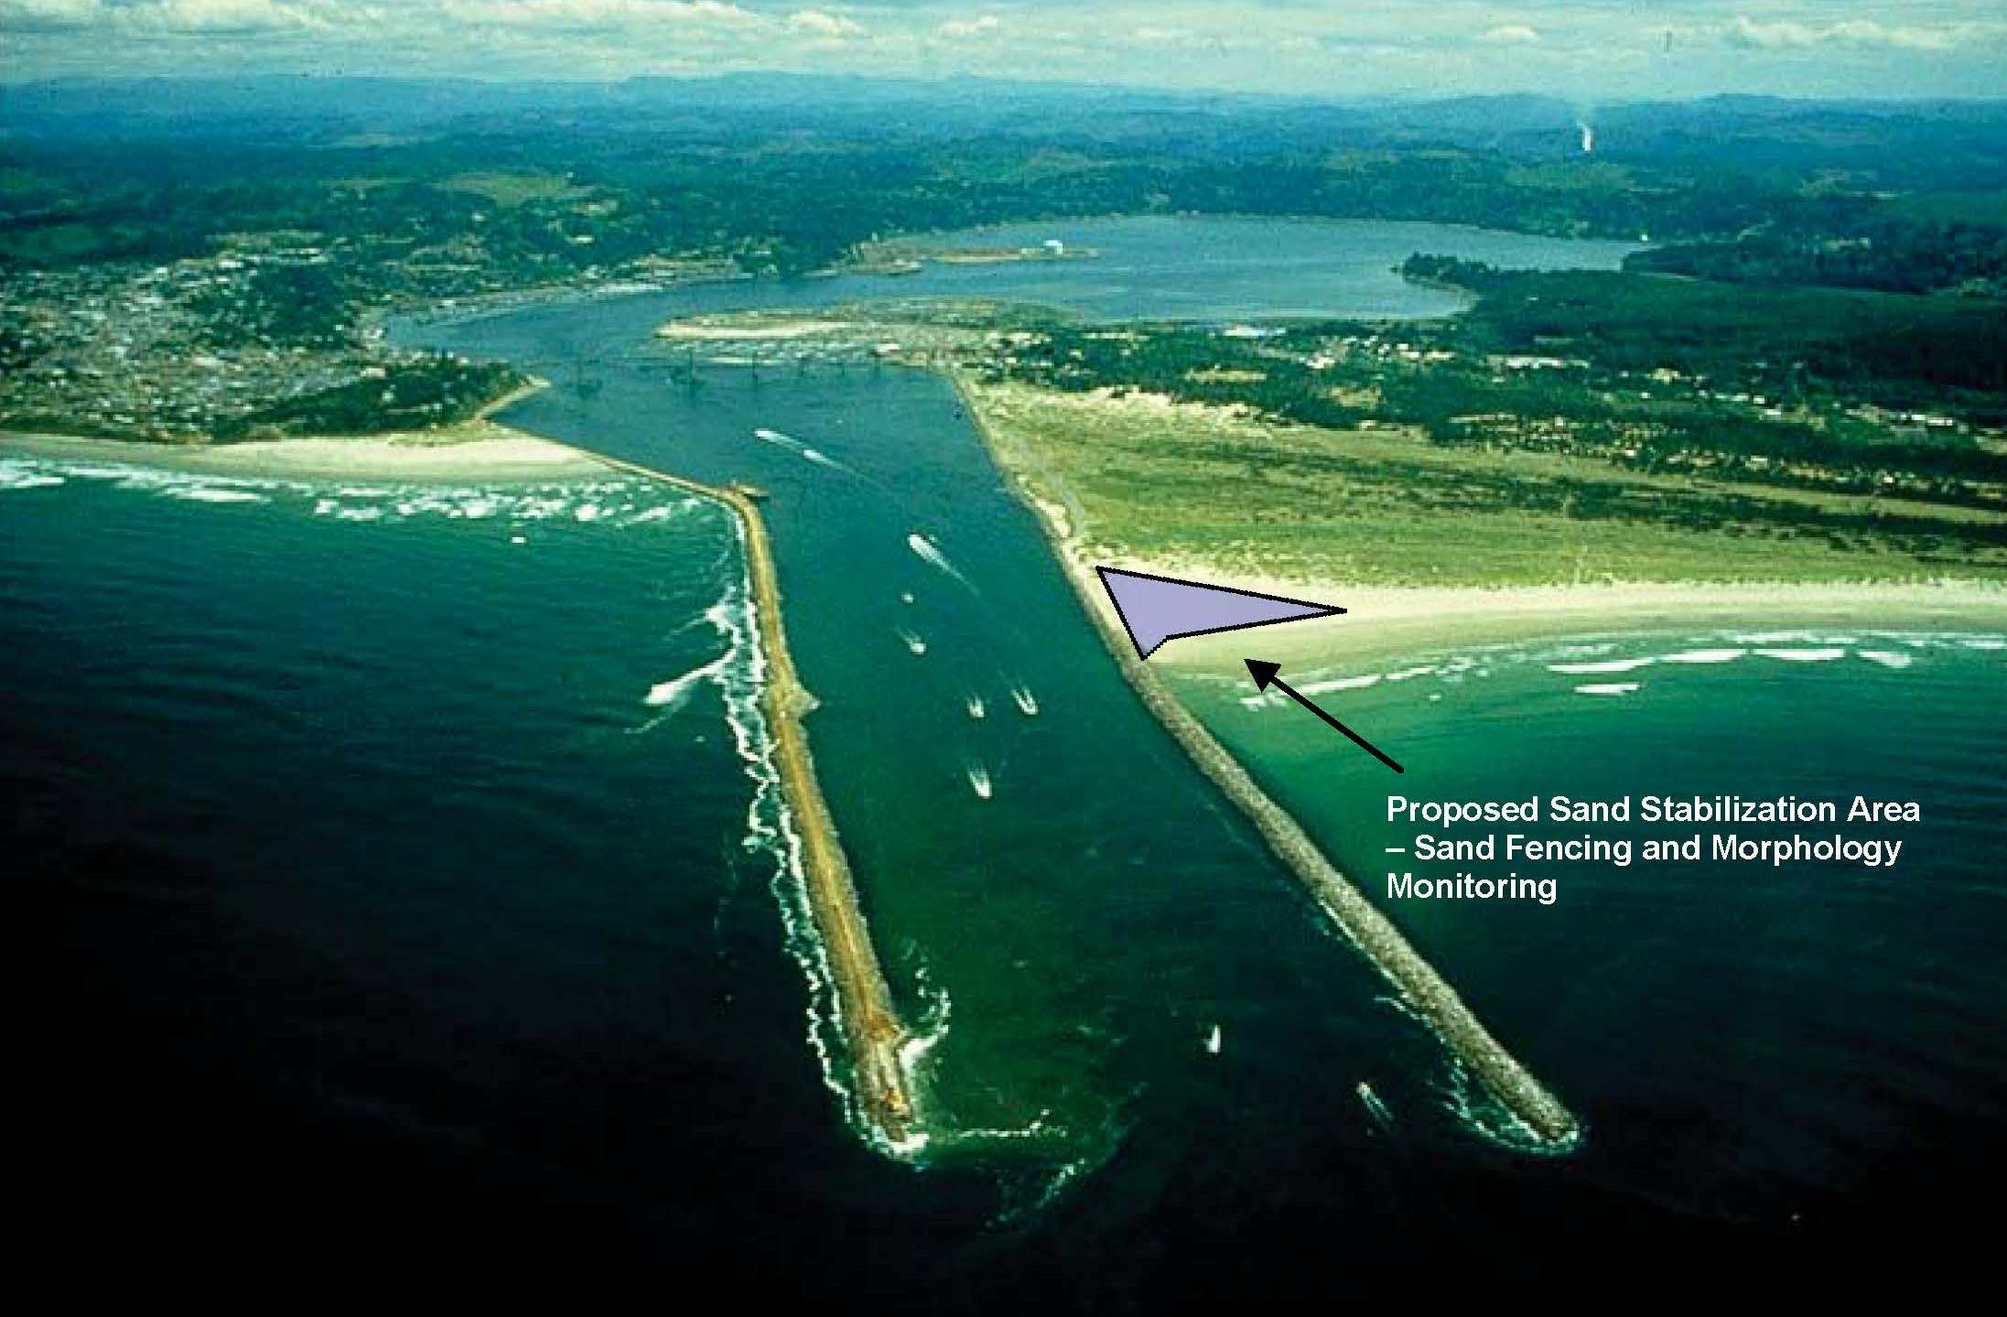
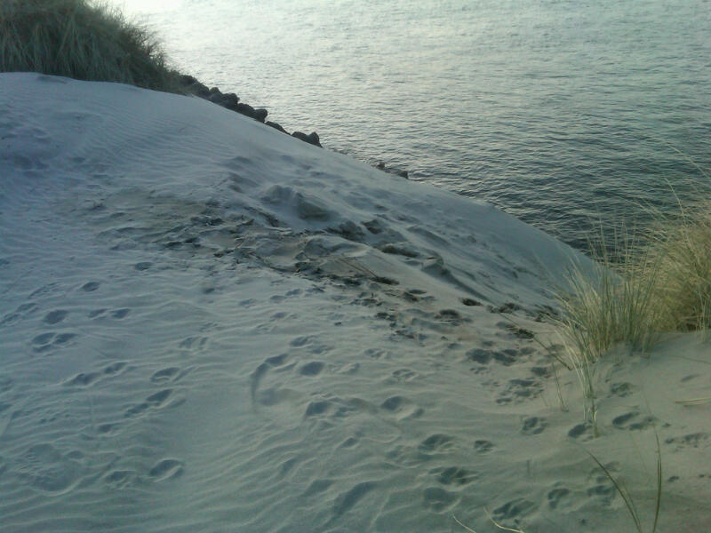
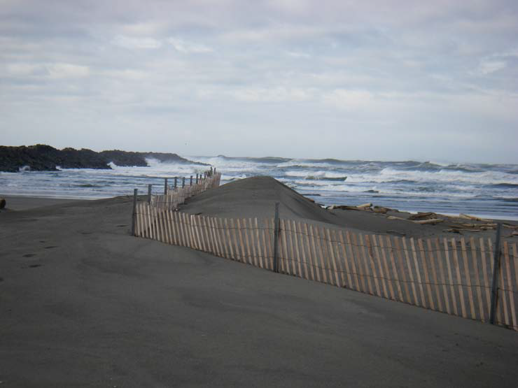
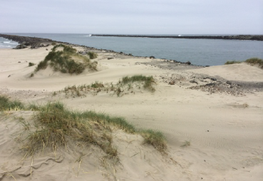
FY14 Oregon Shoreface Stabilization

Slide 8
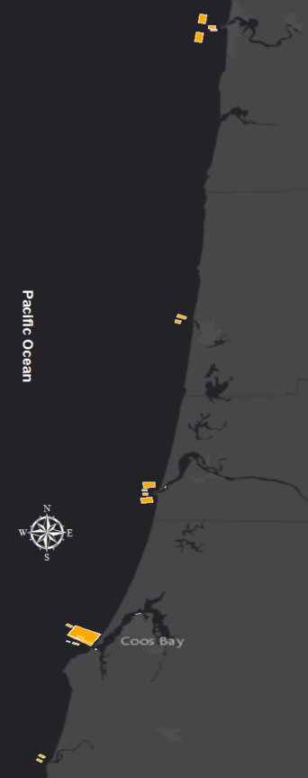
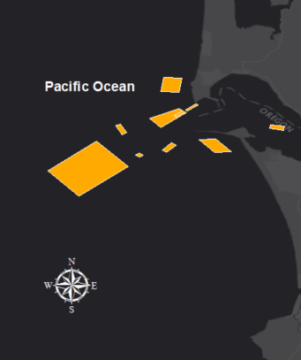
Sediment Mobility on the OR/WA Coast
Evaluating the Depth of Closure for nearshore placement sites.

Slide 9
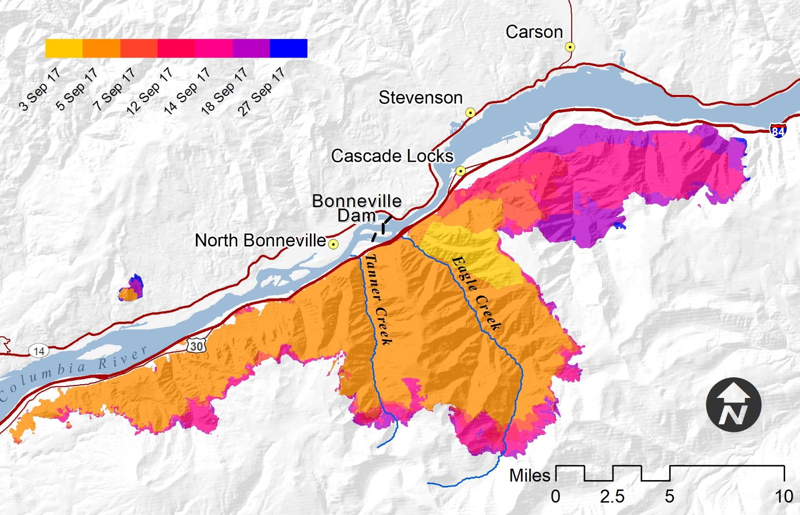
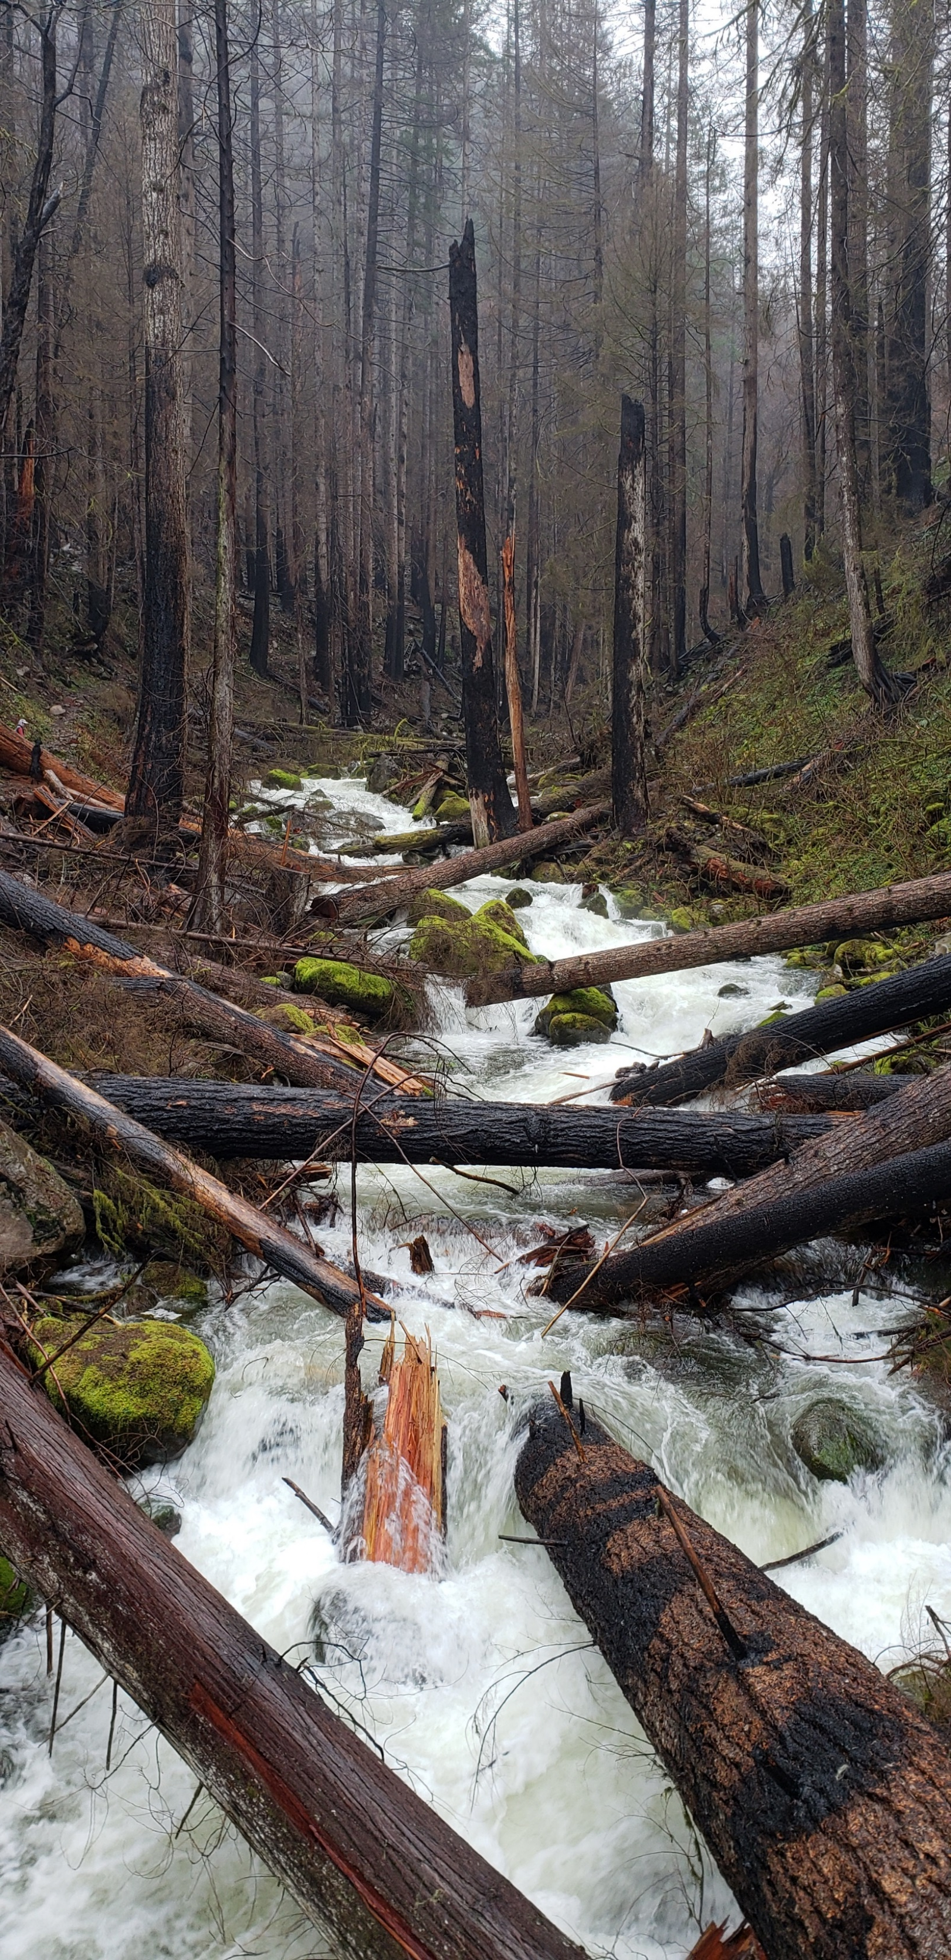
Eagle Creek Fire

Slide 10
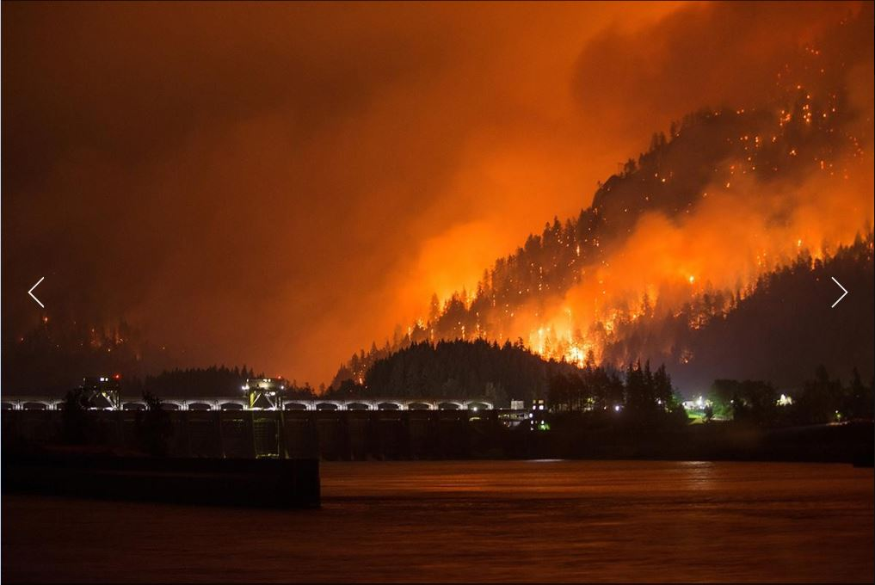

Slide 11
FY20 NWP RSM Projects
Hydrodynamic Controls on Sand Wave Growth in the Lower Columbia River
  Develop a method to better understand sand wave growth in the Columbia River to reduce operational costs of managing them.
  Analyze flow criteria that promote sand wave growth and movement.
  Analyze historic areas of sand wave growth.
Life Cycle Cost Analysis of RSM Strategies
  Analyze cost-benefits of individual RSM projects in an effort to promote sustained implementation of RSM strategies.
  Portland District will be used as a case study.
  Focus on savings and benefits of nearshore placement v offshore placement.

