Slide 1
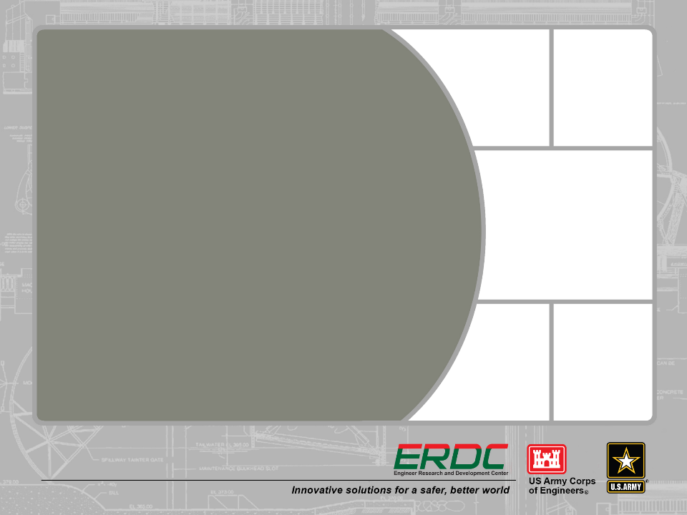
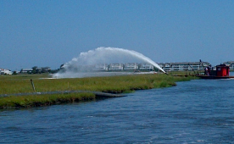
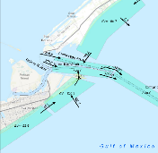
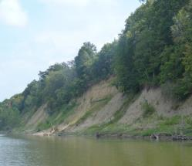
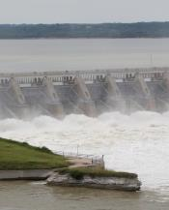
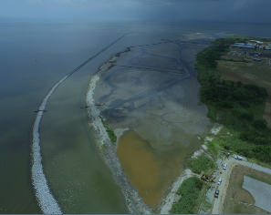
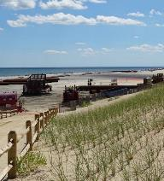


regional sediment management in the USACE
Katherine E. Brutsché, PhD
Program Manager
National Regional Sediment Management Program
Dave Perkey
Deputy Program Manager, Coastal
David May
Deputy Program Manager, Inland

Slide 2
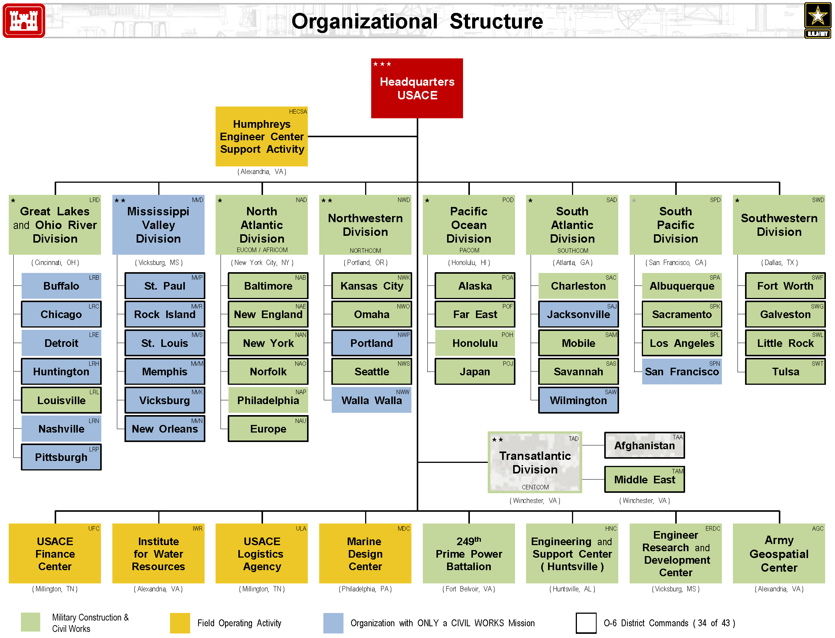

Slide 3
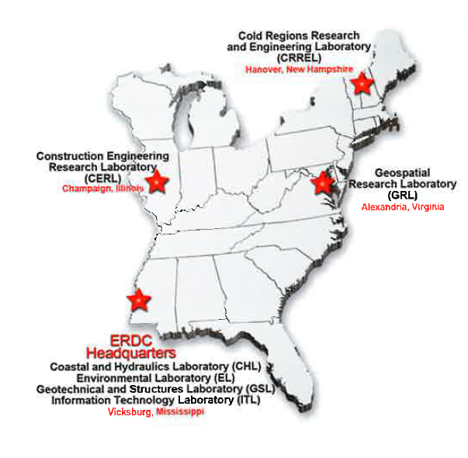
ERDC Labs

Slide 4
Civil Works RD&T
Navigation /Eddie Wiggins
Flood and
Coastal / Julie Rosati
Environmental /
Al Cofrancesco
Dredging Operations and Environmental Research
Todd Bridges
Flood & Coastal Systems
Brandon Boyd
Ecosystem Mgmt & Restoration
Trudy Estes
Coastal Inlets Research
Tanya Beck
Coastal Field Data Collection Jeff Waters
Aquatic Nuisance Species Linda Nelson
Navigation Systems Patty Dijoseph
Coastal Ocean Data Systems Jeff Waters
Aquatic Plant Control Linda Nelson
Regional Sediment Mgmt Katie Brutsché
Water Operations
Technical Support Pat Deliman
Dredging Operations
Technical Support
Burton Suedel
Monitoring Completed
Navigation Projects
Lyn Hales
R&D Program
Technology Program
Demo & Data Program

Slide 5
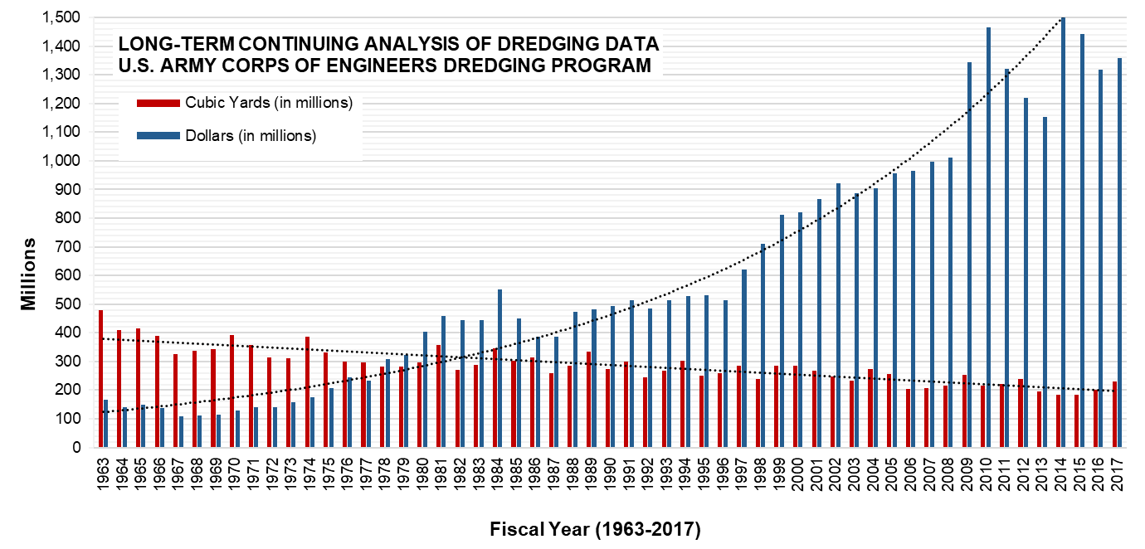
The Corps moves 200 million cu yds of sediment annually…
…at a cost of more than $1 billion per year

Slide 6


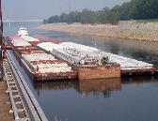
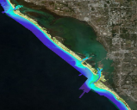
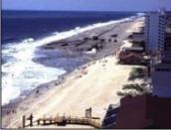
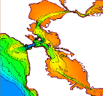
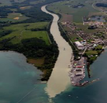
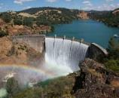
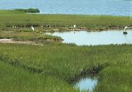
Regional Sediment Management
Established 1999, CERB Charge
“A systems approach using best management practices for more efficient and effective use of sediments in coastal, estuarine, and inland environments for healthier and more resilient systems.”
Recognizes sediment as a valuable resource
Work across business lines, projects, and authorities to create short and long-term economically viable and environmentally sustainable solutions
Improve operational efficiencies and natural exchange of sediments
Consider regional implications of project scale actions and benefits
Apply/Enhance tools and technologies for regional approaches
Share lessons learned, information, data, tools, and technologies
Communicate and collaborate

Slide 7

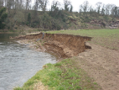
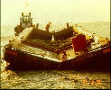
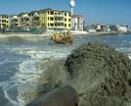
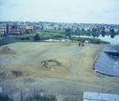

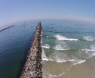

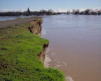
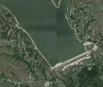
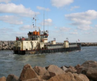
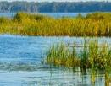

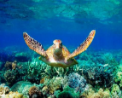
RSM Goals and Strategies
Reduce
Upland/CDF
Disposal
Bypass
Backpass
Sediments
Reduce Erosion
Keep sediments in the system
Mimic natural sediment processes
Reduce unwanted sedimentation
Environmental enhancement
Maintain & protect infrastructure
Stabilize
Structures
Save
Capacity
Reduce
Channel
Shoaling
Reduce
Runoff
Ecosystem
Habitat
Restoration

Slide 8

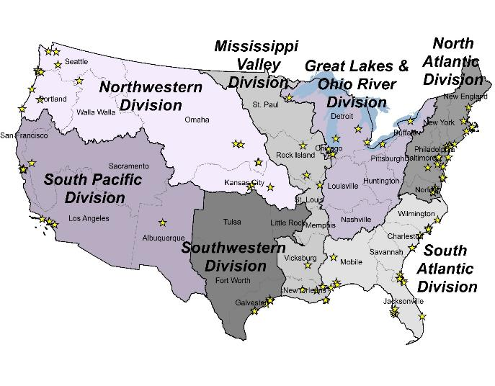

















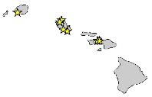
















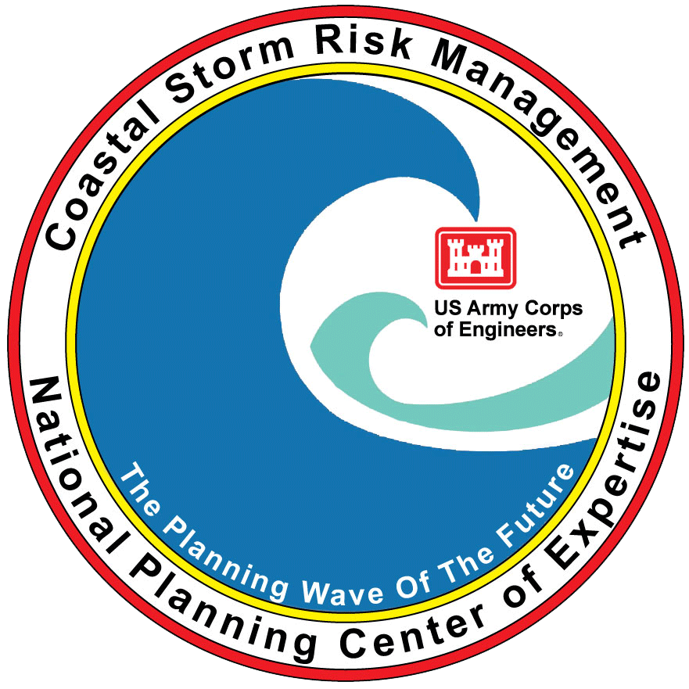

National RSM Program Participation (2000-2019)
>230 Projects and Section 1122
Collaboration
Tools & Technologies
Pacific Ocean
Division
29 Districts
ERDC, IWR, HEC
FSBPA

Slide 9

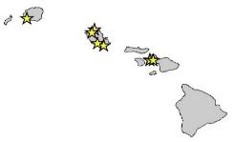


RSM Collaboration: National and Regional Teams
West Coast
RSM Group
Nat’l PCX
Coastal Storm
Risk Mgmt
Coastal Working Group
Great Lakes Tributary
Model Program
RSM Team
EWN Proving
Ground Buffalo
River Engineering Working Group
EWN Proving
Ground Philadelphia
CA Sediment
Management
Work Group
Inland RSM Team
DE Estuary
RSM Team
Joint Airborne
LIDAR Bathymetry
TCX
Nat’l Ecosystem
Restoration PCX
SAD RSM
Regional CX
Pacific Ocean
Division
EWN Proving
Ground Galveston
Pacific Ocean Division
Navigation CoP
Gulf of Mexico
Alliance/RSM
District
Interagency/Stakeholder Working Groups

Slide 10
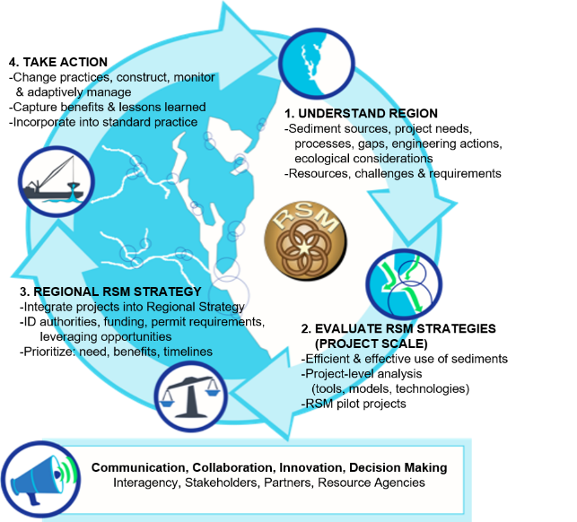
RSM Process

Slide 11
RSM Program Project Types
Research and Development
  Tool Enhancement/Development
  New RSM Strategy Demos
  Evaluating BU Hurdles
  Quantification of BU in the USACE
RSM Implementation Projects
  Sediment Budgets
  Evaluating Innovative RSM Alternatives (Project Specific)
  Creating Regional RSM Strategies
  Optimization
  Stakeholder and Resource Agency Workshops
RSM University
Others
  Great Lakes Coastal Resiliency Study Scope
  WRDA 2016 Section 1122 Pilot Projects

Slide 12
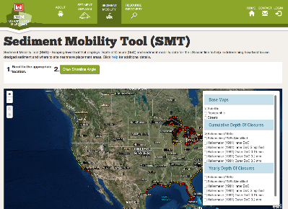
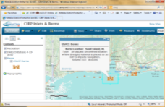
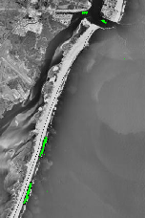
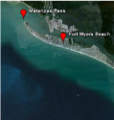
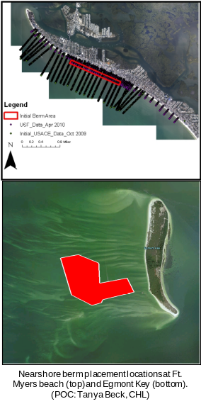
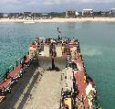
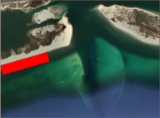




Nearshore Berm Research, Guidance, and Tools
http://navigation.usace.army.mil/SEM/SedimentMobility
SMT
Preliminary tool: educated decisions w/limited data
Estimates
Frequency of sediment mobility
On/Offshore migration direction
Dominant axis of wave direction to estimate alongshore migration
d₅₀ (mm) | Frequency of Mobilization | Predicted Sediment Migration
0.1 | 16 – 38% | 83% Offshore
0.2 | 14 – 30% | 60% Onshore
0.3 | 12 – 26% | 84% Onshore
Assateague
Island, MD
Berm Database
South Padre
Island
Egmont
Vilano
Ft. Myers
Pensacola

Slide 13
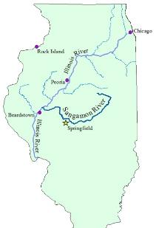
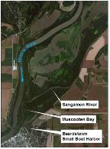
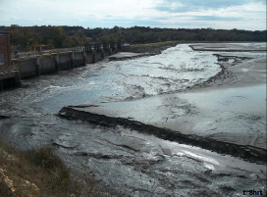
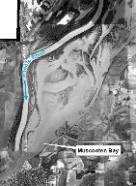
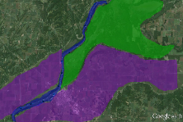
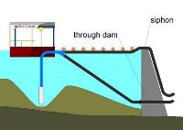
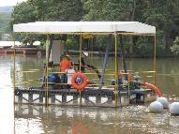
Riverine and Reservoir RSM
Sedimentation Impacts at the Confluence
of the Sangamon and Illinois Rivers
Fall Creek, Cherry Creek, Spencer Dam
Reservoir Flushing
Spencer Dam
ENV
Monitoring and Model Enhancements
Impacts & Benefits Increased
Sediments Below Reservoirs
FRM
NAV
Innovative Reservoir Sediment
Bypassing Techniques
Reduce Sedimentation
Beneficial Use
Shoreline Restoration
Environmental Restoration
Consequences of Channelization
Land Use Impacts
Stakeholder Collaboration

Slide 14
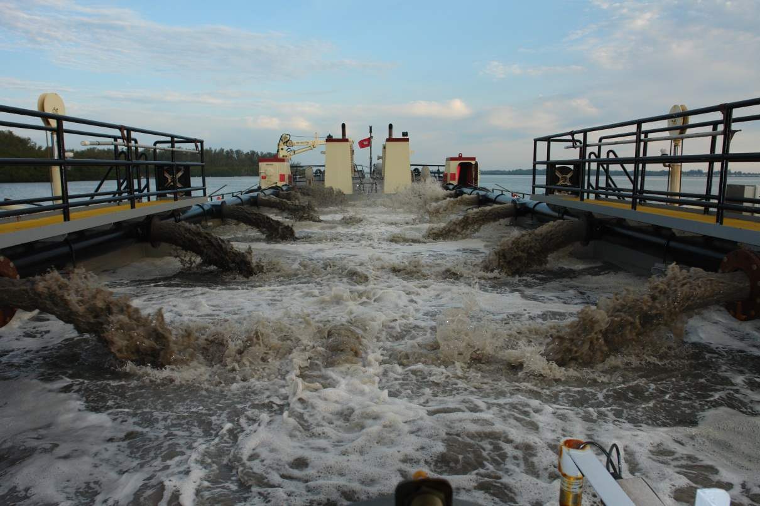
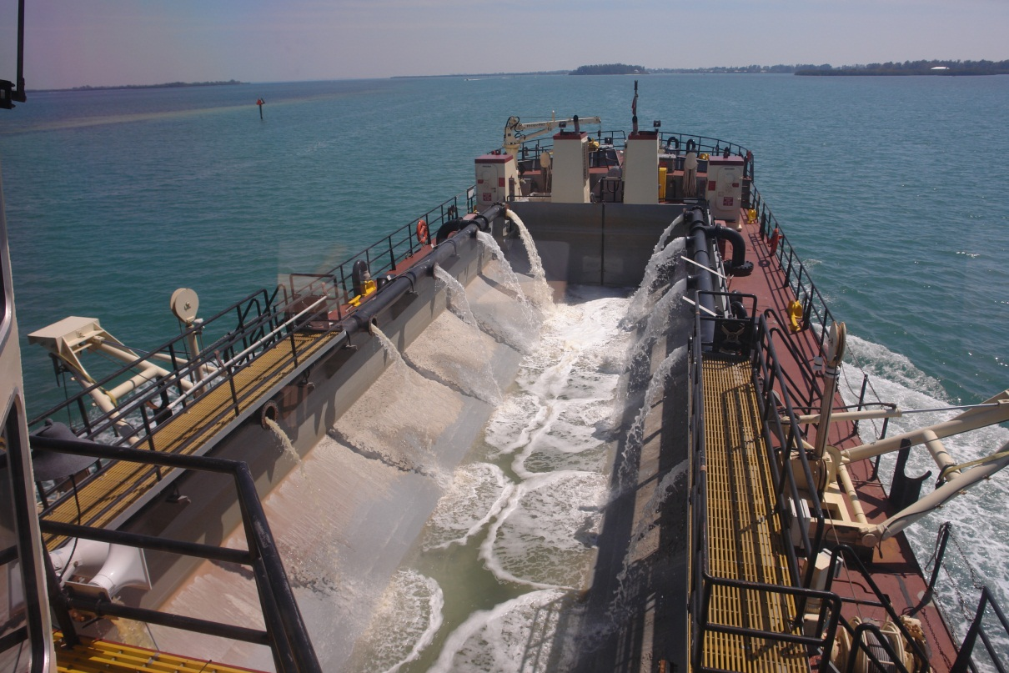
Sediment Sorting during the Dredging and Placement Process
BLUF: The objective of this study is to quantify sediment sorting and the corresponding changes in sediment characteristics during dredging and placement operations. These objectives are motivated by a desire to better inform sediment compatibility analyses and subsequent management of sediment resources.
Challenge/Objectives
Perform extensive literature review of previous studies
Determine best practices for sampling during the dredging process
Quantify changes in sediment sorting through the dredging process
87% of fines removed
70% - overflow
30% - beach outwash
Approach
Complete conceptual model/literature review on sediment sorting through the dredging process
Laboratory testing of weir sampling methods
Field study on dredge to identify loss points and quantify sediment sorting

Slide 15


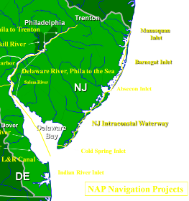
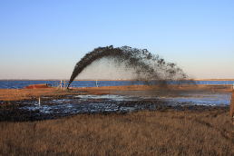


Post Sandy Recovery – New Jersey
Navigation, Environmental Restoration
POC Monica Chasten
Goal
ID alternatives for dredging placement options at multiple sites. The purpose is to use EWN and RSM concepts to develop short-term (post-Sandy) and long-term dredging strategies
Description/Challenges
Post-Sandy, Federal channels in inlets and
waterways require dredging
Regular O&M funds small amounts of dredging
or none at all
Post-Sandy funds have increased available
funding and presented opportunities for action
Objectives
Develop dredging strategies to better
utilize Post-Sandy and future funds to
  Reduce future dredging requirements
  Cross business line approach
  Improve environmental benefits

Slide 16

St. Augustine Inlet, FL and Vicinity
Combining multiple projects (CG, O&M), sand bypassing, shoreline erosion
erosional area
shoaling area
offshore borrow area
inlet bypassing
beneficial use
beach nourishment
$2M cost savings
Reduced dredging/environmental impacts
Combined permit
Emergency sand sources
Notes:
16
The St. Augustine Beaches are in need of renourishment, however, material from the original borrow area (ebb shoal) is currently unavailable due to permit issues. RSM provided SAJ the opportunity to evaluate several local projects within a regional context to find a solution. Sediment sources, erosional areas, project schedules, and funding resources from multiple projects in the vicinity were evaluated to determine how sediment can best be managed among all the projects. The goal is to get sand from the sources to the sinks through inlet bypassing, beneficial use, and beach nourishment.
The effort identified the potential to combine the dredging and placement of the O&M funded maintenance dredging of the Intracoastal Waterway and the CG funded St. Augustine Beach Shore Protection Project. Through coordination with the State of FL, the beach project, and the inlet sponsors the permitting will be combined.
The RSM benefits of combining the O&M and CG projects are the potential cost savings of $5-7 million in dredge mob/demob, lower risk of environmental impact with less dredging, combining permits, and having back-up sources for emergency nourishments as was necessary in 2005 due to the 2004 hurricane season.

Slide 17


RSM Example: Mobile Bay, AL
Navigation and Environmental Restoration, $12M Savings
WRDA86:
Place all dredged sediments in ODMDS
- 4.0 Mcy/yr, Hopper Dredge, 20-Miles
- Tripled maintenance costs
2014 Decision reversed
- ERDC Tools and Technologies
- RSM Interagency Work Group
Fill Brookley
Dredge Hole
$6M annual value
  Thin Layer Placement in Mobile Bay
  Sand Island Beneficial Use Area (SIBUA)
    -Downdrift benefits to Dauphin Island
-Protect lighthouse
Fill dredge holes
  -Brookley Hole, Oyster Holes
  Gaillard Island
  - Biodegradable Containment
  - Marsh Creation
- Brown Pelican
Future in-Bay placement:
Thin Layer Placement
-1000 acre emergent marsh
Gaillard
Island
-Biodegradable
Containment
-Marsh Creation
-Brown Pelican
Fill Mined
Oyster Holes
ODMDS
1, 2, 3, 10, 11, 13
Thin Layer Placement Cells
Sand Island BU
Notes:
Alabama Department of Conservation and
Natural (ADCNR), State Lands Division
ADCNR, Marine Resources Division
Alabama Department of Environmental
Management (ADEM)
Alabama State Port Authority
U.S. Fish and Wildlife Service
NOAA, National Marine Fisheries Service
Alabama/Mississippi Sea Grant
Mobile Bay National Estuarine Program
Others….

Slide 18






Galveston Entrance Channel RSM
Tricia Campbell, Ashley Frey, Andy Morang
Challenge
Funding challenge to maintain Galveston Entrance Channel and upland PAs
Dredge 1.5-2MCY every 18-24 months, $6-8M
Objectives
Solutions to reduce channel sedimentation &
dredging requirements
Allow more flexibility to manage overall project
Coordinate w/PAS Galveston Park Board of
Trustees Galveston Island study 50 yr mgmt plan
Maximum Sediment Saved by Implementing
Each Alternative Individually
Sand-tighten jetties: 113,000 CY/YR
Prevention of wind-blown sand: 21,000 CY/YR
Back-passing plant with spur dikes 150,000 CY/YR
Close boat cut in North Jetty: 160,000 CY/YR
Place PA A material on beach: 300,000 CY/YR
  MAXIMUM POSSIBLE SAVINGS OF ALL ALTERNATIVES:
  690,000 CY/YR* ~ $2.8M/YR (based on $4/CY)
  Park Board Adopted Sand Management Plan 2015
Coastal Modeling System
Coastal Modeling System
Sediment Budget Analysis System
Particle Tracking Model
Particle Tracking Model (PTM)

Slide 19

Seattle District, Ediz Hook Post-dam removal shoreline change analysis
POC: David R. Michalsen, P.E.
BLUF: Two dams on the Elwha River were removed in late 2011, sending a large pulse of sediment into the Elwha River Littoral Cell (ERLC). Ediz Hook located at the downdrift end of the ERLC began a beach nourishment program in 1978 to mitigate for loss of sediment supply from the delta and shoreline armoring. Now that sediment from the ER delta has been restored, we are investigating how this large sediment pulse will affect O&M of Ediz Hook over the next 50-year life cycle
Problem Statement/Issue
Ediz Hook protects the only deep-draft NAV channel on the Strait of Juan de Fuca
USCG has a strategic air station on Ediz Hook for S&R
O&M program partners with City of Port Angeles to renourish Ediz Hook with cobble ~5-10 years. O&M funding and cost-share $$ are not routinely available (deferred maintenance)
Loss of nearshore habitat due to beach coarsening
Approach to Address Problem
Determine if O&M demands will decrease & if so when will this occur?
Can sand/gravel vs. cobble be utilized in future nourishment(s) to increase habitat value?
  Develop sediment budget over ERLC
  Perform shoreline change modeling to help guide future management decisions

Slide 20

Great Lakes Coastal Resiliency Scoping Study
The Great Lakes Coastal Resiliency Study (GLCRS) is a collaborative effort by 8 Great Lakes states, Corps of Engineers, NOAA, USGS, FEMA, and USEPA to improve the resiliency of the Great Lake coastline. To protect the immense economic, environmental and social value of the Great Lakes shoreline, this study will identify areas vulnerable to severe storms.

Slide 21

WRDA 2016 Section 1122 BU Pilot Projects
Section 1122 of WRDA of 2016 requires the USACE to establish a pilot program to carry out ten projects for the beneficial use of dredged material
RSM is currently funding the Project Implementation Plan phase

Slide 22



Historical Navigation Sediment Utilization:
Where, when, volume of sediments placed beneficially? Where can we improve?
District Data 1998-2017
Coastal/Inland Navigation Projects
210 Mcy/yr Total
51% placed beneficially
10 Mcy/yr placed on beaches
2.5 Mcy/yr Unknown

Slide 23
Common Beneficial Use Roadblocks
Risk aversion
Fear of the unknown
  “We’ve been doing it like this for 30 years, why change?”
Timing
  Lining up dredging with a receiving site
Cost
Any others?

Slide 24
Paths forward
Consistent communication
  Have a collaborative RSM plan from beginning
  Create Interagency Working Groups
Quantify/illustrate benefits
  What is the cost of no action?
Creative and innovative concepts
Pilot projects to help alleviate risk
  Educated decision making
  Scale up to larger projects
Find cost effective alternatives
  Cost sharing opportunities
Any others?

Slide 25
How do I get involved?
Work with your District on creating proposals that might help you manage your sediment more efficiently
Join an Interagency RSM Team in your District
Participate in stakeholder workshops

Slide 26











Regional Sediment Budgets
Local Actions=Regional Benefits
Regional Sediment Management
= Resilient Healthy Systems
RSM@usace.army.mil
Katherine.E.Brutsche@usace.army.mil
ODMDS
Regional Strategies
Riverine &
Reservoir Mgmt
Data Management and Access
Ecosystem/Aquatic Habitat
Improved Relationships
Outreach & Training

