Slide 1
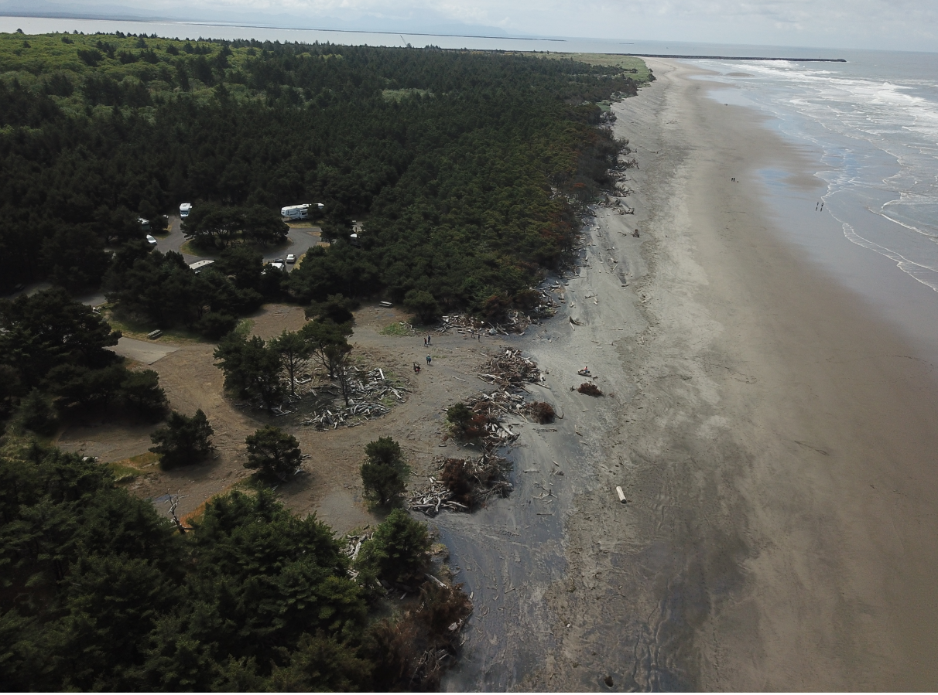
PARK
AT
RISK
FIGHT
OR
SURRENDER
ONLY
ONE
REALISTIC
SOLUTION!

Slide 2
DIRECT BEACH PLACEMENT

Slide 3
DIRECT BEACH PLACEMENT
3.25 Mm3 of sand is lost each year from the Benson Beach
No Primary DUNE left – expect that rate to increase

Slide 4
DECISION TIME
IS THE PARK
WORTH SAVING
SIMPLE
YES OR NO

Slide 5
YES OR NO
LCSG
SAVE IT
OR LET IT GO

Slide 6
YES OR NO
NEARSHORE DISPOSAL
IS A
DECISION
TO
LET THE PARK GO

Slide 7
YES OR NO
DIRECT BEACH PLACEMENT
IS A
DECISION
TO
SAVE THE PARK

Slide 8
The Fishing Perspective BENSON BEACH – Save the Park
Dredging is a necessary to maintain not only deepdraft transportation but also Fishing’s access to the sea – FISHING IS DREDGE DEPENDENT
Fishing depends 100% on a PFH – PROPERLY FUNCTIONING HABITAT
OUR PRIMARY GOAL IN DREDGING IS TO MAINTAIN CHANNELS WITH THE LEAST IMPACT TO HABITAT REASONABLY POSSIBLE – OUR INTEREST IN BENSON BEACH DISPOSAL
NO DEAD SAILORS
NO DEAD CRAB
MOST EFFECTIVE USE OF SEDIMENTS TO MAINTAIN OUR COAST LINE POSITIONING
CRCFA IS ENCOURAGED BY THE NEW SCIENCE BEING DEVELOPED AT THE MCR
beneficial USE OF SEDIMENTS HELPS FISH DEPENDENT COMMUNITIES
THRIVE NOT JUST SURVIVE

Slide 9
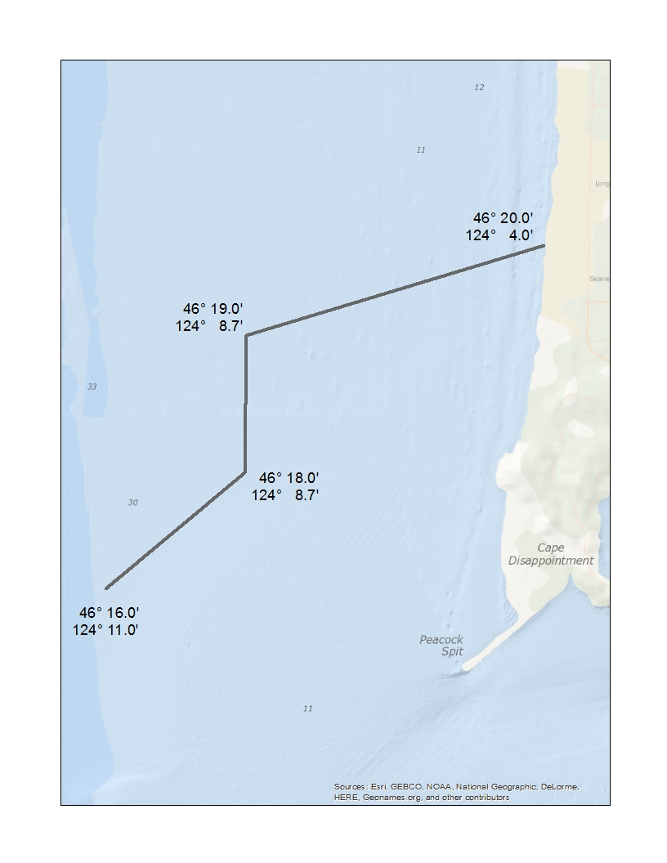
Mudhole
IGNORED
Tradeoff
Ignored
Original Proposal
Near Shore for
Closing outer portion of SWS
MUDHOLE

Slide 10
Building
TRUST
LCSG Beneficial Use RSM program
Science Based
Slow
Deliberate Steps
Builds TRUST
Even in Nearshore

Slide 11
The 3rd Cape D Technical Forum
Slide from 2009 Presentation
Job 1
Reduce the RISK of FATALITY
INCREASE SAFETY
Realize “least cost” Disposal must include
LIFE SAFETY
-----------------------------------------
LCSG – Good Job addressing
safety – No Nearshore Mounding
No recent Additional fatalities
Need to Ensure Annual post disposal bathymetry

Slide 12

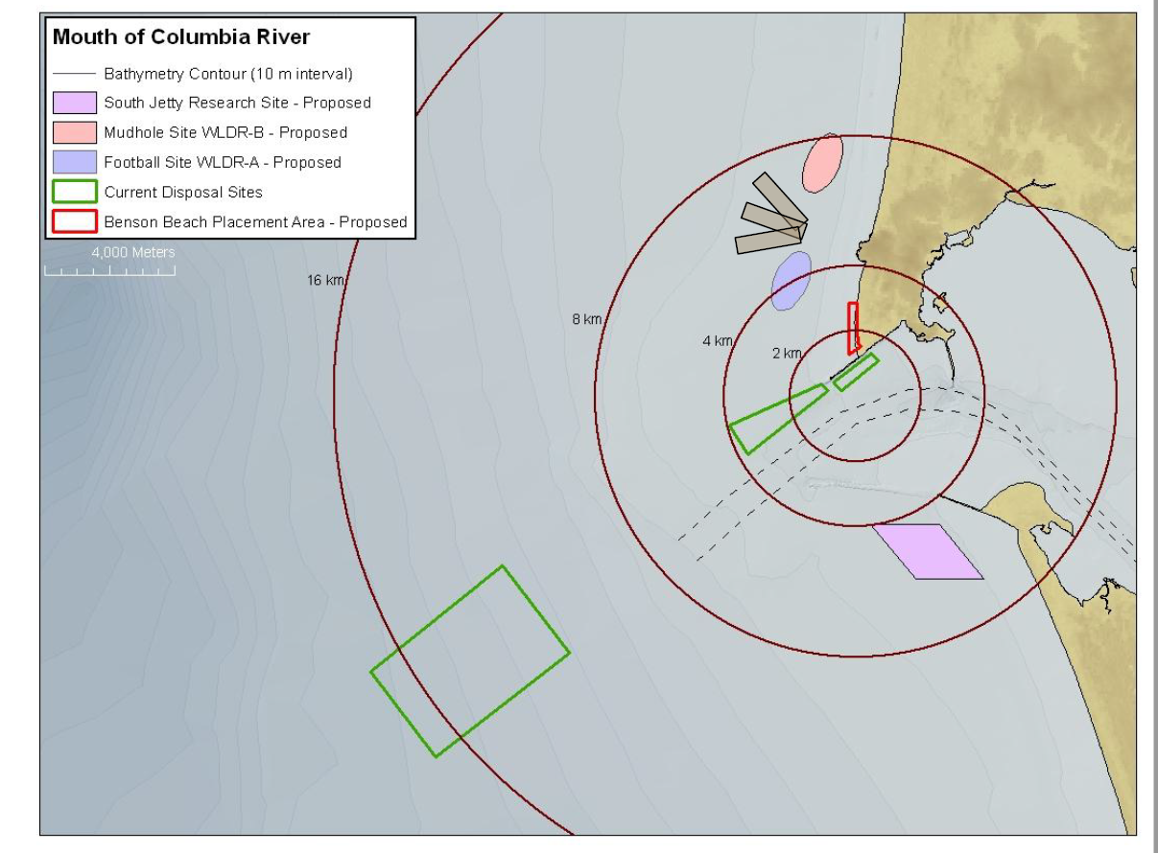



Mudhole
Within
Current DWS Haul
Distance
Average SJS & NHS Haul Distances
Haul Distances
Changed
Mudhole line not to scale
0 - RM

Slide 13
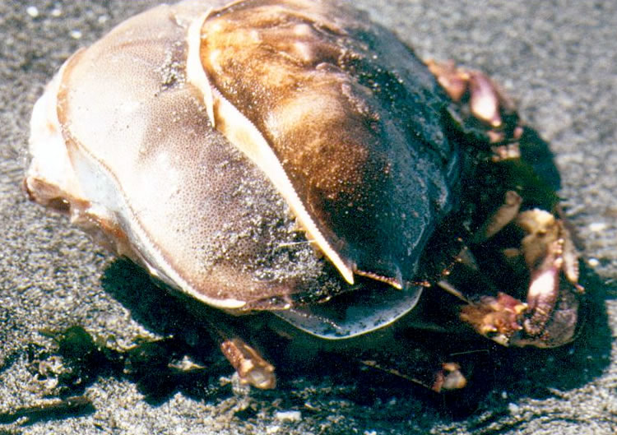
Molting Crab
Vulnerable
Even Enhanced Disposal NEEDS
Biologic Timing
AOID MOLT
Earlier or Later is Better

Slide 14
BENSON BEACH
STATE PARK AT RISK

Slide 15
BENSON BEACH
STATE PARK AT RISK
Nothing Stopping the Sea

Slide 16
2007 Cape D Technical Forum
Best use of sediment
BEST SAND CAPTURE MECHANISM
Unanimous consent by all prominent coastal engineers and scientist
On the beach or in the adjacent surf zone
Nothing has changed – Direct Beach Placement = Best Option

Slide 17

North Head Site
More Beneficial than the Deepwater Site to Littoral Drift
However the EFFECTS ARE NOT MEASURABLE ON THE BEACH
Park Still at RISK

Slide 18
Review Costs and Opportunities
Review new Congressional Mandates of 2007 & 2014 WRDA’s
New Congressional Mandates
Least Cost Option has Changed
Cost of original Benson Beach Disposal bid for the 2010 250,000 cy
Within 10 cents/yard of hauling to Deepwater Site

Slide 19
Sediment on Benson Beach
BENEFITS & adds protection for the North Jetty
Protects large investment in North Jetty rebuild
Protects popular state park from disappearing
Direct MEASURABLE Benefit to nearshore littoral drift and coastal erosion abatement

Slide 20
Congress is working on a new government dredge
with pump ashore capability
Congress recognizes Direct Beach Placement NEED

Slide 21
LEAST COST OPTION
MAKE PERMANENT PUMP ASHORE INFRASTRUCTURE
LEAVE PIPE BURIED ON THE BEACH
PUMP ASHORE ANNUALLY TO MAINTAIN BEACH EQUILIBRIUM
SAND CAPTURE MECHANISM IS A MUST
Reduces Mobe DeMobe Costs Dramatically

Slide 22
PARK
AT
RISK
FIGHT
OR
SURRENDER
ONLY
ONE
REALISTIC
SOLUTION!

Slide 23
PARK
AT
RISK
FIGHT
OR
SURRENDER
COASTAL
SEDIMENT
RIGHTS

Slide 24
THANK YOU
CONTINUE TO ADDRESS LIFE SAFETY
&
CRAB SURVIVABILITY
As
LCSG continues to address
GROWING
COASTAL EROSION PROBLEM
SAVE the PARK

