Slide 1
Summary of Initial dredged material placement operations at north head site (NHS) & evaluation of bathymetry response
An Interim Progress Report to MCR Stakeholders
Astoria, Oregon
Portland District
7 DEC 2018

Slide 2
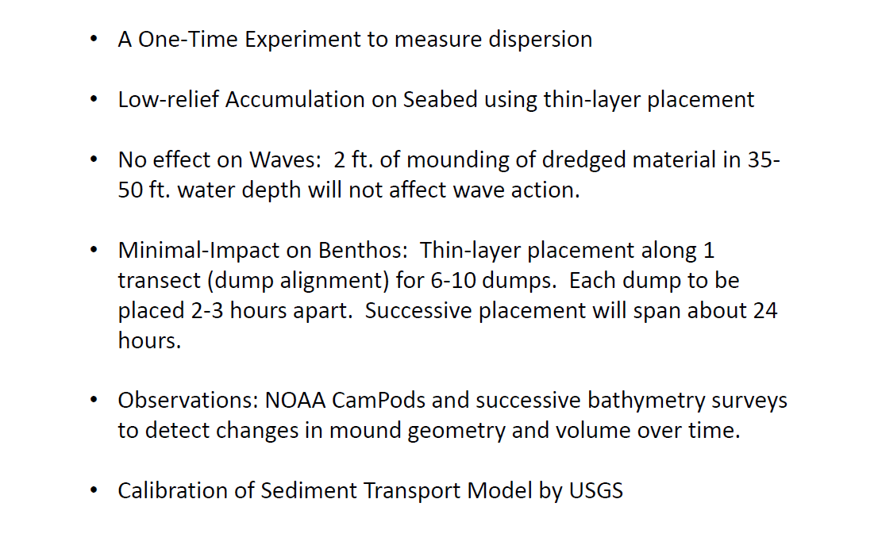
Review of Intended Concept: Presented in MAY 2018

Slide 3
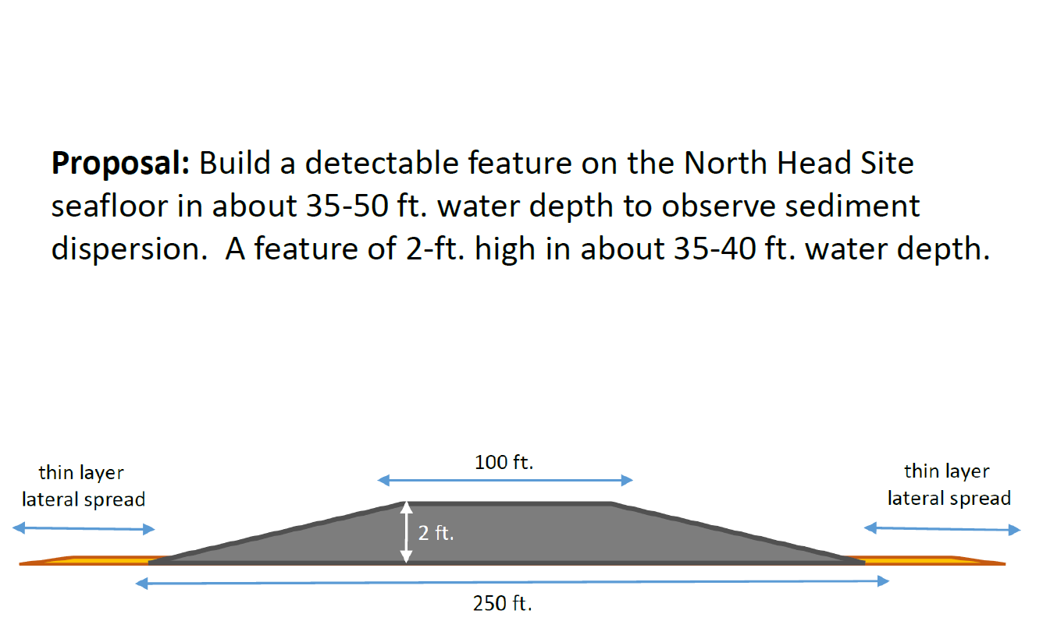
Review of Intended Concept: Presented in MAY 2018

Slide 4
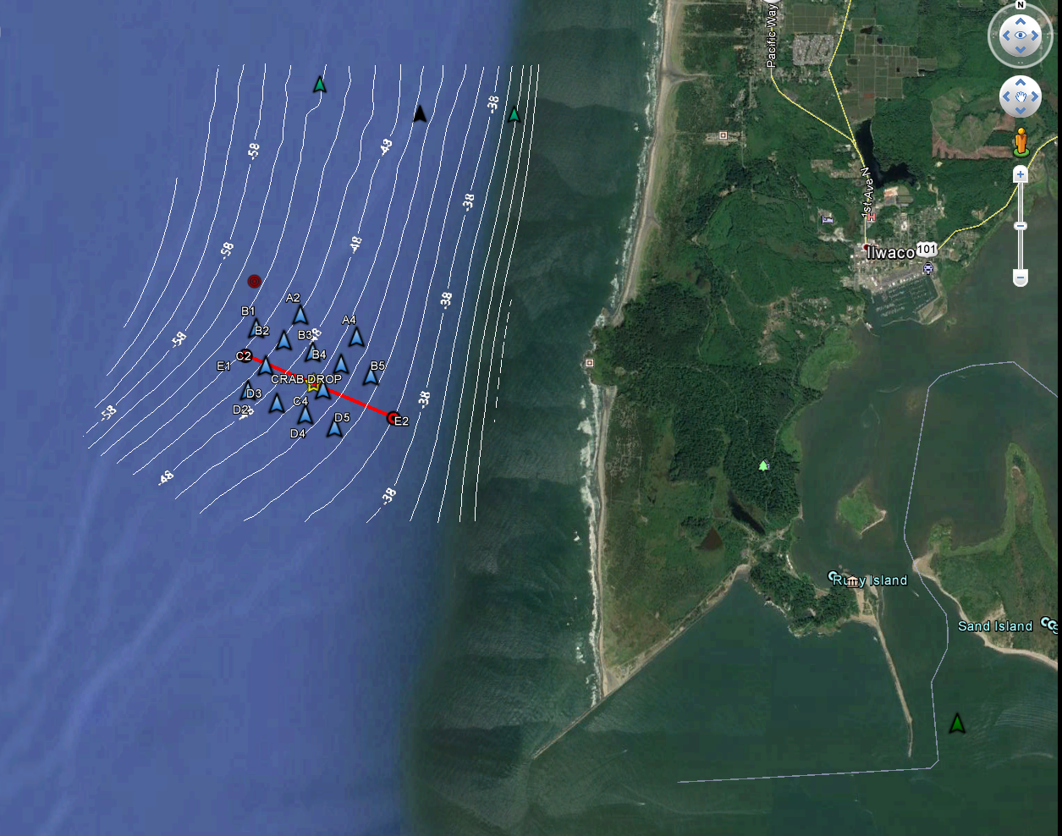
NORTH HEAD STUDY AREA
Pacific
Ocean
North Head
Benson Beach
Peacock Spit
Mouth of Columbia River

Slide 5
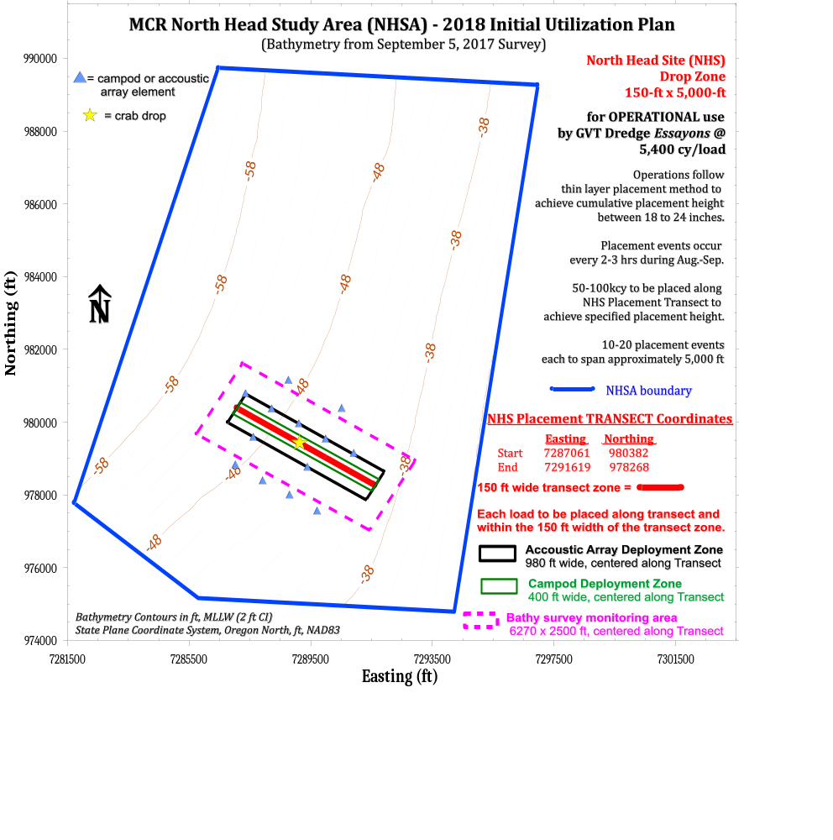

Slide 6
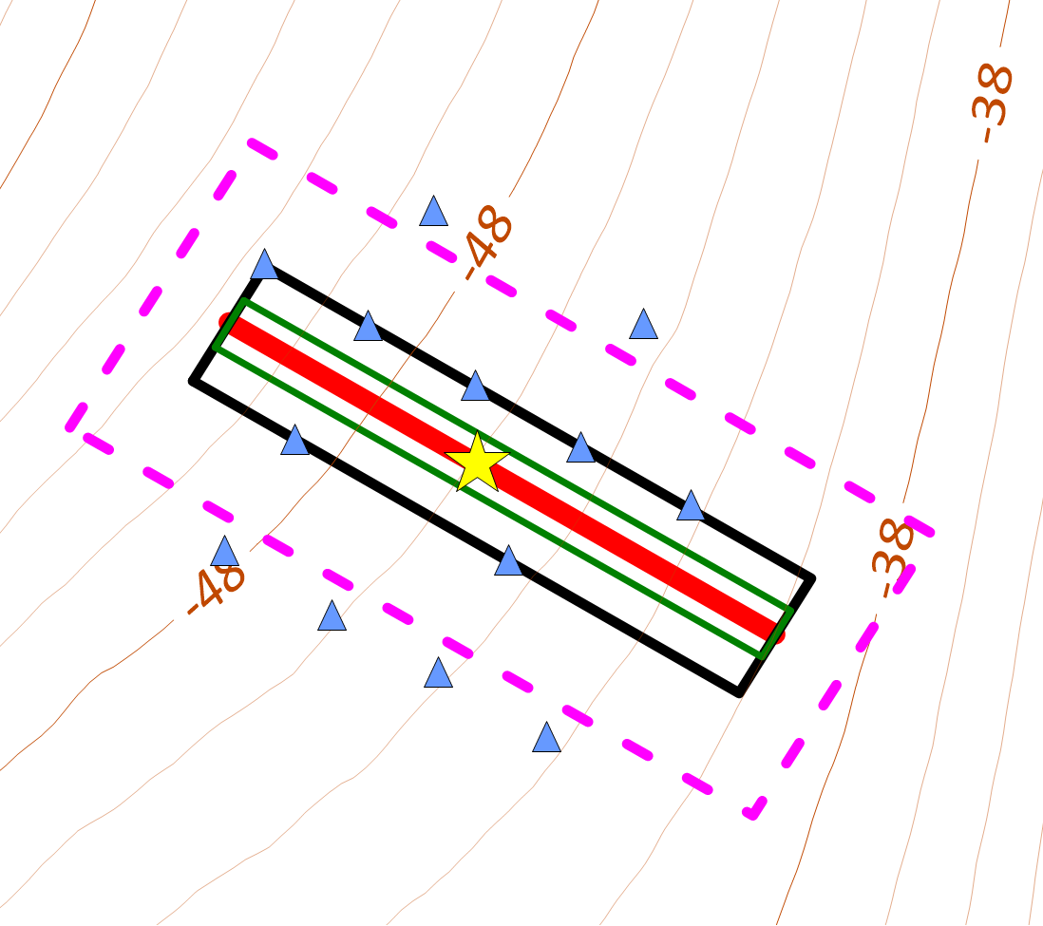

Slide 7
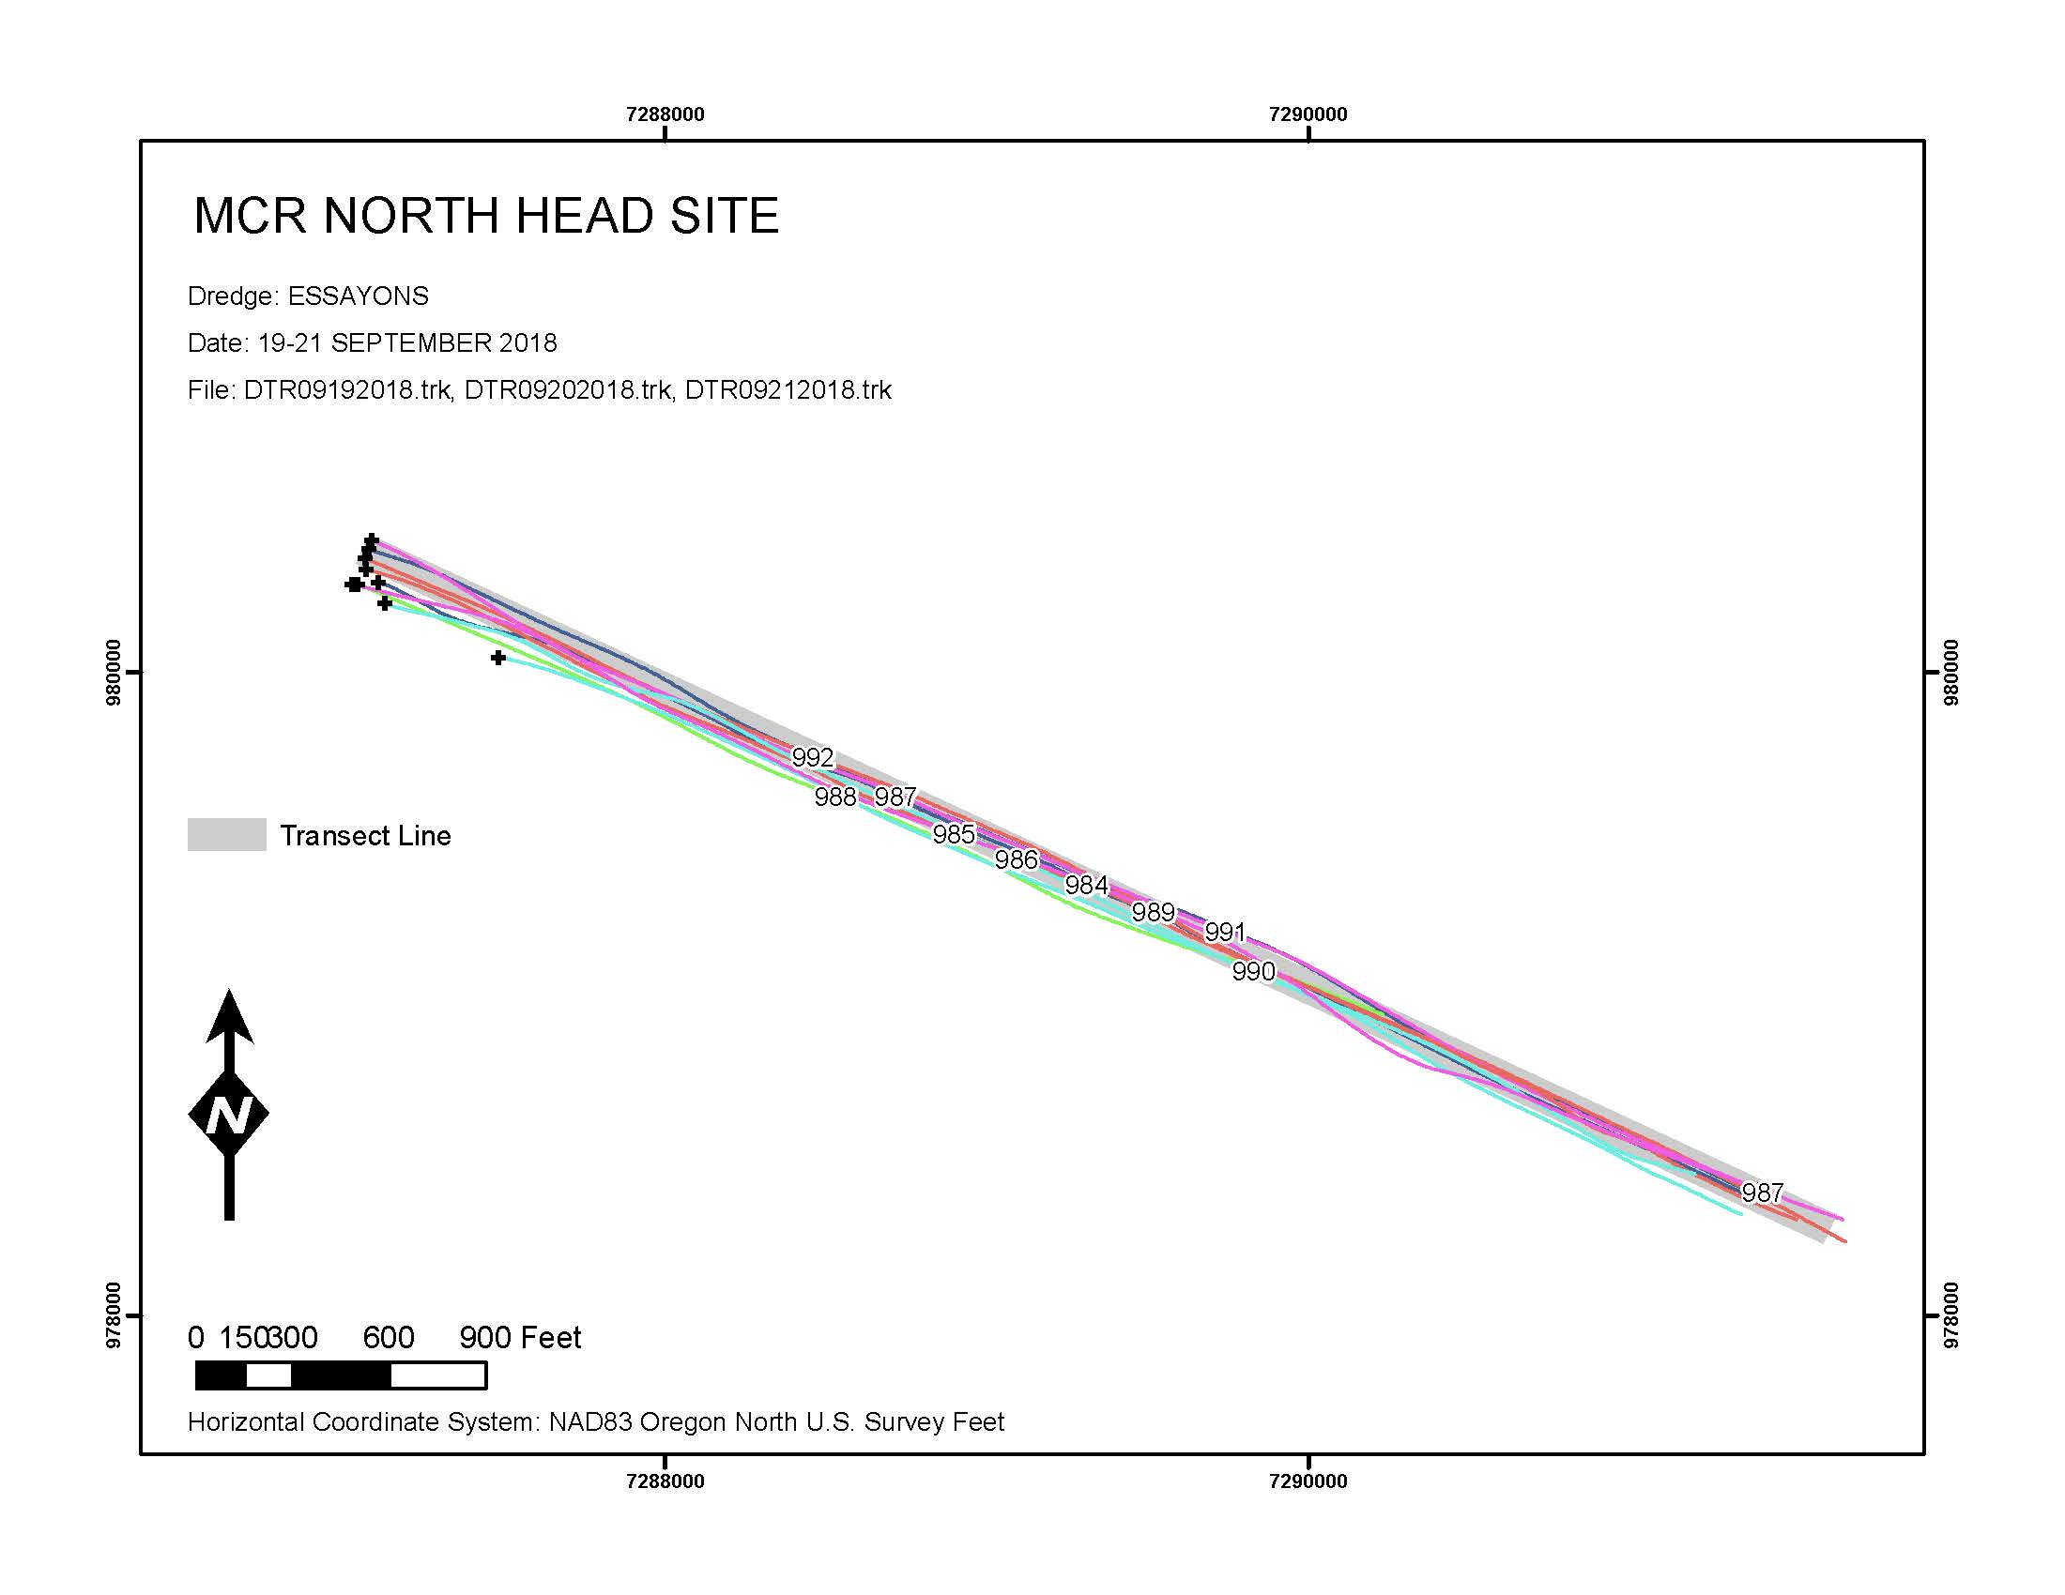
19-21 SEP 2018
Hopper Dredge Tracklines
During Placement Operations
9 loads placed along
prescribed 150-ft wide transect zone
150 ft wide
transect zone

Slide 8
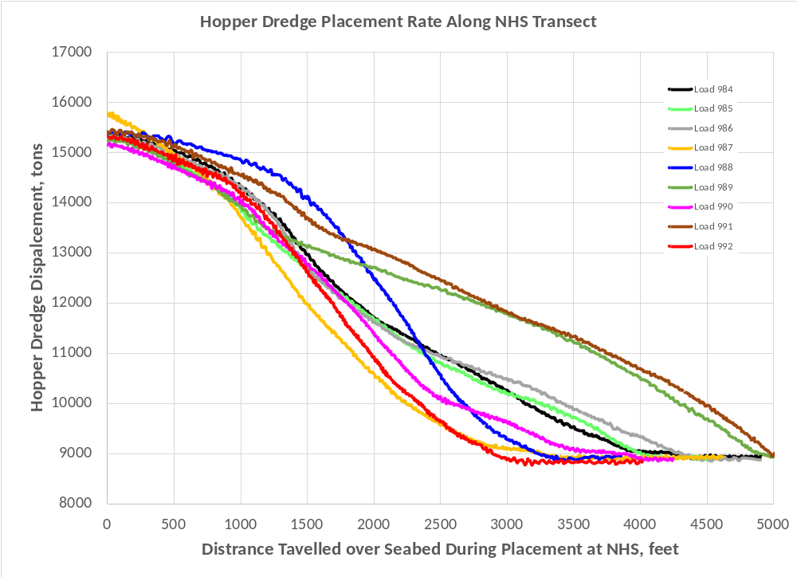
23 min
21 min
18 min
23 min
17 min
18 min
22 min
20 min
19 min
FULL Hopper Load (5000 CY)
EMPTY Hopper Load (0 CY)
START Dump
END Dump

Slide 9
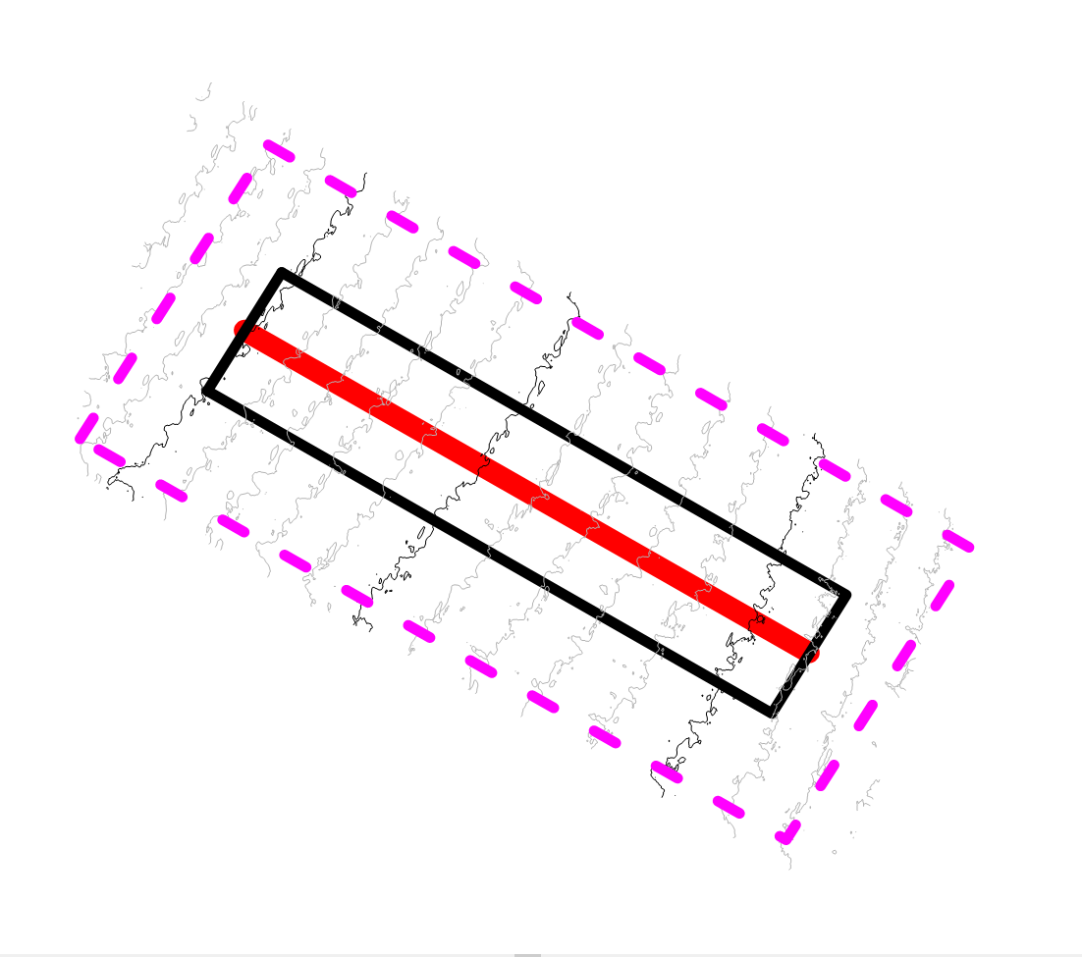
30 days BEFORE initial placement
-51 ft MLLW
-46 ft MLLW
20 AUG 2018
-41 ft MLLW

Slide 10
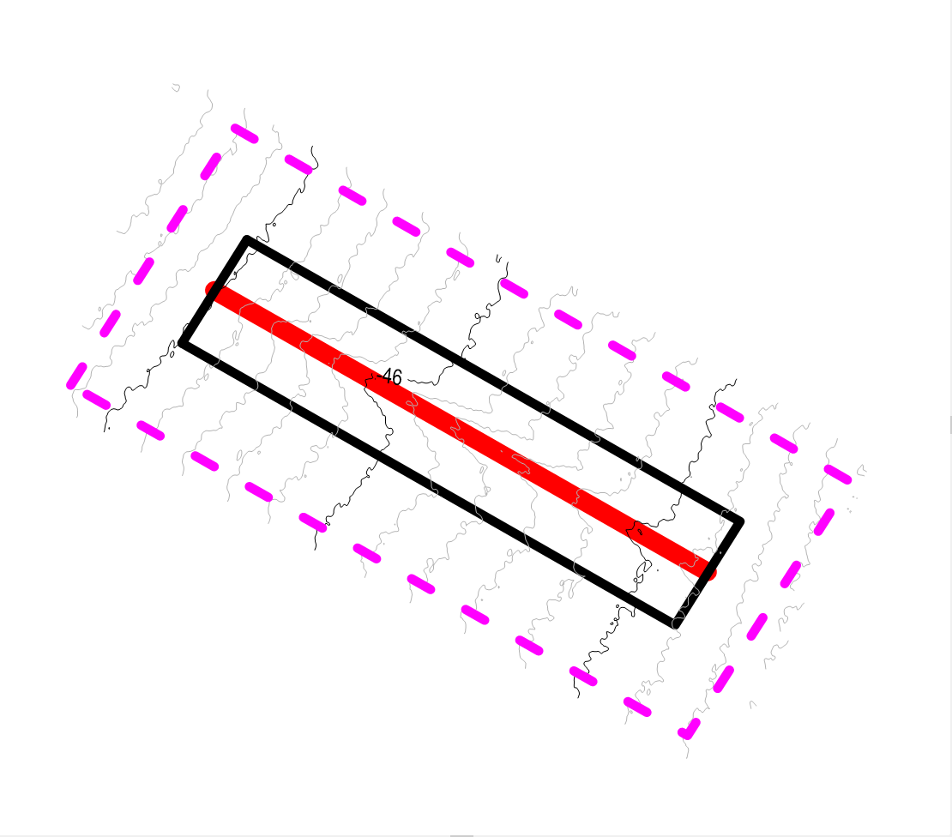
0 day AFTER placement
9 loads placed during 19-20 SEP = 51,000 CY
by hopper dredge Essayons (~5,500 cy/load)
material = fine-medium sand dredged from
MCR-FNC (dia=0.15 – 0.35 mm)
-51 ft MLLW
-46 ft MLLW
21 SEP 2018
-41 ft MLLW

Slide 11
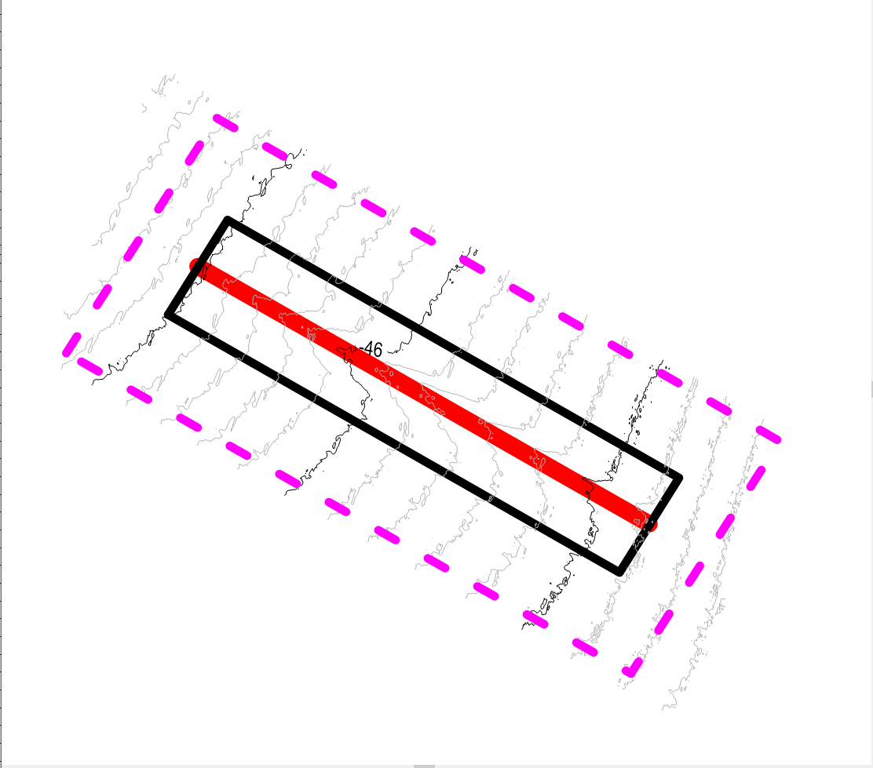
7 days AFTER placement
-51 ft MLLW
-46 ft MLLW
27 SEP 2018
-41 ft MLLW

Slide 12

22 days AFTER placement
-51 ft MLLW
-46 ft MLLW
11 OCT 2018
-41 ft MLLW

Slide 13
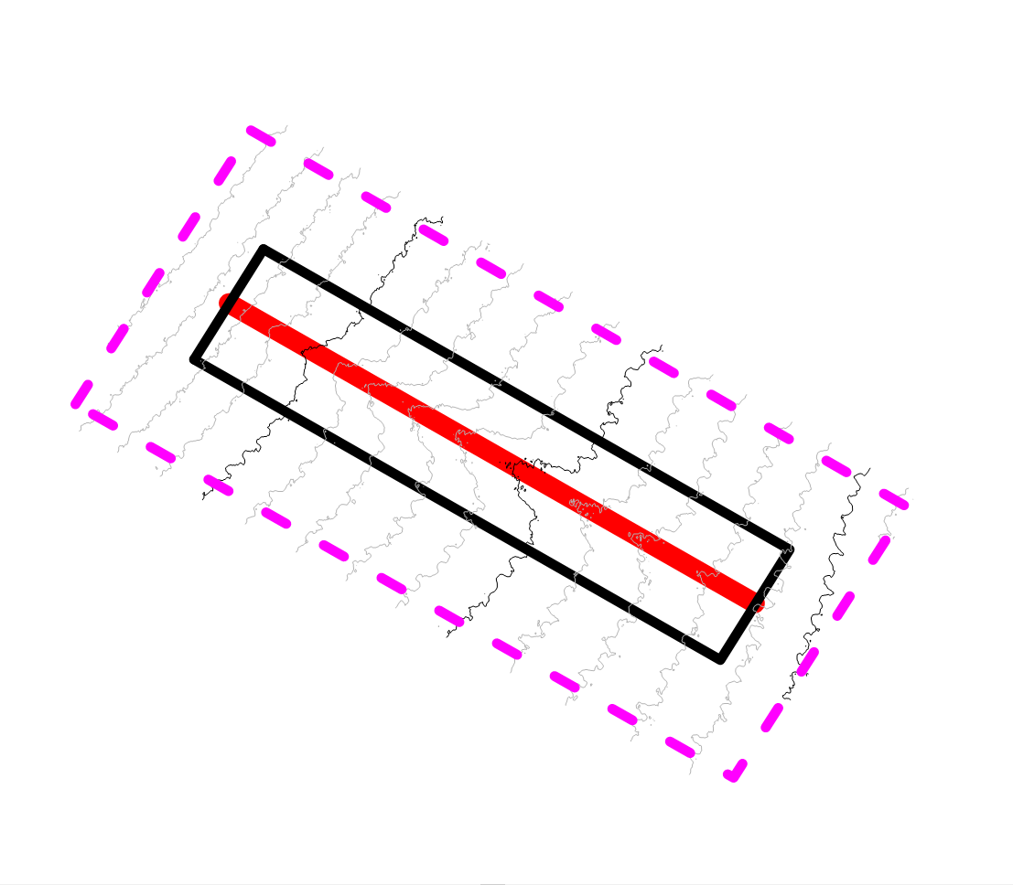
61 days AFTER placement
17 Kcy on Seabed within “mound” feature
32 Kcy eroded off of mound feature
during 21 SEP – 20 NOV
-51 ft MLLW
-46 ft MLLW
-41 ft MLLW
20 NOV 2018

Slide 14
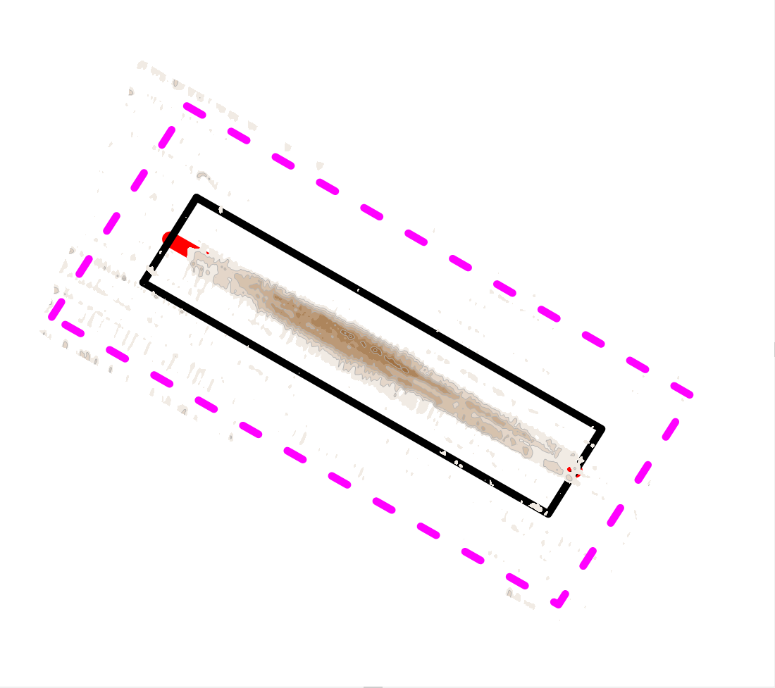
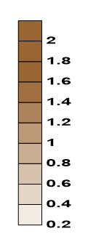
0 day AFTER placement - 51,000 CY placed
49 Kcy on Seabed within “mound” feature
Deposition, ft
Survey Difference
20 AUG-21 SEP 2018
Max mound height = 1.9 ft with respect to 20 AUG seabed

Slide 15
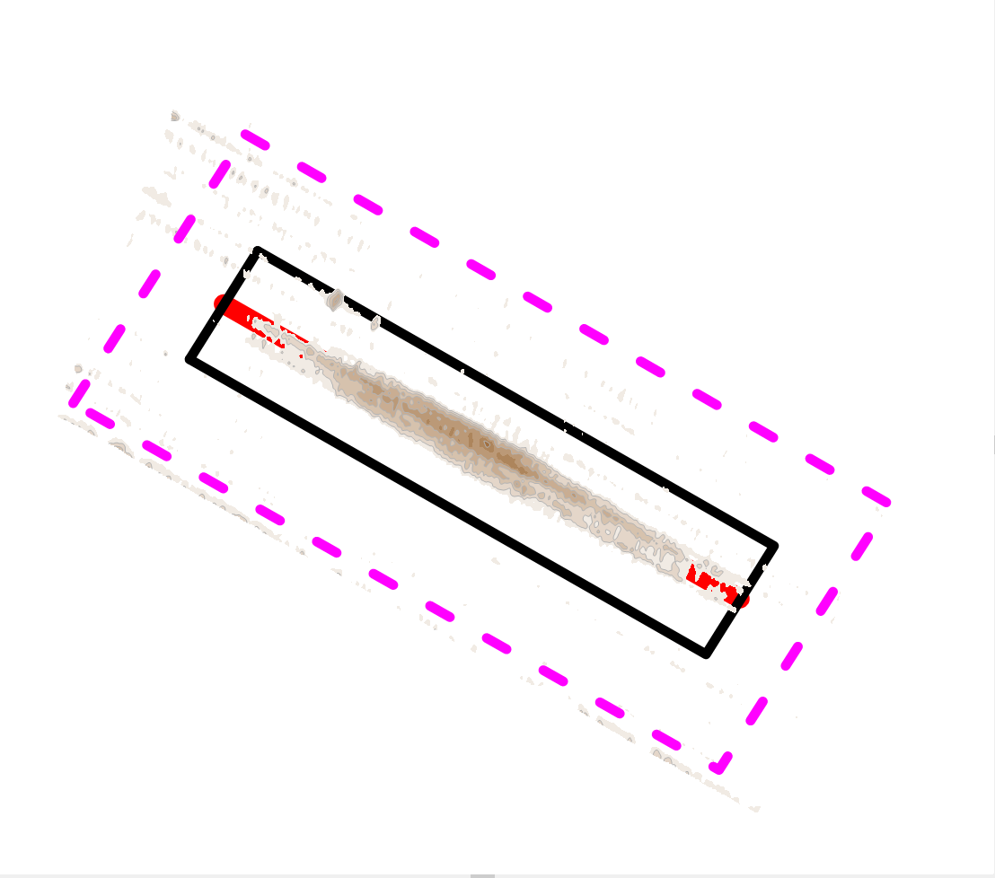
7 days AFTER placement - 51,000 CY initially placed
37 Kcy on Seabed within “mound” feature
12 Kcy eroded off of mound feature
during 21 SEP – 27 SEP
Deposition, ft
Survey Difference
20 AUG-27 SEP 2018
Max mound height = 1.5 ft with respect to 20 AUG seabed

Slide 16
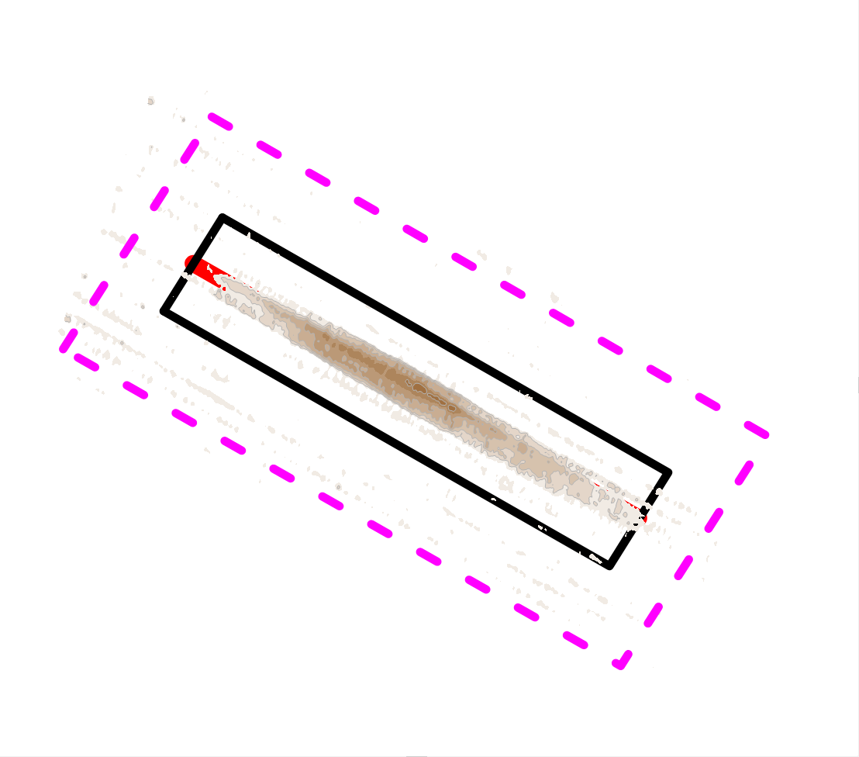
22 days AFTER placement - 51,000 CY initially placed
46 Kcy on Seabed within “mound” feature
9 Kcy deposited on bathymetry
during 27 SEP – 11 OCT
1 Kcy net erosion from 21 SEP
Deposition, ft
Survey Difference
20 AUG-11 OCT 2018
Max mound height = 1.5 ft with respect to 20 AUG seabed

Slide 17
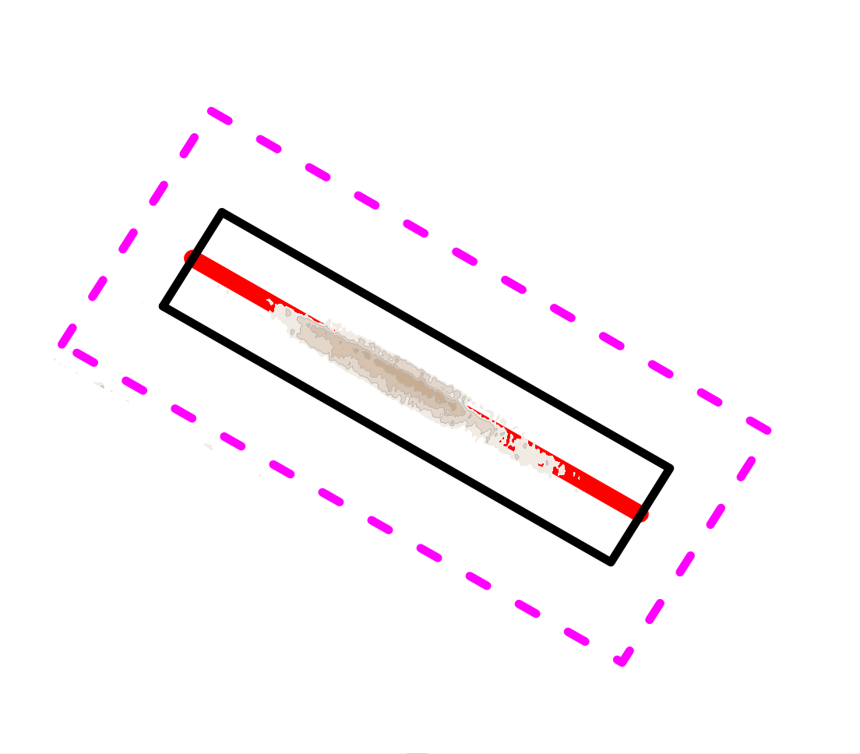
61 days AFTER placement - 51,000 CY initially placed
17 Kcy on Seabed within “mound” feature
29 Kcy eroded off mound feature
during 11 OCT – 20 NOV
32 Kcy net erosion from 21 SEP
Deposition, ft
Survey Difference
20 AUG-20 NOV 2018
Max mound height = 1.0 ft with respect to 20 AUG seabed

Slide 18
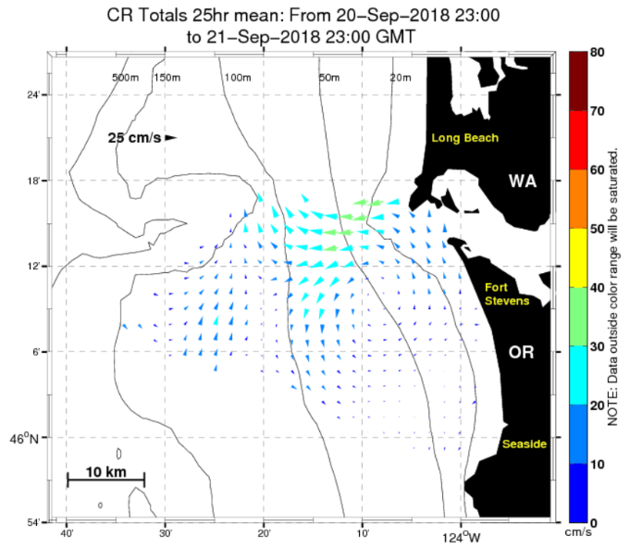
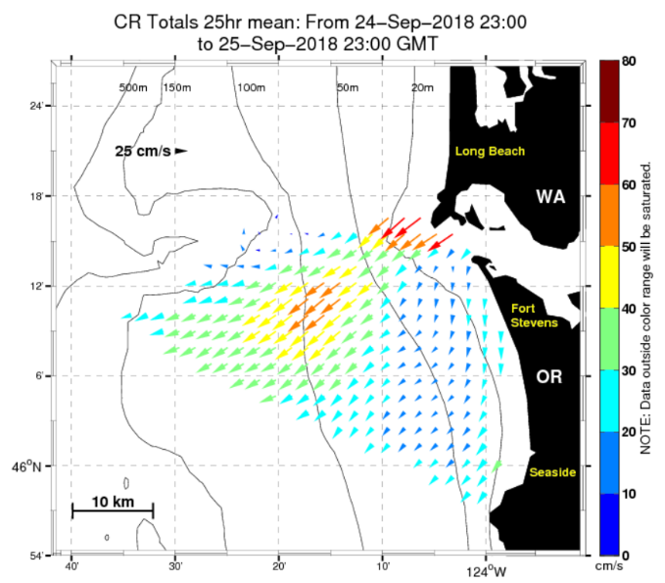
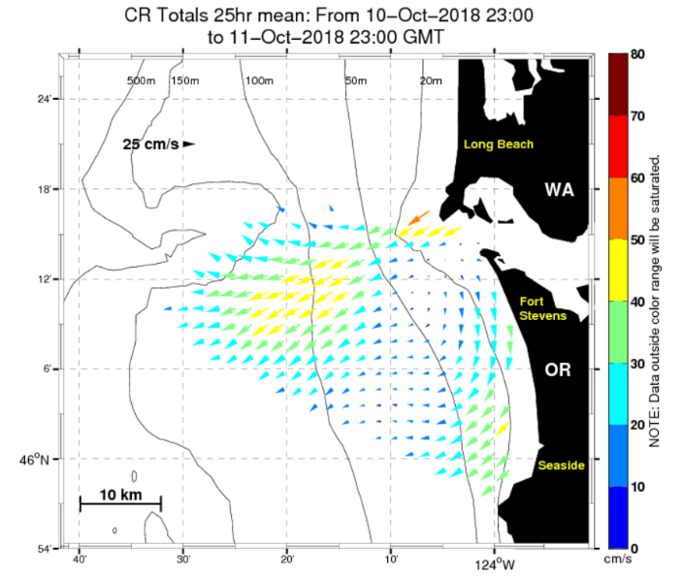
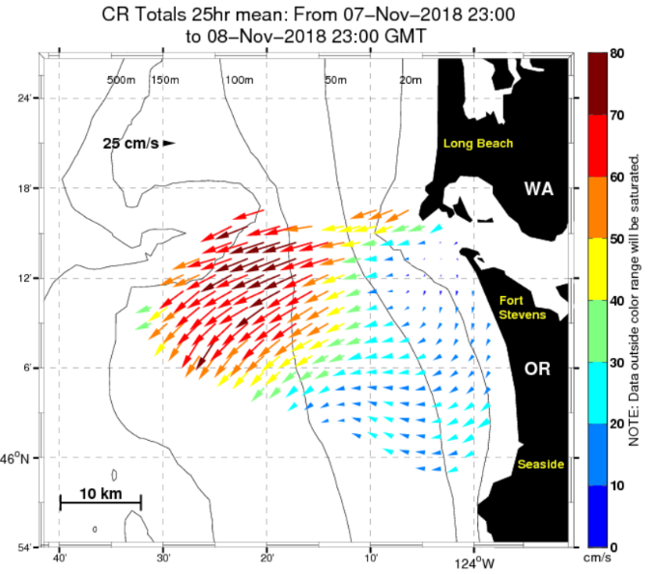
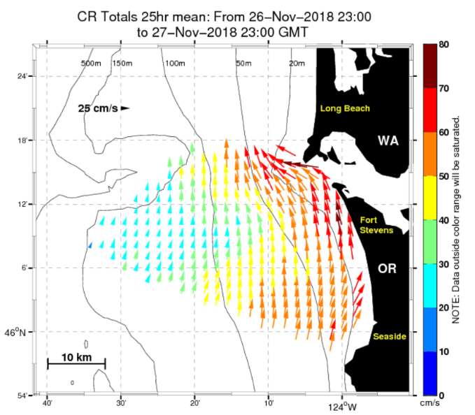
NHS
Placement
SURFACE CURRENTS
21-SEP
survey
27-SEP
survey
11-OCT
survey
20-NOV
survey

Slide 19
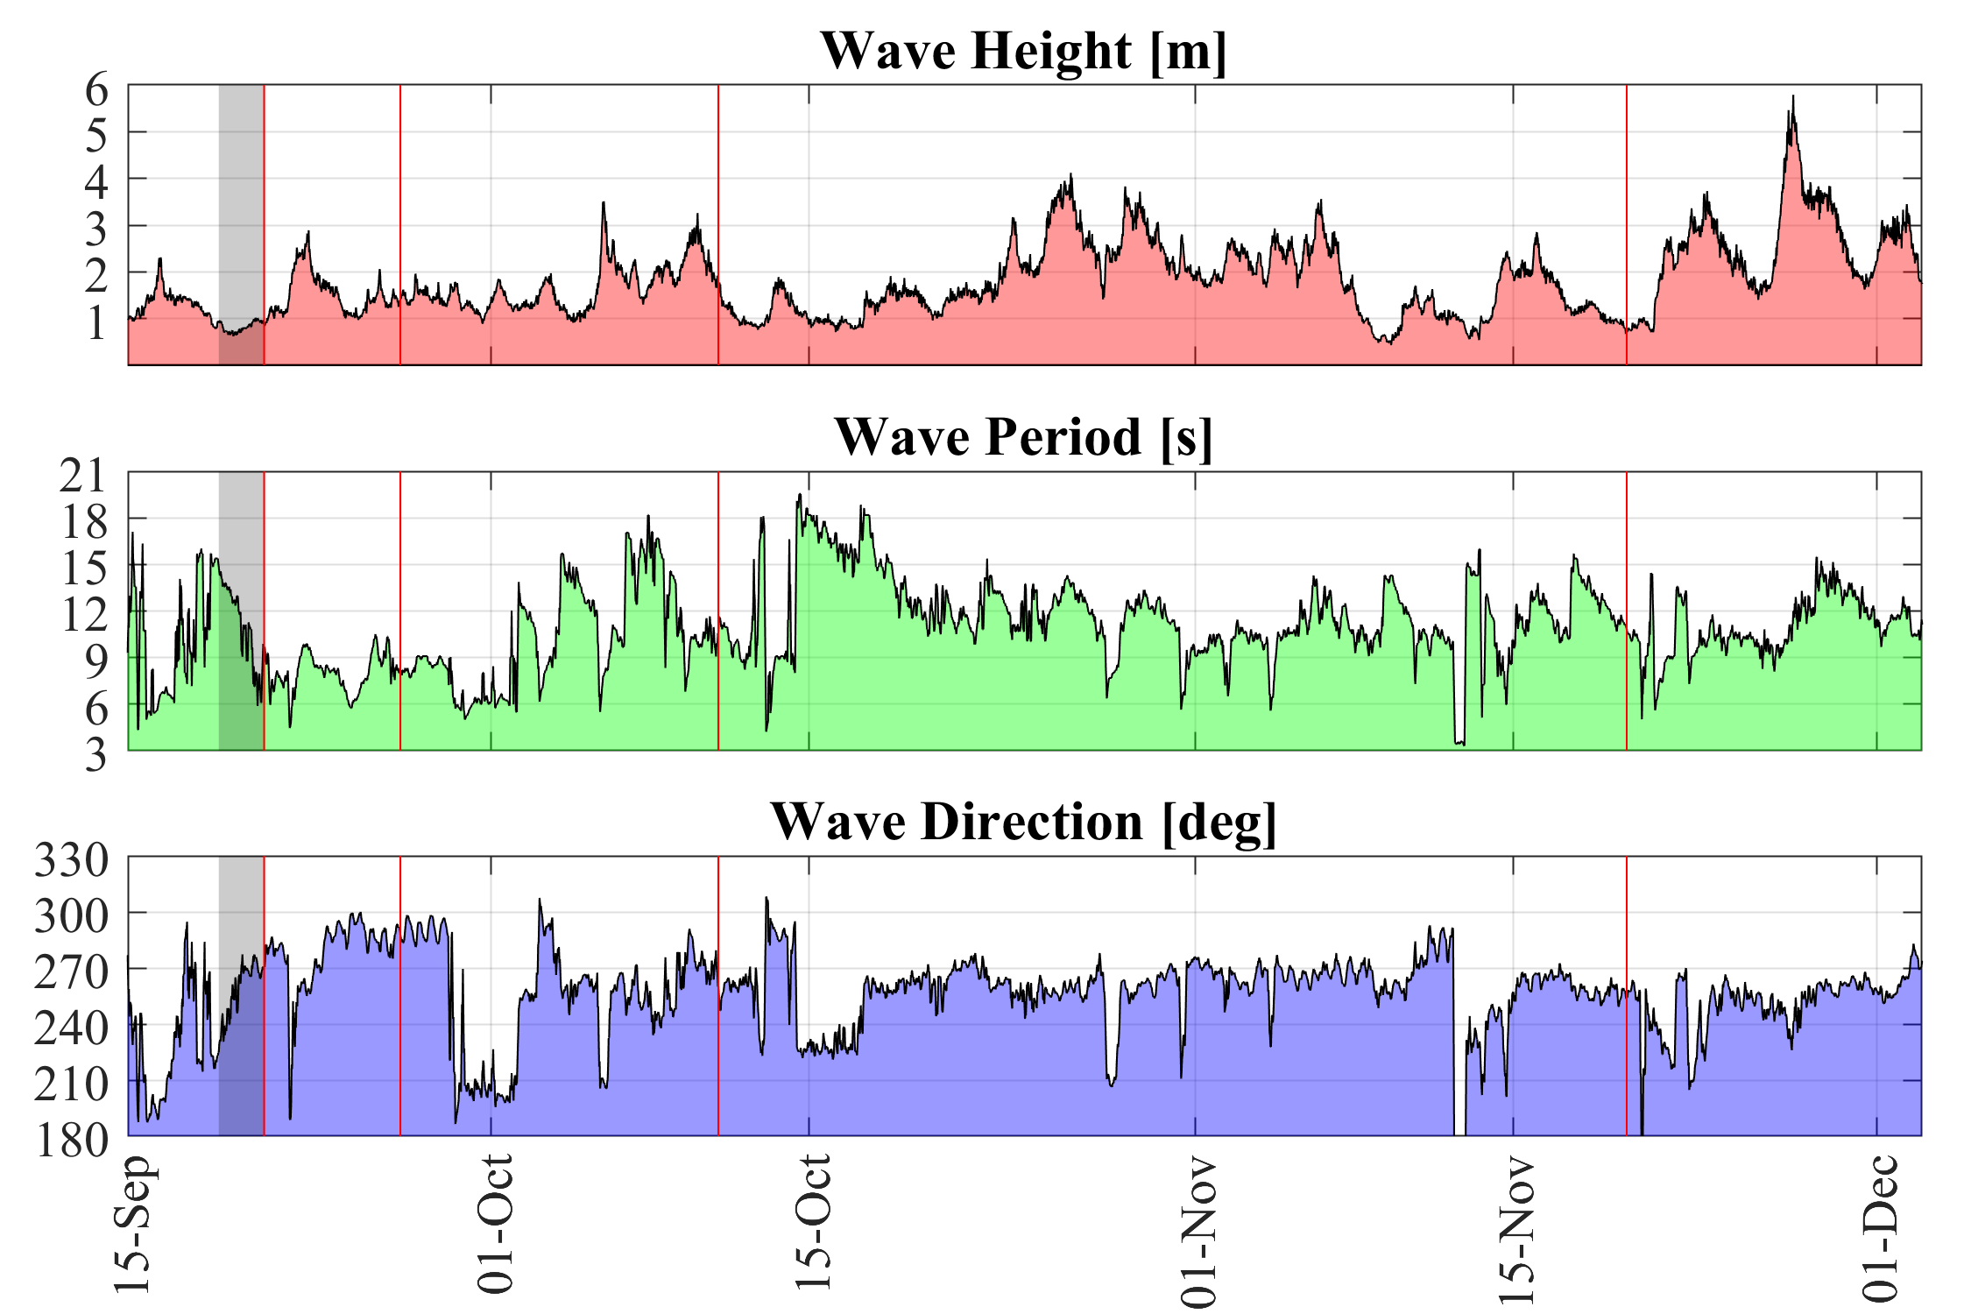
Significant bottom
transport

Slide 20
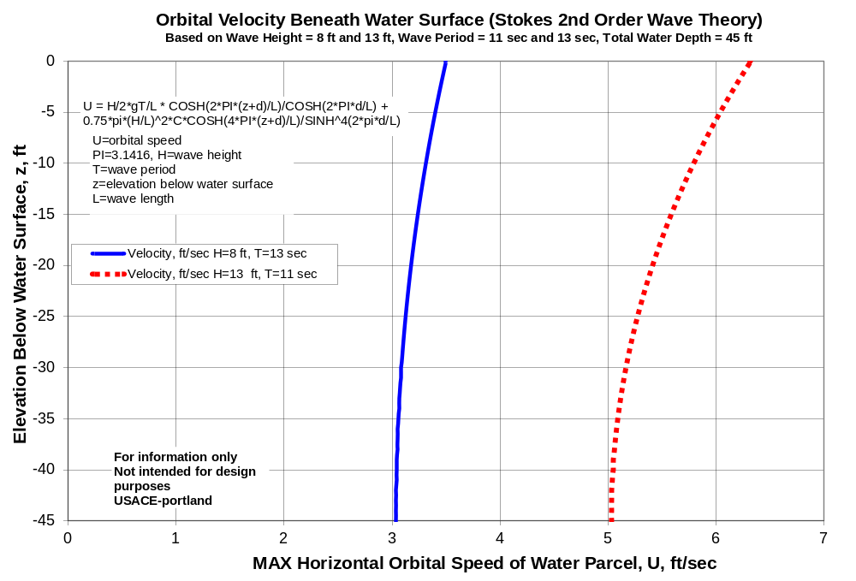
Currents > 2 ft/sec can mobilize fine-medium sand

Slide 21
NHS-Interim Findings
9 loads (51,000 cy) of sand where placed by the gvt hopper dredge Essayons along a 5,000 ft-long transect, using thin-layer placement method, and produced a 2 ft high mound. The mound was 5,000 ft long and 300 to 500 ft wide. All 9 loads were released within the 150 ft wide placement transect.
Placement occurred during 19-21 SEP 2018, in water depth of 40-50 ft depth along the northern flank of Peacock Spit.
Post-placement surveys were conducted at 0 days, 7 days, 22 days, and 60 days after placemnt completion.
At day 0, the initial detectable volume of placed material along the mound feature was 49,000 CY (2,000 cy of dredged material was dispersed to the surrounding seabed during placement). By day 7, the detectable mound volume had been reduce to 37,000 cy due to sediment dispersion (12,000 cy dispersed from mound). Waves were 3-10 ft high, 6-10 sec, and S-NW.
At day 22, 9,000 cy of sediment had been re-deposited onto the mound area by waves and currents stirring sediment on Peacock Spit (waves were 3-12 ft high, 6-18 sec, and S-NW).
By day 60, the mound volume had been reduced to 17,000 CY (loss of 32,000 cy since day 0). Max mound height was 1 ft.

Slide 22
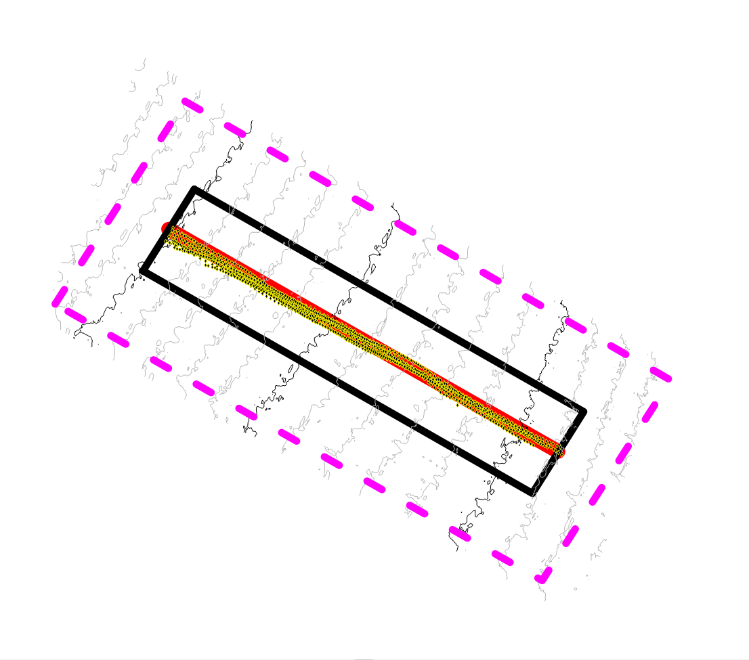
20 AUG 2018
21 SEP 2018
27 SEP 2018
20 AUG 2018
11 OCT 2018
20 NOV 2018

Slide 23
49 Kcy on Seabed
20 AUG-21 SEP 2018 1.7 ft
20 AUG-27 SEP 2018 1.5 ft
17 Kcy on Seabed
32 Kcy eroded
20 AUG-11 OCT 2018 1.5 ft
20 AUG-20 NOV 2018 1.0 ft

Slide 24
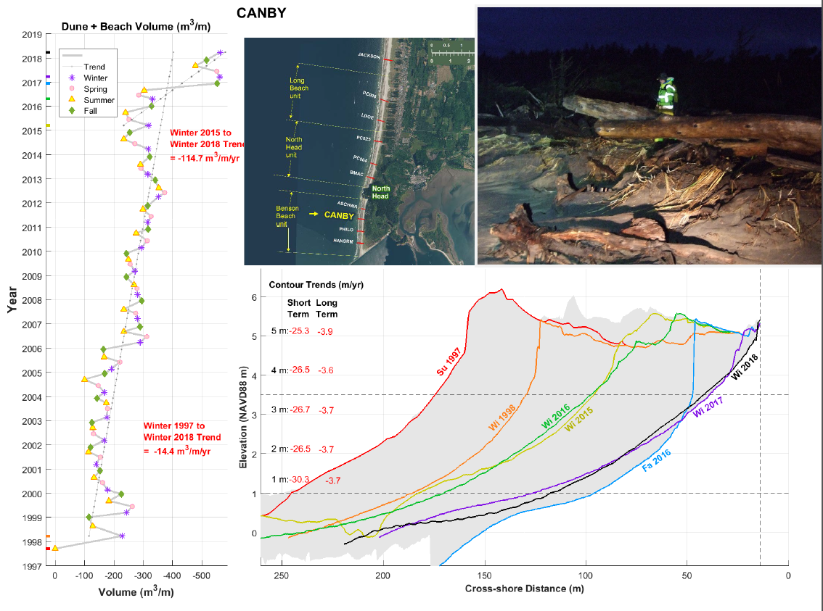
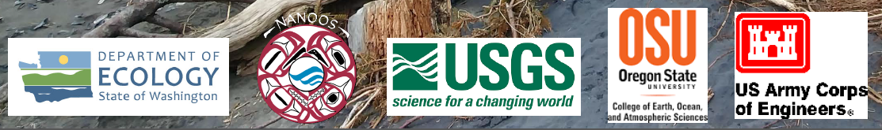

Slide 25
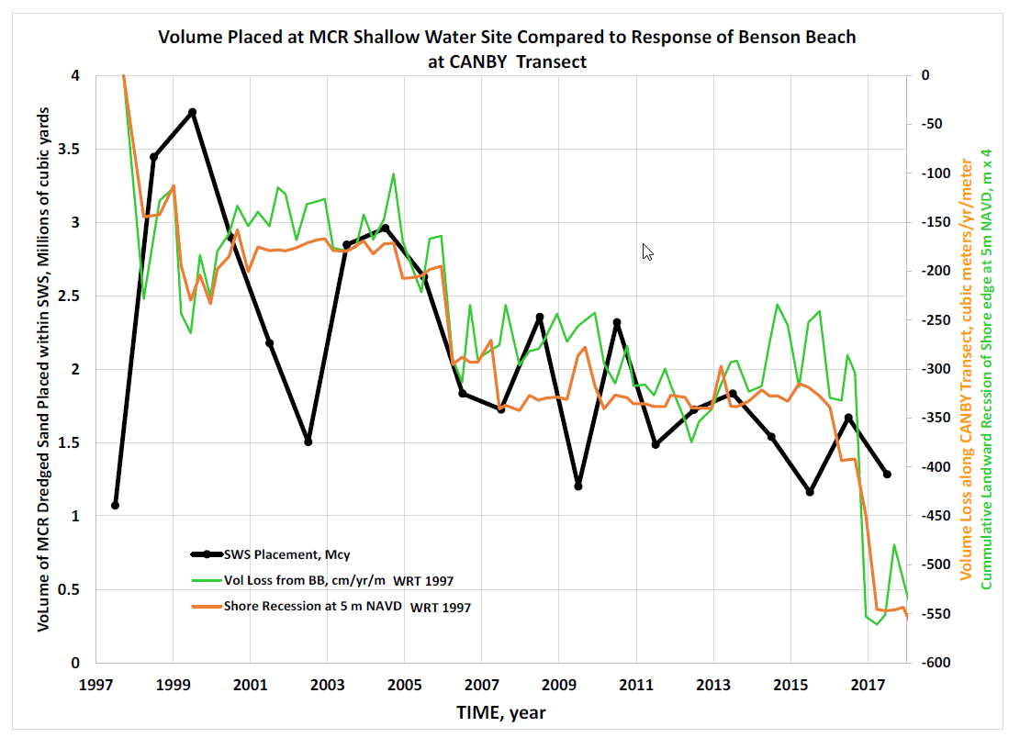
The Health of Benson Beach appears to be related to how much dredged material we place at SWS.
The less placed at SWS, the more
erosion occurs along Benson Beach.

