Slide 1
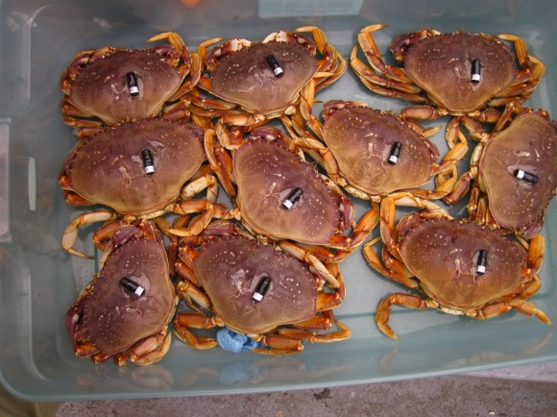

Mouth of the Columbia River
Crab Telemetry Study
Curtis Roegner
MCR Program
Meeting
~
Astoria, OR
7 December 2018

Slide 2
2018 OPTIONS: 10-14 additional receivers (32)
Repeat SJS experiments w/ increased gates
Mound experiment at NHS: cumulative impact
Small impact array at SJS and increased gates N & S
1.
2.
3.
NHS
NHS
NHS
ESTUARY
ESTUARY
ESTUARY
SJS
SJS
SJS

Slide 3
2018 OPTIONS: 10-14 9 additional receivers (32 25)
Mound experiment at NHS: Cumulative impact
  Residence time
  Migration direction
  Migration rate
2.
NHL
NH ARRAY
ESTUARY
JA
BB
TB
SJL
SL

Slide 4
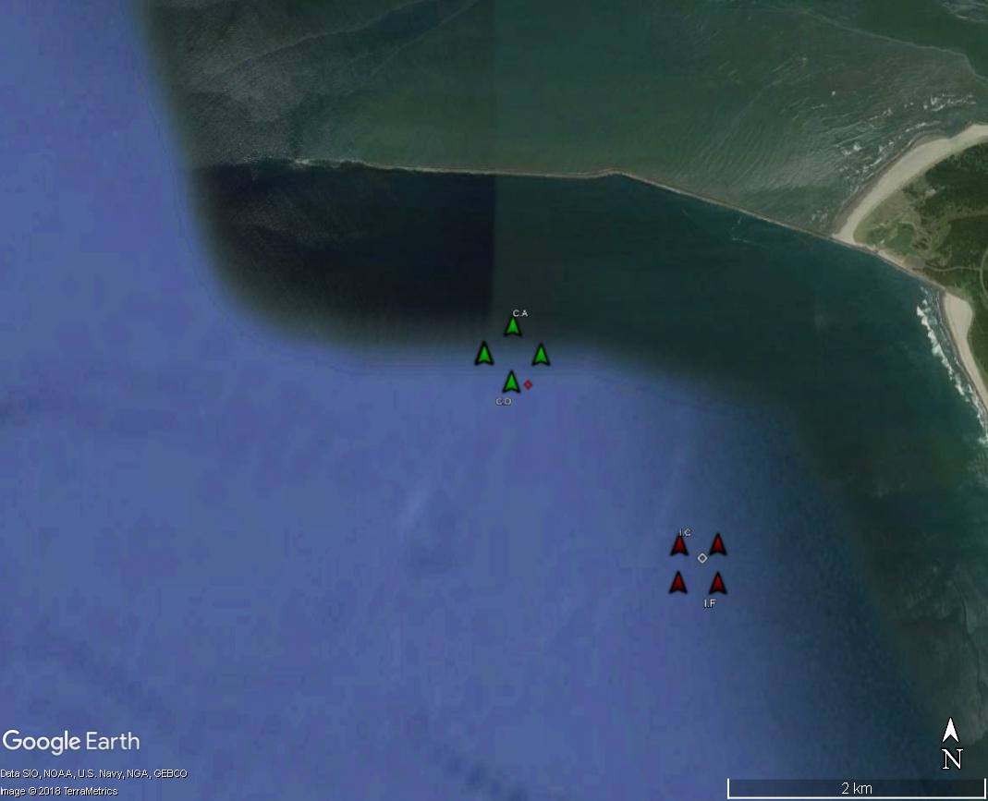
2014-2015
SJS
CONTROL
IMPACT

Slide 5
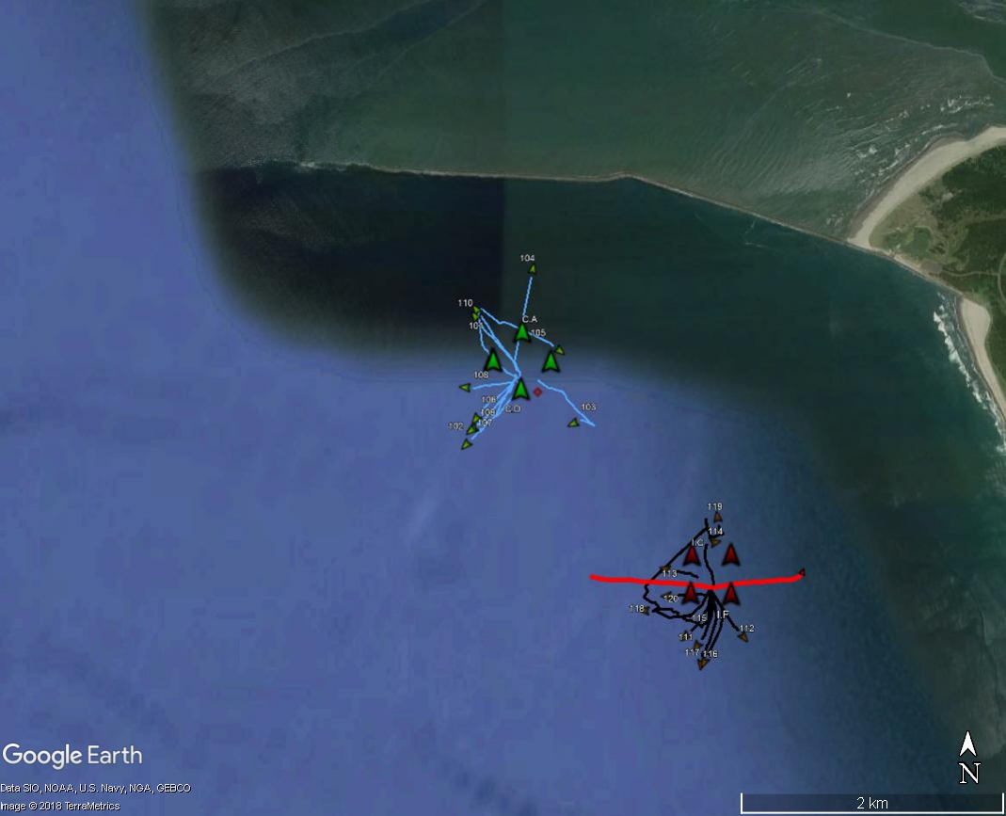
2015
RELEASE 4
ESSAYONS TRACK

Slide 6

2016-2017
SJS
IMPACT
CONTROL

Slide 7

2015 & 2016
SJS
2015
2016

Slide 8
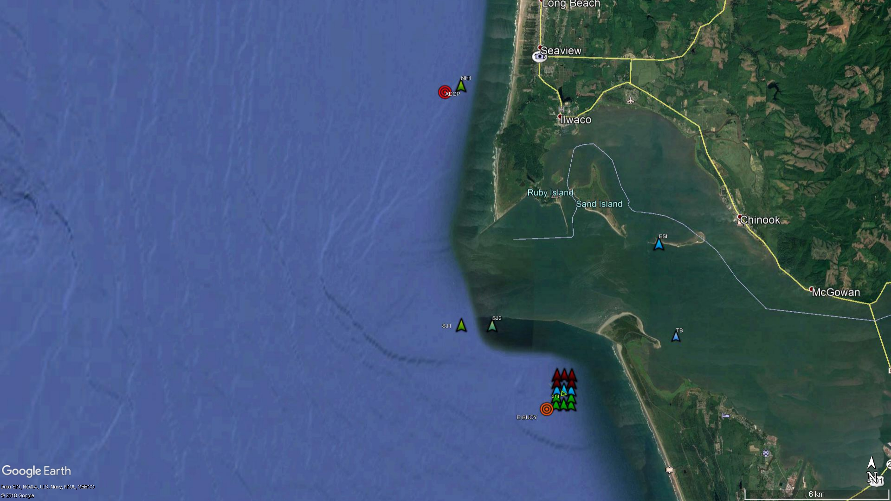
2016
SJS
SENTINEL
ESTUARY
SENTINEL
GATE
ARRAY

Slide 9
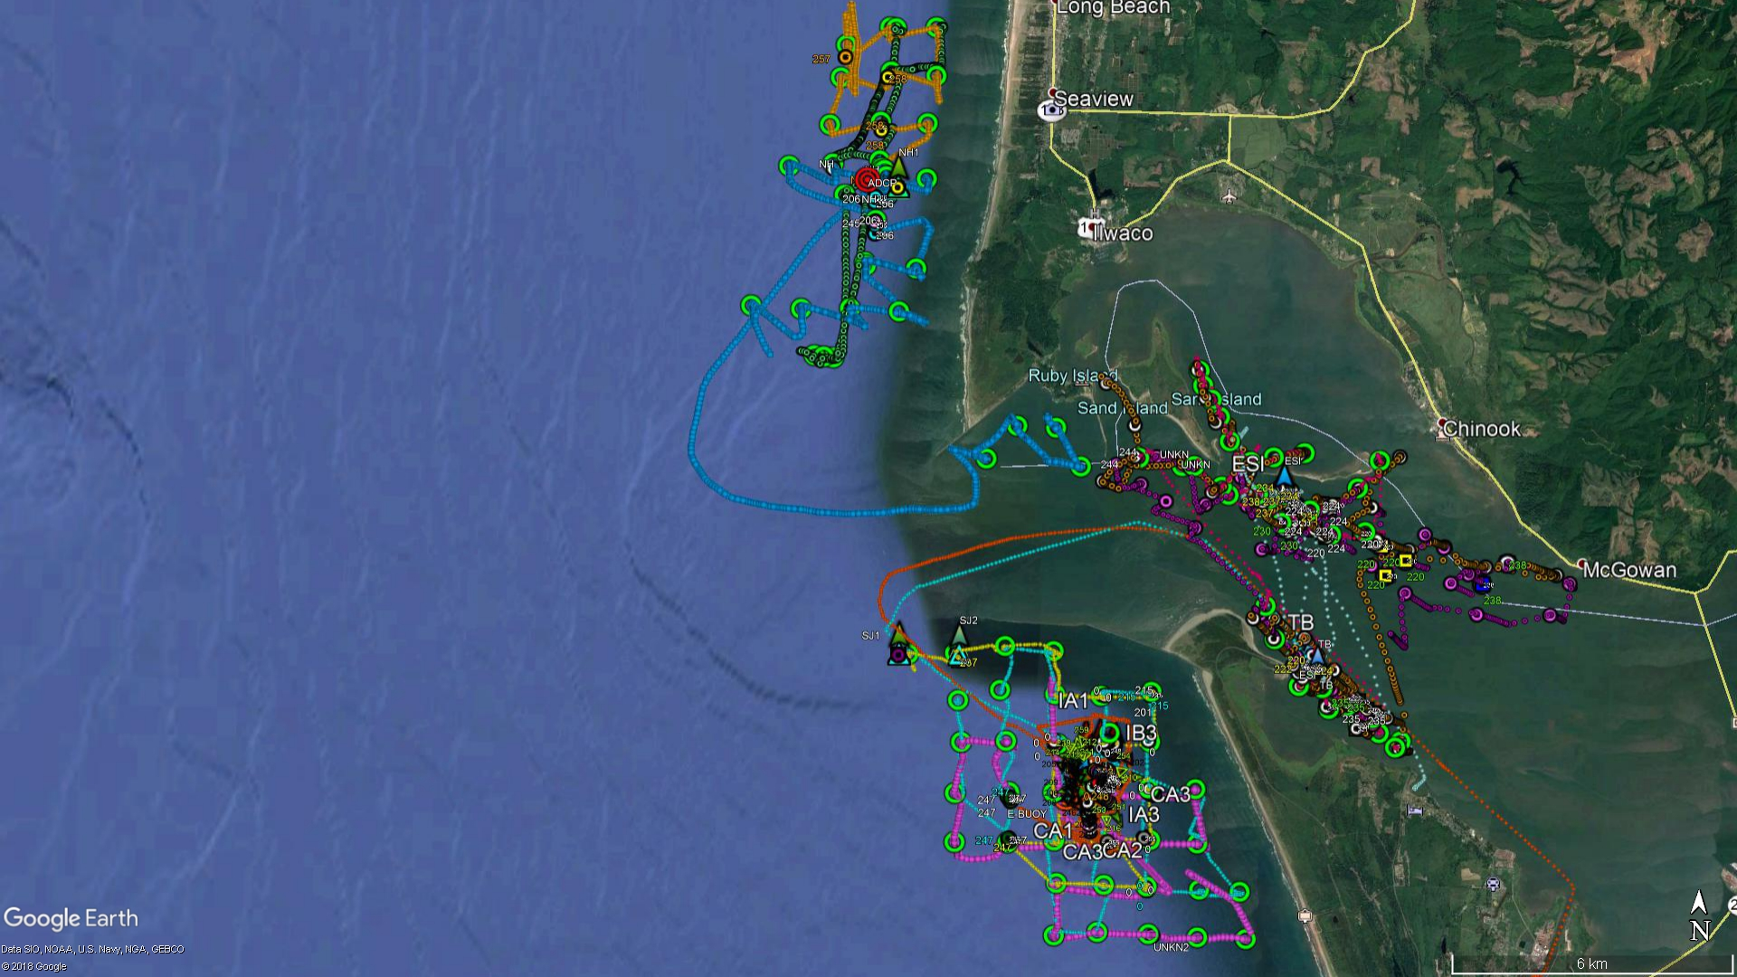
2016
SJS
HYDROACOUSTIC SURVEY TRACK

Slide 10
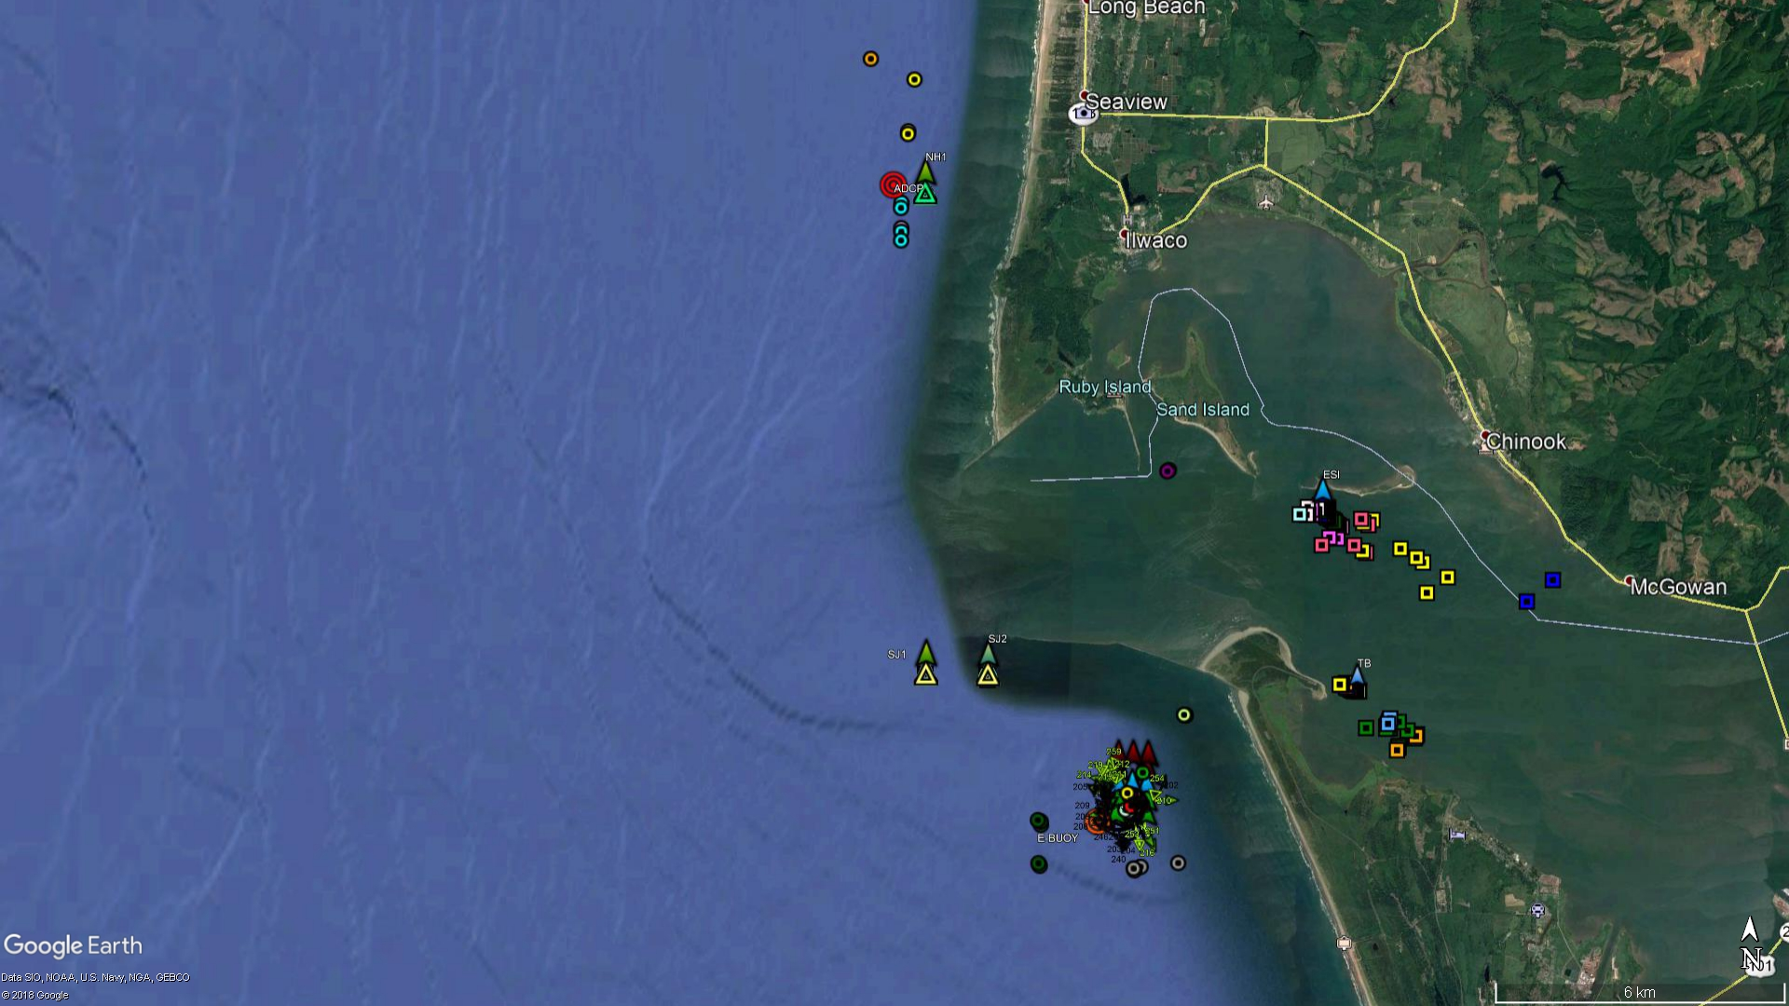
2016
SJS
5/40
E-RELEASE 2 16 CRABS
2/40
1/16
17/40
RELEASE 7 & 8 40 CRABS
1/40*

Slide 11
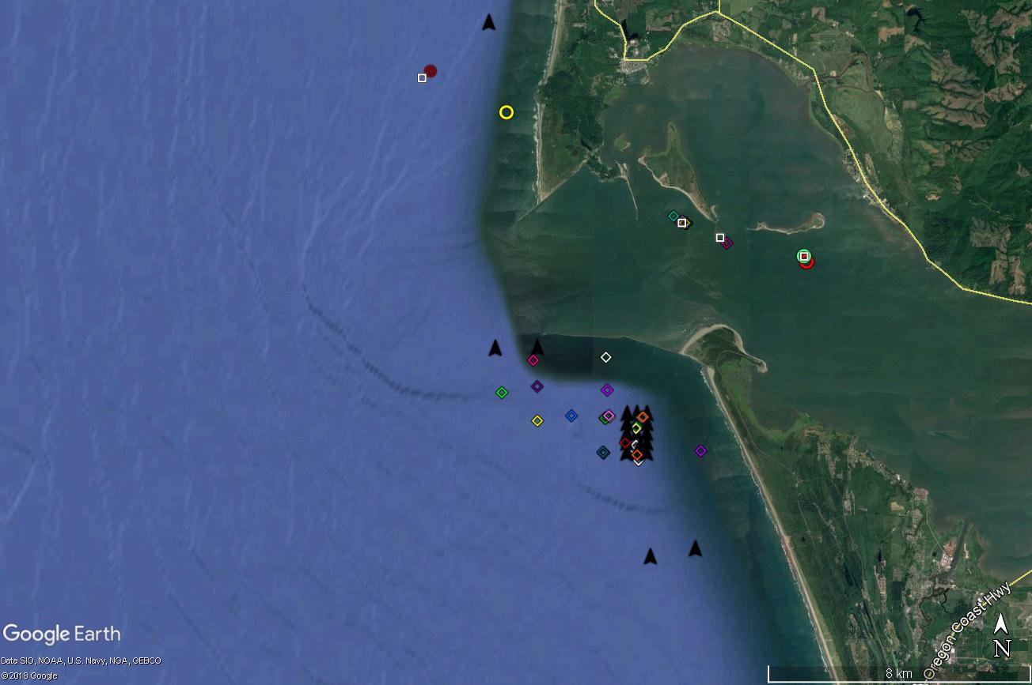
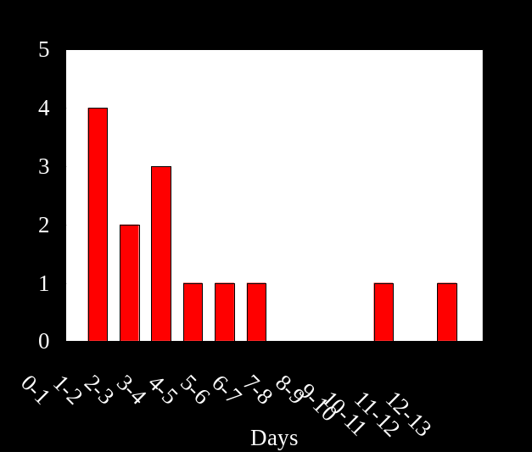
2017
SJS
0
2/5
Mean time = 4.52 ± 3.61 days
Range = 1.14 – 12.19 days
X
14/17
X
0

Slide 12
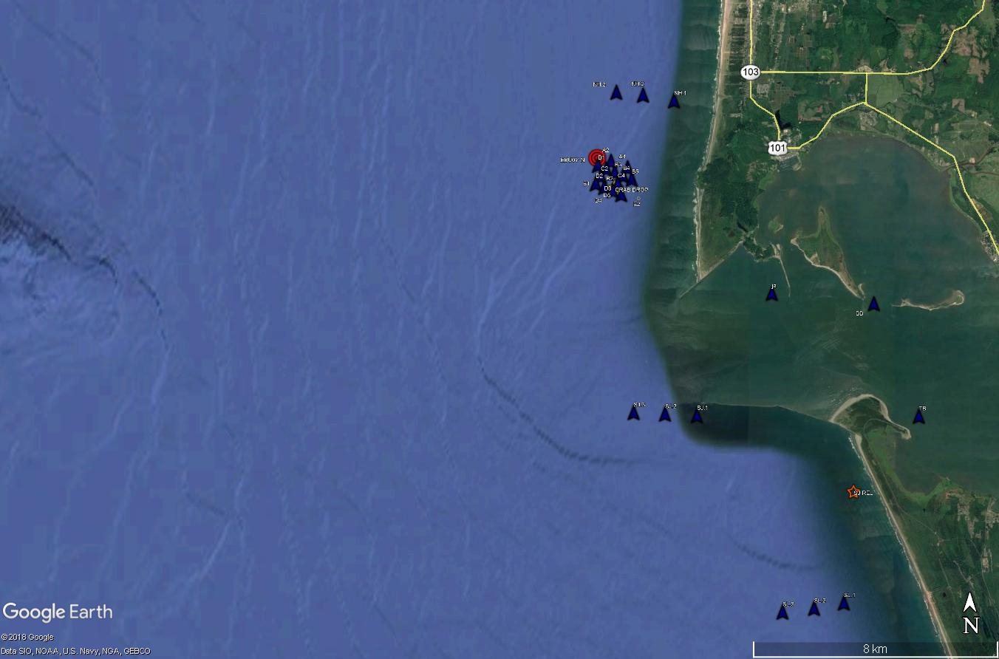
2018 EXPERIMENTS – MOVED TO NH SITE
TAG RELEASES
ESTUARY (E1) VRS SOUTH JETTY (SJ)
  22 & 23 August
MOUND EXPERIMENT
  19 Sept: IMPACT (MI) & ESTUARY (ME)
  21 Sept: CONTROL (MC1)
  28 Sept: CONTROL 2 (MC2)
HABITAT COMPARISON
  28 Sept: CONTROL 2 (MC2)
  3 October: FALCON COVE RELEASE (FC)

Slide 13
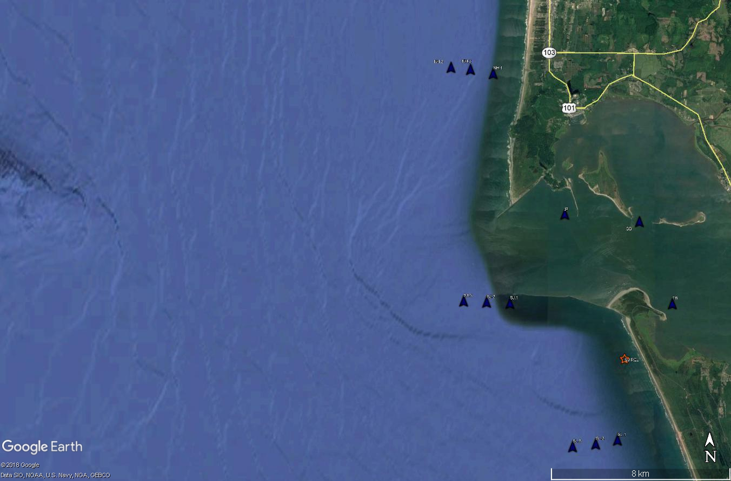
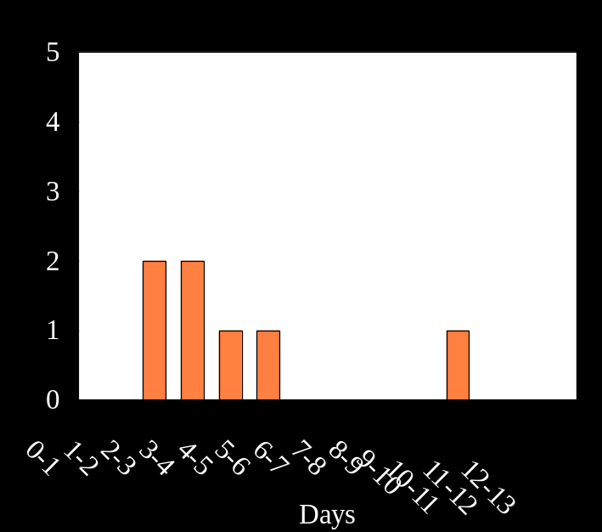
2018 OCEAN AND ESTUARY RELEASES
22-23 AUGUST
1
0
9.9 d
X
9
TRAVEL TO SJL
28.1 d
1
7
0
10
17.9 d
0
1

Slide 14
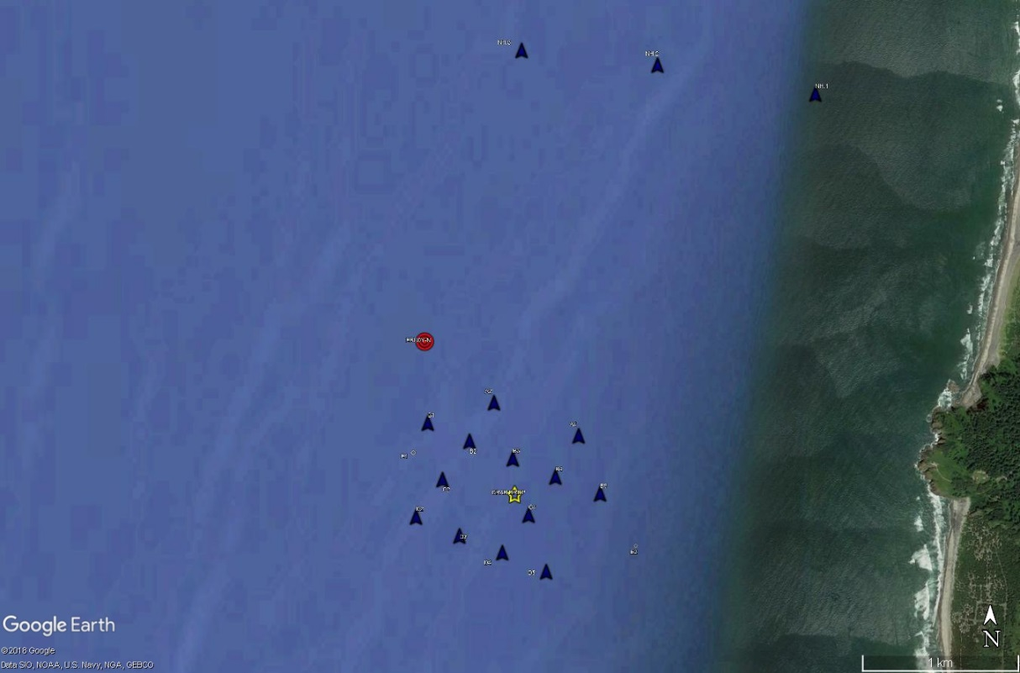
2018 MOUND EXPERIMENT
EBUOY
ESSAYONES TRACK
TAG RELEASES
19 Sept: IMPACT (MI) & (ME)
21 Sept: CONTROL (MC1)
12 DAYS: CONTROL 2 (MC2)

Slide 15
2018 MOUND EXPERIMENT
1
0.2 d
47.9 d
X
10
0
TAG RELEASES
19 Sept: IMPACT (MI) & (ME)
21 Sept: CONTROL (MC1)
12 DAYS: CONTROL 2 (MC2)
0

Slide 16
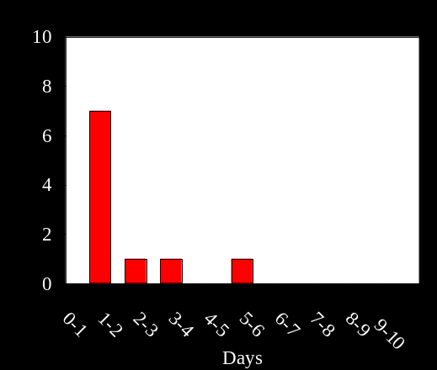
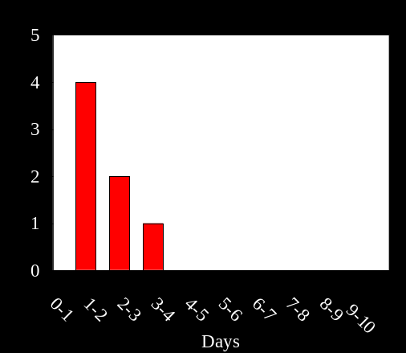
2018 MOUND EXPERIMENT
7
1
0.2 d
10
RESIDENCE IN ARRAY
TRAVEL TO NHL
47.9 d
X
10
0
0
TAG RELEASES
19 Sept: IMPACT (MI) & (ME)
21 Sept: CONTROL (MC1)
12 DAYS: CONTROL 2 (MC2)
0
0

Slide 17
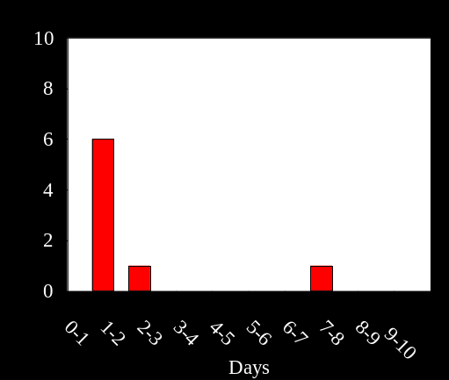
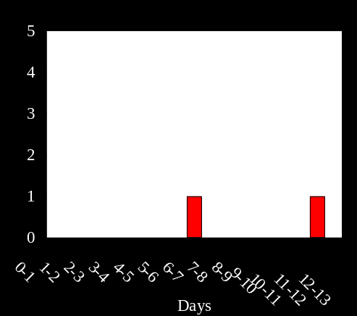
2018 MOUND EXPERIMENT
2
9
RESIDENCE IN ARRAY
TRAVEL TO NHL
7.4 d
X
1
TAG RELEASES
19 Sept: IMPACT (MI) & (ME)
21 Sept: CONTROL (MC1)
12 DAYS: CONTROL 2 (MC2)
0

Slide 18
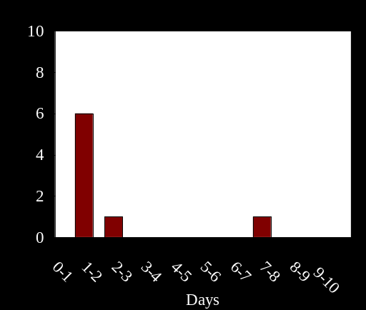
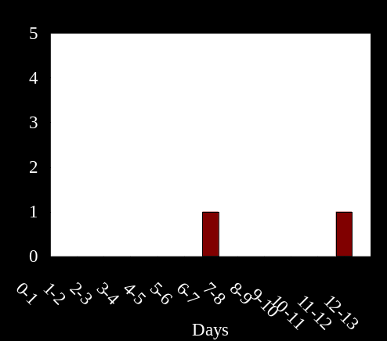
2018 MOUND EXPERIMENT
2
10
RESIDENCE IN ARRAY
TRAVEL TO NHL
34.6
X
1
TAG RELEASES
19 Sept: IMPACT (MI) & (ME)
21 Sept: CONTROL (MC1)
12 DAYS: CONTROL 2 (MC2)
0

Slide 19
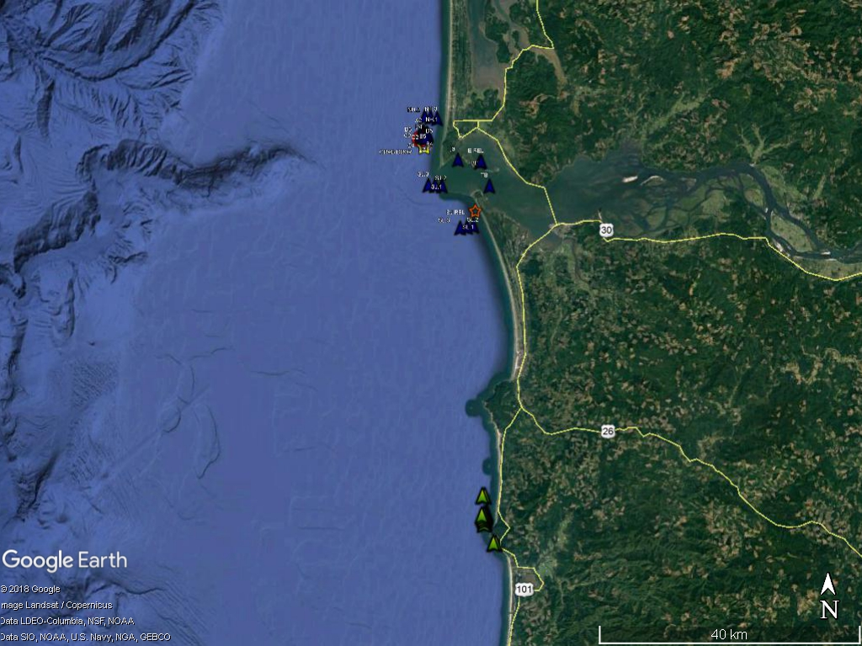
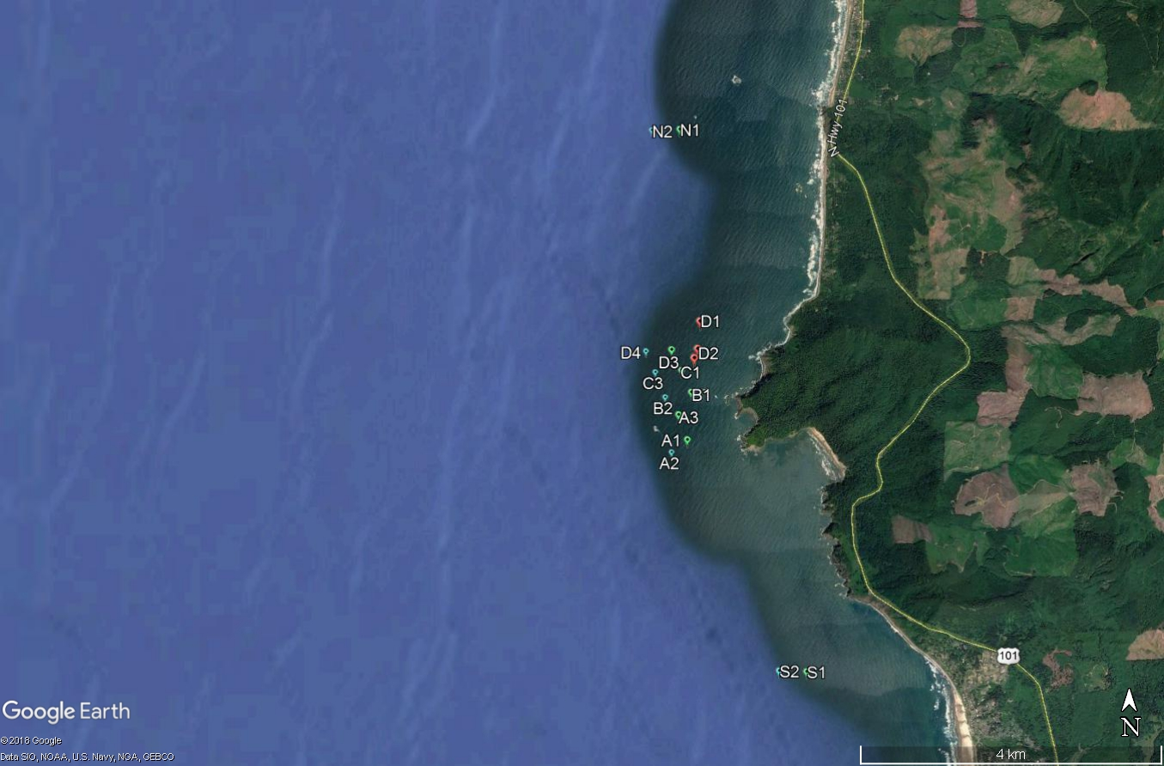
HABITAT COMPARISON STUDY
ROCKY VRS SANDY HABITATS
NEAR SIMULTANEOUS RELEASES
  @ FC & MCR
WILL EXAMINE RESIDIENCE TIME
TO DATE:
NO FC CRABS AT MCR
DATA FROM FC NOT AVAILABLE YET
SJL REDEPLOYED
NHL GATE
ARRAY
MCR
SJL GATE
SL GATE
GATE
ARRAY
GATE
FALCONCOVE
ARRAY
GATE
GATE

Slide 20
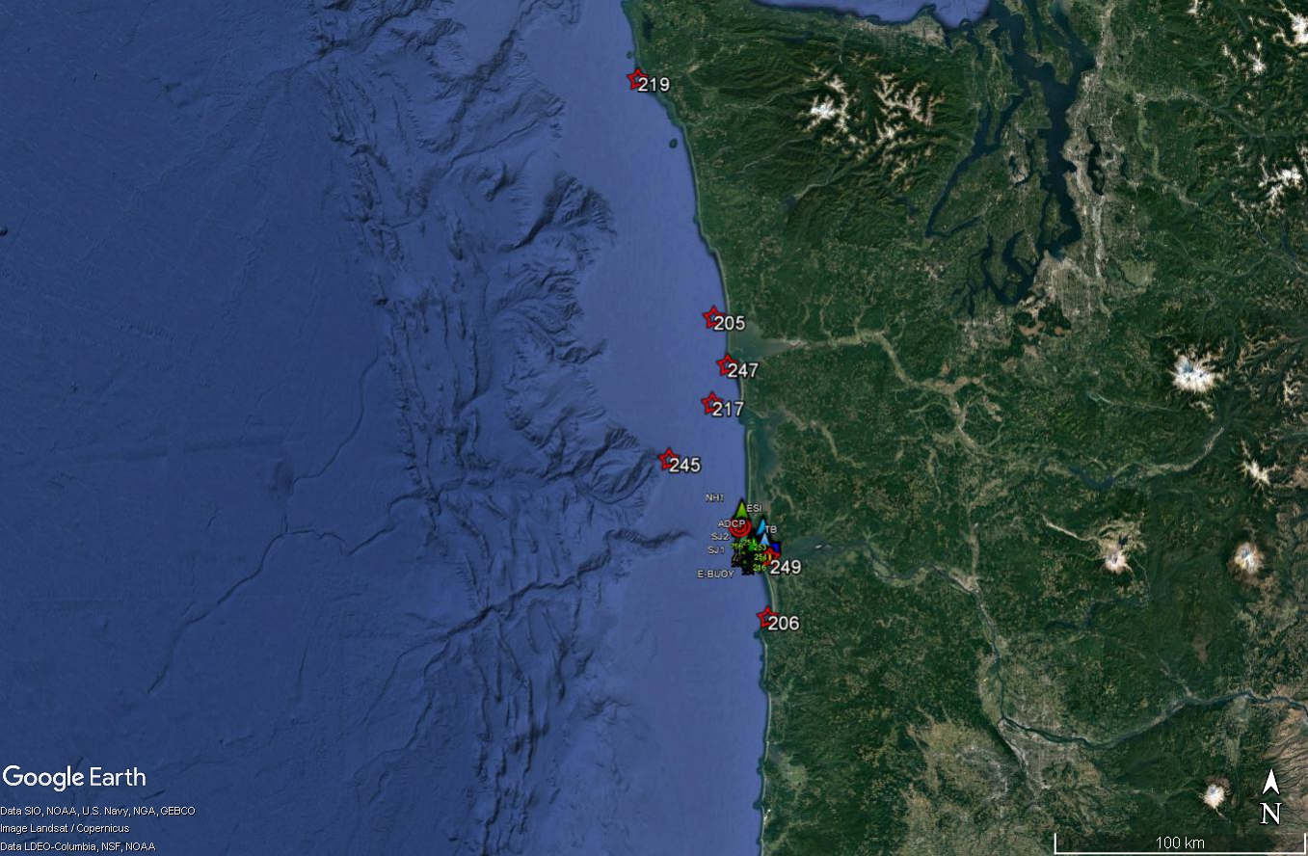
SUMMARY OF TAG STUDIES
ACUTE IMPACT VARIABLE
NO EVIDENCE OF INCREASED MORTALITY
CRABS HIGHLY MOBILE
NORTHWARD MIGRATION
LIMITED IMPORT/EXPORT FROM ESTUARY
MOUND EXPERIMENT (PRELIMINARY)
SIMILAR RESIDENCE IN ARRAY
  BTW CONTROL & IMPACT
IMPACT –STRONG NORTHWARD MIGRATION
UNKNOWNS
EXTENT OF NORTHWARD MOVEMENT
CUMULATIVE EFFECT OF IMPACTS
LaPUSH
RELEASE
SEASIDE

Slide 21
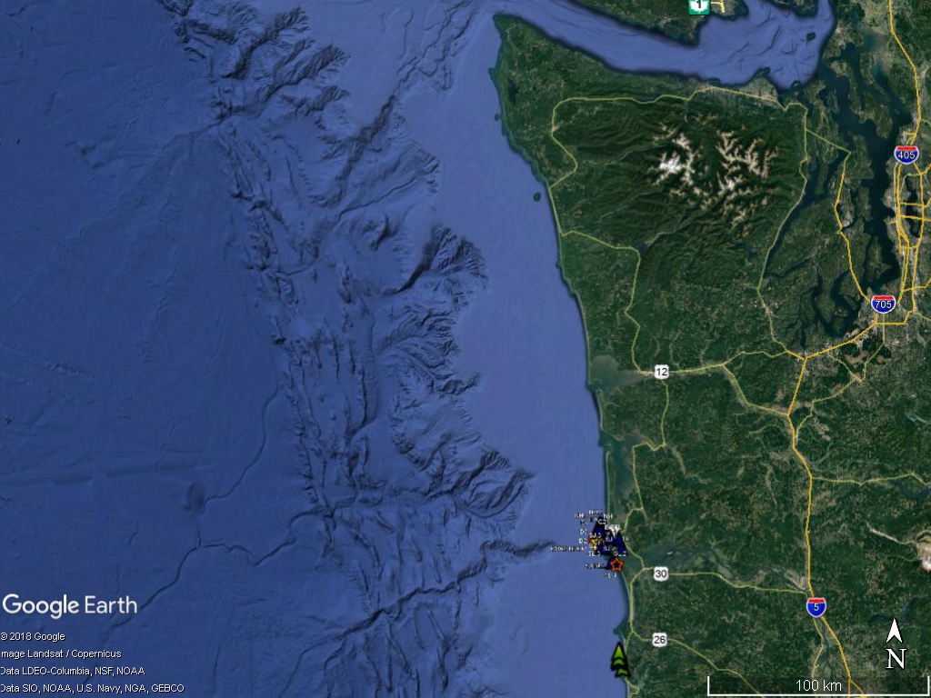
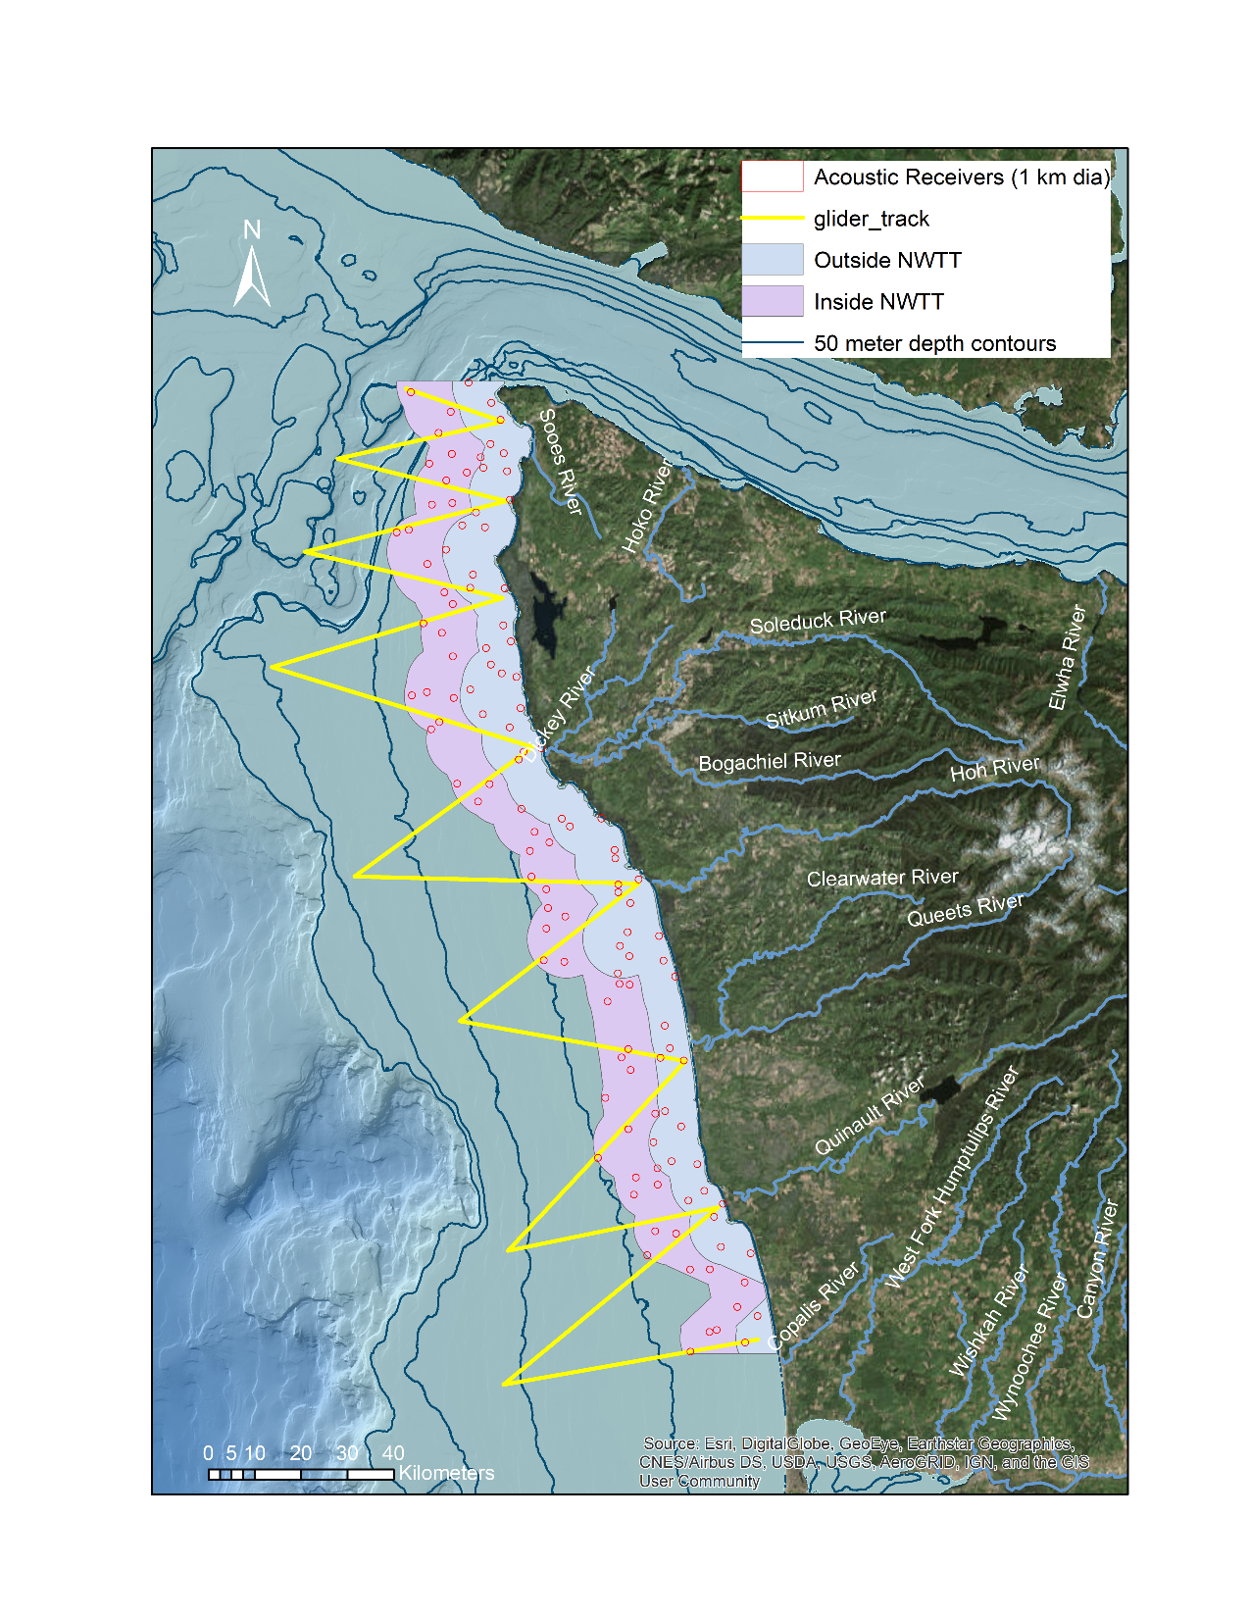
OPPORTUNITY FOR 2019
EXAMINE LARGE-SCALE MIGRATION PATTERNS
FILL IN GAP BEWTEEN MCR AND OLYMPIC ARRAY
CRAB BEHAVIOR AND LOW DO PATTERNS
New salmon tracking array

Slide 23
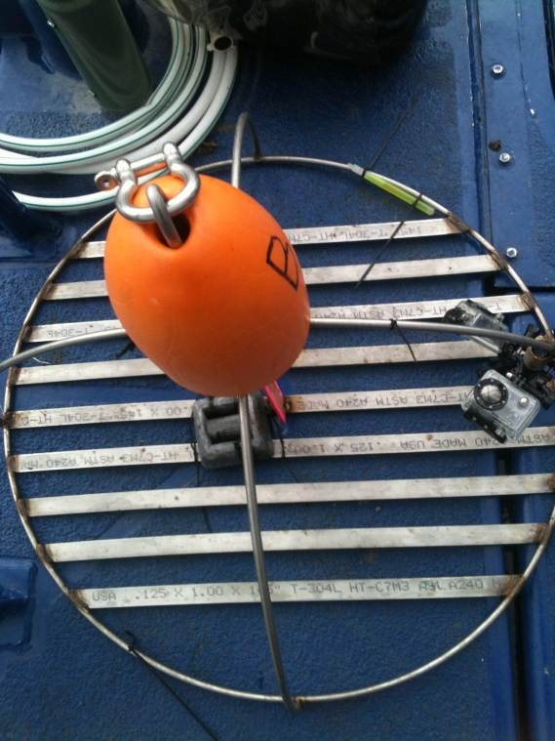
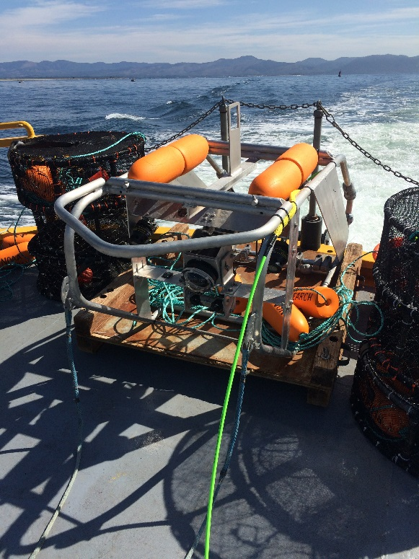
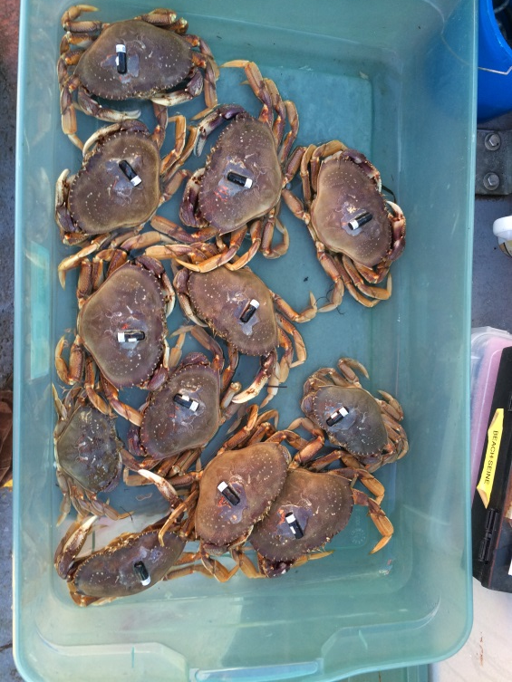
VIDEO and ACOUSTIC TELEMETRY TECHNIQUES
1. CamPod
Used to measure
acute effects of disposal including sediment depth & Impact on fauna
2. Acoustic Tracking
Used to measure
acute & cumulative impacts on crabs
3. Benthic video sled
Used to compare
invertebrate and fish abundances in different habitats

Slide 24
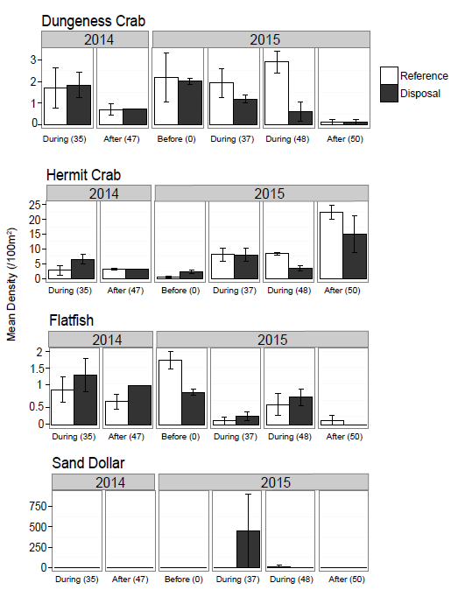
BENTHIC VIDEO SLED

Slide 25
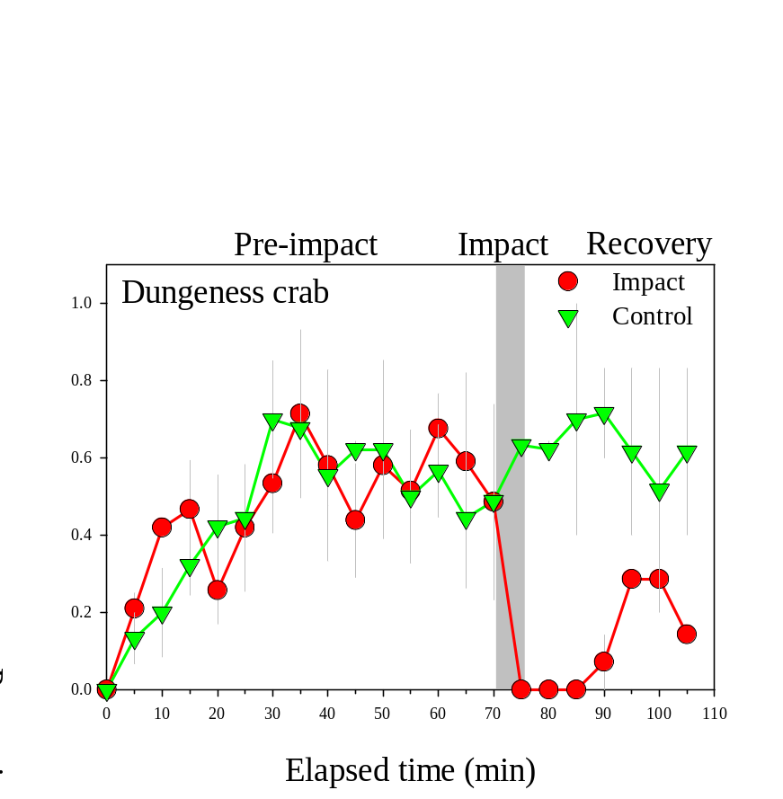
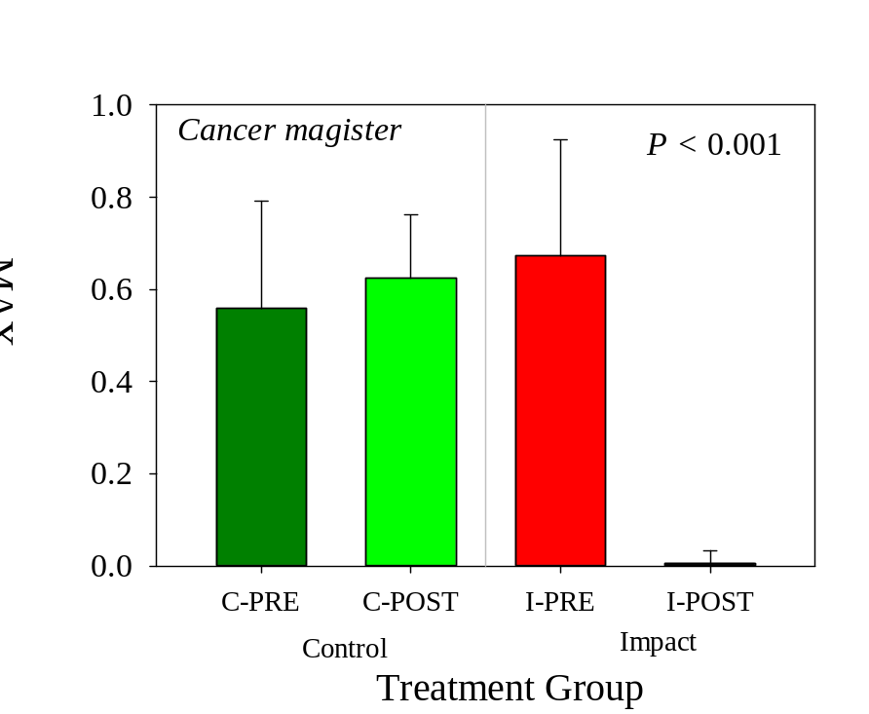
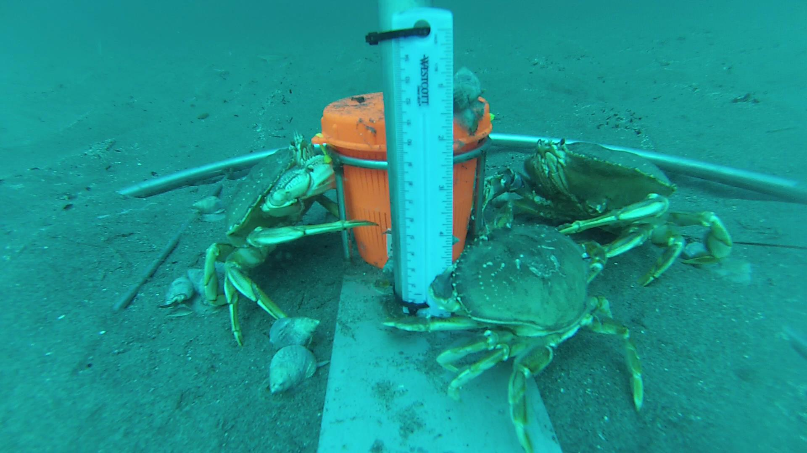
CAMPOD
IMPACT-CONTROL RESULTS

Slide 26
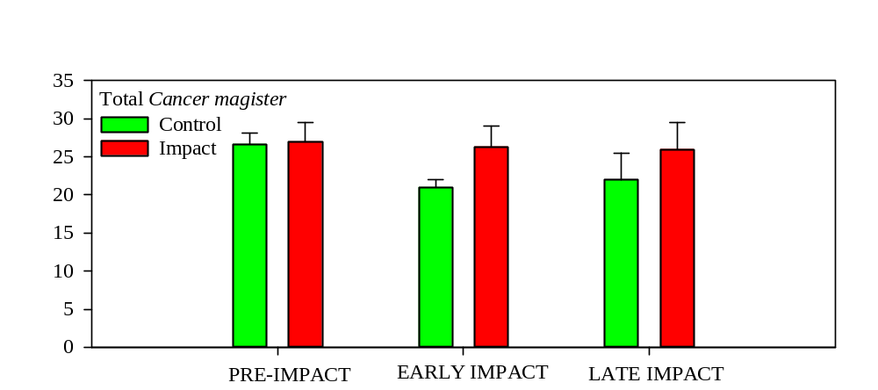
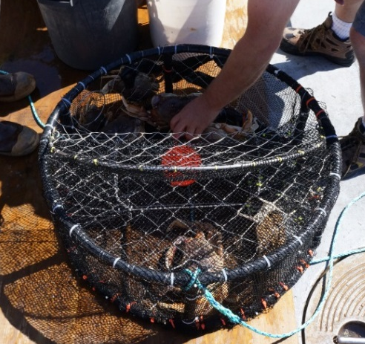
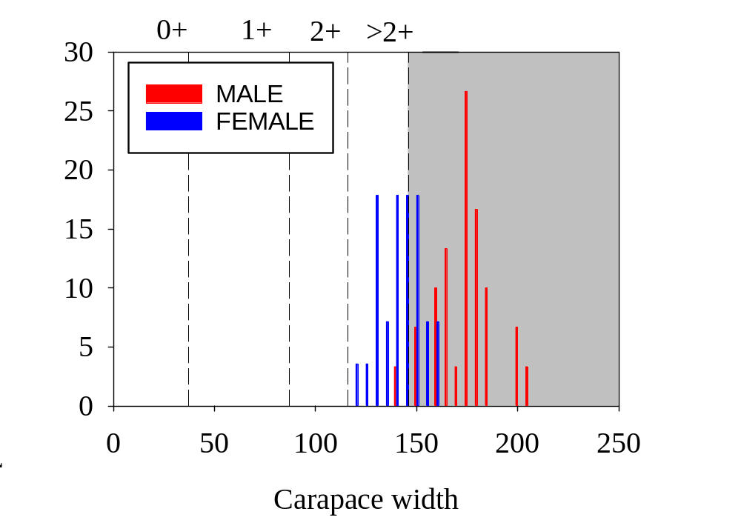
CRAB TRAP
CRAB ABUNDANCE, SEX, & SIZE FREQUENCY

Slide 27
LaPUSH
RELEASE
SEASIDE

Slide 28
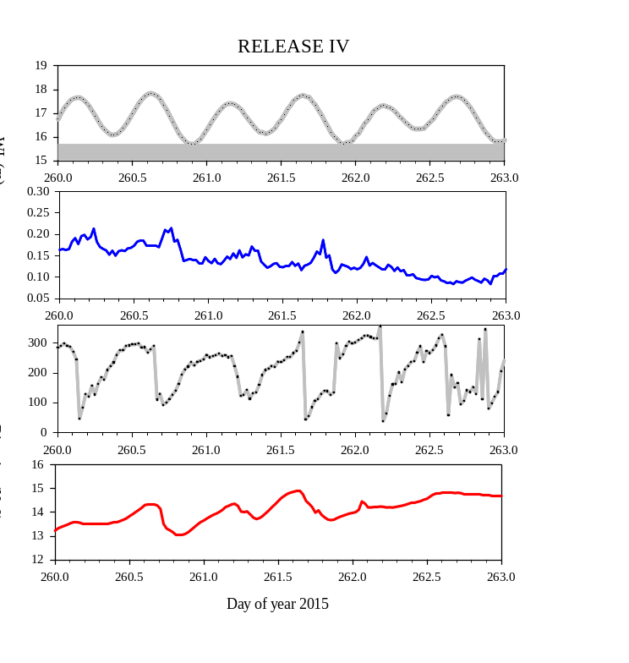
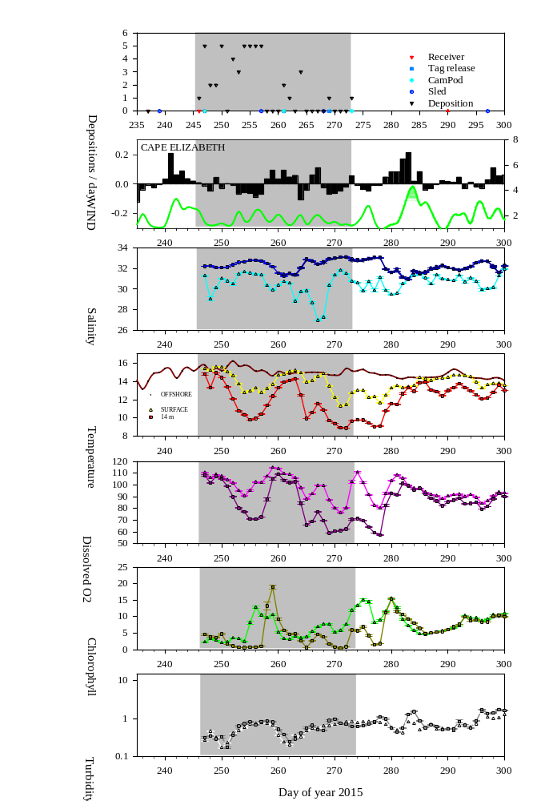
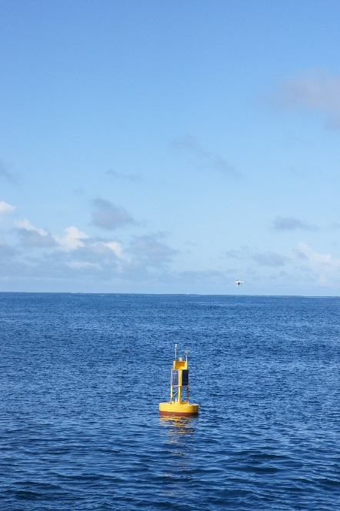
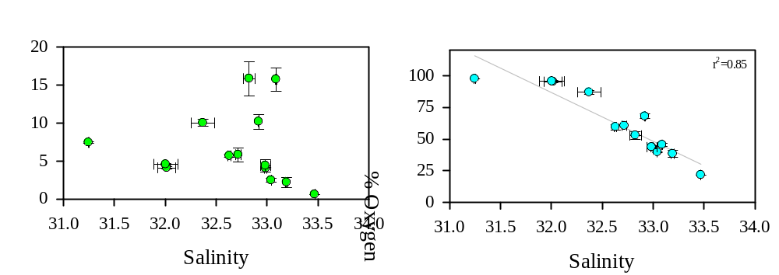
ENVIRONMENTAL BUOY
VELOCITY
TIME SERIES DATA
CHLOROPHYLL AND OXYGEN

Slide 29
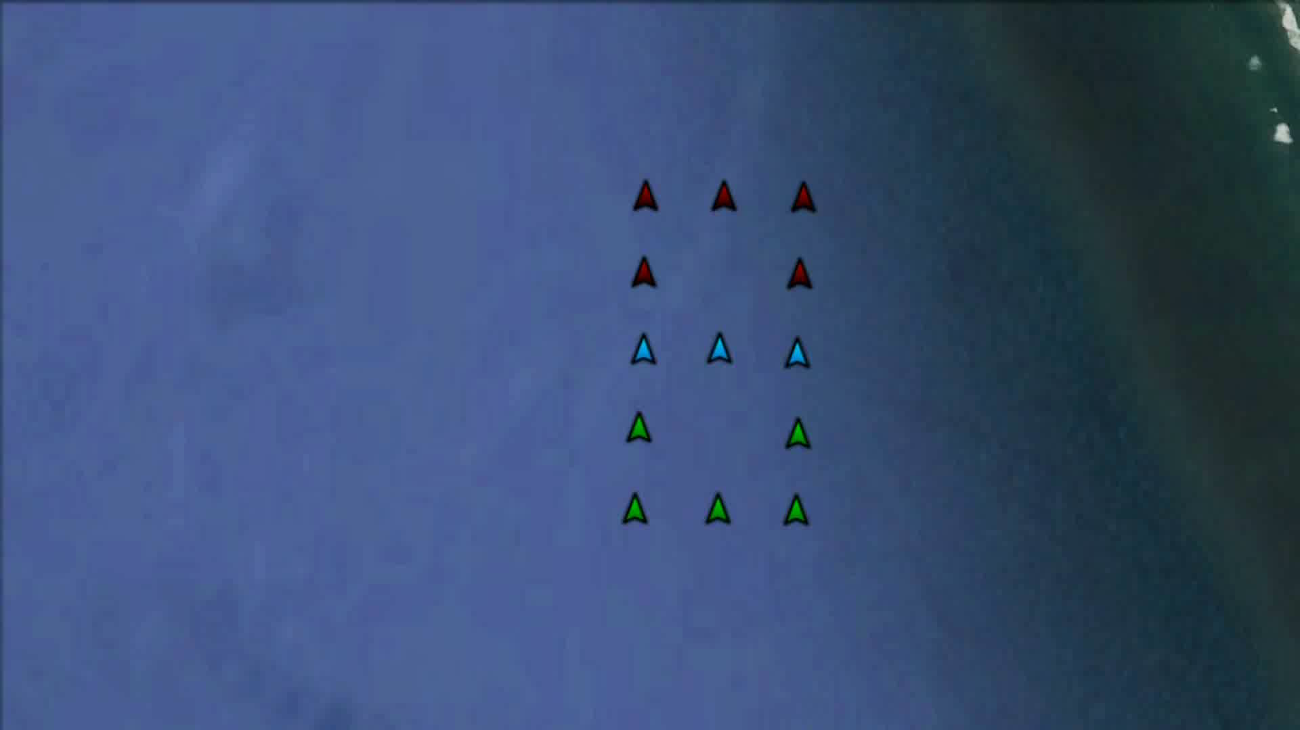
2016 Tag Releases

Slide 30
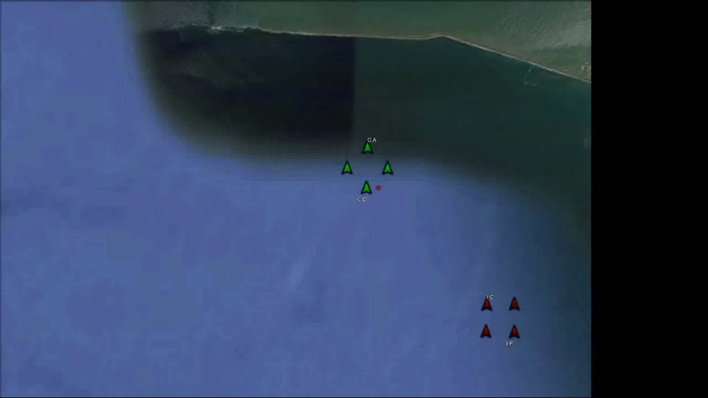
2015 Tag Releases

Slide 31


Slide 32
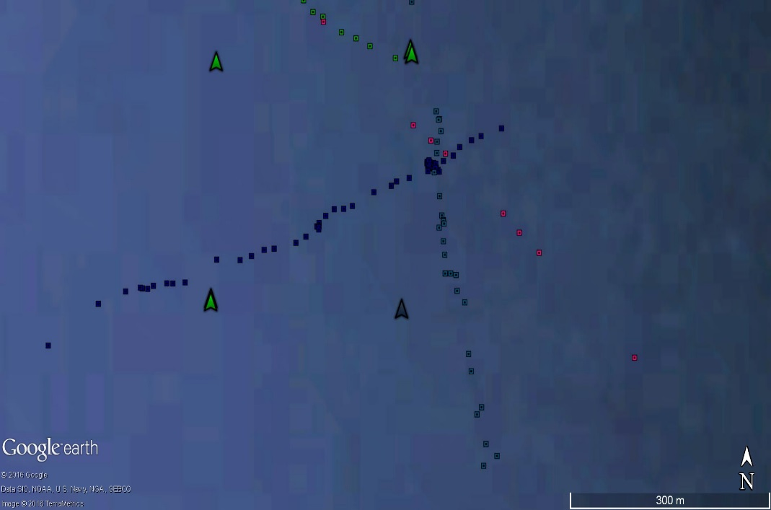
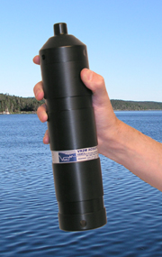
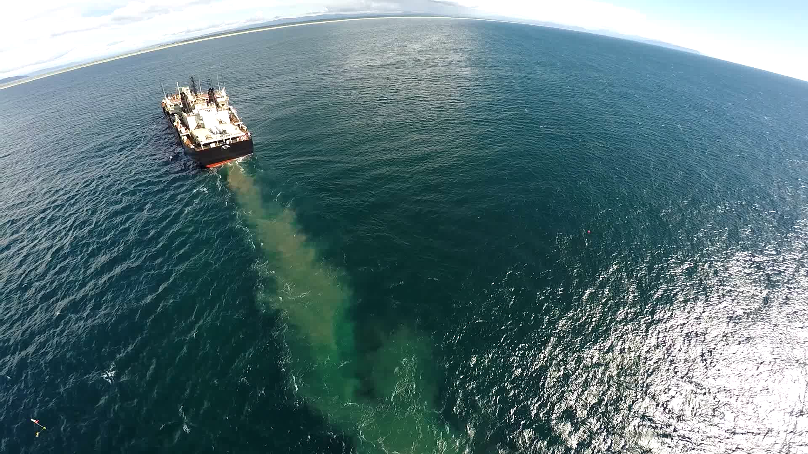
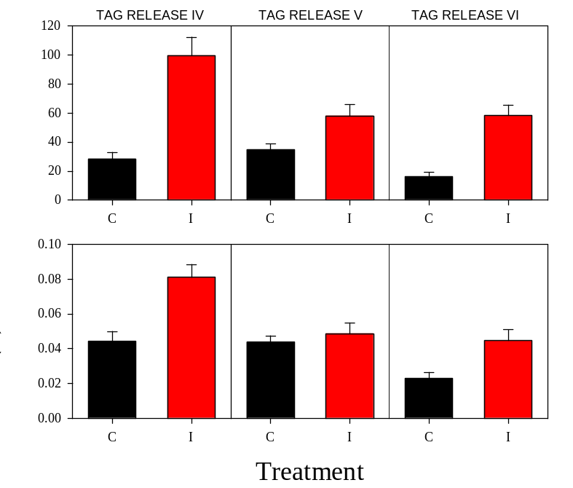

ACOUSTIC TAGS
IMPACT-CONTROL STATISTICS AND BEHAVIOR
0.01 m/s
7.5 h
0.06 m/s
DEPOSITION EVENT
RECEIVER
TAGGED CRABS
0.14 m/s
EXPERIMENTAL DESIGN

Slide 33
COMPARISON OF METHODS USED IN BENTHIC MCR BENTHIC IMPACT STUDY
METHOD | PURPOSE & ORGANISMS | DATA TYPE | PROS | CONS | FINDINGS
BENTHIC VIDEO SLED | DETERMINE DENSITY AND SPATIAL DISTRIBUTION LARGER MOBILE EPIFAUNA AND SESSILE INVERTEBRATES | SURVEY BEFORE-IMPACT-AFTER EXPERIMENTAL DESIGN | RAPID SAMPLING HIGH REPRODUCIBILITY | VISIBILITY-LIMITED SPECIALIZED ANALYSIS | TEMPORAL EFFCT > TREATMENT EFFECT N LOWER AT SJS THAN DWS
BAITED CRAB POTS WITH FINE MESH LINING | TIME SERIES OF ABUNDANCE & SIZE PRIMARILY CRAB, SOME GASTROPODS, FISH | SIZE FREQUENCY DATA INDIVIDUAL METRICS (SEX. LIMB LOSS, ECT) | "HANDS ON" DATA COMPATIBLE WITH OLDER DATA SETS. VISIBILITY-INDEPENDENT | REQUIRES 2 CONSECUTIVE CRUISE DAYS FOR 24-H SOAK | NO TREATMENT EFFECT MAINLY ADULTS MALES > FEMALES
BENTHIC VIDEO LANDER (CAMPOD) | ACUTE EFFECTS OF DEPOSITION MOBILE MACROINVERTEBRATES & FISH | PRESENCE/ABSENCE RELATIVE TO DEPOSITION IMPACT-CONTROL EXPERIMENTS | EASILY DEPLOYED AND ANALYZED BEHAVIORAL OBSERVATIONS | LIMITED BATTERY LIFE VISIBILITY-LIMITED | SIG IMPACT EFFECT SEDIMENT LEVEL MINIMAL SHORT DURATION
ACOUSTIC TAGS | ACUTE AND LONG-TERM MOVEMENTS DUNGENESS CRABS (STURGEON, SHARKS) | IMPACT-CONTROL DESIGN FINE SCALE, INDIVIDUAL BEHAVIOR | VISIBILITY-INDEPENDENT LONG TERM BEHAVIORAL DATA | SPECIALIZED ANALYSIS SPATIAL SCALE RECEIVER-LIMITED | SLIGHT IMPACT EFFECT HIGHLY MOBILE MIGRATION NORTH? CUMULATIVE EFFECT?
ENVIRONMENTAL BUOY | COLLECT BIOPHYSICAL METRICS | TIME SERIES DEPTH STRATIFIED | PROVIDES CONTEXT TO ALL DATA COLLECTION CAPTURES EVENT SCALE LONG TERM DATA (CLIMATE CHANGE) | VISIBILITY-INDEPENDENT LONG TERM DATA | PHYSICAL CONDITIONS (HIGH TEMP, LOW DO) MAY EFFECT BEHAVIOR

